Slide 1
Data Center TCP (DCTCP)
Mohammad Alizadeh, Albert Greenberg, David A. Maltz, Jitendra Padhye Parveen Patel, Balaji Prabhakar, Sudipta Sengupta, Murari Sridharan

Slide 2
Outline
1. Problem Statement
2. Design Goals
3. DCTCP Algorithm
4. Analysis
5. Evaluation
6. Conclusions
7. Q&A

Slide 3

Data Center Packet Transport
Cloud computing service provider
Amazon, Microsoft, Google
Transport inside the DC
TCP rules (99.9% of traffic)
How’s TCP doing?

Slide 4
TCP in the Data Center
We’ll see TCP does not meet demands of apps.
Incast
Suffers from bursty packet drops
Builds up large queues:
Adds significant latency.
Wastes precious buffers, esp. bad with shallow-buffered switches.
Operators work around TCP problems.
Ad-hoc, inefficient, often expensive solutions
“Our” solution: Data Center TCP
Notes:
Carefully control the amount of data each worker sends;
Add jitter to the data communication to avoid synchronization

Slide 5
Case Study: Microsoft Bing
Measurements from 6000 server production cluster
Instrumentation passively collects logs
Application-level
Socket-level
Selected packet-level
More than 150TB of compressed data over a month

Slide 6



Workloads
Partition/Aggregate
(Query)
Short messages [50KB-1MB]
(Coordination, Control state)
Large flows [1MB-50MB]
(Data update)
Delay-sensitive
Delay-sensitive
Throughput-sensitive

Slide 7




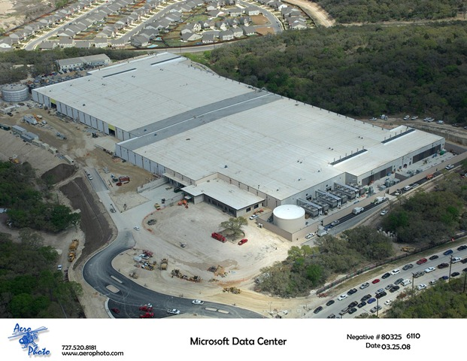









TLA
Deadline = 250ms
Picasso
Time is money
Strict deadlines (SLAs)
Missed deadline
Lower quality result
MLA
………
MLA
Deadline = 50ms
“Bad artists copy.
Good artists steal.”
“The chief enemy of creativity is good sense.“
“I'd like to live as a poor man
with lots of money.“
“Computers are useless.
They can only give you answers.”
“Everything you can imagine is real.”
“It is your work in life that is the ultimate seduction.“
“Inspiration does exist,
but it must find you working.”
“Art is a lie that makes us
realize the truth.
Deadline = 10ms
Worker Nodes
EECS 582 – W16

Slide 8
Impairments
Incast
Queue Buildup
Buffer Pressure

Slide 9


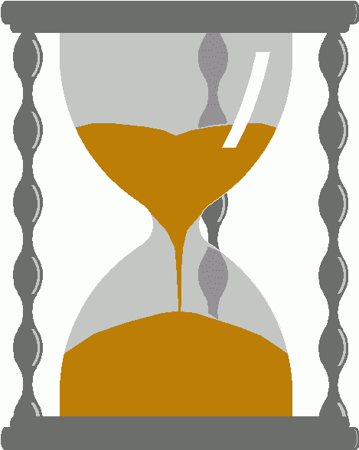
Incast
Worker 1
Synchronized mice collide.
Caused by Partition/Aggregate.
Aggregator
Worker 2
Worker 3
RTO_{min} = 300 ms
Worker 4
TCP timeout

Slide 10
Queue Buildup
Sender 1
Receiver
Sender 2
Measurements in Bing cluster
For 90% packets: RTT < 1ms
For 10% packets: 1ms < RTT < 15ms

Slide 11
Data Center Transport Requirements
High Burst Tolerance
Incast due to Partition/Aggregate is common.
Low Latency
Short flows, queries
3. High Throughput
Large file transfers

Slide 12
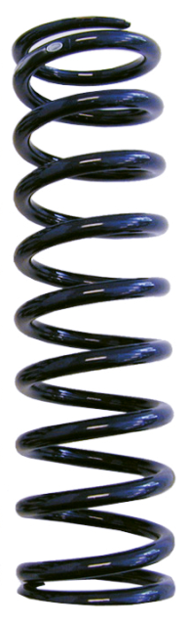
Balance Between Requirements
High Throughput
High Burst Tolerance
Low Latency
Deep Buffers:
Queuing Delays
Increase Latency
Shallow Buffers:
Bad for Bursts &
Throughput
Objective:
Low Queue Occupancy & High Throughput
DCTCP
Reduced RTO_{min} (SIGCOMM ‘09)
Doesn’t Help Latency
AQM – RED:
Avg Queue Not Fast
Enough for Incast

Slide 13
Review: The TCP/ECN Control Loop
Sender 1
ECN = Explicit Congestion Notification
ECN Mark (1 bit)
Receiver
Sender 2

Slide 14
Two Key Ideas
React in proportion to the extent of congestion, not its presence.
Reduces variance in sending rates, lowering queuing requirements.
Mark based on instantaneous queue length.
Fast feedback to better deal with bursts.
ECN Marks | TCP | DCTCP
1 0 1 1 1 1 0 1 1 1 | Cut window by 50% | Cut window by 40%
0 0 0 0 0 0 0 0 0 1 | Cut window by 50% | Cut window by 5%

Slide 15
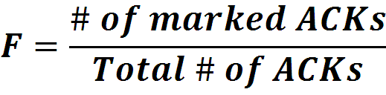

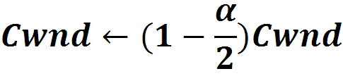
Data Center TCP Algorithm
B
K
Don’t
Mark
Switch side:
Mark packets when Queue Length > K.
Mark
Sender side:
Maintain running average of fraction of packets marked (α).
In each RTT:
Adaptive window decreases:
Note: decrease factor between 1 and 2.
Notes:
SRTT = (1-alpha)*SRTT+alpha*R’

Slide 16
DCTCP in Action
(Kbytes)
Setup: Win 7, Broadcom 1Gbps Switch
Scenario: 2 long-lived flows, K = 30KB

Slide 17
Why it Works
High Burst Tolerance
Large buffer headroom → bursts fit.
Aggressive marking → sources react before packets are dropped.
Low Latency
Small buffer occupancies → low queuing delay.
3. High Throughput
ECN averaging → smooth rate adjustments, cwind low variance.

Slide 18
Analysis
Window Size
W*+1
W*
(W*+1)(1-α/2)
Time

Slide 19
Analysis
Packets sent in this
RTT are marked.
Window Size
W*+1
W*
(W*+1)(1-α/2)
Time

Slide 20
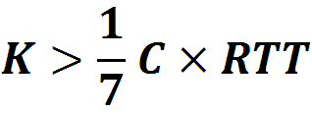
Analysis
How low can DCTCP maintain queues without loss of throughput?
How do we set the DCTCP parameters?
Need to quantify queue size oscillations (Stability).
bandwidth-delay product
85% Less Buffer than TCP

Slide 21
Evaluation
Implemented in Windows stack.
Real hardware, 1Gbps and 10Gbps experiments
90 server testbed
Broadcom Triumph 48 1G ports – 4MB shared memory
Cisco Cat4948 48 1G ports – 16MB shared memory
Broadcom Scorpion 24 10G ports – 4MB shared memory
Numerous benchmarks
– Throughput and Queue Length
– Multi-hop
– Queue Buildup
– Buffer Pressure
– Fairness and Convergence
– Incast
– Static vs Dynamic Buffer Mgmt

Slide 22
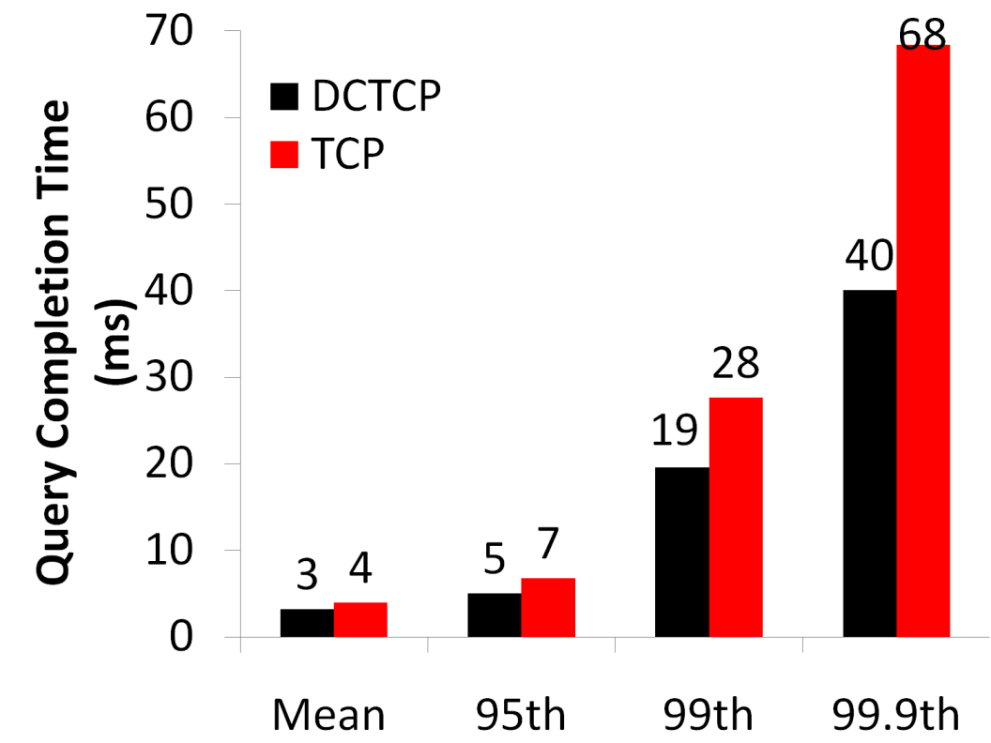
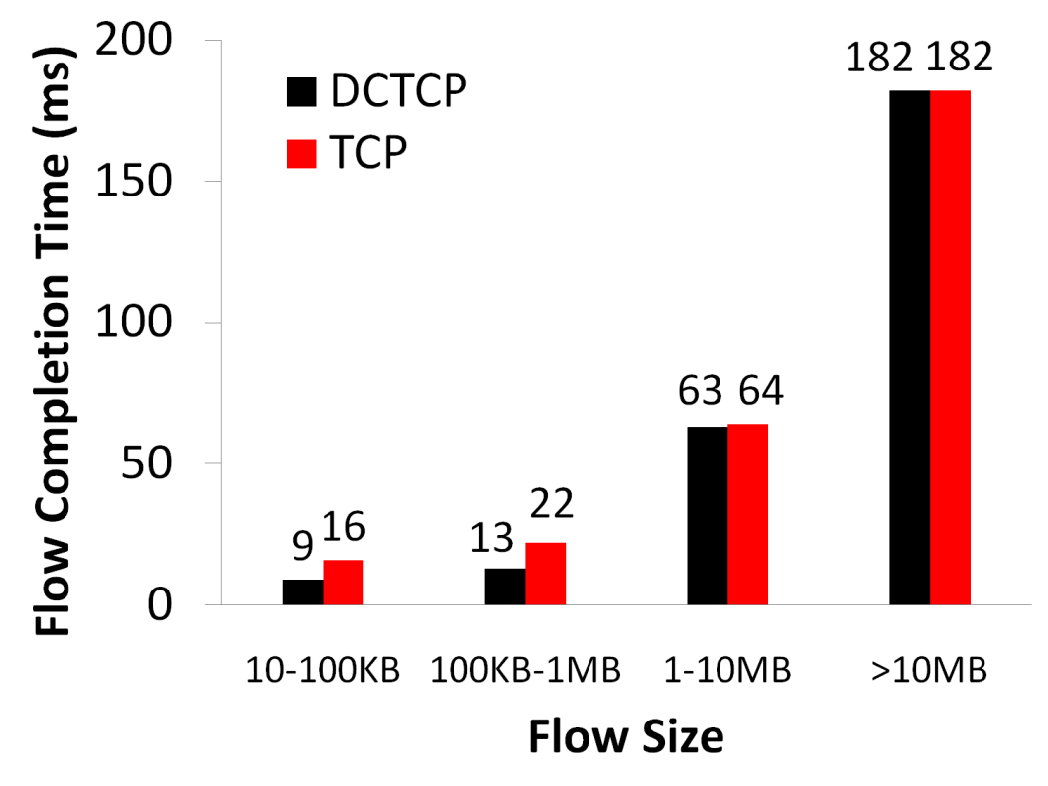
Evaluation
Background Flows
Query Flows

Slide 23
Evaluation
Background Flows
Query Flows
Low latency for short flows.

Slide 24
Evaluation
Background Flows
Query Flows
Low latency for short flows.
High throughput for long flows.

Slide 25
Evaluation
Background Flows
Query Flows
Low latency for short flows.
High throughput for long flows.
High burst tolerance for query flows.

Slide 26
Conclusions
DCTCP satisfies all our requirements for Data Center packet transport.
Handles bursts well
Keeps queuing delays low
Achieves high throughput
Features:
Very simple change to TCP and a single switch parameter K.
Based on ECN mechanisms already available in commodity switch.

Slide 27
Discussions
1. Will DCTCP perform worse in the internet?
2. How about SDN using fine-grained TE? OpenTCP?
3. Not compatible with SACK, which reduces the # of ACKs
4. Convergence really doesn’t matter?
5. RTT-fairness (favors small RTT flows)?
See “Analysis of DCTCP: Stability, Convergence, and Fairness”

Slide 28
Q&A

