Slide 1
Optimization
of
RSA Algorithm
Group 5:
Frank 1930026136
Connor 1930026139
Jorian 1930026170

Slide 2
Content
1. Montgomery Modular multiplication Algorithm
2. Karatsuba Multiplication Algorithm
3. Karatsuba C Codes
4. Our result

Slide 3
1. Montgomery Modular multiplication Algorithm

Slide 4


Montgomery Modular Multiplication Algorithm
$$z = x∗y mod n$$
$$① x′ = x∗r mod n；$$
$$②y′ = y∗r mod n；$$
$$③z′ = x′∗y′∗r^{−1} mod n；$$
$④z = z^{′}∗r^{−1}mod n$
($r^{−1}$ here means the inverse of r under n.)
n: generally a prime number, time-costing.
r: generally a power of 2, time-saving.
4

Slide 5
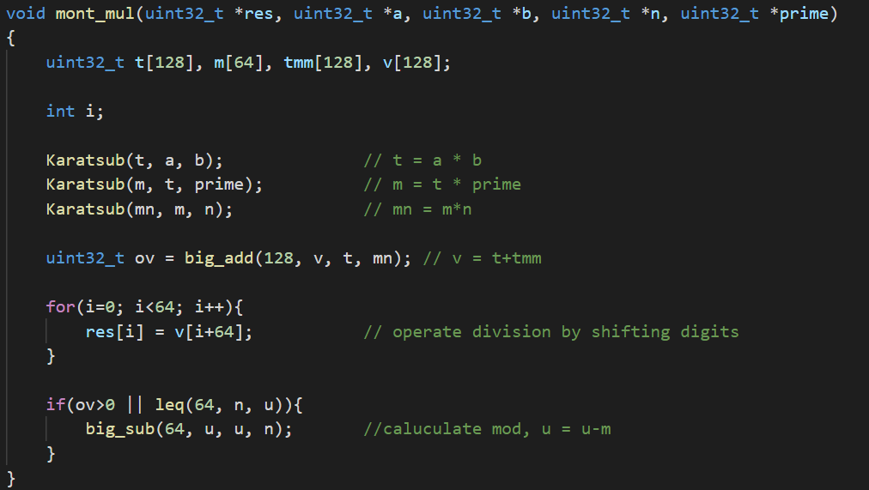

Montgomery Modular Multiplication Algorithm
Montgomery Modular multiplication
for $a×b$ in $R(r,n)$ 1、 $t=a⋅b$ 2、$m=t⋅n^{′}(modr)$ 3、$u=(t+m⋅n)/r$ 4、$u≥n$ ，output $u−n$, otherwise $n$
·

Slide 6
2. Karatsuba Multiplication Algorithm

Slide 7

Description of Karatsuba’s Algorithm
Procedure Karatsuba(num1, num2)
if (num1 < 10) or (num2 < 10)
return num1∗num2 // Back to traditional Multiplication
m = max(size_base10(num1), size_base10(num2)) // Calculates the size of the numbers
m2 = m/2
high1, low1 = split_at(num1, m2) // Split the digit sequences about the middle
high2, low2 = split_at(num2, m2)
// split_at("12345", 3) will extract the 3 final digits, giving: high="12", low="345".
z0 = Karatsuba(low1,low2)
z1 = Karatsuba((low1+high1),(low2+high2))
z2 = Karatsuba(high1,high2)
return $(z2∗10^(2∗m2))+((z1−z2−z0)∗10^(m2))+(z0)$

Slide 8
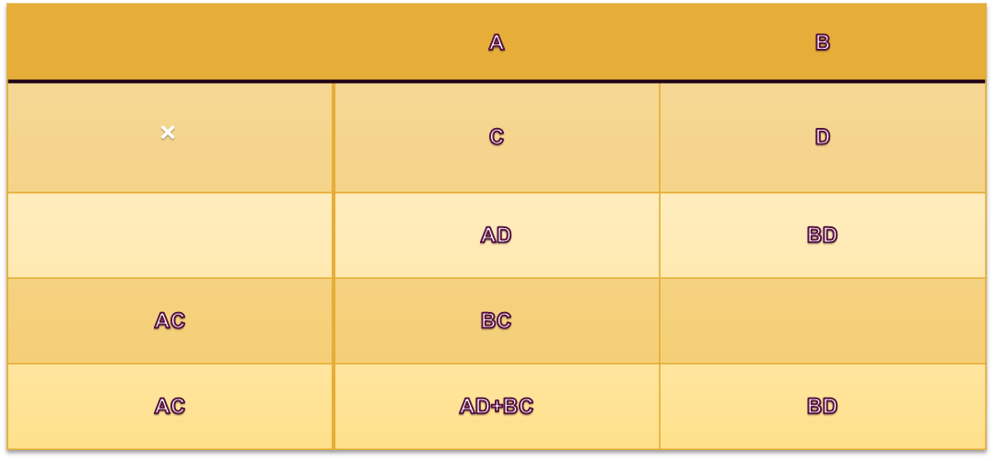

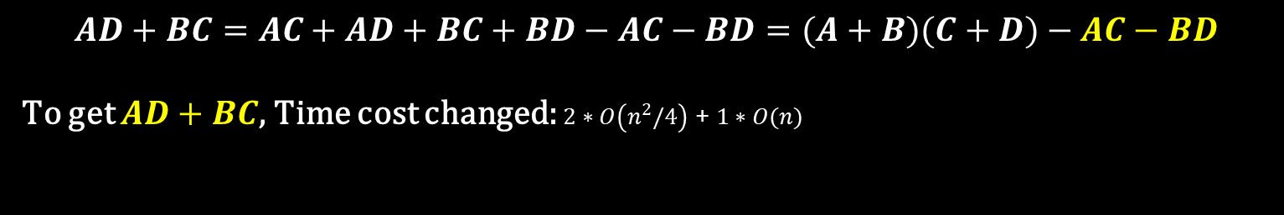
 | A | B
$$×$$ | C | D
 | AD | BD
AC | BC
AC | AD+BC | BD
$$AD+BC=AC+AD+BC+BD−AC−BD=(A+B)(C+D)−AC−BD$$
To get $AD+BC$, Time cost changed: $2∗O\left(n^{2}/4\right)$ + $1∗O(n)$
$1∗O\left(n^{2}/4\right)$ +$4∗O(n)$

Slide 9

Time complexity:
Karatsuba Multiplication Algorithm: $O\left(n\log_{2}⁡3\right)$
Remark:
For two number ($2^{k}$ digit), we need ${ 3}^{k}$ times multiplication
$$k=\log_{2}{n}，3^{k}=3^{\log_{2}{n}}=2^{\left(\log_{2}{3}∗\log_{2}{n}\right)}=$$
$$2^{\left(\log_{2}⁡n∗\log_{2}⁡3\right)}=n^{\log_{2}⁡3}$$
$$T(n)=3T(n/2)+6n=O\left(n\log_{2}⁡3\right)$$

Slide 10
3.
Karatsuba C Codes

Slide 11
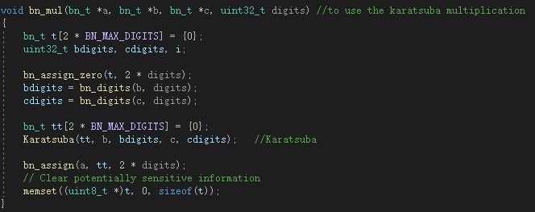
Karatsuba C Codes:
bn_mul(): to call Karatsuba main function:

Slide 12
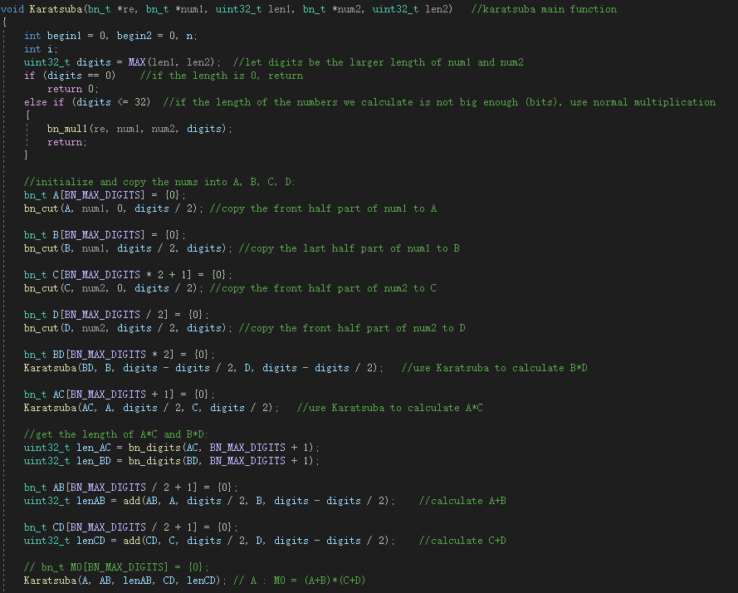
Karatsuba():
the main function to do the mutiplication

Slide 13
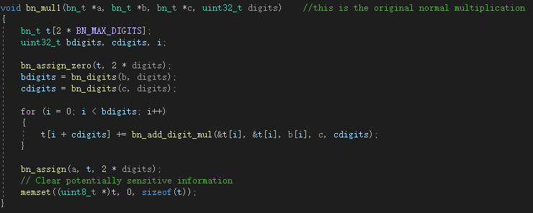
Karatsuba C Codes:
bn_mul1(): to do the normal (slow) multiplication:

Slide 14
Karatsuba():
the main function to do the multiplication

Slide 15
Karatsuba C Codes:
bn_cut(): to copy the big number from one to another:

Slide 16
Karatsuba():
the main function to do the multiplication

Slide 17
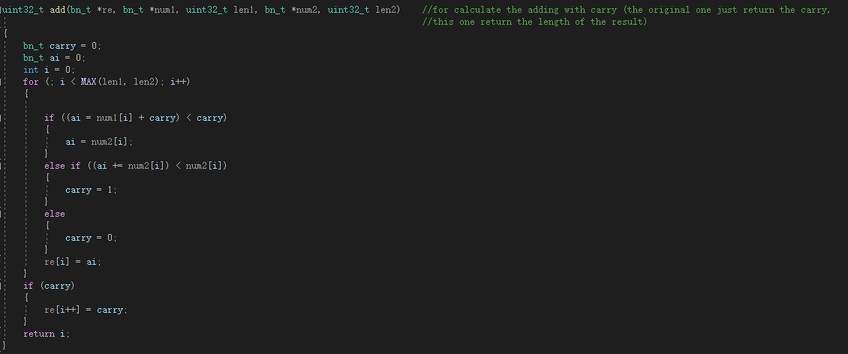
Karatsuba C Codes:
add(): to do the new addition:

Slide 18
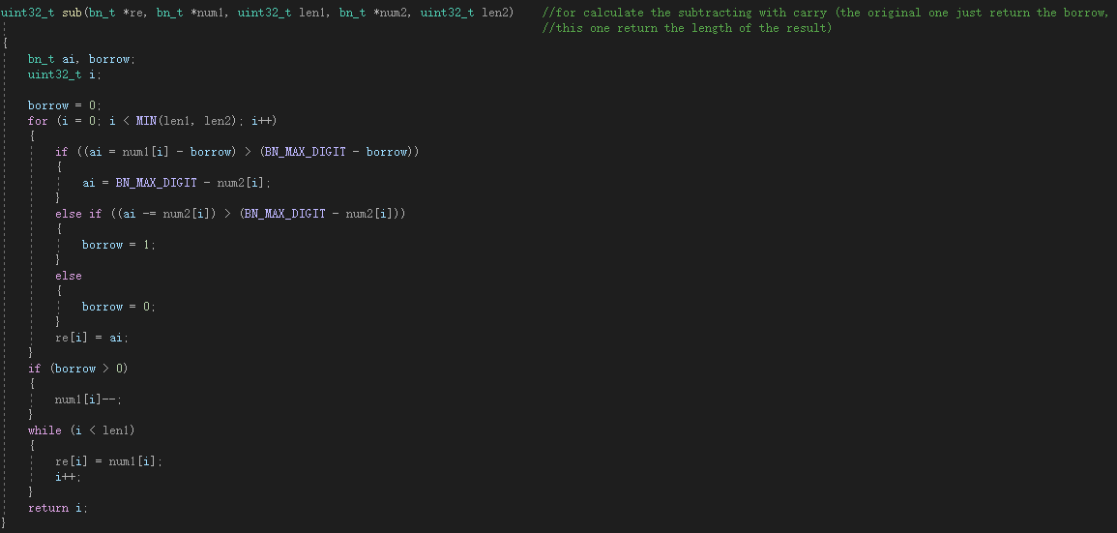
Karatsuba C Codes:
sub(): to do the new subtraction:

Slide 19
Karatsuba():
the main function to do the multiplication

Slide 20
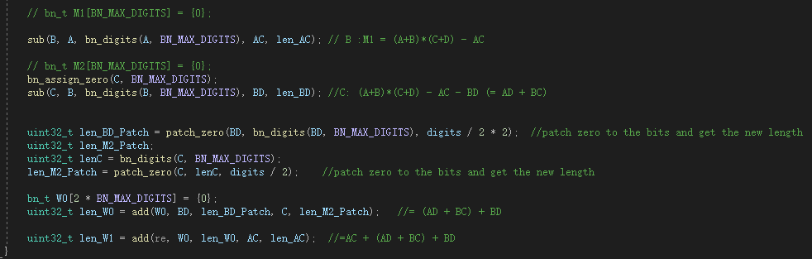
Karatsuba():
the main function to do the multiplication

Slide 21
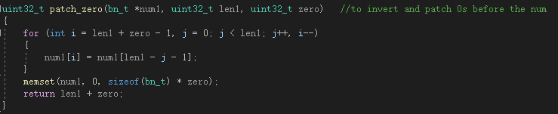
Karatsuba C Codes:
patch_zero(): to add 0s to the numbers:

Slide 22
Karatsuba():
the main function to do the multiplication

Slide 23
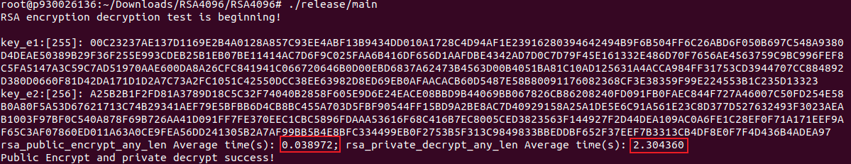
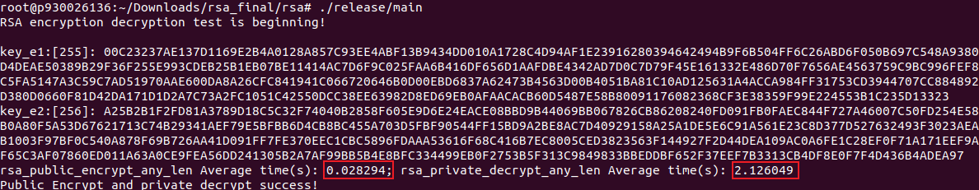

Our results:
Before:
Encrypt: improve $10ms$ (within $30ms$ now)
After:
Decrypt: improve $0.1−0.2 s$

Slide 24
Summary and Reflection
The data is not big enough and does not take full advantage of Karatsuba big number multiplication.
Although the time complexity of Karatsuba is low but the recursion is used many times, so it is difficult to optimize.
The data structure is complicated to calculate, and multiple functions are needed to complete various calculations.

Slide 25
THANKS!

