Slide 1



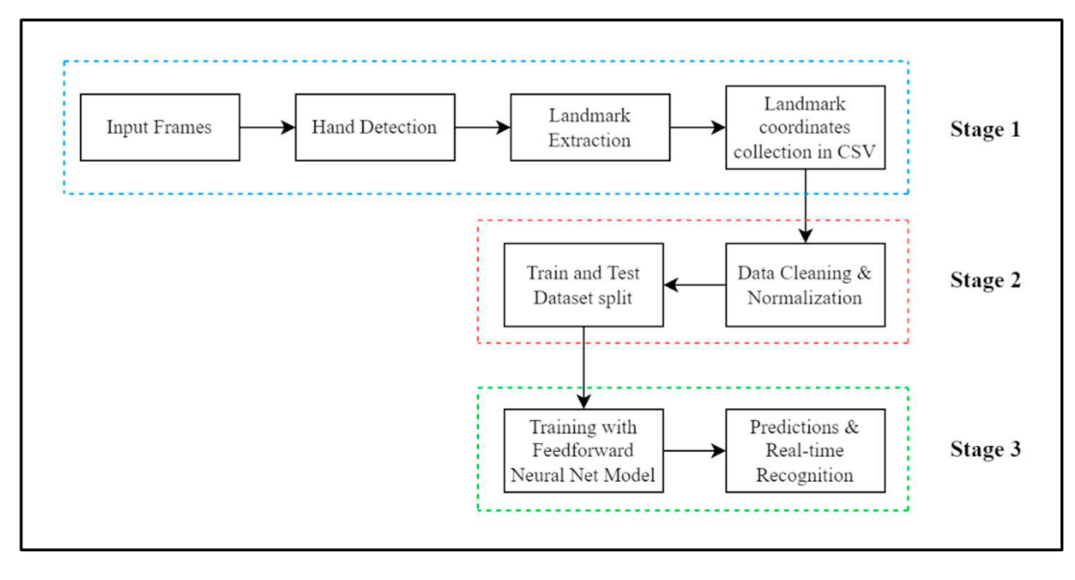

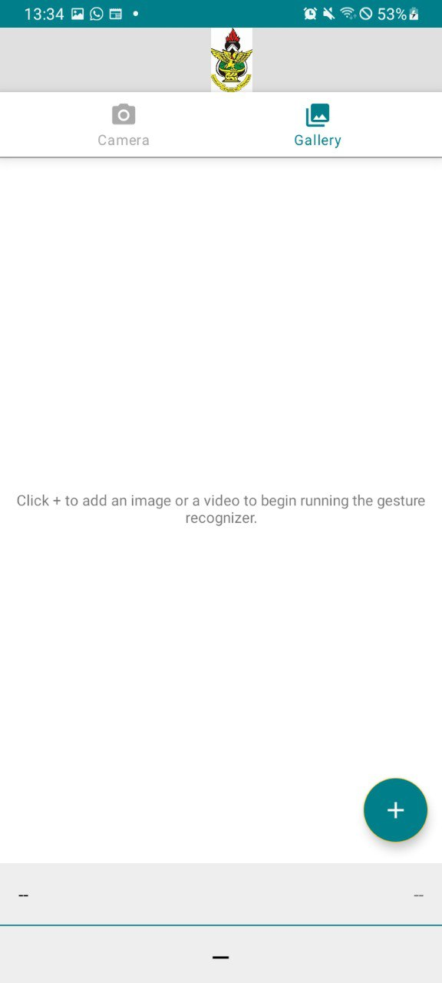
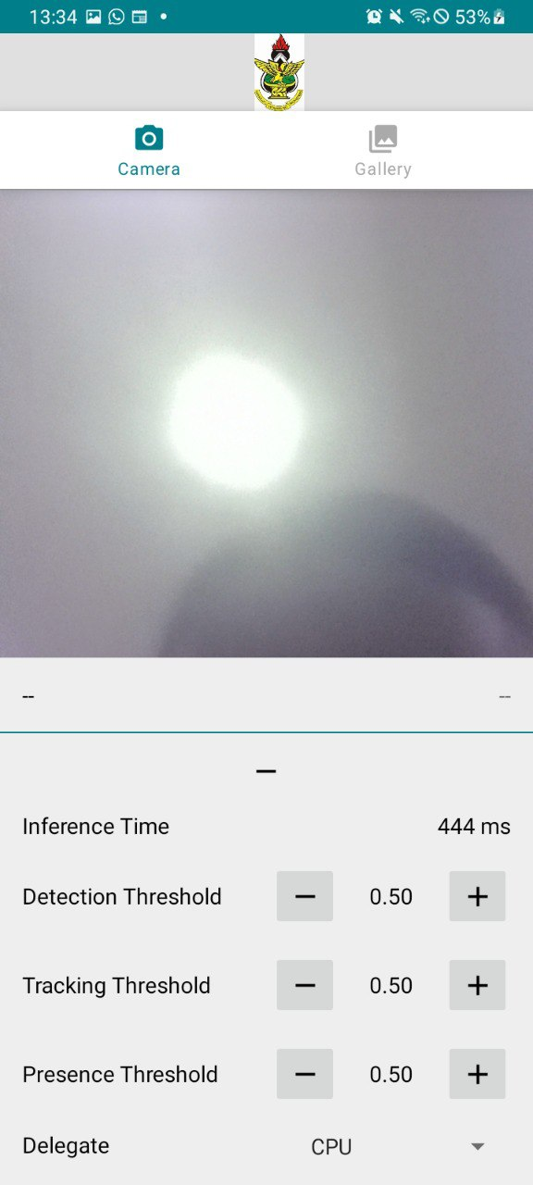
SIGN LANGUAGE DETECTION AND INTERPRETATION USING MEDIAPIPE AND DEEP LEARNING
ABALO EMMANUEL KOFI And ANSAH ERNEST
SUPERVISOR: DR. ROSE-MARY OWUSUAA MENSAH GYENING
ABSTRACT
AIMS AND OBJECTIVES
RESULT ANALYSIS
The goal of this project is to build a real-time system for recognizing and interpreting signs using MediaPipe and deep learning methods that are capable of robust performance. For instance, the utilization of MediaPipe’s effective pose detection features together with deep neural networks will enable right recognition and interpretation of sign language movements by the automated system. The technology can have several applications ranging from teaching, medical care as well as communication with people who cannot hear or have hearing impairments. Additionally, the performance of the system will be assessed through strict testing and validation using various sets of sign language gestures.
Creating a framework that is capable of accurately recognizing different hand signals through live films or pictures taken at different moments in time..
Ensure that the system can process and interpret sign language gestures in real-time, enabling seamless communication..
Develop an easy to use interface that is user-friendly and can be accessed by both hearing and deaf persons.
Make the system capable of handling different hand shapes, lighting conditions, and background complexities.
Improved User Experience: Interactive and fluid user experience features such as feedback when retrieving user data and app data.
Scalability and Flexibility: Icon and other elements that are flexible, simple, and easy to find for rapid and seamless interaction and operations.
Communication: Simple and better communication to promote collaboration between the sign language user and an individual in real-time .
METHODOLOGY AND PROJECT TOOLS
INTRODUCTION
Project tools used for this project include Android studio , Android Emulator , Media Pipe , TensorFlow Lite and Open CV .
USER INTERFACE
The foundation of communication in sign language is the representation of emotions through visual sign patterns (Arpita and Arkshit, 2021). Developing a sign language interpretation system is quite commendable as it affects the society greatly. While at this, we are inclusive and break the communication barriers between sign language users and those who do not understand it. This not only complies with accessibility accommodation requirements but also with growing market demand for emerging solutions across sectors. Furthermore, designing such a system is an opportunity for technological advancement by taking advantage of machine learning and computer vision to develop accurate and efficient translation models. Computer vision-based Sign Language Recognition technologies are frequently used for feature extraction, such as for boundary modeling, contouring, gesture segmentation, and hand shape estimation. However, none of these methods are small enough to function in real-time applications on mobile devices, hence they are limited to platforms with powerful CPUs. Furthermore, the difficulty of hand-tracking persisted across all of these methods. In order to overcome this limitation, our suggested methodology built upon Google's ground-breaking, quickly expanding open-source MediaPipe project and implemented a machine learning algorithm on top of it to create a pipeline that is simpler, faster, more affordable, portable, and easy to set up. This pipeline can be utilized as a sign language recognition system.
INPLEMENTATION AND TESTING
Android Studio: Android was used to implement the user-friendly interface of the mobile applications on the screen. The user interface for the web-application side was created using Flutter-Web.
Android Emulator: The android emulator was used to run, test and debug the mobile applications.
Visual Studio Code: In our project we used visual studio code, which served as our development platform, to implement and run the codes.
Testing: Look at the webcam and display different gestures you would wish the system to recognize. Pay attention to the following while you do the gestures. You have to keep in mind that task automation is not a one-off event.
CONCLUSION
Based on our experience working on the sign language identification app using deep learning and MediaPipe, here are some conclusions drawn from our project:
Effective Model Selection: We found that choosing the right deep learning model architecture significantly influenced the app's performance. Models combining convolutional and recurrent neural networks proved effective for recognizing complex sign gestures with reasonable accuracy and real-time processing capability.
2. Data Diversity is Key: One of the critical conclusions was the importance of diverse and well-annotated datasets. We realized that training our models on a wide variety of sign languages, dialects, and signing styles was crucial for improving generalization and accuracy across different user scenarios.
3. Optimization Challenges: Implementing MediaPipe for real-time hand and gesture detection presented several optimization challenges, particularly in ensuring smooth performance on mobile devices. We focused on optimizing model inference speed without compromising accuracy, leveraging techniques like model quantization and hardware acceleration.
4. User-Centric Design: User feedback played a pivotal role in shaping the app's development. Understanding how users interacted with the app, their preferences for gesture recognition accuracy versus response time, and their feedback on the user interface guided iterative improvements to enhance overall usability and satisfaction.
PROBLEM STATEMENT
Although tremendous progress has been made in technology, it is still evident that a gap exists between the hearing and non-hearing people regarding communication. Most of the current procedures of sign language interpretation depend on human translators who may not always be available as this takes time and money to access. In addition, chances are high that these methods are less accessible in rural or marginalized areas. Thus, there is an urgent requirement for a consistent, reachable and less costly technology able to effectively identify and interpret sign language gestures as they occur.

