Slide 1
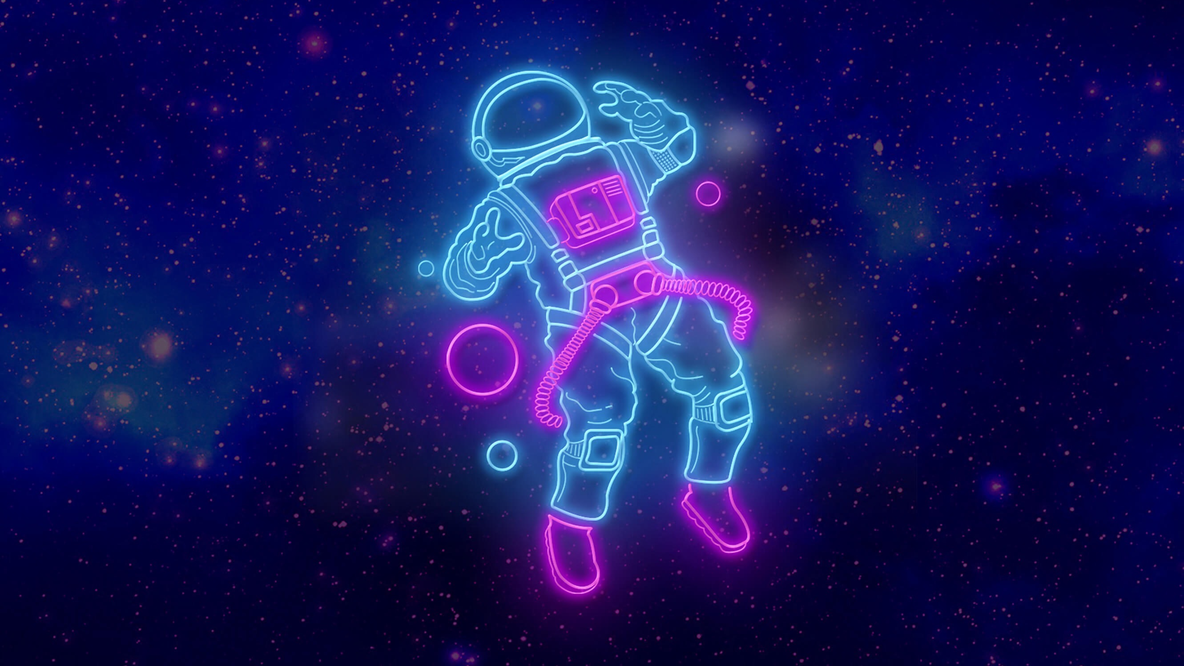
My Vocabulary
Word No
.
Meaning
Note

Slide 2
