Slide 1

SOCIAL COMPANY BLOG
Presented by:
NITHIN REDDY S-160118737103
KOUSHIK REDDY G-160118737101

Slide 2
CONTENTS
INTRODUCTION
MOTIVATION
EXISTING SYSTEM AND PROBLEM STATEMENT
PROPOSED SYSTEM
ARCHITECTURE OF PROPOSED SYSTEM
RESULTS AND SCREENSHOTS
CONCLUSION
FUTURE SCOPE
BIBILOGRAPHY

Slide 3
INTRODUCTION
A social company blog (shortening of “weblog”) is an online journal or informational website displaying information in the reverse chronological order, with the latest posts appearing first. It is a platform where a group of writers share their views on an individual subject

Slide 4
MOTIVATION
Now a day’s people are dependent on technology. They like to catch up on everything using their mobiles. Most researchers have a problem of not having enough resources to fund their research due to lack of investors.
With a social company blog, we can easily blog post our research on a global platform which interested investors can see and invest in the research. Thus the researcher can easily save a lot of time and maybe his research too. It is very convenient. Researchers and scientists with the right tools and funding can change the world.

Slide 5
EXISTING SYSTEM AND PROBLEM STATEMENT
EXISTING SYSTEM :TWITTER,MASTODON
These are some of the existing systems.
PROBLEM STATEMENT:To provide a platform where users can easily express their opinions on a particular topic and help users in the following ways-
Develop and Strengthen Relationships With Existing And New Customers. ...
Connect People To a brand or topic

Slide 6


PROPOSED SYSTEM
SIGN IN TO THE ACCOUNT USING CREDENTIAL
REGISTER TO CREATE AN
ACCOUNT IN AnyBlog
READ BLOGS POSTED BY EVERYONE ON AnyBlog
UPDATE OR DELETE THE POST FROM YOUR ACCOUNT.
LOGOUT OF THE WEB-APP.
BLOG post anything from your account.

Slide 7
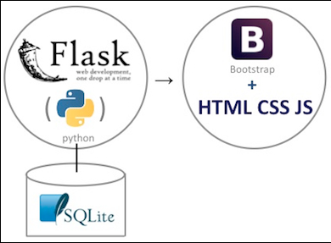
ARCHITECTURE OF PROPOSED SYSTEM
Programming language PYTHON is used.
Flask is a micro web framework written in Python. It is classified as a microframework because it does not require particular tools or libraries. This is the framework which was used to create the web-app.
Bootstrap is a free and open-source CSS framework directed at responsive, mobile-first front-end web development.
SQLite is a relational database management system contained in a C library. In contrast to many other database management systems, SQLite is not a client–server database engine. Rather, it is embedded into the end program.

Slide 8
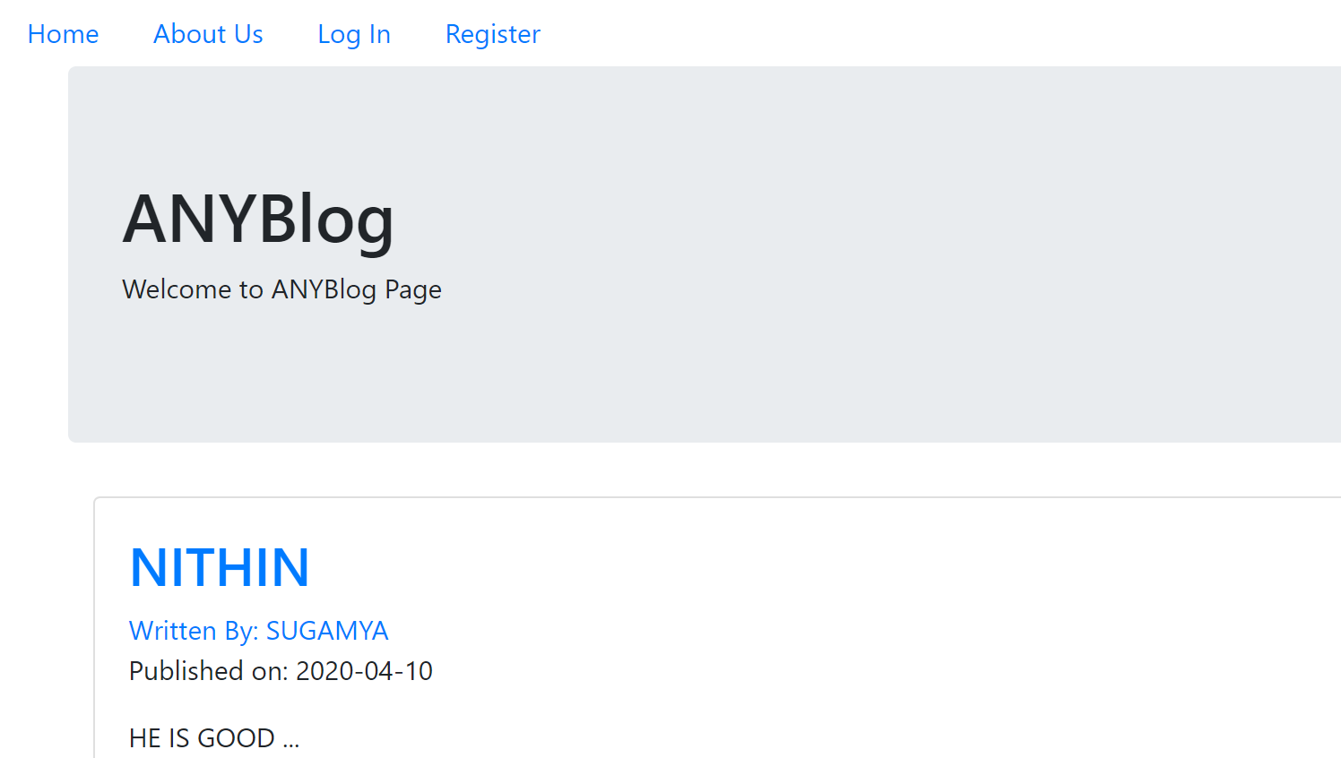
Results and screenshots
As we can see in the screenshot BELOW, users can directly see the blog posts made by all the users in the homepage itself. We can also find a navigation bar through which we can access the login page and registration page.

Slide 9
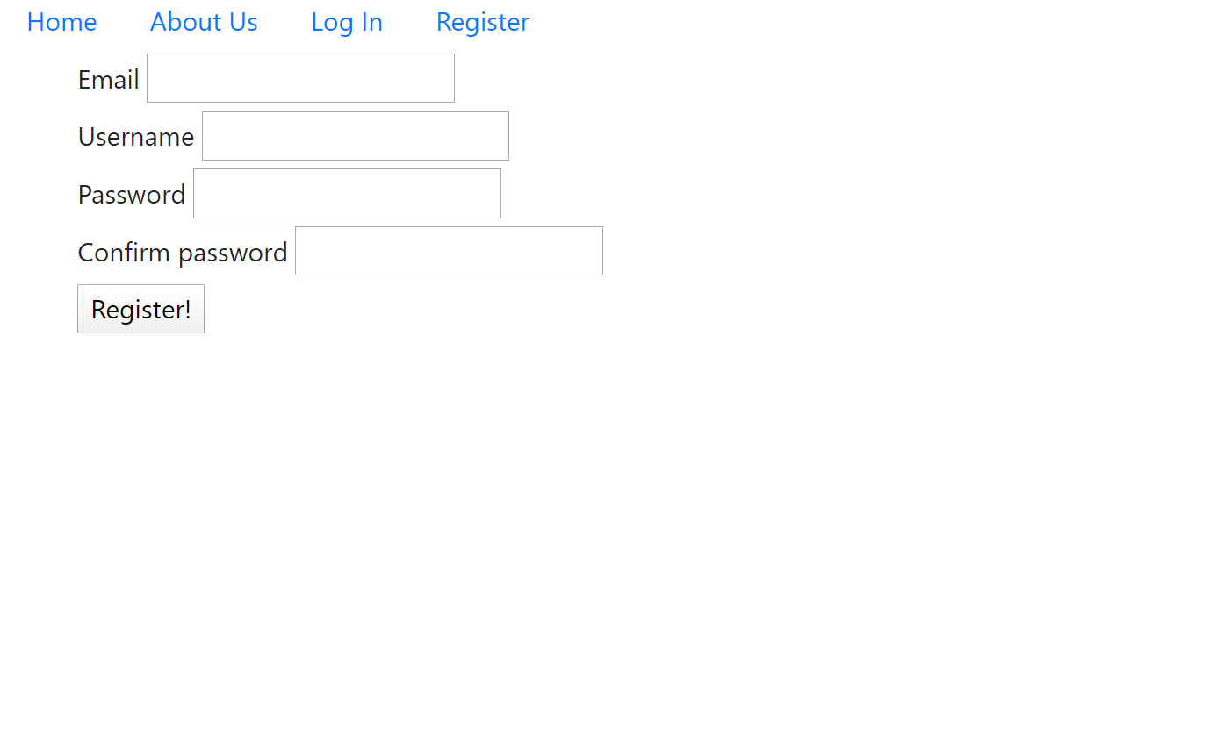
Results and screenshots
The BELOW screenshot shows the details required for a person to create an account in the blog system . A user can create an account through this.

Slide 10
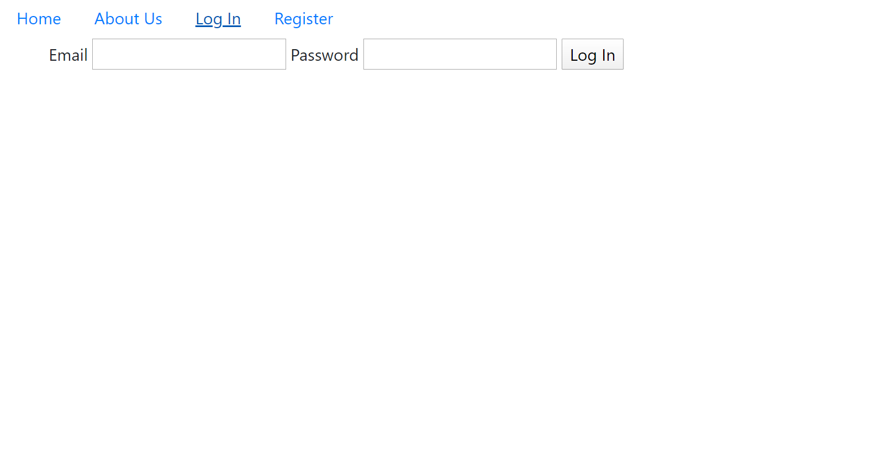
Results and screenshots
The user can login to the blog using the email and password as shown below-

Slide 11
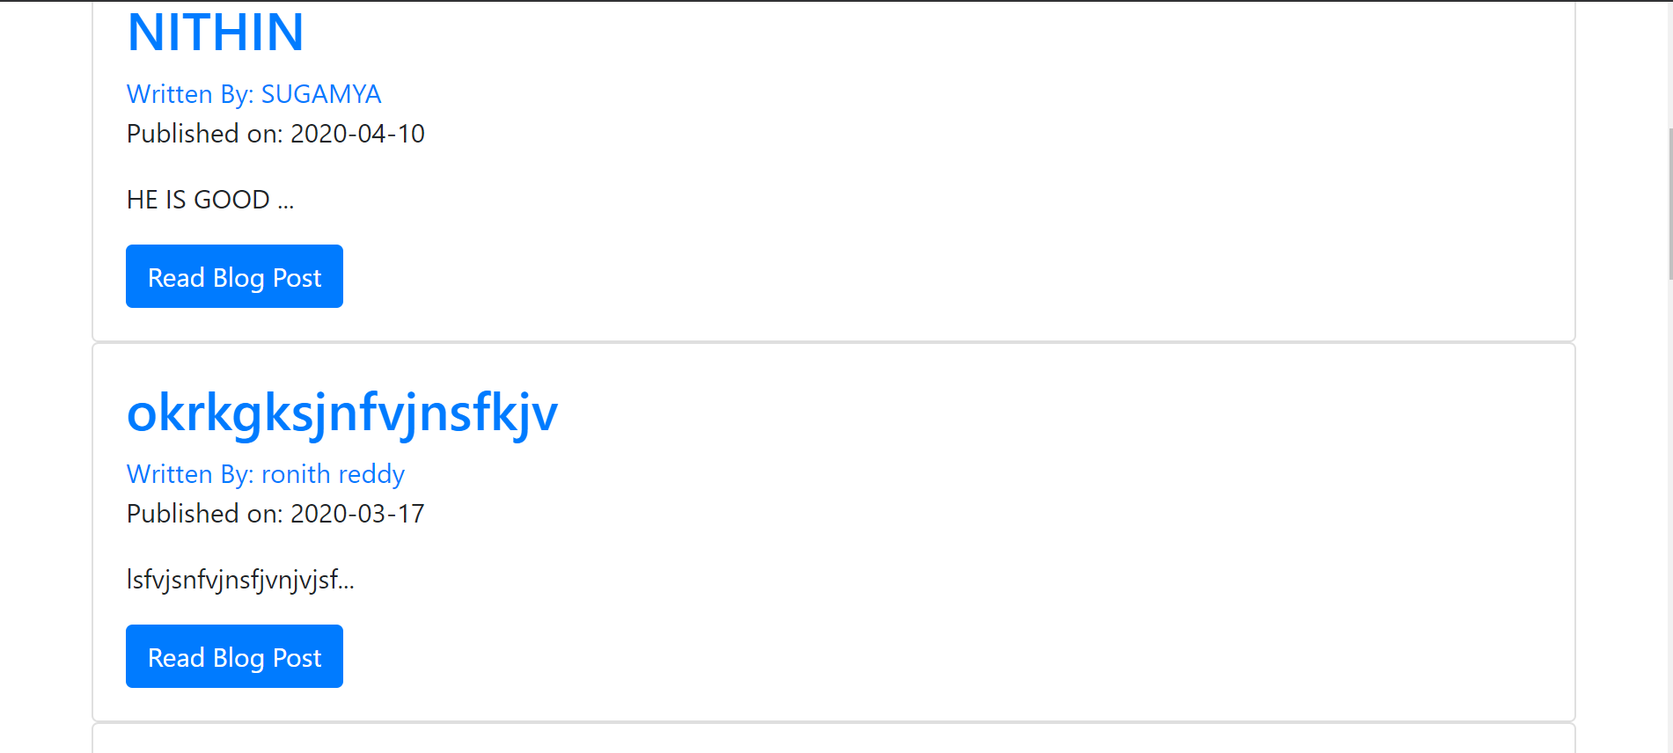
Results and screenshots
This is a screenshot of one of the blogpost in the social company blog.

Slide 12
CONCLUSION
This project is aimed at developing a Social company blog. A need for a blog is definitely needed as it gives the following advantages for its users
allow users to create accounts
allow users to login to their account
provide a platform where users can easily share their opinion on a particular topic

Slide 13
Future scope
A need for a blog is definitely needed in the near future as it gives the following advantages for its users-
goal of our project is to create a web-app which can-
allow users to create accounts
allow users to login to their account
provide a platform where users can easily share their opinion on a particular topic.

Slide 14
bibilography
https://www.youtube.com/watch?v=MwZwr5Tvyxo&list=PL-osiE80TeTs4UjLw5MM6OjgkjFeUxCYH
https://www.geeksforgeeks.org/flask-creating-first-simple-application/
https://getbootstrap.com/docs/4.4/layout/overview/
https://flask.palletsprojects.com/en/1.1.x/

Slide 15


