Slide 1
Harmony: Model Checking Concurrent Programs without a Learning Curve
Robbert van Renesse

Slide 2
What is the problem?
In CS4410, most students were unable to solve most concurrency problems correctly
caused significant frustration because the students felt they had adequately tested their programs
Teaching staff spent lots of time checking solutions visually and giving feedback to students
and also made plenty mistakes

Slide 3
What is the problem?
In CS4410, most students were unable to solve most concurrency problems correctly
caused significant frustration because the students felt they had adequately tested their programs
Teaching staff spent lots of time checking solutions visually and giving feedback to students
and also made plenty mistakes
Why?
Concurrent programs are notoriously hard to test

Slide 4
Model Checking to the rescue?
Runs all possible executions, incl. any corner cases
Discovers easy to explain bugs

Slide 5
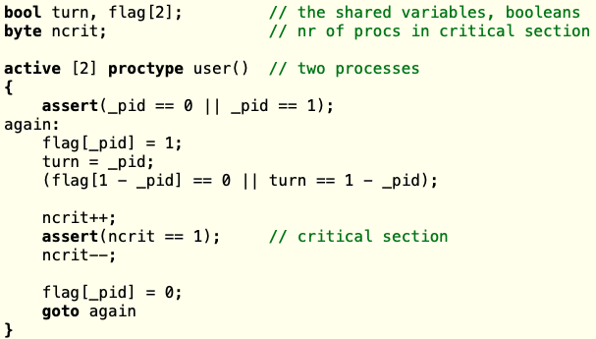
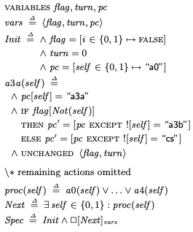
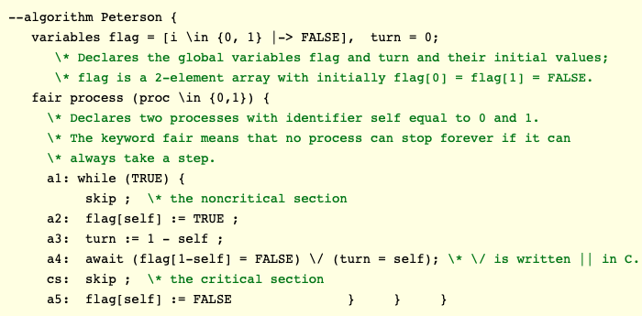
Model Checking to the rescue?
Runs all possible executions, incl. any corner cases
Discovers easy to explain bugs
But learning curve is steep: unfamiliar formalisms
Spin
TLA+
PlusCal

Slide 6
Enter Harmony, a Python dialect
flags = [ False, False ] turn = 0 def thread(self): while True: flags[self] = True turn = 1 - self while flags[1 - self] and (turn == (1 - self)): pass pass # critical section flags[self] = False spawn thread(0) spawn thread(1)
Peterson’s Algorithm

Slide 7
Correctness checking
Safety properties
invariant violations, uninitialized variables, divide-by-zero, etc.
Liveness properties
non-termination
Hyperproperties
Absence of Busy Waiting
Data Race Freedom
Linearizability
(requires annotating linearization points)

Slide 8
Success story
Harmony found data races in both concurrent queue implementations in a 25-year-old PODC paper with over 1300 citations
tacitly assume sequentially consistent memory

Slide 9
Features beyond Python
Modules implemented in Harmony
spinlocks, condition variables (both Mesa and Hoare), semaphores, synchronized queues, barrier synch, etc.
Choice function
Atomic blocks
build your own atomic primitives
“Volatile” variables
variables with sequential consistency
Continuations
you can implement fork() yourself
Invariant statements
predicates checked in every state
Liveness checking
without temporal logic formalism
Interrupts
handling interrupts is hard too
choose { 1, 2, 3 }
atomic: x, y = y, x;
sequential x, y;
stop x; go x;
invariant 1 < x < 5;
trap handler();

Slide 10
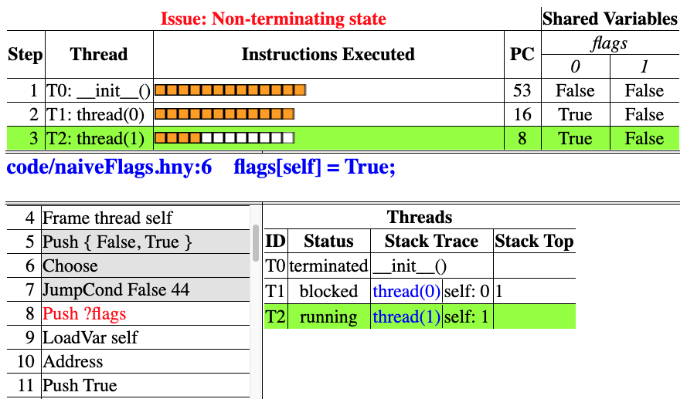
Visualizer/Animator

Slide 11
Visualizer features
Stepping, forwards and backwards
per bytecode instruction
per line of Harmony code
per context switch
Quick view of history that leads to bug
Detailed view of each thread in each state
stack trace
variables

Slide 12
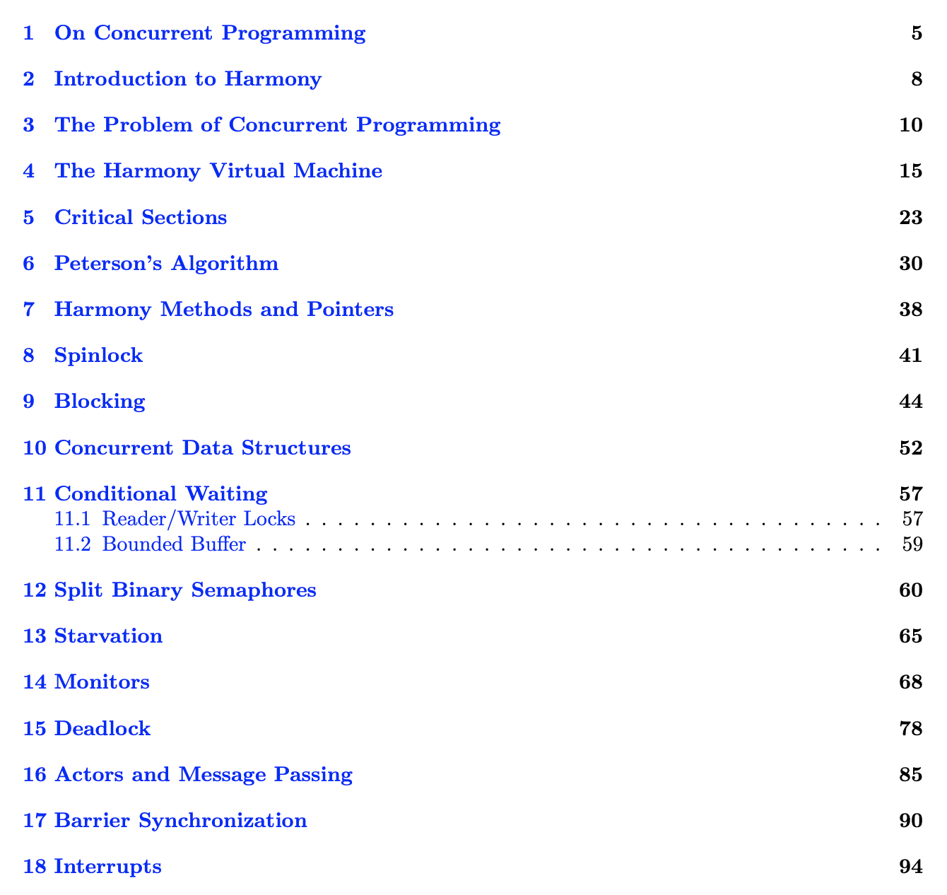
Free Text Book (145 pages)

Slide 13
Early experience (Fall 2020, Spring 2021)
Integrated with Microsoft Visual Studio Code IDE
A purely online IDE available running in the cloud
Students were able to use this immediately
Significantly better solutions to problem sets
Students still need to write the test programs
and add assertions and/or invariants
Solutions can be auto-graded
Understandable bug reports to students
Book and code: harmony.cs.cornell.edu

