Slide 1

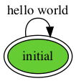

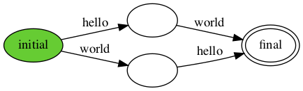
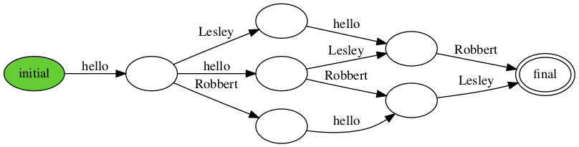
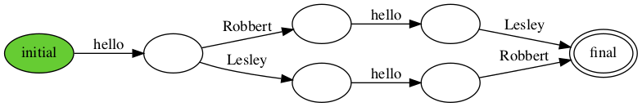

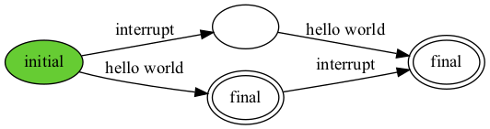
print “hello world”
print choose { “hello”, “world” }
while choose { False, True }:
print “hello world”
def p(s): print s
spawn p("hello")
spawn p("world")
def hello(name):
print "hello"
print name
spawn hello("Lesley")
spawn hello("Robbert")
def hello(name):
atomically:
print "hello"
print name
spawn hello("Lesley")
spawn hello("Robbert")
x = False
def f():
print "hello"
atomically:
x = True
def g():
atomically when x:
print "world"
spawn f()
spawn g()
def handler():
print "interrupt"
def thread():
trap handler()
print "hello world"
spawn thread()

