Slide 1
Harmony: Model Checking Concurrent Programs without a Learning Curve
Robbert van Renesse

Slide 2
What is the problem?
In CS4410, most students were unable to solve most concurrency homework problems correctly
caused significant frustration because the students felt they had adequately tested their programs
Teaching staff were spending a lot of time checking solutions visually and providing detailed feedback
and also made mistakes

Slide 3
What is the problem?
In CS4410, most students were unable to solve most concurrency homework problems correctly
caused significant frustration because the students felt they had adequately tested their programs
Teaching staff were spending a lot of time checking solutions visually and providing detailed feedback
and also made mistakes
Why?
Concurrent programs are notoriously hard to test

Slide 4
Model Checking to the rescue?
Runs all possible executions, incl. any corner cases
Gives short “counter-examples”

Slide 5
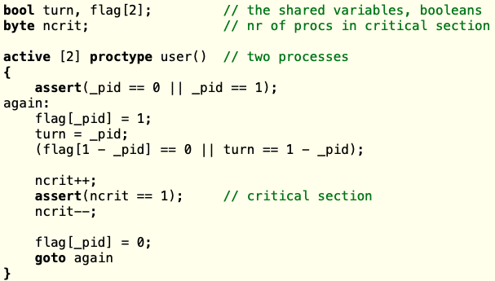
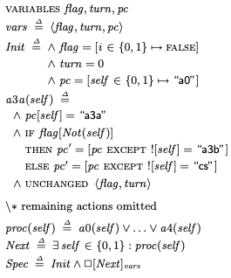
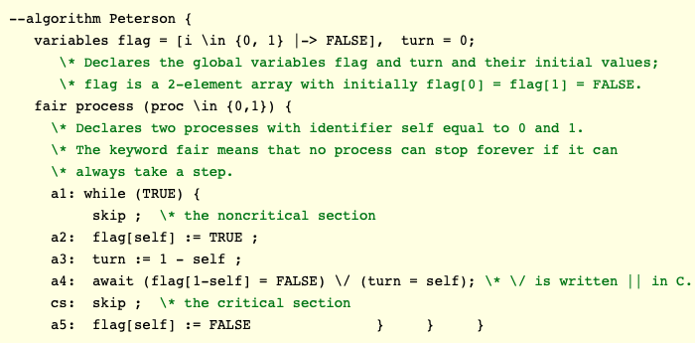
Model Checking to the rescue?
Runs all possible executions, incl. any corner cases
Gives short “counter-examples”
But learning curve is steep: unfamiliar formalisms
Spin
TLA+
PlusCal

Slide 6
Enter Harmony, a Python dialect
flags = [ False, False ] turn = 0 def thread(self): while True: flags[self] = True turn = 1 - self while flags[1 - self] and (turn == (1 - self)): pass pass # critical section flags[self] = False spawn thread(0) spawn thread(1)
Peterson’s Algorithm

Slide 7
Correctness checking
Safety properties
Assertion/invariant violations, uninitialized variables, divide-by-zero, etc.
Liveness properties
Absence of deadlock
Hyperproperties
Absence of Busy Waiting
Data Race Freedom
Linearizability
(requires annotating linearization points)

Slide 8
Success story
Harmony found data races in both concurrent queue implementations in a 25-year-old PODC paper with over 1300 citations
tacitly assume sequentially consistent memory

Slide 9
Harmony features beyond Python
Modules implemented in Harmony
locks, condition variables (both Mesa and Hoare), semaphores, synchronized queues, barrier synch, etc.
Choice function
Atomic blocks
build your own synch primitives
“Volatile” variables
variables with sequential consistency
Continuations
you can implement fork() yourself
Invariant statements
predicates checked in every state
Interrupts
handling interrupts is hard too
choose { 1, 2, 3 }
atomic: x, y = y, x;
sequential x, y;
stop x; go x;
invariant 1 < x < 5;
trap handler();

Slide 10
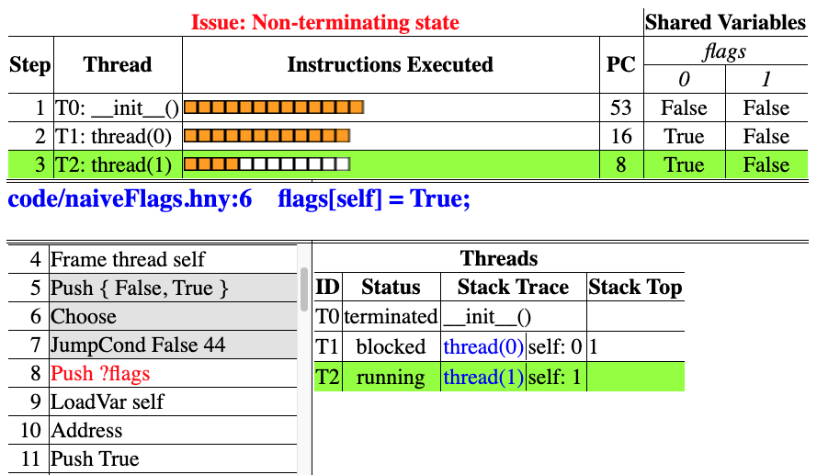
Visualizer/Animator

Slide 11
Visualizer features
Stepping, forwards and backwards
per bytecode instruction
per line of Harmony code
per context switch
Quick view of history that leads to bug
Detailed view of each thread in each state
stack trace
variables

Slide 12
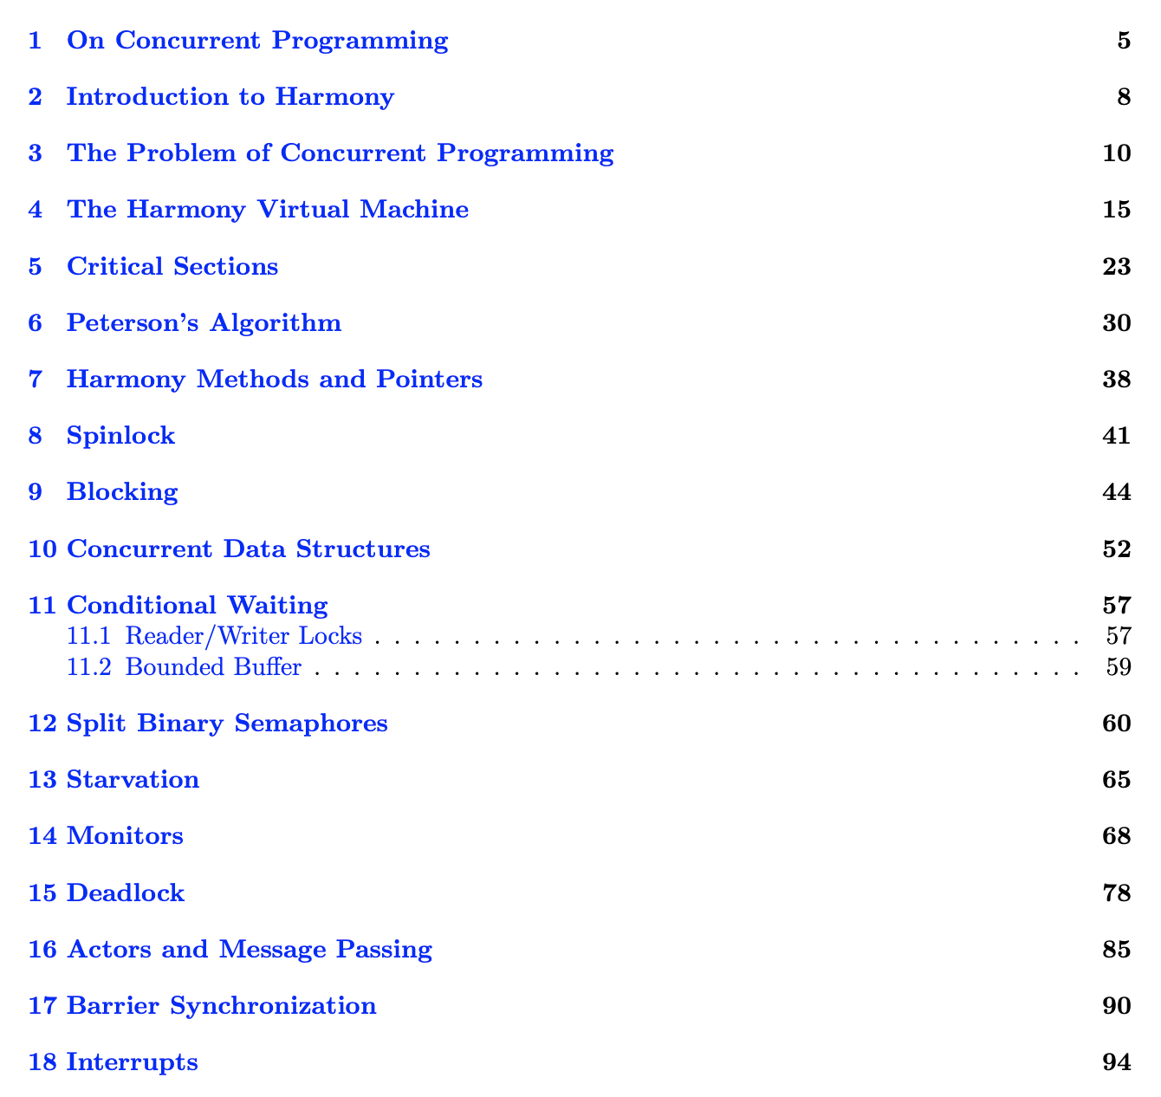
Free Text Book (145 pages)

Slide 13
Early experience (Fall 2020, Spring 2021)
Students were able to use this immediately
Significantly better solutions to problem sets
Harmony is not an oracle: students still need to specify what assertions/invariants to check
Homework assignments can be auto-graded
Understandable bug reports to students
Integrated with Microsoft Visual Studio Code IDE
A purely online IDE available running in the cloud
Book and code: harmony.cs.cornell.edu

