Slide 1
Images

Slide 2

Architecture
Application
PlayMorphia
Play!Framework
Morphia
Mongo Driver
MongoDB

Slide 3
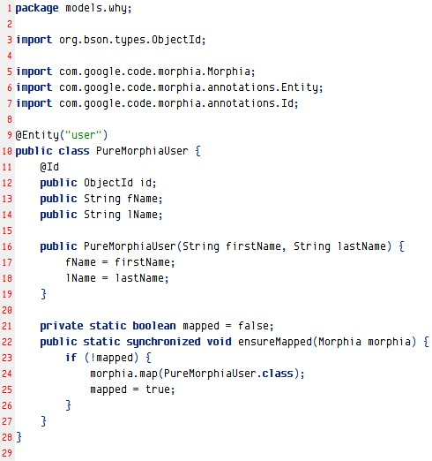
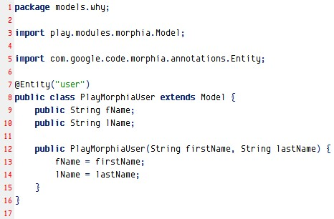
Comp – Model class
Pure Morphia model class
PlayMorphia model class

Slide 4
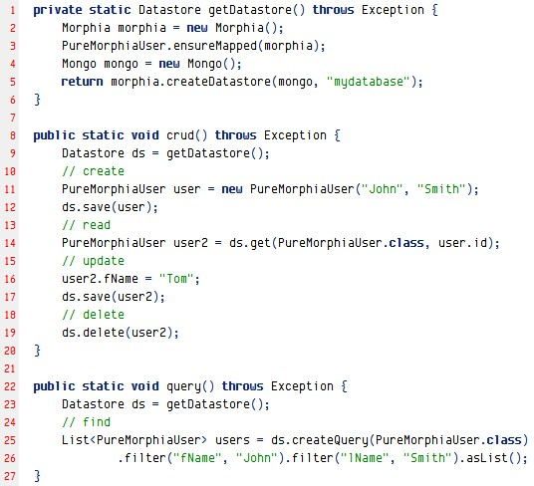
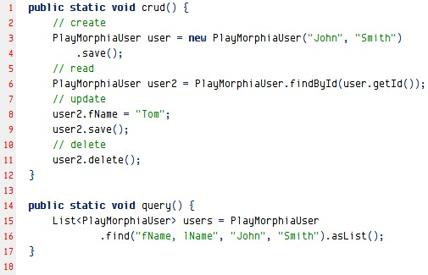
Comp – use model
Pure Morphia model app
PlayMorphia model app

Slide 5
Model architecture
PlayMorphia Model Archtecture
Java Common Object Contract
toString(); hashCode(); equals()
Play!Framework DB Model
_key(); _save(); _delete
…
CRUD
Query
Statistics
MorphiaQuery
Miscs (Timestamp, LifeCycle, Low level int…)
Annotation Classes

Slide 6

Model lifecycle - Create
PlayMorphia Events
On Add
Morphia Events
Added
Pre Load
On Load
Post Load
To DBObject
Loaded
Pre Persist
On Update
Pre Save
Updated
Post Persist
Write to MongoDB
On Delete
Deleted

Slide 7

Model lifecycle - Update
PlayMorphia Events
On Add
Morphia Events
Added
Pre Load
On Load
Post Load
To DBObject
Loaded
Pre Persist
On Update
Pre Save
Updated
Post Persist
Write to MongoDB
On Delete
Deleted

Slide 8
Model lifecycle - Load
PlayMorphia Events
On Add
Morphia Events
Added
Pre Load
On Load
Post Load
Read from MongoDB
Loaded
Pre Persist
On Update
Pre Save
Updated
Post Persist
On Delete
Deleted

Slide 9

Model lifecycle - Delete
PlayMorphia Events
On Add
Morphia Events
Added
Pre Load
On Load
Post Load
Delete from MongoDB
Loaded
Pre Persist
On Update
Pre Save
Updated
Post Persist
On Delete
Deleted
Morphia does not support delete events

Slide 10
Model lifecycle – Batch Delete
PlayMorphia
Batch Events
Morphia Events
On Batch Delete
Pre Load
Batch Deleted
Post Load
Delete from MongoDB
Pre Persist
Pre Save
Post Persist
Morphia does not support batch delete events

Slide 11
Cloud Model
play
Post A
[play architecture]
architecture
Post B
[play mvc test]
test
mvc

Slide 12
Cloud Diagram
archtecture: 1
test: 1
play: 2
mvc: 1

