Slide 1
Images

Slide 2

Architecture
Application
PlayMorphia
Play!Framework
Morphia
Mongo Driver
MongoDB

Slide 3
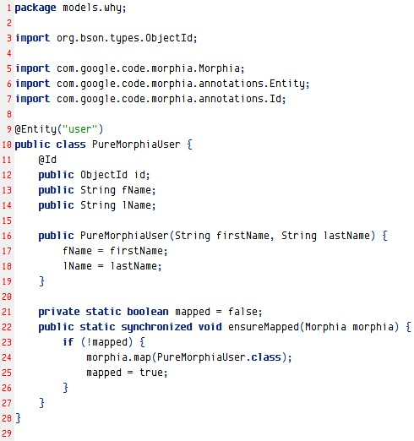
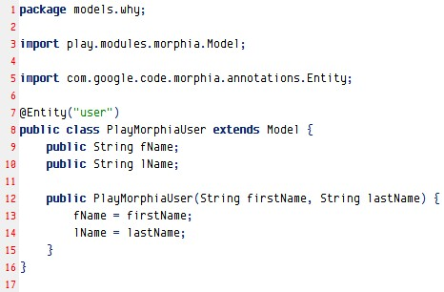
Comp – Model class
Pure Morphia model class
PlayMorphia model class

Slide 4
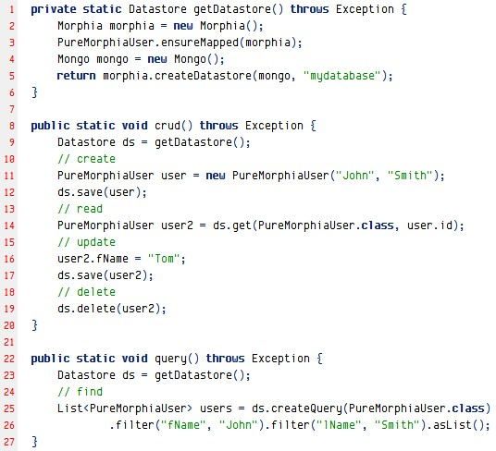
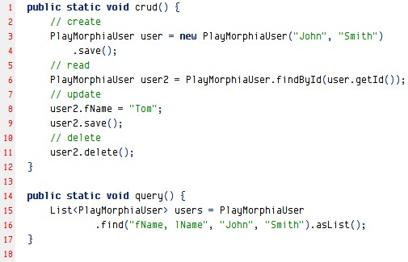
Comp – use model
Pure Morphia model app
PlayMorphia model app

Slide 5
Model architecture
PlayMorphia Model Archtecture
Java Common Object Contract
toString(); hashCode(); equals()
Play!Framework DB Model
_key(); _save(); _delete
…
CRUD
Query
Statistics
MorphiaQuery
Miscs (Timestamp, LifeCycle, Low level int…)
Annotation Classes

