Slide 1
Images

Slide 2

Architecture
Application
PlayMorphia
Play!Framework
Morphia
Mongo Driver
MongoDB

Slide 3
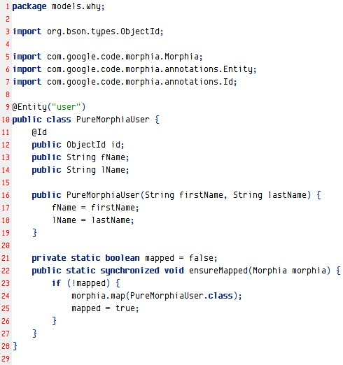
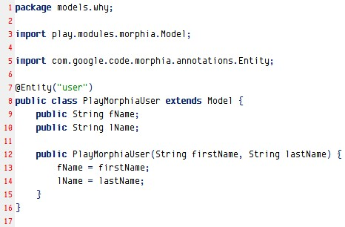
Comp – Model class
Pure Morphia model class
PlayMorphia model class

Slide 4
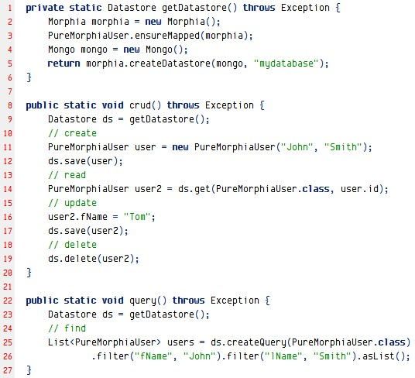
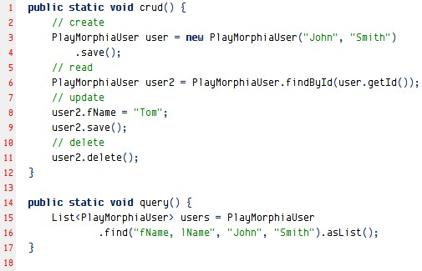
Comp – use model
Pure Morphia model app
PlayMorphia model app

