Slide 1
Design Space Exploration of Verifiable Credential Schemas using Partial Graph Modeling
Farkas Martin, Bertalan Zoltán Péter, Imre Kocsis
(CS)²- The 14th Conference of PhD Students in Computer Science
Notes:
Good afternoon Ladies and Gentlemen. I’m Martin Farkas from the Critical Systems Research Group a the Budapest University of Technology, and I will discuss our work, Design Space Exploration of Verifiable Credential Schemas using Partial Graph Modeling

Slide 2
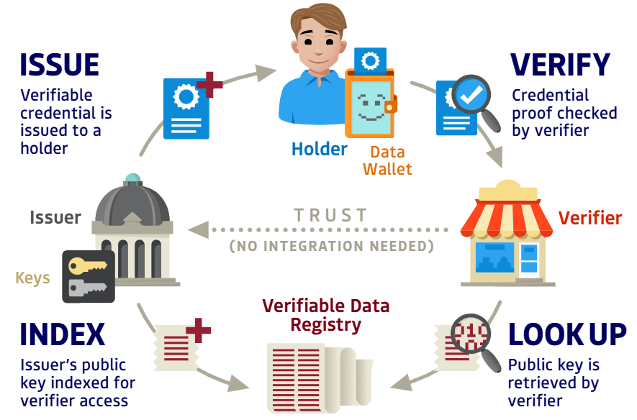
The Trust Triangle of Verifiable Credentials
Trust Over IP Foundation
Notes:
In today’s day and age, there is a growing demand for self-determination over our digital identities and the data we share over the internet . There is a novel identity paradigm that has been developing for decades and is now called Self-Sovereign Identity. It is supported by W3C standards and multiple EU intiatives such as the european blockchain and the european digital identity wallet.
These emerging approaches towards identity and claim management are creating a world where issuers of credentials, such as institutions and busineses issue digital credentials to holders, who then can present them to a verifier, both in a peer-to-peer manner. The Verifier can check the authenticity of the claims presented without contacting the issuer, rather by looking up a public registry. These digital credentials – as defined by the W3C – are called Verifiable Credentials.
This scheme and Verifiable Credentials are a part of SSI, but they are meaningful outside its context.

Slide 3

W3C Verifiable Credentials
Digital Diploma Verifiable Credential
University
Graduate
Workplace
Credential Metadata
Claims
Name
Year of graduation
GPA
Proofs
Etc.
Issue diploma
Present diploma
VDR
Notes:
Verifiable Credential provide a standardized method for for digitally representing, issuing, and verifying claims about a subject.
They are essentialy a piece of machine readable data coupled with a cryptographic signature or some other verifiaction method by their issuer. They are managed in so called wallets.
It is important to note that verifying a Verifiable Credential does not directly imply the truth of the claims encoded in it, only their authenticity, integrity, and currency. Rather, after authenticity and currency are established, a verifier may evaluate the claims based on their own policy and trust in the author.
A Verifiable Presentation is a tamper-evident and digitally signed package of one or more Verifiable Credentials (VCs) that an individual or entity (the holder) presents to another party (the verifier) to prove certain information or claims about themselves. VPs provide a mechanism for securely and privately sharing credentials in a verifiable way. Along with the authenticity of the claims they prove the authenticity of the entity presenting them.
One example, that is already widely available through europe, is a Digital University Diploma. The University issues a digital certificate to its gradutate, the autheticity of which can be verified without contacting the instituion directly.
Also, here is a growing need for limited information sharing in digital communication contexts. In SSI, this means in concrete terms the possibility of partial proof of personal attributes, for which the technology is provided by the relatively novel Zero-Knowledge Proofs (ZKPs), which provide privacy-enchancing features for VPs. An illustration for this using our example is that a workplace requires an applicant to have a GPA higher than a predetermined number. Using ZKPs, the applicant can provide a proof of this fact – and only this fact – without revealing any additional data from their digital diploma, like their year of graduation.
We are working on specifically the w3c credential data model, but our approach can be applicable to other formats as well

Slide 4
Design challenges of Verifiable Credential Schemas
Requirements on individual claims
Public/private – sensitivity of information
Short/long term
ZKP construction
Entity alignment
Possible shortcomings of VC schema designs
Shortfalls in privacy characteristics
Low expressiveness with and without ZKPs
Key question
How do we group a heterogenous set of claims with different requirements into a set of Verifiable Credential Schemas?
Notes:
Verifiable Credential Schemas are a shared definition of a specific VC data model. For example, a schema for a university diploma would define that it should contain the name of the institution, the graduation year, and the graduate’s GPA. They are generally stored in Verifiable Data Registries, which are public, verifiable repositories of shared knowledge, often built using Distributed Ledger Technolgogies.
We were interested in the design of interrelated Verifiable Credential Schemas. What consequences does their design has? What are the special requrements these claim sets have?
We observed that even with the use of Zero-Knowledge Proofs, how the required claims are grouped together influences the privacy characteristics of such a system. Also, if we systematically design VC schemas, it is possible to achieve larger expressive power, especially when comparing if ZKPs are used.
We identified some requirements individual claims may have in interrelated VC schemas:
A claim can be more or less sensitive to the subject. It would be desirable to not have claims of very different sensitivity in the same credential. One intuitive reason for this is to prevent accidental disclosure of a sensitive claim when the subject only wants to share the less sensitive one.
A claim can be expected to be valid for a varying amount of time. A concert ticket is valid until the time of the event, a birth certificate is valid thorought a person’s life. As credentials can have an expiry date, or can be revoked, proper gourping of these claims is crucial.
Entity aligment means that one claim in one credential has the same subject as another claim in another credential, and that this correlation should be able to be discovered.
- When constructing a complex ZKP, it may be required to store public and private inputs in the same credential. An example would be: which month does a presented bill correspond to without revealing the amount

Slide 5
Towards Systematic design of VC ecosystems
Model Driven Architecture approach
Graph based meta-models for claims and VCs
Generation using Partial Graph modeling
Notes:
Our contributions are the following
A model driven architecture approach for designing Verifiable Credential Schemas from Information Graphs; our approach provides tracability and enables interoprability between different Verifiable Credential Data models, such as JSON-SD and Hyperledger Anoncreds
A graph based meta model for representing Information graphs, VC schemas, and specific VC data models
And the systematic generation of diverse models using partial graph modeling, specifically a tool named Refinery

Slide 6
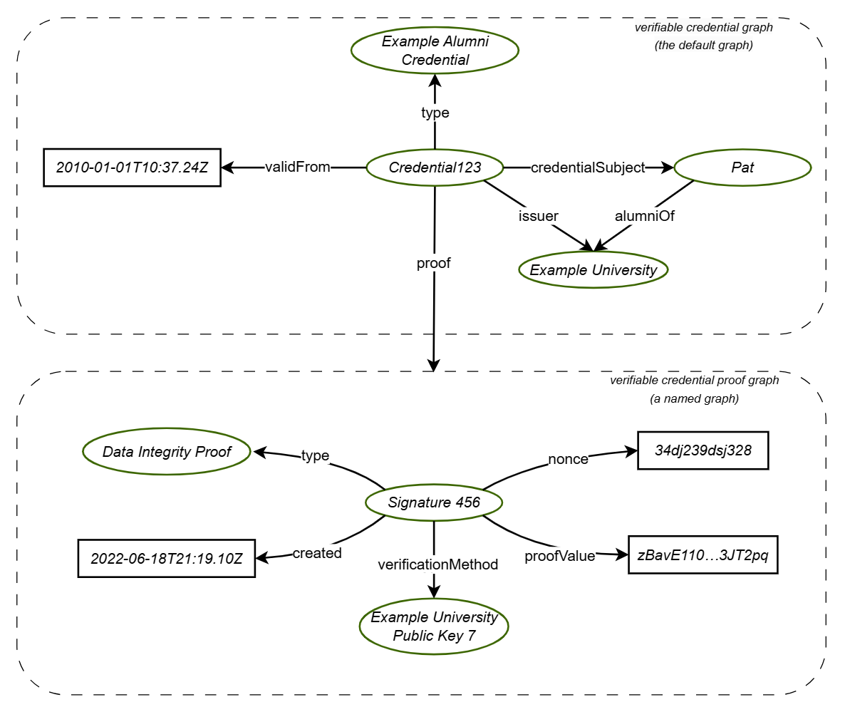
Verifiable Credentials as Knowledge graphs
Claims can be expressed as subject-property-value relationships
Verifiable Credentials can be represesented as Knowledge Graphs
Notes:
!Read slide
!Explain the example

Slide 7
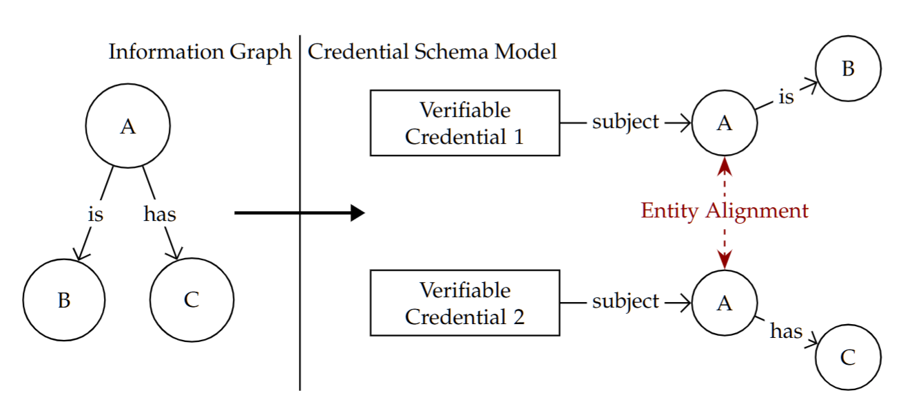
Decomposing a Knowledge Graph to a set of VCs
Notes:
!Explain the slide
So lets say the two claims are that tom has blue eyes and tom is a man. One design would be to store these facts in the same credetnial. Another one, analogous to the right side of the figure, is to store these claims in two separate credentials, where the aligned entity is tom

Slide 8
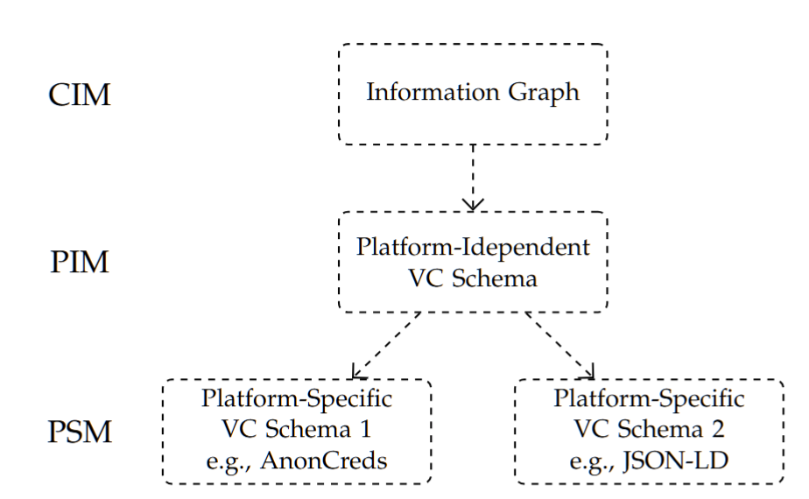
Model-driven Architecture approach
Traceability between IGs and VC Schemas
Interoperability between platform specific schema models e.g. SD-JWT, JSON-LD, Hyperledger Anoncreds
Notes:
!Read slide
!Explain the individual arrows, i.e. the steps of the flow

Slide 9
Benefits of MDA for DSE
Systematically generate interrelated VC schemas
Satisfy complex requirements (sensitvity, long/short term)
Traceability from Knowledge graph to VC Schema
Semantic alignment between specific VC standards
Applying formal methods and CAD at the PIM level

Slide 10
Partial Graph Modeling
Verifiable Credentials/Presentations can be expressed as Knowledge Graphs
Requirements: graph patterns and constraints
Refinery is able to generate diverse graph solutions against requirement sets
Notes:
Using Partial Graph Modeling, we can pose hard constraints
There are many different tools to do this, we chose refinery, because it can automated generation of diverse, consistent graph models
Incremental creation of solution sets

Slide 11
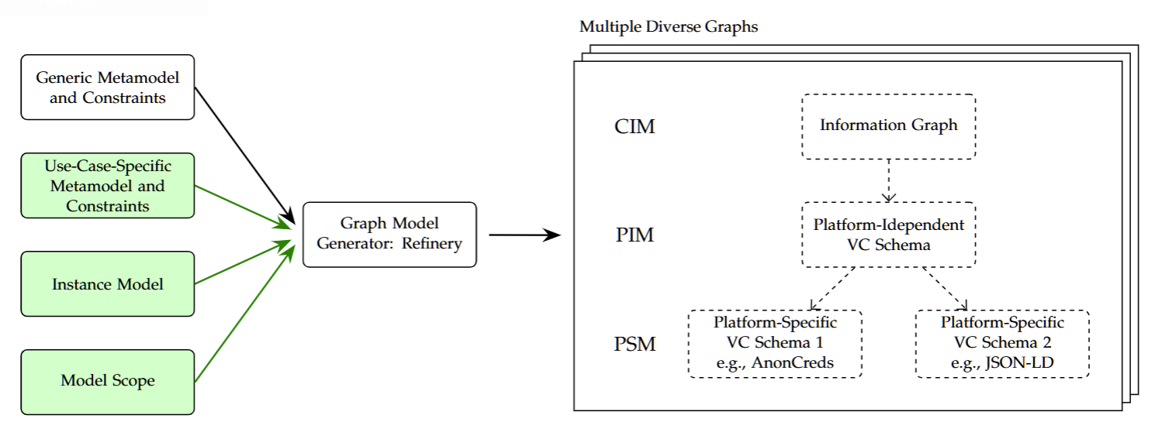
Architecture of model generation
Notes:
Metamodel: Types for nodes and edges; how can they be connnected
Predicates: Named patterns in the generated model
Error Predicates: Unwanted patterns, effective for shrinking the design space
Instance model: Specific instances that must be in the model
Model Scope: Desired size-range of the model, per type and overall
Metamodels we have:
Information graph
Credential graph
One for each platform specific VC standard
From these metamodels, with the provided constraints we can generate diverse models

Slide 12
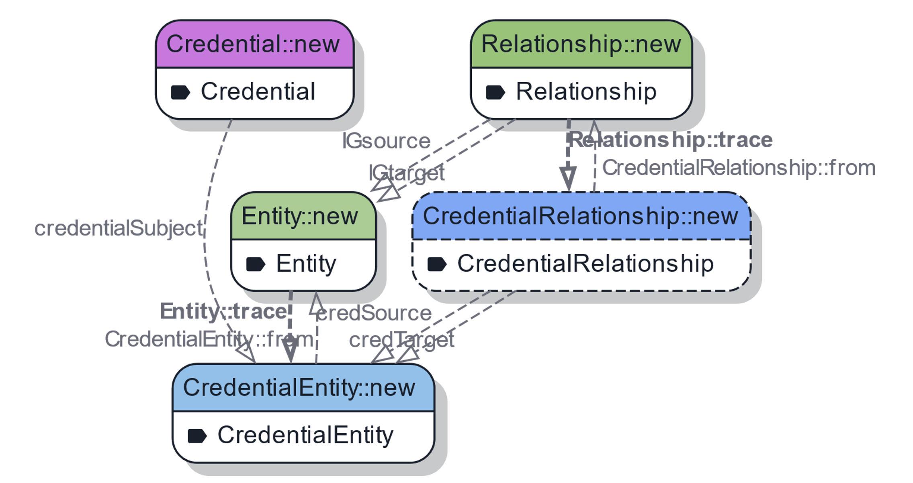
Partial CIM/PIM Metamodel

Slide 13
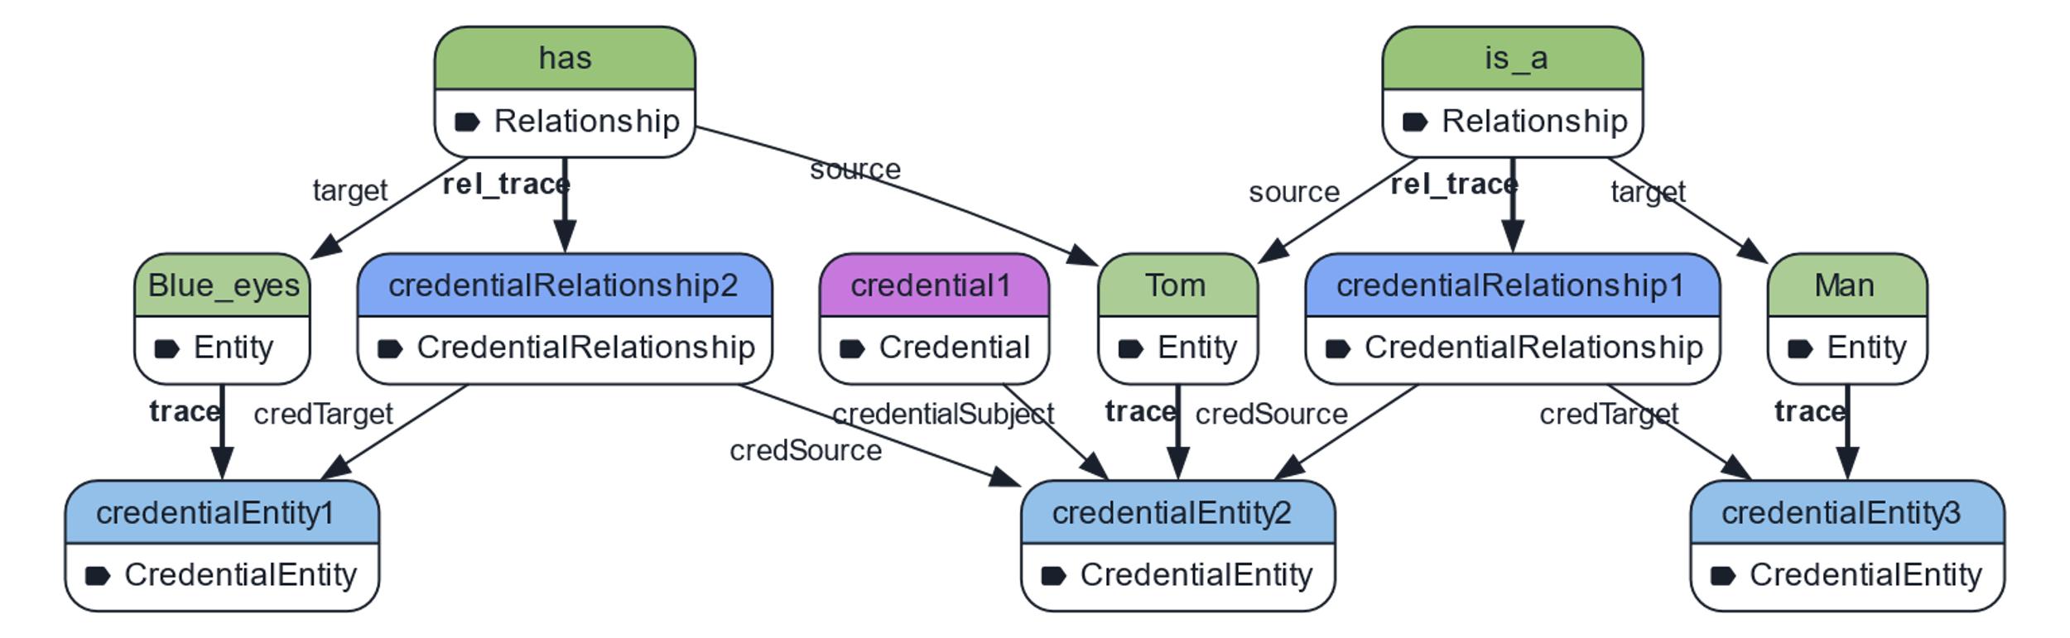
Example generated model w/ 1 Credential

Slide 14
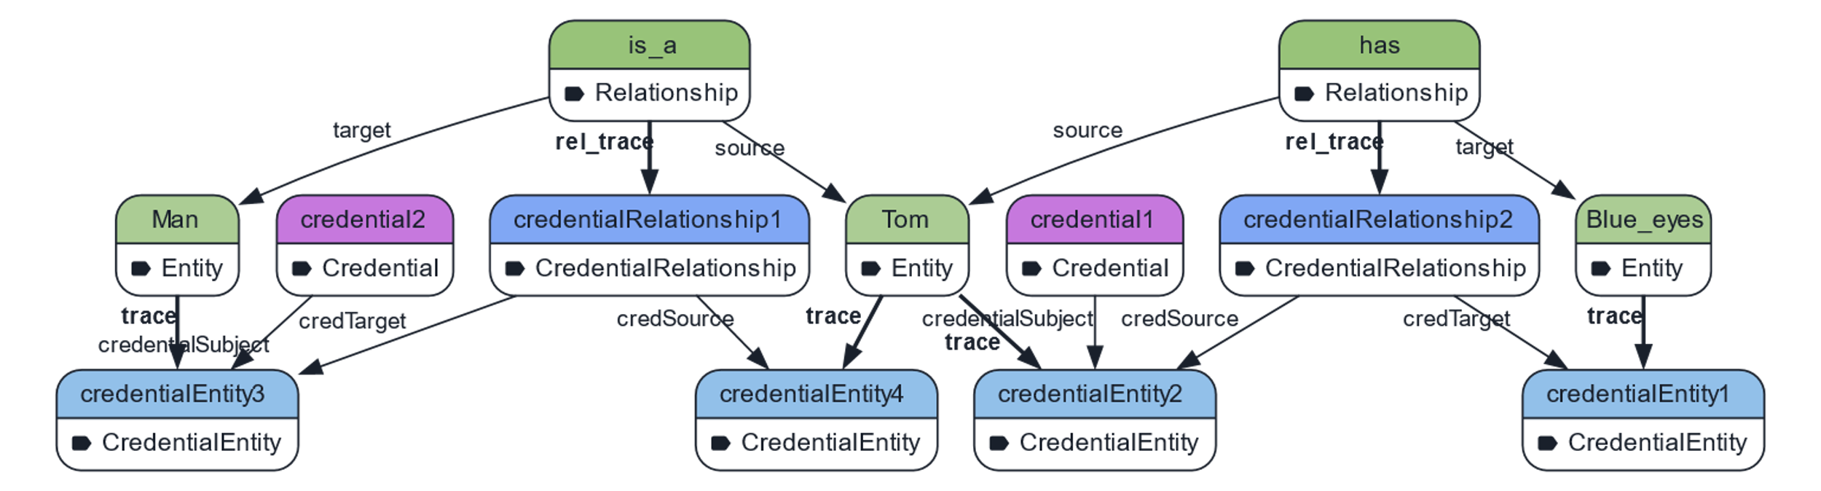
Example generated model w/ 2 Credentials

Slide 15
Conclusion
Novel method for systematically designing interrelated VC schemas from information graphs
MDA for traceability and interoprability
Verifiable Credential Meta-model for Refinery
Future Work
Working out representative, real-life requirements and scenarios
Integrating more platform specific credential representations
Methodology and tooling for a complete design workflow

