Slide 1
Network Devices
-Hari Yuvan

Slide 2
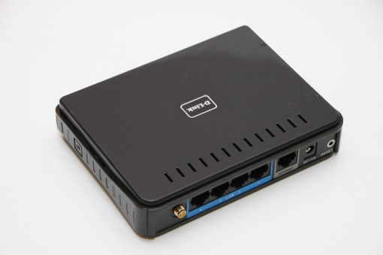
Modem
A modem (short for modulator-demodulator) is a device that allows computers and other devices to connect to the internet by converting digital data into analog signals (modulation) and vice versa (demodulation).

Slide 3
Types of Modems
DSL Modem: Works over telephone lines.
Cable Modem: Connects to the internet via a cable television network.
Fiber Modem (ONT): Used for fiber-optic internet connections.
Dial-up Modem: An older type that uses regular phone lines (largely obsolete).
Wireless Modem: Connects to the internet using cellular networks (e.g., 4G, 5G).
Modems are often combined with routers to create a device that both provides
internet access and distributes the connection wirelessly (Wi-Fi).

Slide 4
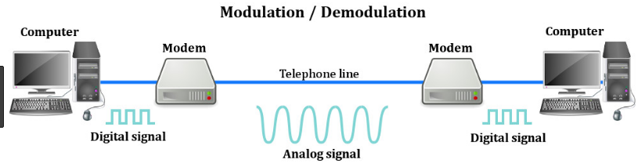
How the Modem works:
Modulation: When data is sent from a computer to the internet (upload), the modem converts the digital signals from the computer into analog signals that can be transmitted over traditional phone lines, cable, or fiber-optic networks.
Demodulation: When data is received from the internet (download), the modem converts the analog signals back into digital signals that the computer can understand.

Slide 5
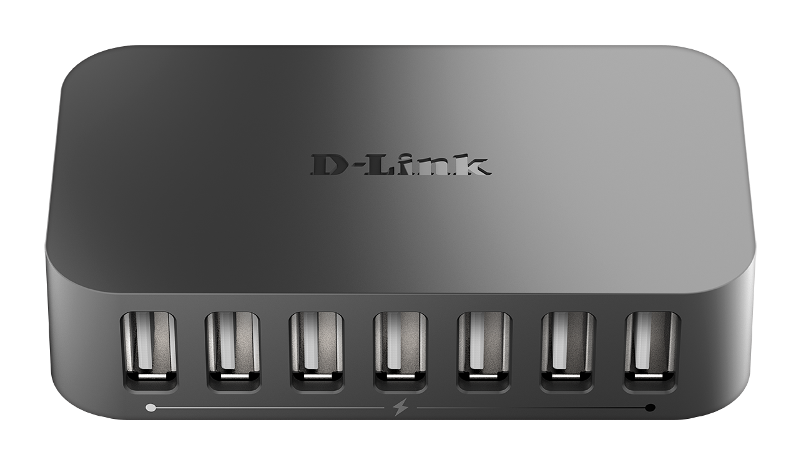
Hub
A hub is a basic networking device used to connect multiple computers or network devices together in a Local Area Network (LAN). It operates at the physical layer (Layer 1) of the OSI model and is responsible for broadcasting data to all connected devices.

Slide 6
Types of hubs
Active Hub: Amplifies the signal before broadcasting it to other devices,
helping extend the distance the data can travel.
Passive Hub: Simply receives and broadcasts the signal without amplifying it.
Intelligent Hub: Also known as a manageable hub, it can provide additional
features like monitoring, diagnostics, and managing network traffic.

Slide 7
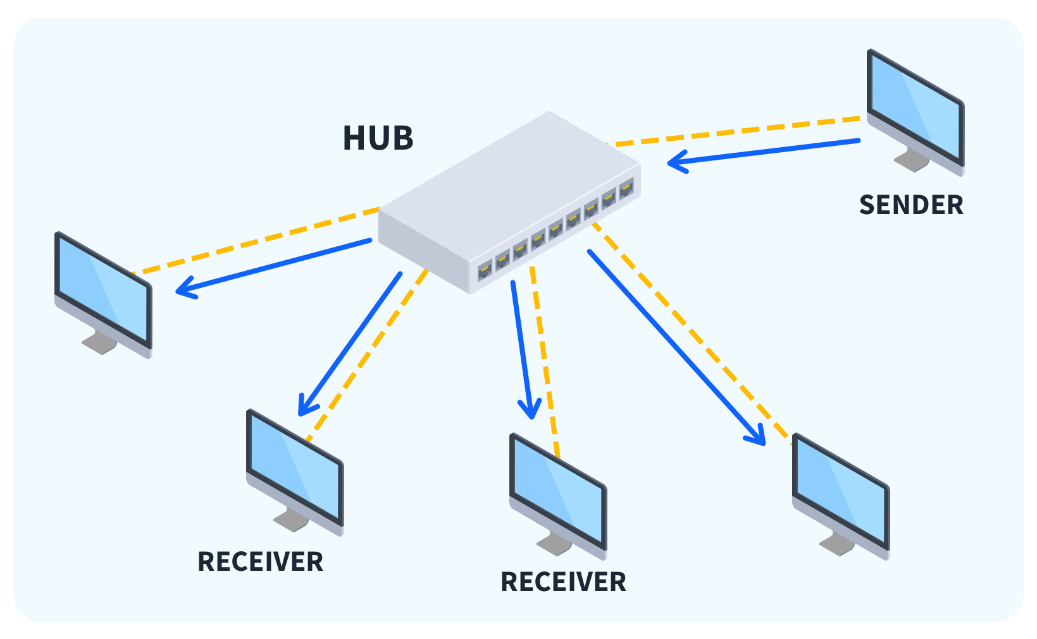
How a Hub Works
A hub has multiple ports, and when a device (such as a computer or printer) is connected to one of these ports, it can communicate with the other devices on the network.
When data (in the form of packets) is sent from one device, the hub broadcasts the data to all other devices connected to it, regardless of the intended destination.
Hubs do not distinguish between devices, and they do not filter or route data; they simply forward data to all ports.

Slide 8


