Slide 1
Optical Flow OpenCV Implementation
Prepared by: Eng. Samer Iskander

Slide 2
Contents
1. Introduction.
2. OpenCV.
3. Downloading the Required Software.
4. Installing OpenCV.
5. Start a new Visual C++ Project for Optical Flow.

Slide 3
Contents Cont.
6. Editing the Project Properties.
6.1 Adding the OpenCV Include Directories.
6.2 Adding the OpenCV Library Directories.
6.3 Referencing Required OpenCV Libraries.
6.4 The Preprocessor Definitions.
6.5 Command Arguments.
6.6 Run The Project/Solution.
7. Code Analysis.
7.1 KLT Tracker.

Slide 4

1. Introduction
It is an implementation of optical flow algorithm with OpenCV and Visual Studio 2015 (any Visual Studio version can be used) using VC++.
Implementation can run either real time to track moving objects or between two frames.

Slide 5

2. OpenCV
OpenCV (Open Source Computer Vision Library) is an open source computer vision and machine learning software library.
OpenCV was built to provide a common infrastructure for computer vision applications and to accelerate the use of machine perception in the commercial products.

Slide 6
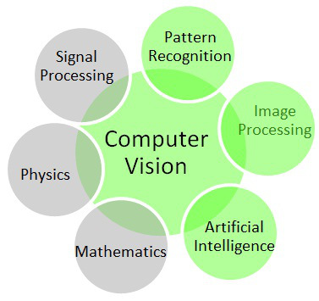
The library has more than 2500 optimized algorithms, which includes a comprehensive set of both classic and state-of-the-art computer vision and machine learning algorithms.

Slide 7
These algorithms can be used to:
- detect and recognize faces,
- identify objects,
- classify human actions in videos,
- track camera movements,
- track moving objects,
- extract 3D models of objects,
- produce 3D point clouds from stereo cameras,
- etc.

Slide 8
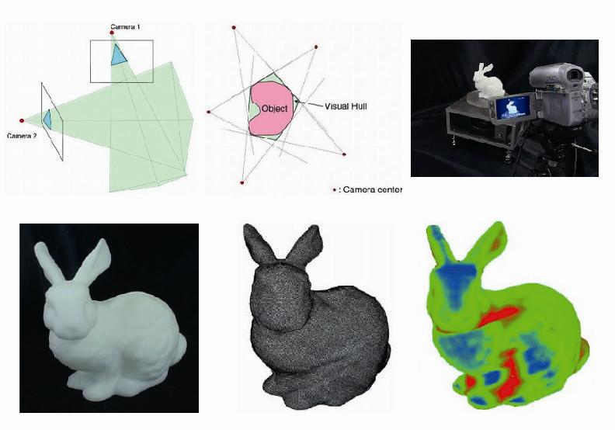

Slide 9


It has C++, C, Python, Java and MATLAB interfaces and supports Windows, Linux, Android and Mac OS.

Slide 10
3. Downloading the Required Software
Download from (opencv.org) or any other website that offers the download http://sourceforge.net/projects/opencvlibrary/files/
For this tutorial, version 2.4.9 will be used.

Slide 11

Then, go to https://www.dropbox.com/login and then sign in using the following information:
Email: robot.vision.files@gmail.com ,
and Password: robotvision
in order to download the Optical Flow Software.

Slide 12
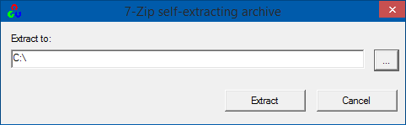
4. Installing OpenCV
Installation requires about 4GB of free disk space.
Run the downloaded executable file (Note that the OpenCV installer simply creates a folder named “opencv” in the chosen “Extract to:”directory).

Slide 13
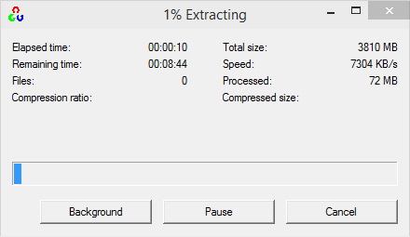
You should choose an extraction directory that is safe, accessible, and unlikely to change. This guide uses an “Extract to:” directory of “C:\”.

Slide 14
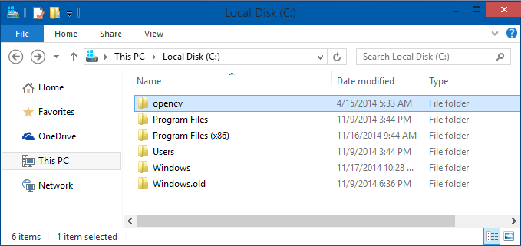
When it closes, confirm that the opencv directory was created in your Extract to: directory of choice:

Slide 15
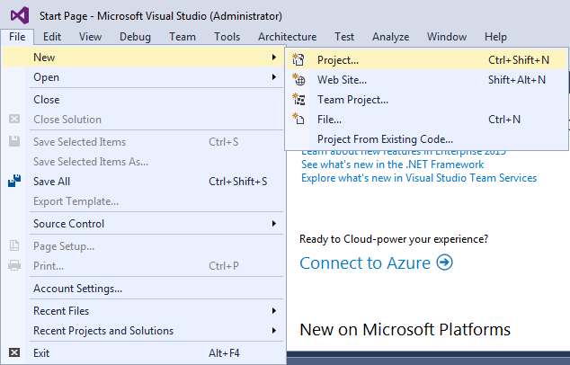
5. Start a new Visual C++ Project for Optical Flow
File -> New -> Project

Slide 16
VC++ -> Win32 Console Application
Write the name you choose for the project.
For example, Optical_Flow
Then, Press OK.

Slide 17
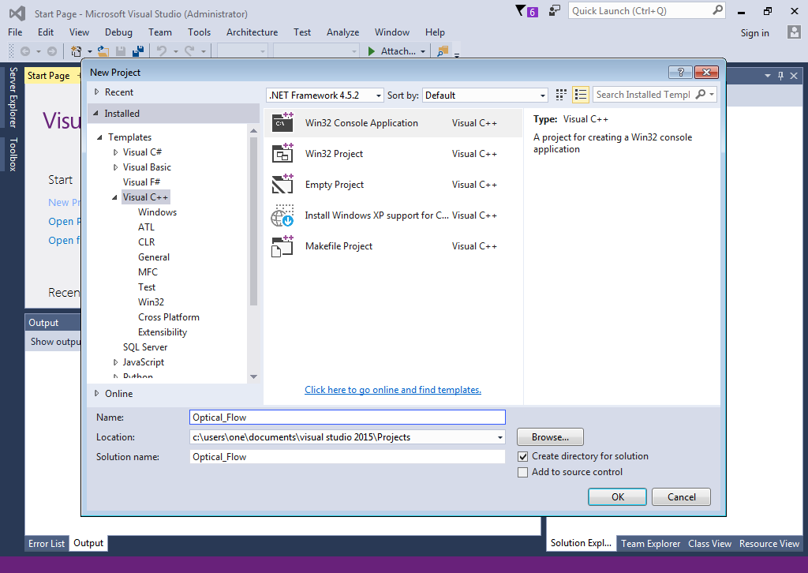

Slide 18
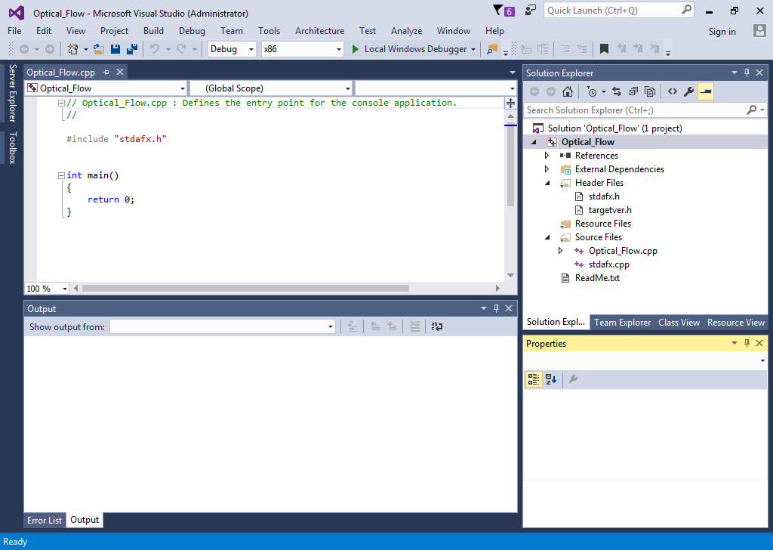

Slide 19
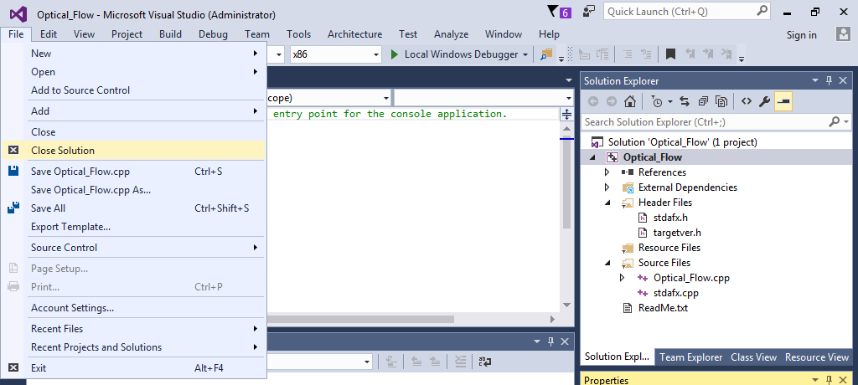
Then, close the project.

Slide 20
Copy the following files
From: OpticalFlow_vs directory (the extracted zip file you have already downloaded from the Dropbox).
<the directory that contains the extracted zip file>\ OpticalFlow_vs\OpticalFlow_vs\OpticalFlow_vs\OptiFlow
For example, C:\OpticalFlow_vs\OpticalFlow_vs\OpticalFlow_vs\OptiFlow
To: the project folder
<the new project directory>\Optical_Flow\Optical_Flow
For example, C:\Users\One\Documents\Visual Studio 2015\Projects\Optical_Flow\Optical_Flow

Slide 21
between.h | between.cpp | image0.jpg
common.h | cv_pyrlk.cpp | image1.jpg
resource.h | main.cpp
Tracker.h | Tracker.cpp

Slide 22
In the new project directory, perform the following steps:
1. Delete the cpp file that contains the main function (its name is the same as the project name).
For example, delete
C:\Users\One\Documents\Visual Studio 2015\Projects\Optical_Flow\Optical_Flow\Optical_Flow.cpp
2. Rename main.cpp to be the same name as the deleted file.

Slide 23
Copy all dll files
From the following directory:
<OpenCV install directory>\build\\x86\vc11\bin
For example, C:\opencv\build\x86\vc11\bin
To
<the new project directory>\Optical_Flow\Optical_Flow
For example, C:\Users\One\Documents\Visual Studio 2015\Projects\Optical_Flow\Optical_Flow

Slide 24
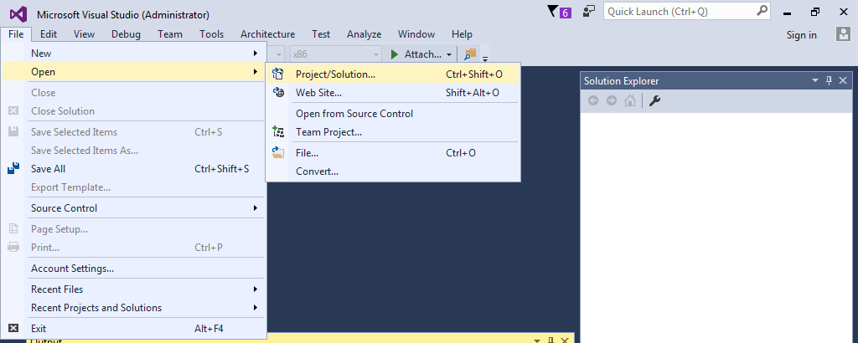
Then, open the project again.

Slide 25
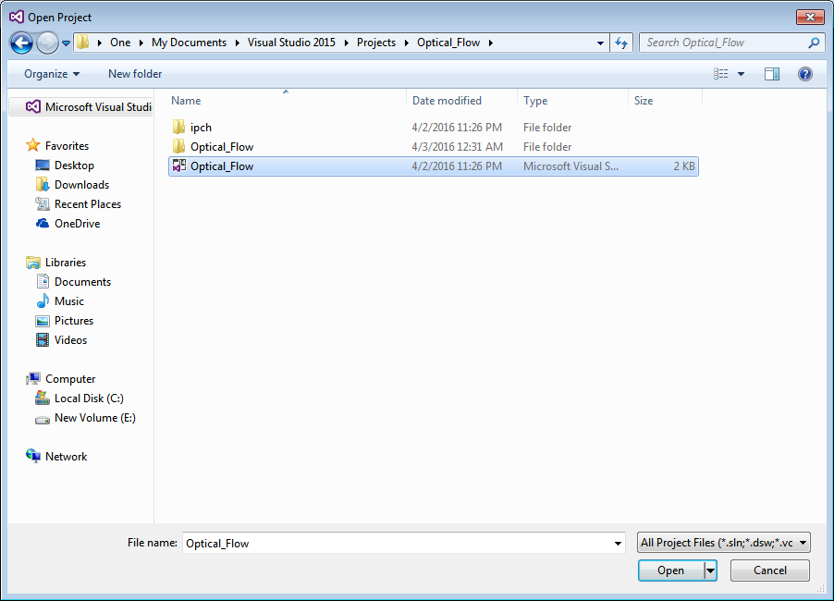

Slide 26
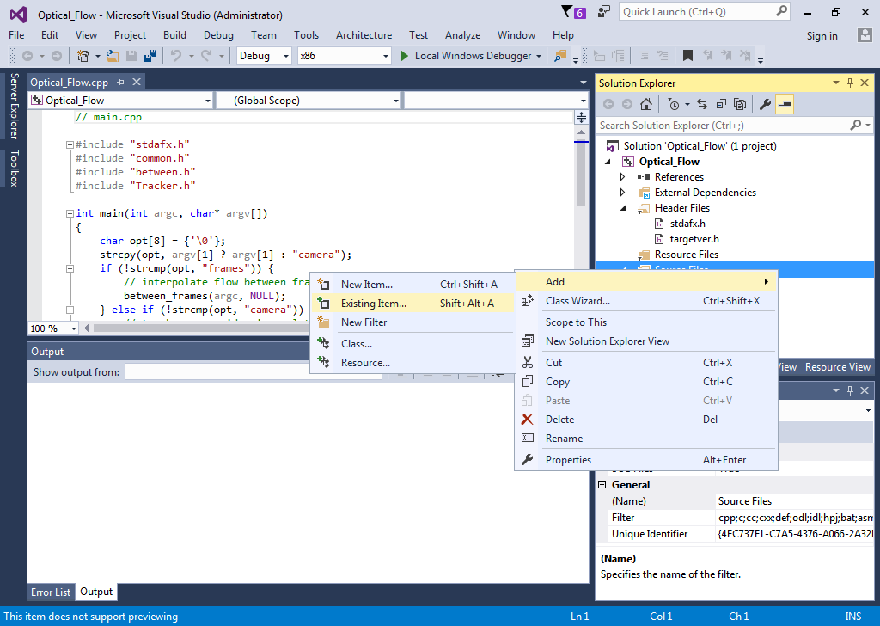
Right click on “Source Files” -> Add -> Existing Item

Slide 27
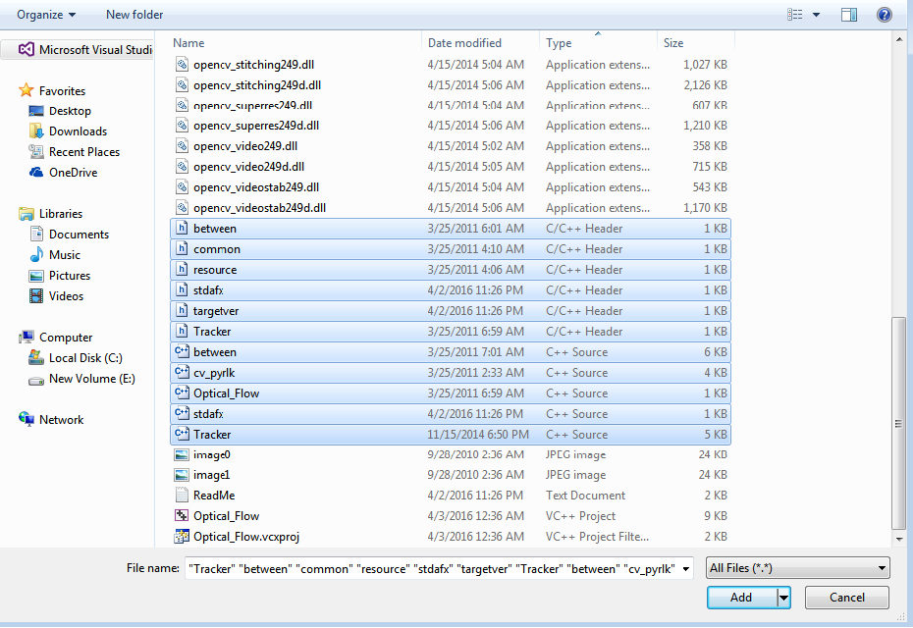
Then, choose all h (header) and cpp files.

Slide 28
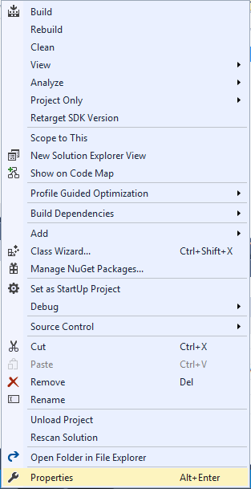
6. Editing the Project Properties
Open the Project Properties window via the Solution Explorer view.
Right click Project>Properties

Slide 29
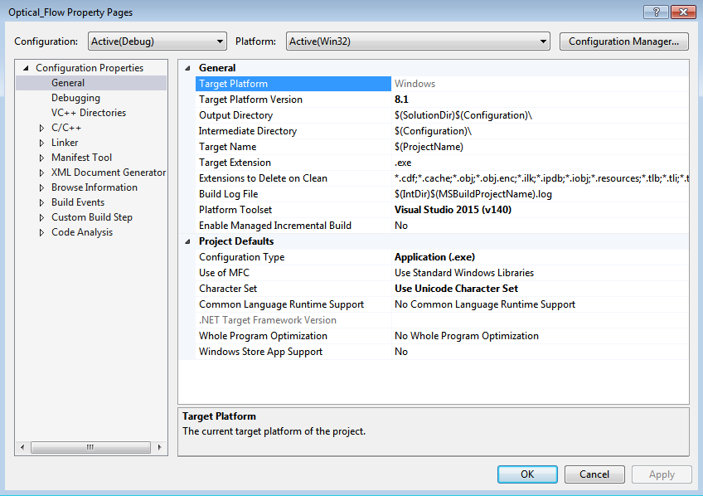

Slide 30
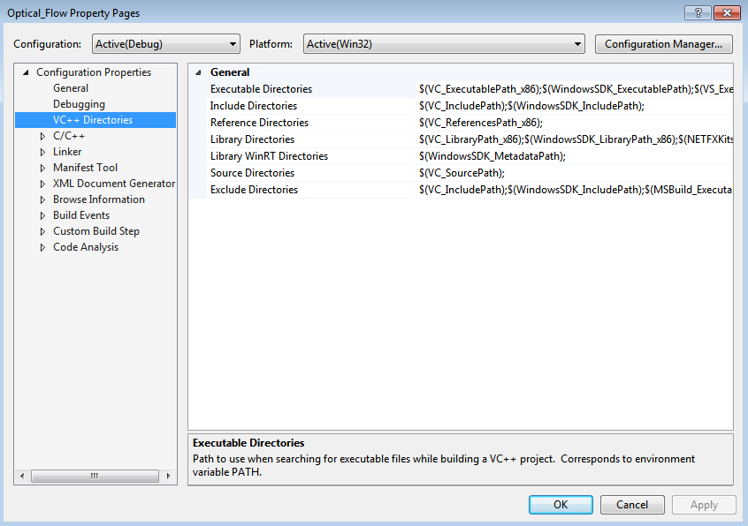
Select VC++ Directories on the left pane of the Project Properties window.

Slide 31
6.1 Adding the OpenCV Include Directories
Edit the Include Directories to point to include the three following directories:
<OpenCV install directory>\build\include
<OpenCV install directory>\build\include\opencv
<OpenCV install directory>\build\include\opencv2

Slide 32
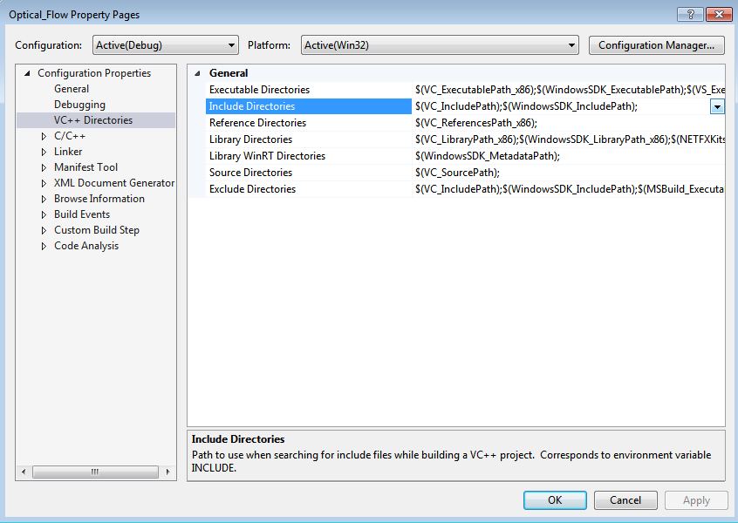

Slide 33
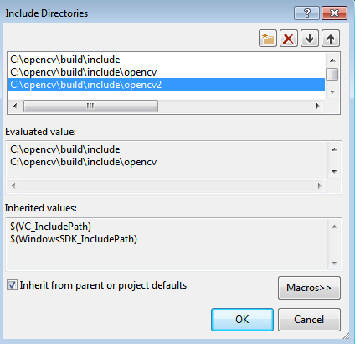
For example, if your install directory was C:\opencv, include the three following directories:
C:\opencv\build\include
C:\opencv\build\include\opencv
C:\opencv\build\include\opencv2

Slide 34
6.2 Adding the OpenCV Library Directories
Edit the Library Directories to include the following directory:
<OpenCV install directory>\build\x86\vc11\lib

Slide 35
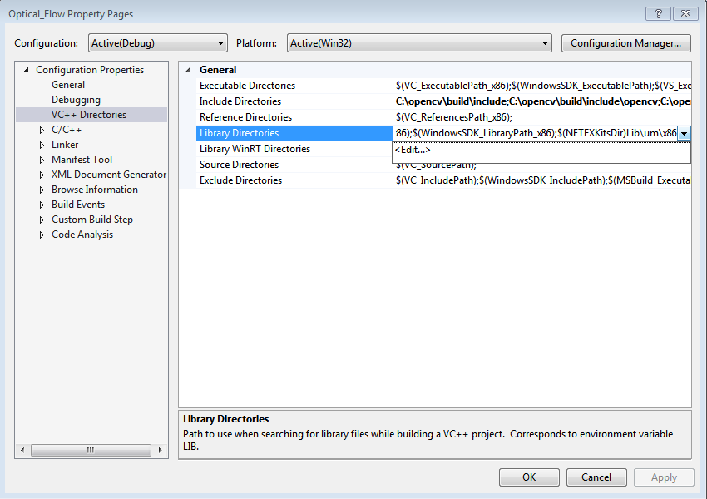

Slide 36
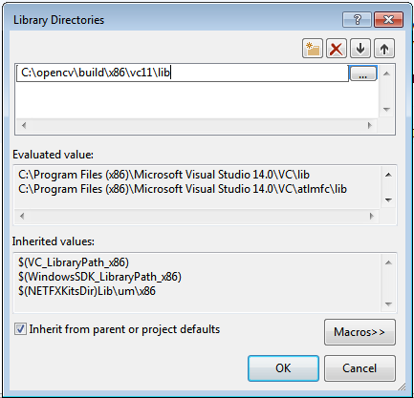
For example, if your install directory was C:\opencv, add the following library directory:
C:\opencv\build\x86\vc11\lib

Slide 37
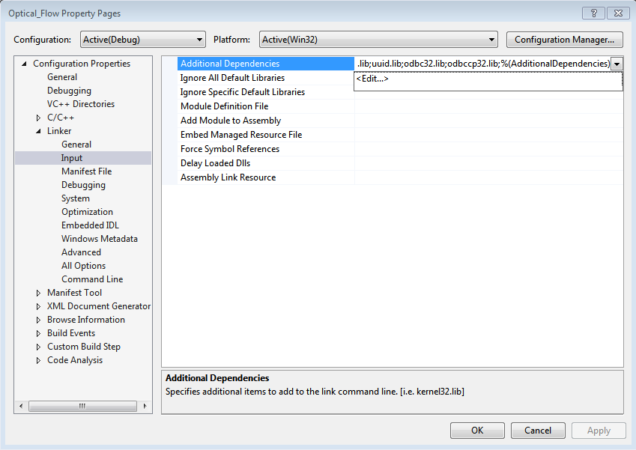
6.3 Referencing Required OpenCV Libraries
To add OpenCV libraries, you must add the .lib files to Linker>Input>AdditionalDependencies.

Slide 38
opencv_calib3d249.lib
opencv_calib3d249d.lib
opencv_contrib249.lib
opencv_contrib249d.lib
opencv_core249.lib
opencv_core249d.lib
opencv_features2d249.lib
opencv_features2d249d.lib
opencv_flann249.lib
opencv_flann249d.lib
opencv_gpu249.lib
opencv_gpu249d.lib
opencv_highgui249.lib
opencv_highgui249d.lib
opencv_imgproc249.lib
opencv_imgproc249d.lib
opencv_legacy249.lib
opencv_legacy249d.lib
opencv_ml249.lib
opencv_ml249d.lib
opencv_nonfree249.lib
opencv_nonfree249d.lib
opencv_objdetect249.lib
opencv_objdetect249d.lib
opencv_ocl249.lib
opencv_ocl249d.lib
opencv_photo249.lib
opencv_photo249d.lib
opencv_stitching249.lib
opencv_stitching249d.lib
opencv_superres249.lib
opencv_superres249d.lib
opencv_ts249.lib
opencv_ts249d.lib
opencv_video249.lib
opencv_video249d.lib
opencv_videostab249.lib
opencv_videostab249d.lib

Slide 39
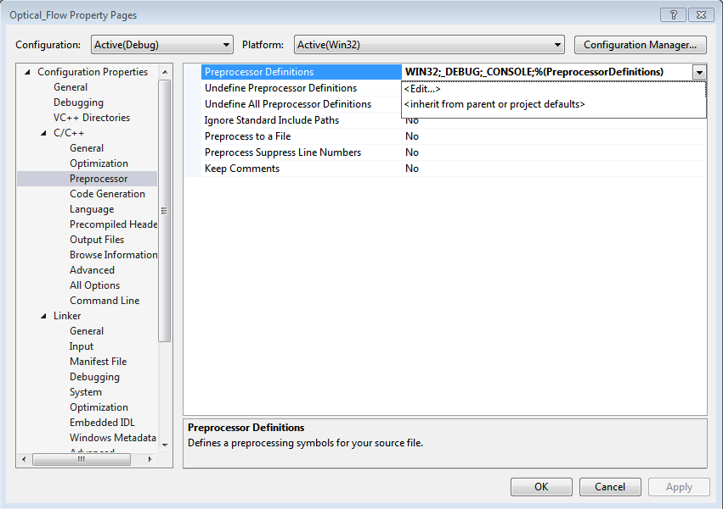
6.4 The Preprocessor Definitions
C/C++ -> Preprocessor ->Preprocessor Definitions

Slide 40
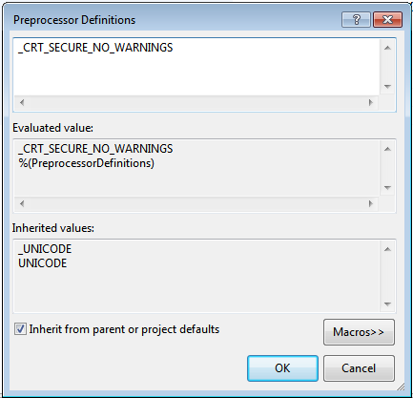
Then, add the following:
_CRT_SECURE_NO_WARNINGS

Slide 41
6.5 Command Arguments
Project Properties >
Configuration Properties >
Debugging >
Command Arguments
i) camera: is for real-time tracking using the webcam.
ii) frames: apply Optical flow between two frames.

Slide 42
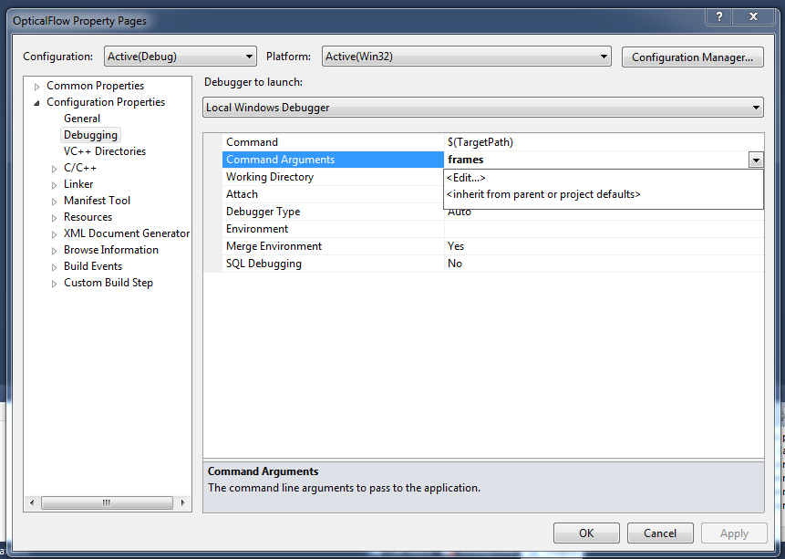

Slide 43
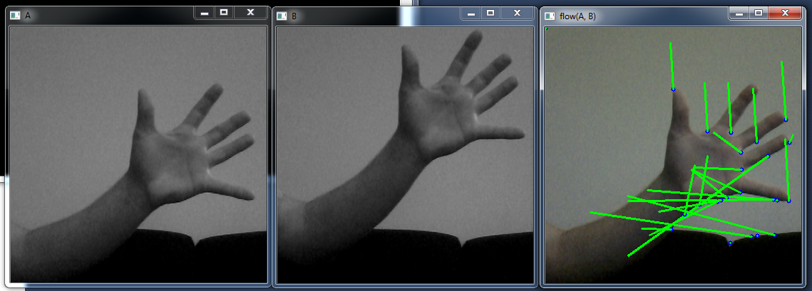
6.6 Run The Project/Solution
Save the project.
Start debugging (F5).

Slide 44

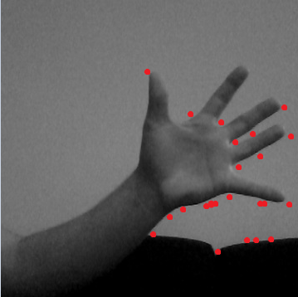
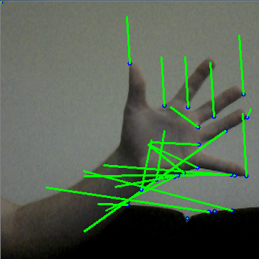
7. Code Analysis
Load
Image 1
Interest
Points
KLT Tracker using 2 images

Slide 45
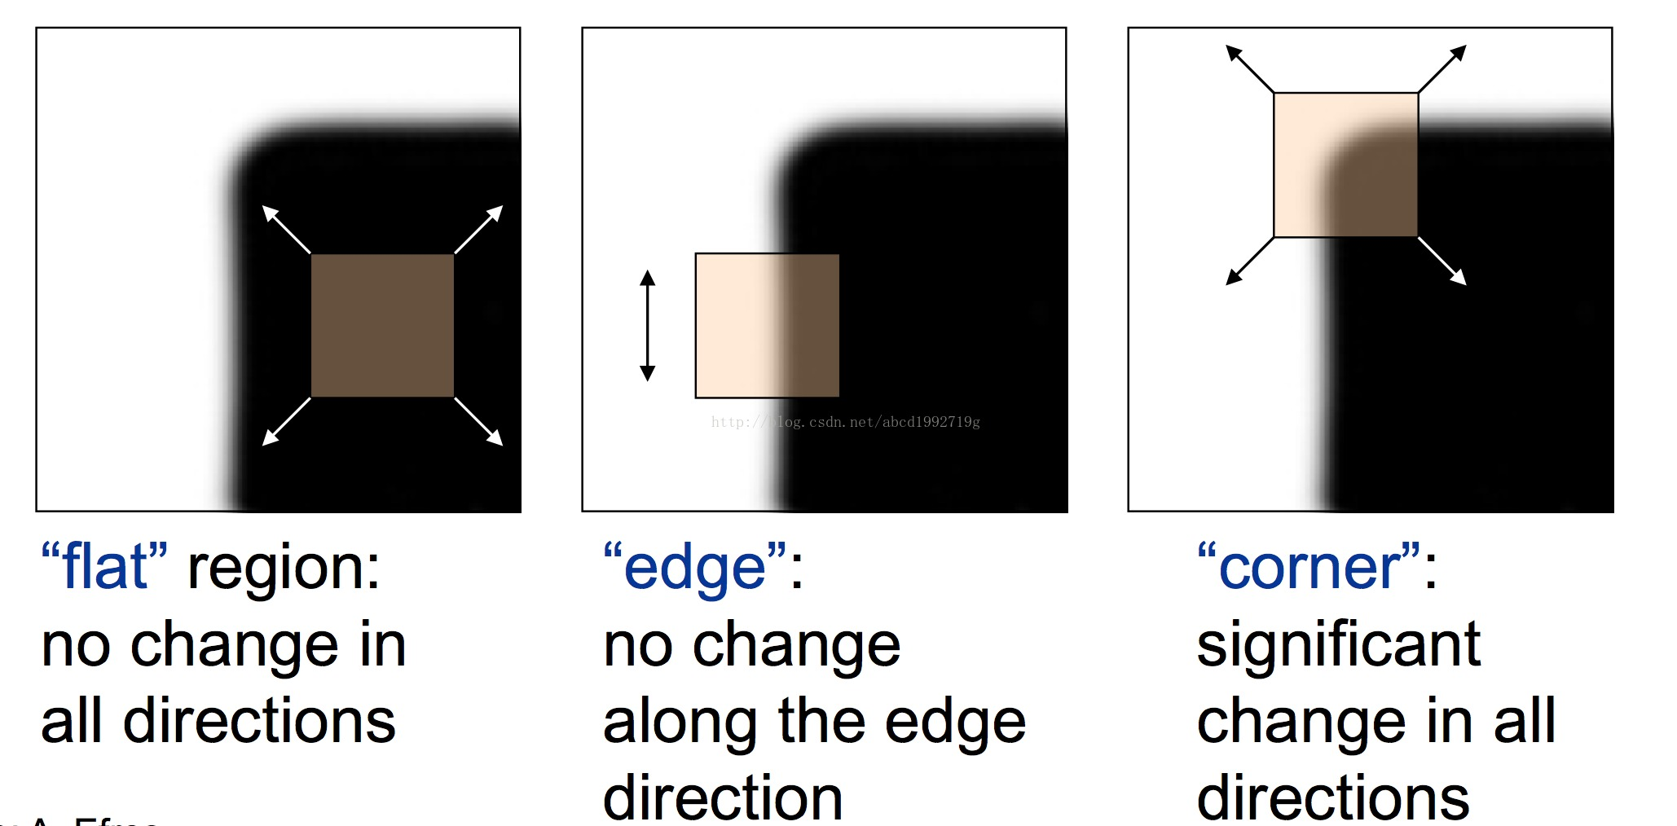
7.1 KLT Tracker
Detect Harris corners in the first frame

Slide 46
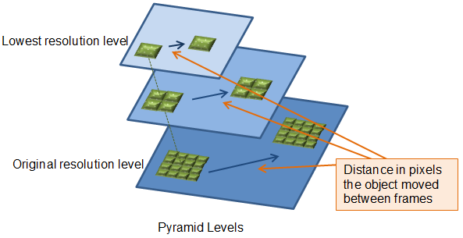
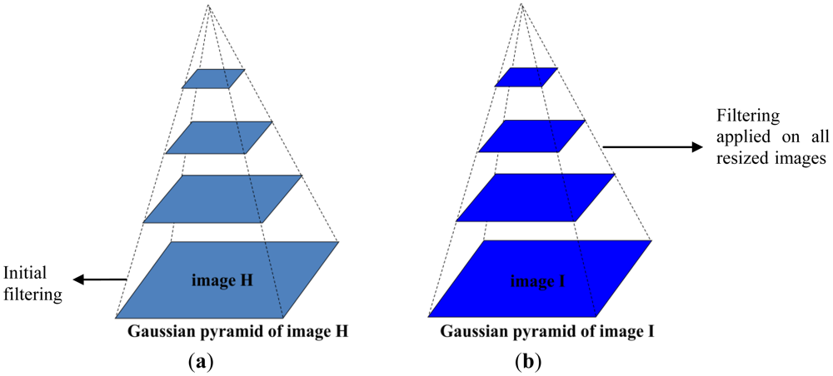
7.1 KLT Tracker
Build the Optical Flow Pyramid

Slide 47
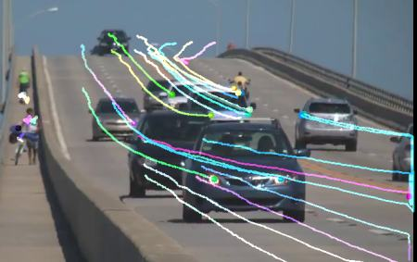
For each Harris corner compute motion between consecutive frames
Link motion vectors in successive frames to get a track for each Harris point
Introduce new Harris points by applying Harris detector at every m frames

Slide 48
Thank You

