Slide 1
MyBahaya
AI-Powered Emergency Reporting & Real-Time Community Alert Platform
FYP1 Presentation · Ahmad Shukri · Universiti Teknikal Malaysia Melaka (UTeM) · 2025/2026
Notes:
Assalamualaikum. Good morning, evaluators. My name is Ahmad Shukri. Today I present MyBahaya — an AI-powered emergency reporting and real-time community alert platform for Malaysia.

Slide 2
Introduction
What is MyBahaya?
Who uses it?
How does it work?
A mobile-first platform enabling Malaysian citizens to report emergencies in real-time, complete with media upload, GPS tagging, and live status tracking.
Citizens submit and track reports. Emergency organizations (Fire, Police, Medical) receive auto-assigned cases. Admins moderate via web dashboard.
Citizen submits photo + GPS → AI analyses severity → Nearest org auto-assigned → FCM push to org & nearby citizens → Status updates in real-time.
Notes:
MyBahaya has three user types: citizens, organizations, admins. Flow: submit → AI → route → notify → track.

Slide 3
Problem Statement
01
02
No Dedicated Reporting App
Slow Emergency Routing
Malaysia has no mobile app for citizens to report non-fire emergencies with media evidence and GPS location in real-time.
Traditional 999 calls rely on human dispatchers. No automated system routes incidents to the nearest available organization.
03
04
No Community Awareness
Fake Report Abuse
Citizens near an incident are not notified, causing late community response and repeated submissions of the same incident.
Without automated verification, emergency services are overwhelmed by false reports — wasting critical response resources.
Notes:
Four problems: no reporting app, slow routing, no community awareness, fake reports. These gaps justify MyBahaya.

Slide 4
Problem Statement — Key Statistics
Sources: DOSM ICT Survey 2024 · MERS 999 ScienceDirect 2026 · The Star 2025 · MJPHM Kelantan Study
99.5%
84.7%
of Malaysians own a mobile phone
of ambulance calls had delayed response
yet no dedicated emergency reporting app exists
Response times exceeded WHO & MOH benchmarks in all districts
📌 DOSM ICT Use & Access Survey, 2024
📌 MJPHM — Kelantan Ambulance Study
169,000+
2–3%
prank / fake calls to MERS 999
of all 999 calls are real emergencies
In 2025 alone — disrupting real emergency responses
Majority are false reports — wasting critical resources
📌 The Star, November 2025
📌 The Sun / CiliSOS — MERS 999 Analysis
Notes:
All statistics from real sources. 99.5% phone ownership confirms mobile reach. 84.7% ambulance delay + response times exceeding WHO benchmarks prove the problem. 169,000 fake calls in 2025 and only 2-3% real calls justify AI fake detection in MyBahaya.

Slide 5
Problem Statement — Existing Work Comparison
Feature | 999 System | MySejahtera | Waze | MyBahaya
Real-Time Community Alerts | ✗ | ✗ | Partial | ✓
Photo / Video Upload | ✗ | ✓ | ✓ | ✓
AI Severity Analysis | ✗ | ✗ | ✗ | ✓
Report Status Tracking | ✗ | ✓ | ✗ | ✓
Auto Organisation Routing | ✗ | ✗ | ✗ | ✓
Fake Report Detection (AI) | ✗ | ✗ | ✗ | ✓
Notes:
Only MyBahaya provides all six features. Competitors lack AI analysis, auto routing, and fake detection.

Slide 6
Objectives
1
To develop a cross-platform mobile application that enables Malaysian citizens to submit emergency reports with multimedia evidence and real-time GPS coordinates.
2
To implement an AI analysis module using Google Gemini 2.5 Flash that automatically assesses incident severity (1–5), identifies hazards, and detects fake reports.
3
To design a geolocation-based routing system that auto-assigns reports to the nearest emergency organisation and delivers real-time FCM push notifications to all stakeholders.
Notes:
Three objectives: build mobile reporting app, implement Gemini AI analysis, design geolocation routing system.

Slide 7
Scope
Users
Functionalities
Malaysian citizens — Android mobile app
Emergency organizations — Fire, Police, Medical
System administrators — Web dashboard
Real-time report submission with photo/video
AI severity analysis & fake detection
FCM push alerts (org + nearby citizens)
Geographic Coverage
Exclusions (FYP 1)
Peninsular Malaysia
5 incident categories: Fire, Medical, Theft, Assault, Other
iOS platform — not in scope
Government API integration — not in scope
Payment or legal processing — not included
Notes:
Scope: Android for citizens, organizations, admins. Peninsular Malaysia. Five categories. iOS and government APIs excluded in FYP1.

Slide 8
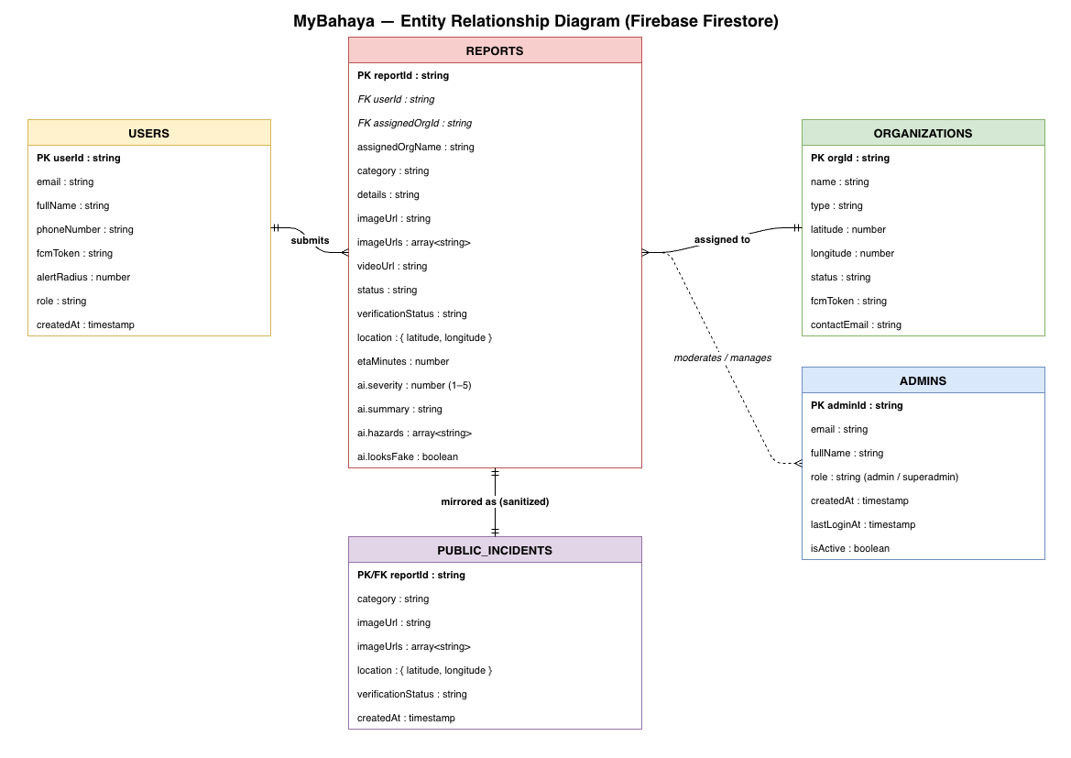
Entity Relationship Diagram (ERD)
5 Entities: USERS · REPORTS · ORGANIZATIONS · PUBLIC_INCIDENTS · ADMINS
(Insert ERD diagram here)
Notes:
Five Firestore collections. Reports link to Users via userId, to Organisations via assignedOrgId, and mirror sanitised data to Public Incidents. Admins manage the platform.

Slide 9
Methodology — Agile SDLC
1
2
3
Planning
Analysis
Design
Define requirements, scope & tech stack selection
User stories, use cases, data requirements
ERD, system architecture & UI wireframes
4
5
6
Implementation
Testing
Deployment
Flutter app, Spring Boot API, Firebase integration
Unit, integration & user acceptance testing
VPS, Nginx, Docker MinIO, domain & SSL setup
Iterative Agile sprints allow continuous feedback and adaptability throughout the project lifecycle.
Notes:
Agile SDLC chosen for its iterative nature. Six phases: Planning through Deployment. Each sprint reviewed with supervisor.

Slide 10
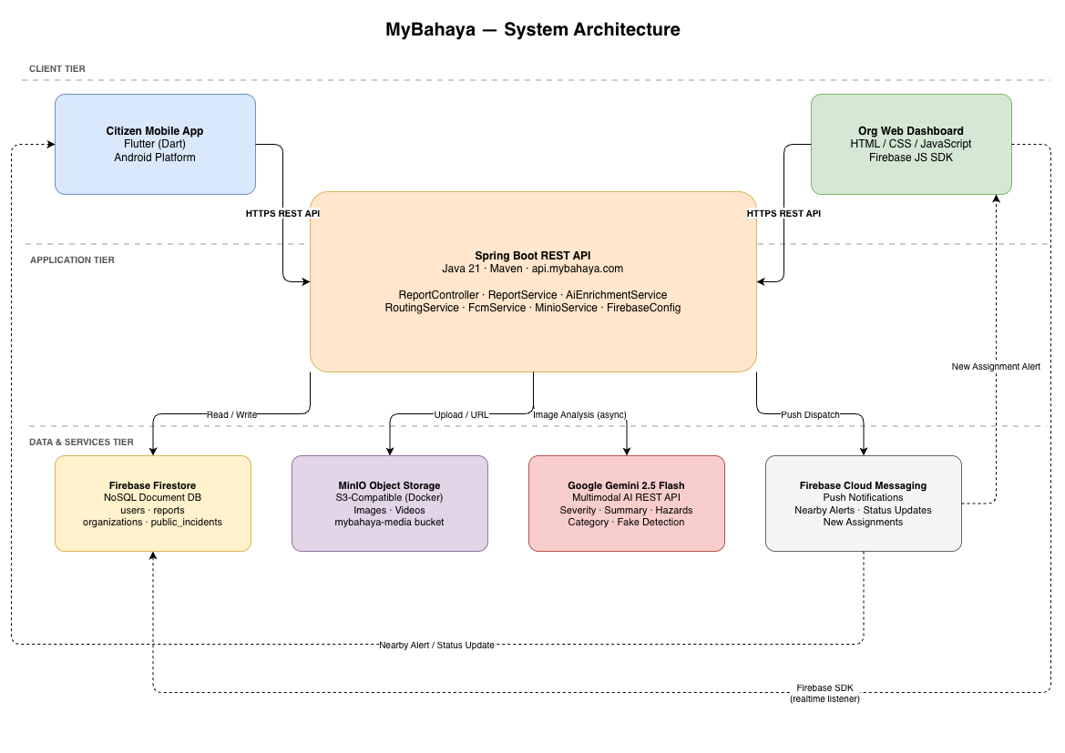
System Architecture Design
[ System Architecture Diagram ]
(Insert System Architecture Diagram here)
Flutter
Spring Boot
Firebase
Gemini AI
MinIO
FCM Push
Notes:
Three-tier architecture: Client (Flutter + Web browser), Application (Spring Boot REST API on VPS), Data (Firebase Firestore, MinIO, Gemini AI, FCM).

Slide 11
Conclusion
1
MyBahaya fills a real gap — no existing platform in Malaysia combines real-time reporting, AI analysis, and community alerting in one app.
2
Geolocation-based routing (Haversine formula) ensures the nearest emergency organisation is notified with an automated ETA estimate.
3
Google Gemini 2.5 Flash provides automated severity scoring (1–5), hazard identification, and AI-based fake report detection.
4
The platform is fully deployed at api.mybahaya.com with Firebase Firestore real-time updates and FCM push notifications.
Thank you · Terima kasih · Q&A
Notes:
MyBahaya addresses all four identified problems and is fully deployed. Ready for the tool demo. Open for questions.

