Slide 1
Vehicle Movement Analysis & Insight Generation in a College Campus Using Edge AI
Problem Statement - 13

Slide 2

Problem Statement
Analyzing vehicle movement and parking in a college campus to enhance security and management, including overcoming challenges in data collection, processing, and analysis. The solution should also match captured vehicle images and license plates to an approved vehicle database and identify unauthorized vehicles.

Slide 3
Unique Idea Brief (Solution)
Edge AI Integration: Uses YOLOv8 for vehicle detection and ResNet-50 for license plate recognition
Real-time Processing: Efficiently processes images and video streams
Continuous Tracking: Employs the SORT algorithm for robust vehicle tracking
Advanced Image Processing: Utilizes sophisticated techniques for accurate license plate recognition
OCR Methodologies: Integrates advanced OCR methods for high accuracy
Database Integration: Connects with a MySQL database for efficient data management
User-friendly Interface: Built with HTML, CSS, and Node.js for seamless user interaction
Enhanced Security: Provides precise vehicle identification, tracking, and data logging to improve campus security and management

Slide 4
Features Offered
Real-time Vehicle Detection: Fast and accurate vehicle identification using YOLOv8 for images and videos.
License Plate Recognition: High-accuracy recognition with ResNet-50, adaptable to various conditions.
Continuous Tracking: Reliable vehicle tracking with the SORT algorithm, even during occlusions.
Advanced Image Processing: Enhanced noise reduction and edge detection for precise character segmentation.
Multi-OCR Integration: Uses EasyOCR and TesseractOCR for secondary validation to ensure accuracy.
Database Management: Secure data storage and management with MySQL, supporting CRUD operations.
User-friendly Interface: Responsive design with HTML, CSS, and Node.js for easy navigation and user interaction.

Slide 5
Processflow
Image Capture - High-resolution cameras capture images and video streams.
Vehicle and Plate Detection
- YOLOv8 models for vehicle identification and license plate localization.
Continuous Tracking- SORT algorithm for maintaining vehicle identity by assigning unique Hash IDs to each vehicle (object).
Image Processing - Resizing, Gaussian blurring, adaptive thresholding, connected components analysis, and bounding box extraction.
License Plate Recognition
- ResNet-50 for high-accuracy character recognition.
- Integrates EasyOCR and TesseractOCR for additional validation.

Slide 6
Processflow
Data Management
- MySQL database for storing detection details and logging events.
- Ensures data accuracy and integrity.
User Interface - HTML and CSS for a responsive interface with navigation, login, feedback forms, and additional information sections.
Node.js Backend - Handles HTTP requests, serves files, performs CRUD operations, and manages data processing.
Performance Evaluation
- Number plate detection: 98.6% accuracy.
- Character recognition: 97.81% accuracy using ResNet-50.
Future Improvements - Additional features for enhanced accuracy and functionality.

Slide 7
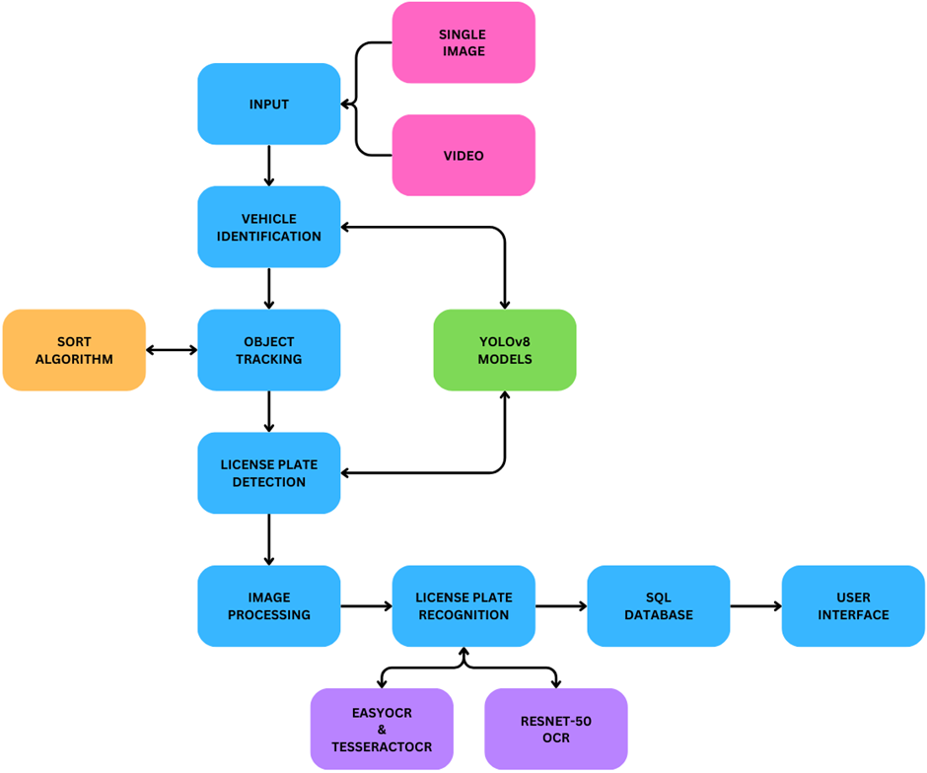
Architecture Diagram

Slide 8
Technologies used
YOLOv8 : For vehicle detection and license plate localization.
ResNet-50 : For character recognition on license plates.
SORT Algorithm : For real-time multi-object tracking.
OpenCV : For image processing tasks such as resizing, blurring, thresholding, and connected components analysis.
EasyOCR and TesseractOCR : For optical character recognition and validation.
MySQL : For database management, storing, and retrieving vehicle and license plate data.
HTML, CSS, and JavaScript : For building the responsive user interface.
Node.js : For backend server operations and handling HTTP requests.
Python : For implementing the machine learning models and image processing algorithms.

Slide 9
Team members and Contribution:
Team Member | Contribution
Rohan Chopade | Trained YOLOv8 models, combined YOLOv8 with SORT, Developed main.py to ensured seamless data flow.
Bhakti Ayarekar | Trained and implemented Resnet-50 OCR, designed responsive navigation, login forms, and feedback sections.
Ankita Yadav | Developed database schema and tables, wrote data insertion and retrieval logic and implemented Nodejs.
Saad Jamadar | Implemented the ResNet-50 OCR and the secondary OCRs and performed Image processing operations.
Chinmay Kulkarni | Worked on FrontEnd and Insights Generation.

Slide 10
Conclusion
An automated system using YOLOv8 for number plate detection and ResNet-50 for recognition enhances parking system efficiency. While YOLOv8 performs well in diverse test scenarios, ResNet-50 achieves 97.8% accuracy on validation data but faces challenges with decorative, fancy, or damaged number plates in real-world environments. Future ANPR advancements could integrate owner ID, vehicle model recognition, and improved traffic control, speed measures, accurate tracking, helmet detection, and increased number plate data for improved accuracy, driven by ongoing research quality improvements.

