Slide 1

GrantLens: AI Grant Auditing and Evaluation Platform
AI-POWERED PRE-SUBMISSION COMPLIANCE FOR RESEARCH GRANTS
CSE299 Project Proposal
Group Members:
1. Anas Ibne Majbha (2322846642)
2. Tazreen Alam (2321506042)
3. Hasin Anzum Inan (2323133042)
4. Israt Jahan Susmi (2112280642)

Slide 2
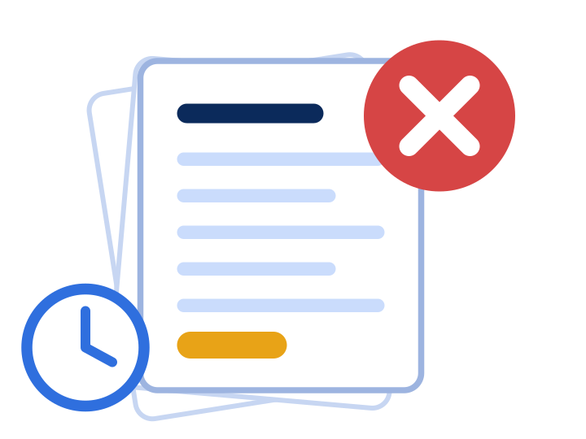
Problem Statement & Objectives
Administrative Disqualification
Missing mandatory sections, e.g. a Data Management Plan, cause instant rejection.
30-40%
1
of submissions rejected at screening for minor compliance mistakes
Constraint Violations
Hard limits on pages, section word counts and funding amounts get broken.
2
50–80 pages of rules · 100+ hours per proposal
Internal Inconsistencies
Text claims two postdocs while the budget funds only one.
3
Objectives
1
Document Ingestion
6
Rewrite Guidance
Missing Evaluation Benchmarks
No automated way to test a draft against official grading rubrics.
4
2
Rule Extraction
7
Institutional Dashboards
3
Compliance Verification
8
Regulatory Q&A (RAG)
Administrative Bottlenecks
Offices spend excessive hours checking drafts against changing guidelines.
4
Cross-Doc Reconciliation
9
Audit Report Generation
5
5
Rubric-Aligned Scoring

Slide 3









Proposed Solution & AI Features
Researcher Portal
Upload call + draft, run instant scans, see Red / Yellow / Green flags, budget reconciliation, rubric scores, rewrite advice, PDF audit export.
AI Features
Automated Guideline Ingestion
Layout analysis builds indexed rule chunks
Deterministic & Semantic Verification
Page caps plus disclosure completeness
Reviewer & Research Office Portal
Aggregate departmental drafts and calls, view AI summaries and scorecards, spot regulatory risks, approve / flag / request changes.
Budget vs. Narrative Reconciliation
Extraction cross-checks budget cells
Simulated Peer-Review Scoring
0–100 on Intellectual Merit, Broader Impacts
Admin Portal
Manage access, roles and privileges; keep guideline archives and templates; maintain vector DB and audit logs; configure rules and scoring weights.
Constructive Rewrite Suggestions
Grounded fixes for weak arguments
Grounded RAG Query Engine
Answers straight from indexed guidelines
Methodology: Requirement Analysis › System Design › Database Design › Frontend Development › Backend API Development › AI Module Development › Integration › Testing › Deployment › Evaluation, using flexible, iterative steps throughout.

Slide 4


Technology, Outcomes & Future Scope
Proposed Technology
Expected Outcomes
Frontend
React.js (Vite), Tailwind CSS, Recharts
Elimination of Administrative Rejections
Backend
Django, Django REST Framework (DRF)
Time Savings for Researchers
Error-Free Financial Alignment
Extraction
PyMuPDF (fitz), pdfplumber
Improved Proposal Competitiveness
Database
PostgreSQL, ChromaDB
Reduced Administrative Overhead
AI & NLP
Python, LangChain, Google Gemini API / Local API
Scope: Future Enhancements
Auth
SimpleJWT, Django Authentication
ERP & Portal Integration
Multi-Institute Workflows
Literature Verification
Mobile Alerts
Deployment
Git, GitHub, Docker, Render / Railway
Live Collaborative Editor
GrantLens is a 24/7 pre-submission reviewer: it catches fatal rule omissions, fixes budget contradictions and grades proposals, so no groundbreaking idea is sidelined by bureaucratic oversight.

