Slide 1

Introduction
IPL
WIN PROBABILITY

Slide 2
IPL WIN
PROBABILITY
Team Details:
Devesh Sharma 2210990265
Devasish Singh Thapa 2210990264
Bhuvain Jhamb 2210990228
Bhargav Singla 2210990214
Faculty Coordinator:
Dr KD Singh
Chitkara University Institute of Engineering and Technology,
Chitkara University, Punjab

Slide 3
Contents
Introduction
Problem Statement
Objectives
Technical Details
Data Description
DataSet Snippets
Model Evaluation
Result and Analysis
Conclusion
Reference Links

Slide 4
Problem Statement
“How can we leverage Artificial Intelligence and Machine Learning techniques to develop a predictive model for IPL win probability, providing stakeholders with valuable insights for strategic decision-making and enhancing the overall cricketing experience?”

Slide 5
Objective
Develop a predictive model for IPL win probability using Recurrent Neural Networks (RNN).
Evaluate the effectiveness of the RNN model in predicting match outcomes compared to traditional machine learning algorithms.
Explore the impact of different match factors on win probability prediction, such as Required Run-Rate, Current Run-Rate ,Balls left,City,Wickets Left.
Provide insights into the dynamics of IPL matches and the factors influencing match outcomes through the RNN model.

Slide 6

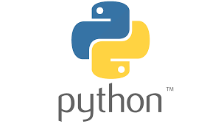

Technical Details
We employed Python as our primary programming language for model implementation.
Our Preferred IDE include Jupyter Notebook and Kaggle.
We used Python Libraries such as Pandas, Numpy, Matplotlib, Tensorflow, Sklearn.
Our project solely focuses on RNN (Recurrent Neural Network) within the
AIML paradigm

Slide 7
Data Description
The dataset comprises match information from IPL seasons, including match results, team performance metrics, player statistics, and match conditions.
Features such as team win-loss records, run rates, batting averages, bowling averages, and toss outcomes are included in the dataset. The dataset also includes contextual information such as venue, pitch conditions, and weather conditions for each match.
Data preprocessing steps involved cleaning the dataset, handling missing values, encoding categorical variables, and scaling numerical features.
Exploratory data analysis (EDA) was conducted to gain insights into the distribution, relationships, and patterns within the dataset, guiding feature engineering and model development processes.

Slide 8
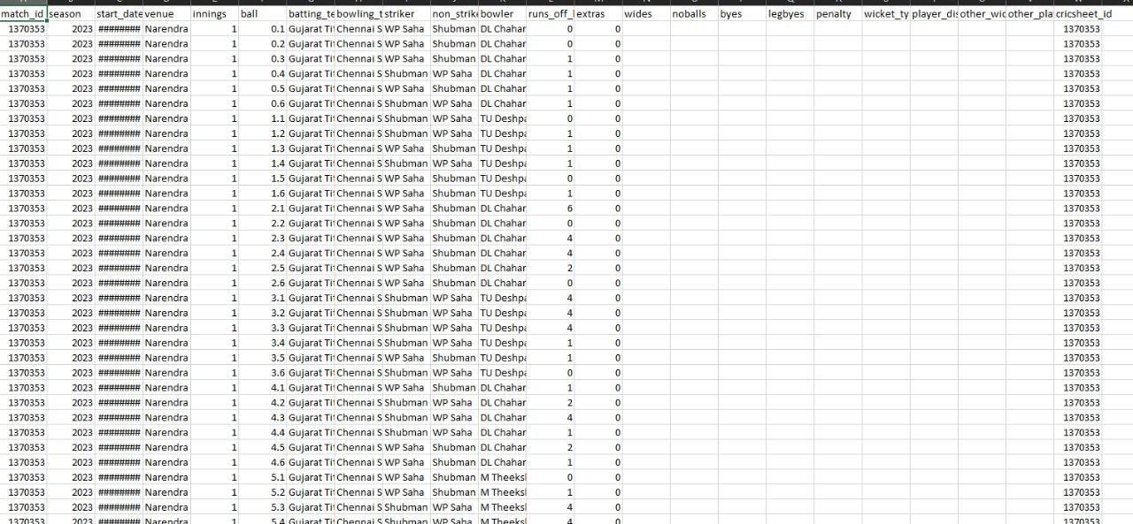
DATASET SNIPPETS

Slide 9
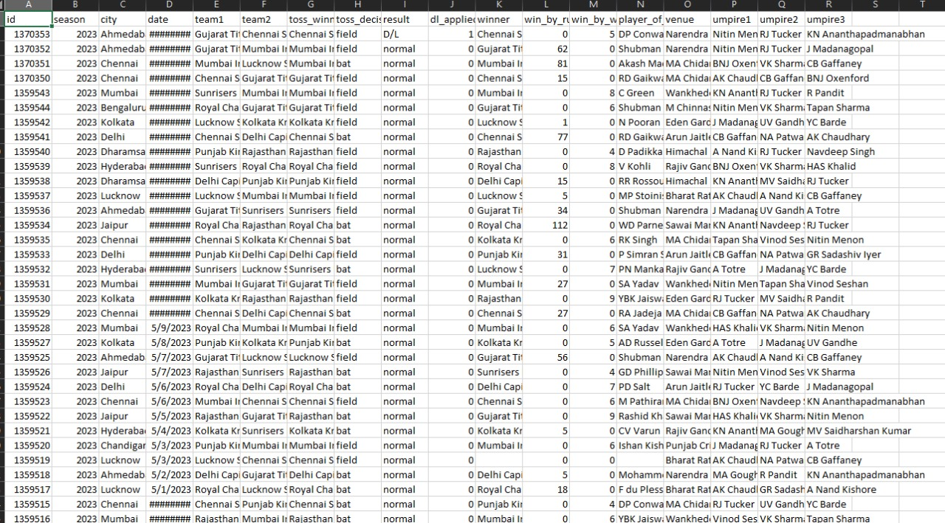
DATA SNIPPETS

Slide 10
MODEL EVALUATION
Accuracy: The percentage of correct predictions made by the model.(TP+TN/TP+TN+FP+FN);
Precision: The ratio of correctly predicted positive observations to the total predicted positives. (TP/TP+FP)
Recall: The ratio of correctly predicted positive observations to the all observations in actual class. (TP/TP+FN)
F1 Score: The weighted average of Precision and Recall.
2*Precision*Recall/Precision+Recall

Slide 11
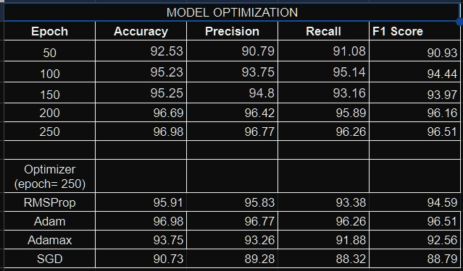
Our Model Optimization
Epochs = 250 Optimizers = Adam

Slide 12
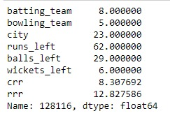

Result and Analysis
INPUT:
RESULT:

Slide 13
Conclusion
Key Findings: The project successfully demonstrated the effectiveness of Recurrent Neural Networks (RNN) in predicting IPL win probabilities, outperforming traditional machine learning algorithms.
Impact: The developed model provides valuable insights into match dynamics and factors influencing match outcomes, empowering stakeholders to make informed decisions and strategies.
Future Prospects: Further refinement and optimization of the RNN model could lead to even more accurate predictions and broader applications in sports analytics. Overall Contribution: The project contributes to the advancement of data-driven approaches in sports analytics, showcasing the potential of AI and ML technologies in revolutionizing sports decision-making.

Slide 14
References/Links used
https://www.kaggle.com/datasets/utkarshtomar736/ipl-mens-cricket-matches-data-2008-2023
https://youtu.be/Ok_zkfWC0gI?si=mQ2LZu3DgMd-9e6G
https://www.analyticsvidhya.com/blog/2022/05/ipl-team-win-prediction-project-using-machine-learning/

Slide 15
Thank You

