Slide 1
COMP 472 A3 Group 9 Presentation
Matthew Segal 40031839
Evan Mateo 27725167
leo benac 40090034
Joanna Lin 40055253

Slide 2
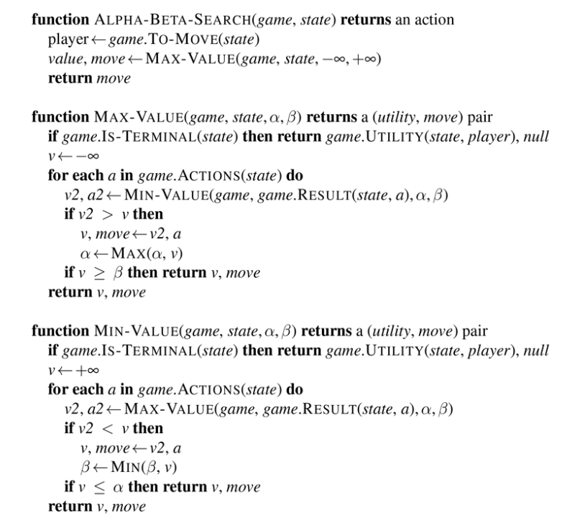
Pseudocode

Slide 3
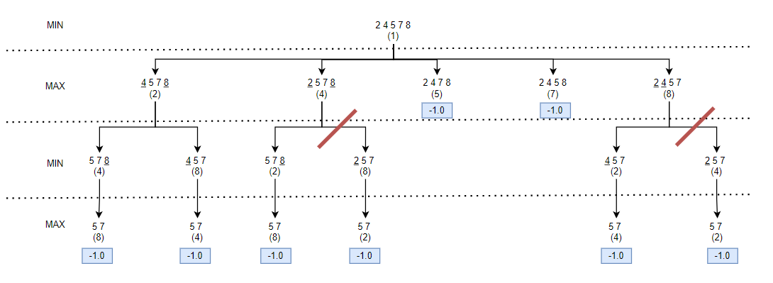
Analysis
output2.txt

