Slide 1
COMP 472 A1 Group 9 Presentation
Matthew Segal 40031839
Evan Mateo 27725167
Joanna Lin 40055253

Slide 2
Note
All data and diagrams used in this presentation represent the results of one possible execution of our code. It is conceivable that running our code might result in slightly different output.

Slide 3
Analysis of Initial Dataset
The given dataset is composed of thousands of reviews for various products.
The initial dataset is composed of:
2 classes – “pos” and “neg”
44502 features (58871 before sanitized)
Sanitized input
Remove all special characters and “emotionless” words (like “to”, “a”, “the”, etc.). This should reduce noisy input a little and lead to superior sentiment classification.

Slide 4
Analysis of Initial Dataset, cont.
Possible reasons for noisy input
Mislabeling
Very long documents
Non-review documents
Misspelling
Mixed sentiment
Example – Non-review document
8463 books neg 7.txt noam chomsky has thrived greatly in this great country of his , yours , and mine - the united states of america . he has made millions of dollars teaching , lecturing , selling his books , and investing
… let us hope he retires outside of our homeland that he hates so much , the united states of america . god bless america , which will continue to give chomsky the right to speak , teach , and make lots of money . raybo

Slide 5
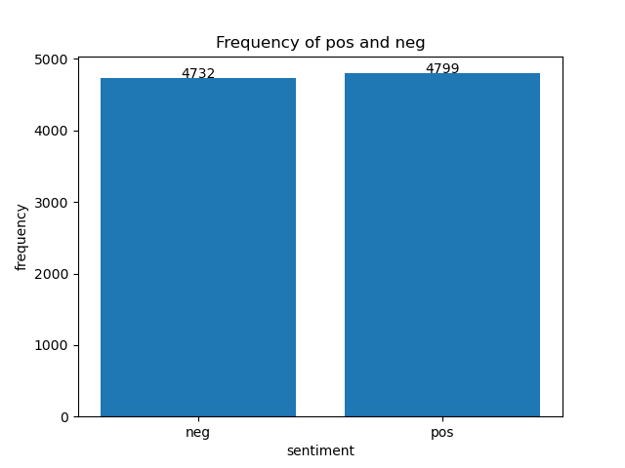
Metrics
Accuracy
Precision
Recall
F1-score
Balanced class distribution → confidence in accuracy

Slide 6
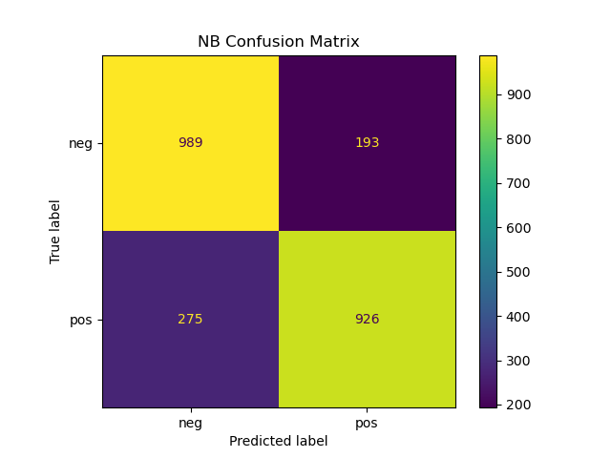
Naïve Bayes
neg pos
precision 0.7824367088607594 0.8275245755138516
recall 0.8367174280879864 0.7710241465445462
f1-score 0.8086672117743254 0.7982758620689654
accuracy: 0.8036088963491398
neg → higher recall (more neg predictions)
pos → higher precision (fewer pos predictions)
1264
1119

Slide 7
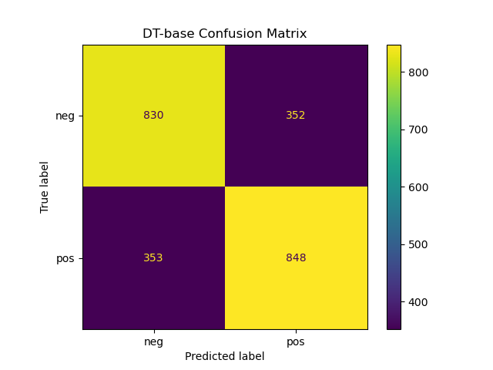
Base Decision Tree
neg pos
precision 0.7016060862214708 0.7066666666666667
recall 0.7021996615905245 0.7060782681099084
f1-score 0.7019027484143764 0.7063723448563098
accuracy: 0.7041544271926143
Lower accuracy compared to NB (0.8036). Hyperparameters Our initial Decision Tree algorithm assumes that the criterion is set to “entropy” and the random_state is 0 (this is to ensure deterministic behaviour during fitting. See https://scikit-learn.org/stable/modules/generated/sklearn.tree.DecisionTreeClassifier.html).
1183
1200

Slide 8
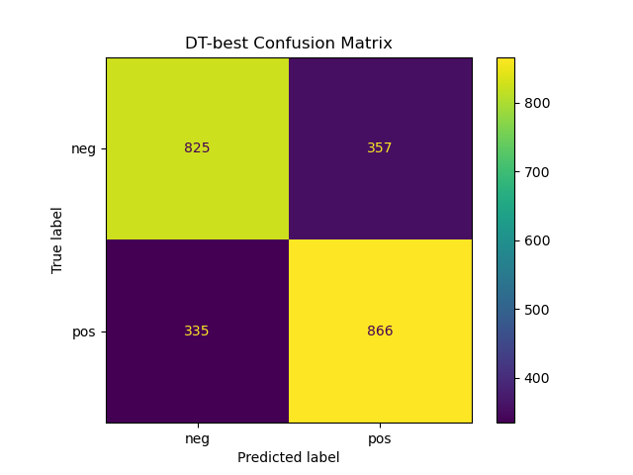
Best Decision Tree
neg pos
precision 0.7112068965517241 0.7080948487326247
recall 0.6979695431472082 0.7210657785179018
f1-score 0.704526046114432 0.7145214521452145
accuracy: 0.7096097356273605
Slightly better than base DT (0.7042).
1160
1223

Slide 9
Further Analysis of the Best Decision Tree
Best Decision Tree = DT + GridSearchCV + Kfold
Hyperparameters searched
criterion – {entropy, gini}
splitter – {best, random}
max_depth – {range between 30 and 100}

Slide 10
Interesting Note on Decision Tree Pruning
One might think that pruning a complex Decision Tree might improve its performance, but we actually found the opposite to be true: altering the max_depth and max_leaf_nodes parameters resulted in less accurate predictions.
There is a parameter of Decision Tree classifiers in sklearn called ccp_alpha which is generally used to find the best Tree possible using Minimal Cost-Complexity Pruning. In other words, setting this parameter to certain values prunes the Tree to avoid over-fitting by certain amounts, see: https://scikit-learn.org/stable/modules/tree.html#minimal-cost-complexity-pruning.
After writing a function to test many possible values for ccp_alpha across many iterations of the Decision tree classifier algorithm, it was found that setting this value to 0 (indicating no pruning at all) maximized accuracy for both training and testing data.

Slide 11
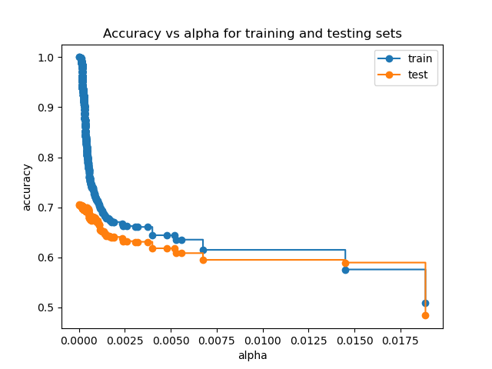
Interesting Note on Decision Tree Pruning, cont.
Here, we see this data. We can see the best way to maximize accuracy for Decision Trees (with this dataset, anyway) is to not prune them at all.
One possible reason for this is our text sanitation. We use an aggressive custom algorithm to remove all special characters and simple words with no emotional affect (“for”, “to”, “a”, etc.) This results in our training and testing data having only useful words in it. So pruning any of these useful words in the Tree will likely reduce accuracy. Also note: even under best accuracy, testing data is much less accurate than training data.

Slide 12
Member Responsibility

Slide 13
Matthew Segal
Wrote the function to sanitize the text: sanitize_text
Wrote the function to create and save all graphical confusion matrices: save_graphical_confusion_matrix
Wrote the function to analyse the relationship between ccp_alpha and accuracy: analyze_ccp_alpha
Provided overall file structure to the repository to improve organization
Improved code style by restructuring main.py to implement a proper entry point by way of a main function
Simplified the code to split the data into training and testing sets by using train_test_split from sklearn
Wrote several custom algorithms to vectorize the data (that were not used in the final product)
Wrote much of the slideshow and presentation

Slide 14
Evan Mateo
Worked on reading the initial dataset
Vectorized words of documents using CountVectorizer
Worked on Naïve Bayes model
Worked on the best decision tree using GridSearchCV and KFold for automatically searching the optimal hyperparameters
Plot class (label) distribution
Worked on outputting list of false positives for task 4 analysis

Slide 15
Joanna Lin
Worked on task 2 Naïve Bayes and base decision tree models
Generated confusion matrix and precision, recall & f1 measure using sklearn’s confusion_matrix and classification_report
Worked on task 3 generating output files for the models containing predictions, confusion matrix and metrics
Helped with task 4 error analysis

