Slide 1
COMP 472 A1 Group 9 Presentation
Matthew Segal 40031839
Leo Benac
Evan Mateo
Joanna Lin

Slide 2
Note
All data and diagrams used in this presentation represent the results of one possible execution of our code. It is conceivable that running our code might result in slightly different output.

Slide 3
Analysis of Initial Dataset
The given dataset is composed of thousands of reviews for various products. These reviews are initially classified using “pos” and “neg” labels to indicate whether the review is positive or negative.
The assignment was to use machine learning to be able to analyze the sentiment of a new unseen review, given analysis of a large training set of the documents.
What is interesting, however, is that the given text is not fully sanitized. We designed an algorithm to process the incoming data to remove all special characters and “emotionless” words (like “to”, “a”, “the”, etc.). This should lead to superior sentiment classification.

Slide 4
Analysis of Initial Dataset, cont.
Another difficult aspect of this dataset is that each review has so many words (each word considered a feature), and each review has a different number of words.
Algorithms that make use of Decision Trees will have much difficulty processing this data, as for each review, the algorithm must determine which words are ideal to branch upon, and there are many possible words.
We noticed that both Decision Tree algorithms were the slowest as a result.
But Naïve Bayes was comparatively fast, since only simple probability calculations need to be performed for each word.
TRUE?

Slide 5
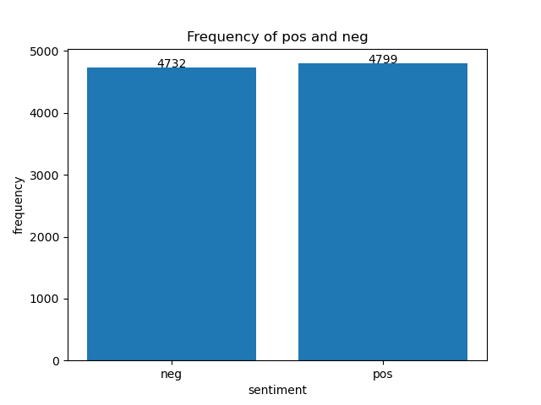
Best Measure to Compare With
The frequencies of positive and negative reviews are roughly equal in the training set, so we find that accuracy is the best measurement to compare algorithms with.
In future slides, we will show all 4 measurements (accuracy, F1 score, precision, and recall), but we will focus on accuracy. This is especially true since the F1 score is really just a weighted harmonic mean of precision and recall.

Slide 6
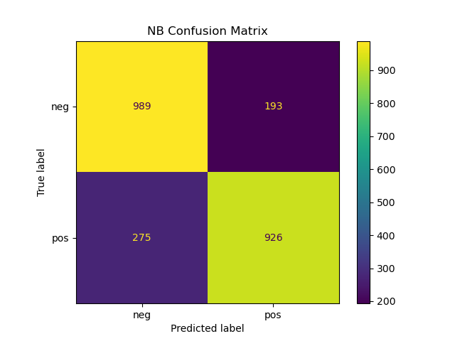
Analysis of the Naïve Bayes Algorithm
neg pos
precision 0.7824367088607594 0.8275245755138516
recall 0.8367174280879864 0.7710241465445462
f1-score 0.8086672117743254 0.7982758620689654
accuracy: 0.8036088963491398
As you can see, Naïve Bayes performed well in terms of accuracy, scoring about 80%. Considering the confusion matrix, most classifications by far were in the True Positive and True Negative categories. Only a relatively small proportion of all data were False Positives or False Negatives.
This algorithm was also very fast, performing much faster than either Decision Tree algorithm. This is because only simple probability calculations are performed for each word in a document. Decision Trees are much more involved algorithms and take longer to compute.

Slide 7
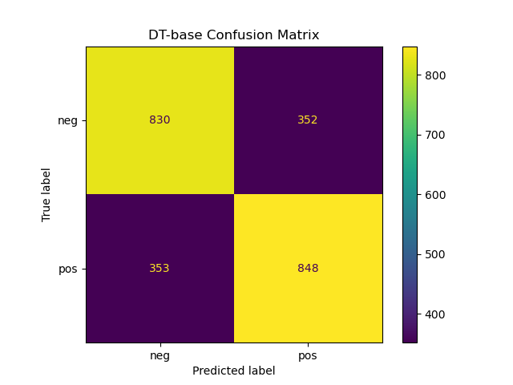
Analysis of the Base Decision Tree Algorithm
neg pos
precision 0.7016060862214708 0.7066666666666667
recall 0.7021996615905245 0.7060782681099084
f1-score 0.7019027484143764 0.7063723448563098
accuracy: 0.7041544271926143
This algorithm performed noticeably worse than the Naïve Bayes approach, scoring only 70.4% accuracy. There are also fewer items in the True Positive and Negative categories, and more items in the False Positive and Negative categories, indicating more misclassification.
Our initial Decision Tree algorithm assumes that the criterion is set to “entropy” and the random_state is 0 (this is to ensure deterministic behaviour during fitting. See https://scikit-learn.org/stable/modules/generated/sklearn.tree.DecisionTreeClassifier.html).

Slide 8
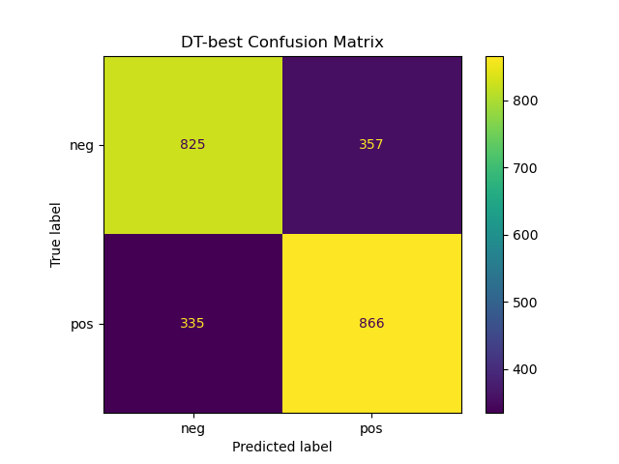
Analysis of the Best Decision Tree Algorithm
neg pos
precision 0.7112068965517241 0.7080948487326247
recall 0.6979695431472082 0.7210657785179018
f1-score 0.704526046114432 0.7145214521452145
accuracy: 0.7096097356273605
This algorithm, surprisingly, performs only very slightly better, giving 70.9% accuracy. Its confusion matrix is also very similar to the base Decision Tree approach, indicating similar proportions of classification and misclassification.

Slide 9
Further Analysis of the Best Decision Tree
The best Decision Tree classifier was found using a custom function that exhaustively tested all combinations of parameters using cross-validation.
We used KFold and GridSearchCV (both from sklearn.model_selection) for this.
EXPLAIN MORE

Slide 10
Interesting Note on Decision Tree Pruning
One might think that pruning a complex Decision Tree might improve its performance, but we actually found the opposite to be true: altering the max_depth and max_leaf_nodes parameters resulted in less accurate predictions.
There is a parameter of Decision Tree classifiers in sklearn called ccp_alpha which is generally used to find the best Tree possible using Minimal Cost-Complexity Pruning. In other words, setting this parameter to certain values prunes the Tree to avoid over-fitting by certain amounts, see: https://scikit-learn.org/stable/modules/tree.html#minimal-cost-complexity-pruning.
After writing a function to test many possible values for ccp_alpha across many iterations of the Decision tree classifier algorithm, it was found that setting this value to 0 (indicating no pruning at all) maximized accuracy for both training and testing data.

Slide 11
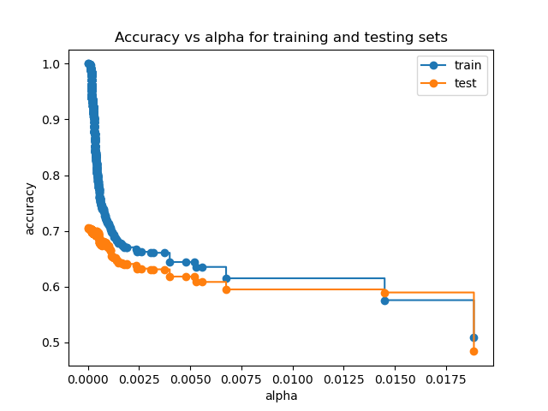
Interesting Note on Decision Tree Pruning, cont.
Here, we see this data. We can see the best way to maximize accuracy for Decision Trees (with this dataset, anyway) is to not prune them at all.
One possible reason for this is our text sanitation. We use an aggressive custom algorithm to remove all special characters and simple words with no emotional affect (“for”, “to”, “a”, etc.) This results in our training and testing data having only useful words in it. So pruning any of these useful words in the Tree will likely reduce accuracy. Also note: even under best accuracy, testing data is much less accurate than training data.

Slide 12
Member Responsibility

Slide 13
Matthew Segal
Wrote the function to sanitize the text: sanitize_text
Wrote the function to create and save all graphical confusion matrices: save_graphical_confusion_matrix
Wrote the function to analyse the relationship between ccp_alpha and accuracy: analyze_ccp_alpha
Provided overall file structure to the repository to improve organization
Improved code style by restructuring main.py to implement a proper entry point by way of a main function
Simplified the code to split the data into training and testing sets by using train_test_split from sklearn
Wrote several custom algorithms to vectorize the data (that were not used in the final product)
Wrote much of the slideshow and presentation

Slide 14
Evan Mateo
BRAG ABOUT YOURSELVES

Slide 15
Joanna Lin
BRAG ABOUT YOURSELVES

Slide 16
Leo Benac
BRAG ABOUT YOURSELVES

