Slide 1
SNF Horizonte Magazine Corpus
December 2018

Slide 2
Corpus statistics – 12/12/18
 | DE | FR | EN
Number of issues | 52 | 52 | 15
Number of articles | 1,239 | 1,239 | 395
Number of tokens | 1,110,757 | 1,340,980 | 426,121
Number of types | 83,615 | 51,658 | 23,544
Notes:
Here are some statistics taken from the intermediate xml files.
These xml files are altered versions of the TET output files which have been processed for article boundaries
The number of tokens and types are according to TET’s wordplus extraction mode
Note on TET’s ‘tokenization’:
TET’s tokenization is not very reliable and needs to be corrected in a further processing step. Below are some examples of the tokenization done by TET:
<Text>.»</Text>
<Text>Nr</Text><Text>.</Text>
<Text>0,5</Text>
<Text>Raum-Zeit-</Text><Text>Inselgruppe</Text><Text>.</Text>

Slide 3
Most frequent ‘types’
DE | FR | EN
schweiz | suisse | swiss
horizonte | qu | research
nationalfonds | recherche | science
schweizerischer | national | says
universität | fonds | national
forschung | horizons | university
akademien | université | horizons
nr | chercheurs | academies
zürich | suisses | foundation
wissenschaft | scientifique | researchers
snf | science | new
Notes:
These results show the 10 most frequent ‘types’ which appear based on the intermediate xml files.
Stopwords and punctuation marks have been filtered out for this table.
These are not true types as lemmatization has not yet been done, but it still provides an idea of the types of texts in the corpus.

Slide 4
Some Challenges
Dealing with PDFs
52 PDFs from 3 ‘eras’
Old: 2005 – 2009
Middle: 2009 – 2012
New: 2014 – 2017
Some publications contain errors (see slide 5)
Some publications are missing pages
Article boundary detection in PDFs
Semi-automatically processed contents pages for article titles and starting page numbers
PDF text extraction
Extraction with TET-lib produces inconsistent XML layouts, making it very difficult to parse automatically
Text is extracted as ‘tokens’ and needs to be reassembled (see slide 6)
Extracted text contains a lot of noise and mixed segments (see slide 7 - 9)
Notes:
This slide provides information about some of the challenges we have faced in producing the corpus.
Dealing with PDFs
The layout of the publications has changed over the years.
This required separate parsing functions for each era in order to be able to extract the contents and insert article boundaries.
Additionally, some contents pages contained mistakes, such as missing articles and incorrect page numbers. The obvious errors were able to be corrected semi-automatically.
Article boundary detection
I used a semi-automatic approach for parsing the contents pages which allows the user to confirm and edit (if necessary) the extracted contents list before article boundaries are inserted.
The TET output also posed challenges for automatic parsing of the contents where titles were sometimes split between paragraph tags.
A possible approach that could potentially yield better results would be to use OCR to process just the contents page from each issue and use this data to then insert article boundaries in the TETML files.
PDF text extraction
Reassembling the text in order to process for proper tokenization is described in the notes on slide 2.
High level information from TETML wordplus files has been used to filter out noise and reduce errors caused by drop-caps.

Slide 5
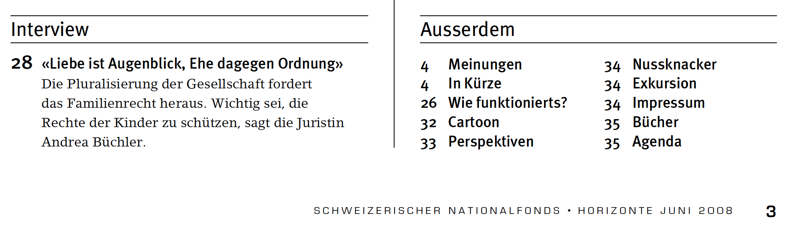
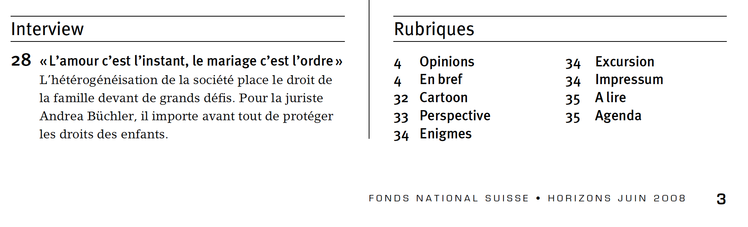
Missing Contents Information
Notes:
German and French issue number 77
The article ‘Boîte à outils’ is missing from the French contents list, even though it appears on page 26 of both the German and French issues. This was discovered when comparing the number of articles boundaries inserted into each issue.

Slide 6
The problem of split text
TET output: | L ’ autre moitié du monde | Der Touchscreen : Zaubern mit dem Finger ? | « Flatland » von Edwin A . Abbott
Corrected output: | L’autre moitié du monde | Der Touchscreen: Zaubern mit dem Finger? | «Flatland» von Edwin A. Abbott
What we want: | L’ autre moitié du monde | Der Touchscreen : Zaubern mit dem Finger ? | « Flatland » von Edwin A. Abbott

Slide 7
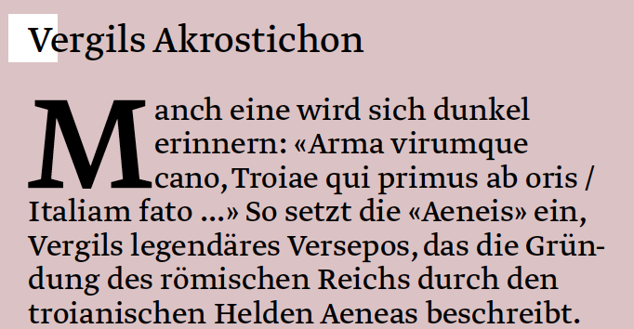
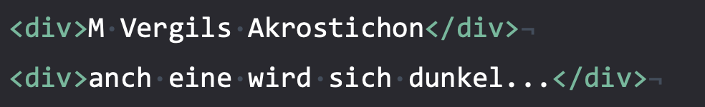
Special handling of ‘drop caps’ required
Notes:
Here, the drop cap ‘M’ is inserted into the previous Para tag.

Slide 8
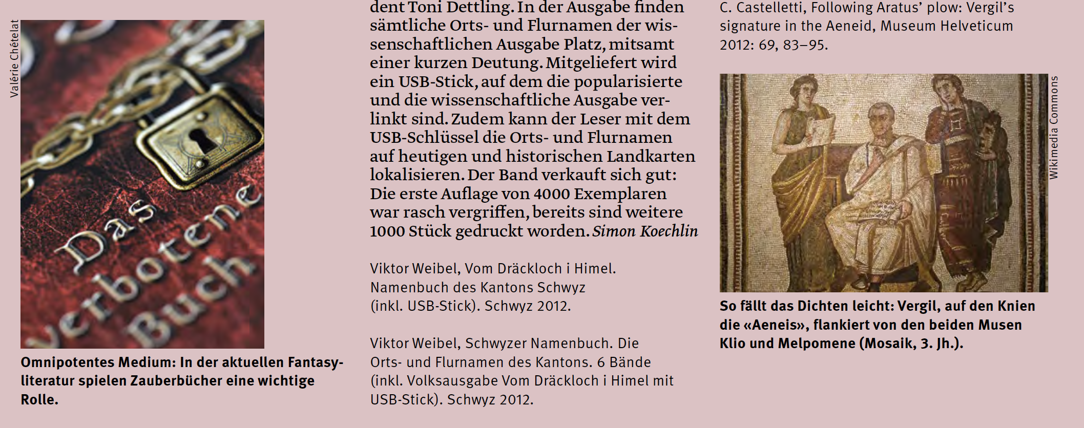
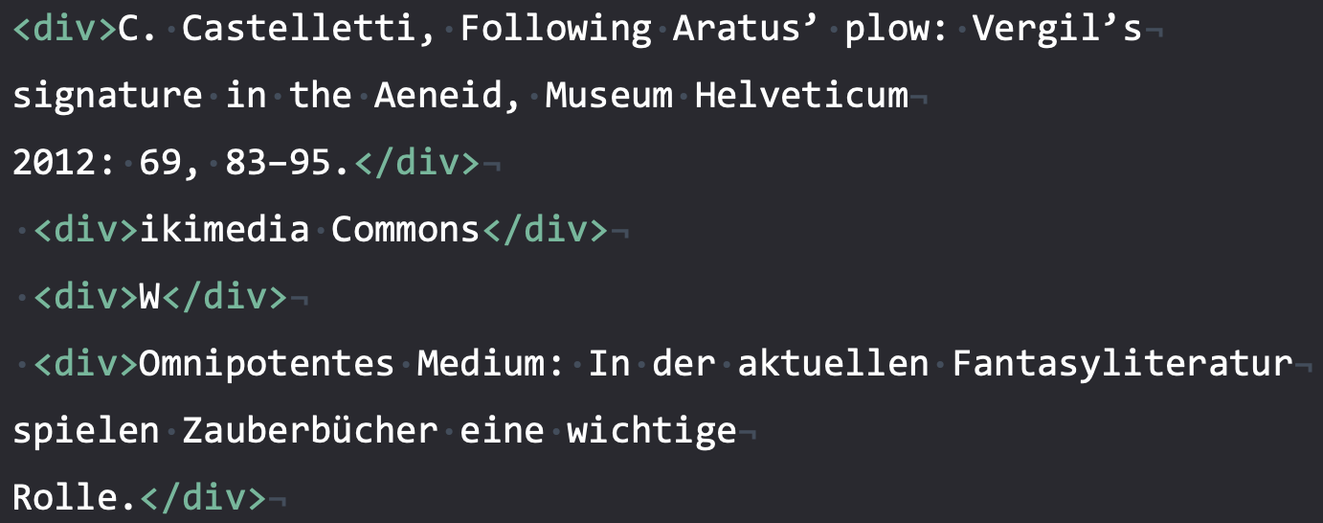
Different noise… same article
Notes:
Here, the ‘w’ from ‘wikimedia’ appears in its own para tag, while the rest of the word appears beforehand
This example is taken from the TET’s page extraction mode, which we used in a preliminary investigation for text extraction. Due to such issues, we found we had better results with TET’s wordplus extraction mode.

Slide 9
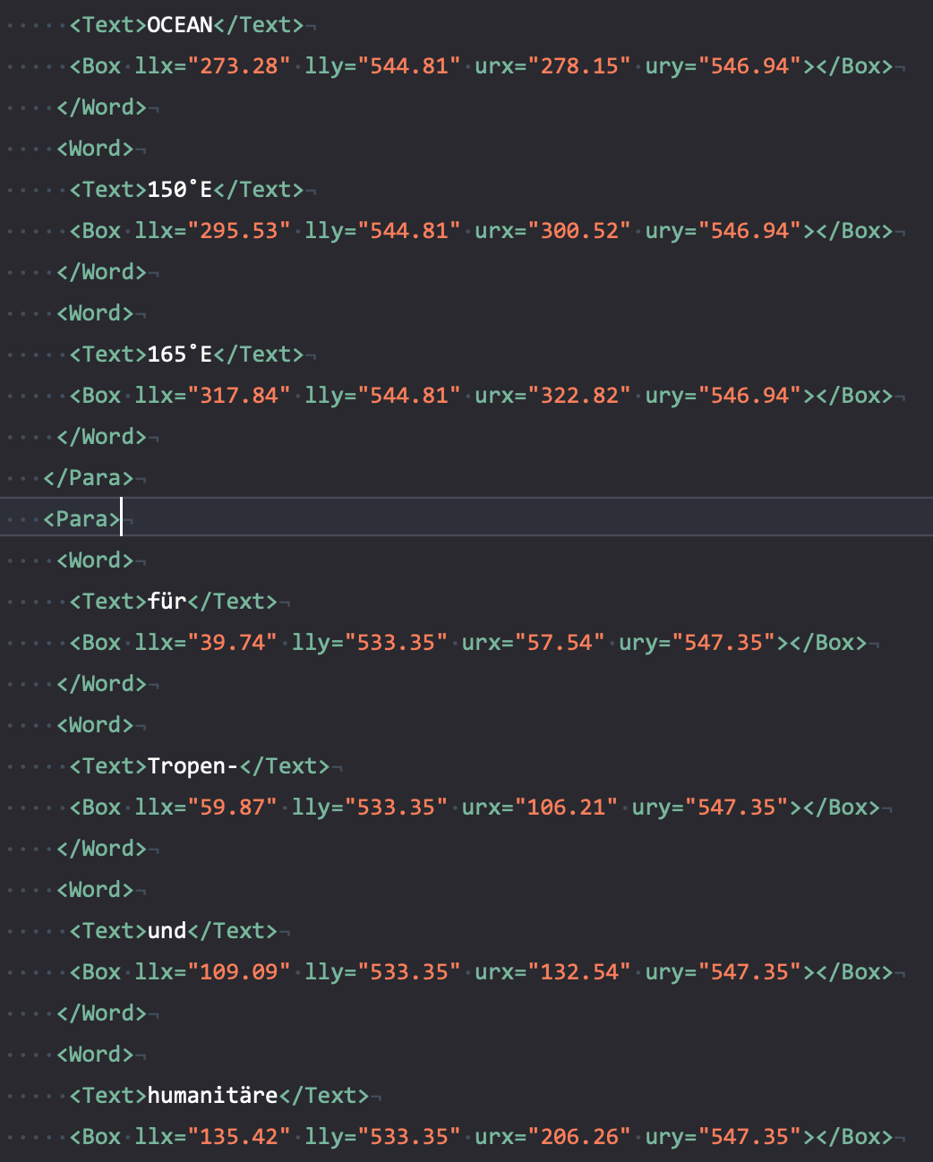
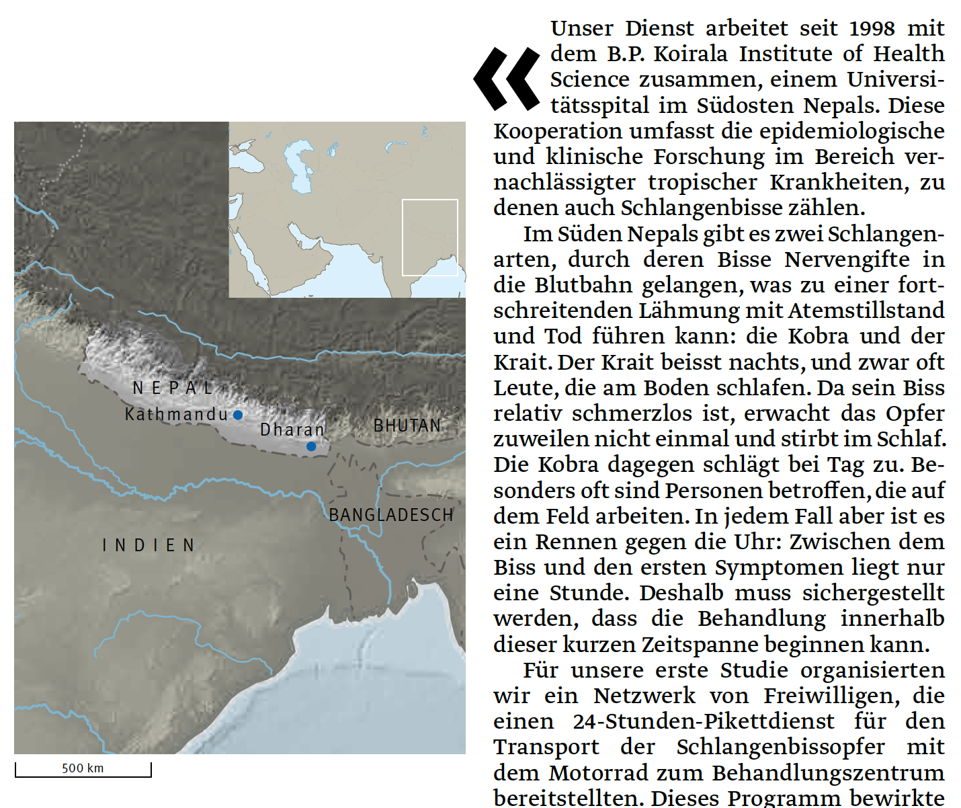
AND…
Invisible text on pages with maps
Splits up paragraphs, sentences and words!
Solution: use fine-grained information from TETML to find candidates and remove
Notes:
This slide shows an example of the invisible text in the TETML wordplus files. The high-level glyph information has been removed from the picture of the XML in order to be able to show how the invisible text splits sentences. We found that the invisible text generally had a smaller font size than the content text and so we implemented a rule to ignore text smaller than font size 8.

Slide 10
Next steps
Use the existing Credit Suisse corpus pipeline to annotate corpus
Cleaning
Tokenization
PoS-Tagging
Lemmatization
Special handling of German compounds and separable prefix verbs
Sentence alignment
Word alignment

