Slide 1
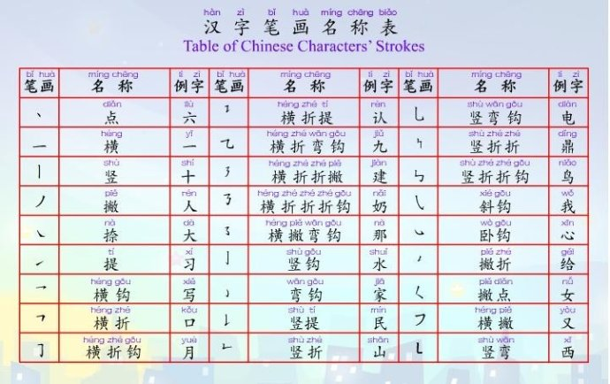
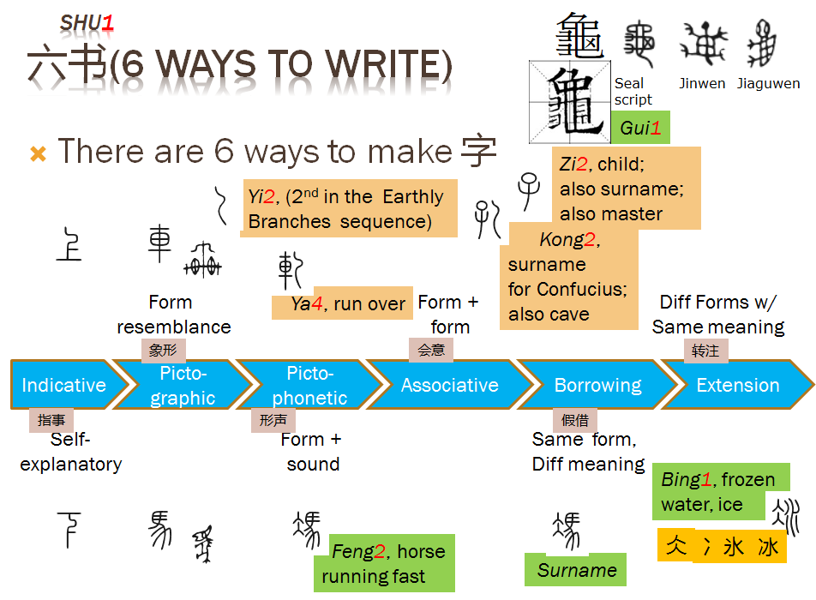
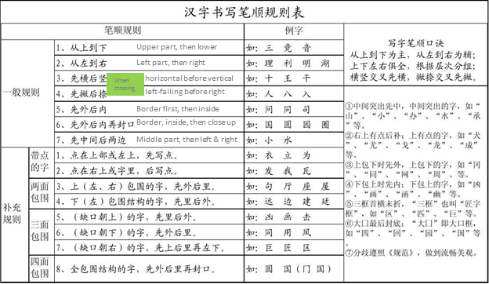
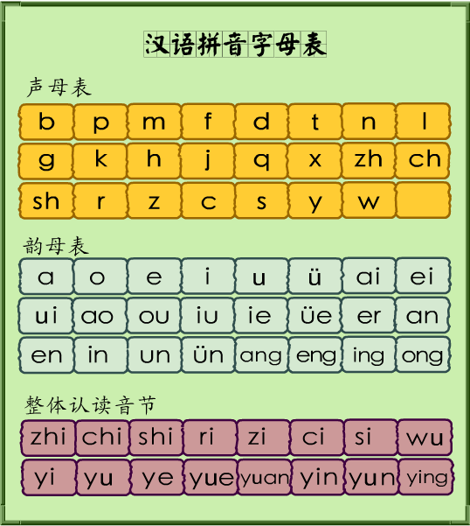
Chinese the Right Way
Introduction
The essence of Chinese lies in Chinese characters, and the difficulty in learning Chinese is also understanding, remembering, and using Chinese characters correctly. A book about the structure of Chinese characters may be the missing link in the existing teaching process. Students who study piano, no matter how junior, will get two textbooks: one for music theory and one for music. There is only one text for learning Chinese. The explanation of the structure of Chinese characters is just a matter of focusing on the new words in this lesson. It is not systematic enough. Speaking gives people a feeling of extra work.
Strokes
6 Ways to Form a Character
Getting Started w/
Strokes
Order of Strokes
Radicals & components
Pinyin
6 Ways to make chars
Featured Lessons
In several formats for you to choose from:
Start Taking Classes
Order of Strokes
Selected Radicals
List of PinYin Symbols
1 | 口 | 11 | 八 | 21 | 十 | 31 | 门 | 41 | 巾
2 | 一 | 12 | 辶 | 22 | 田 | 32 | 王 | 42 | 马
3 | 亻 | 13 | 目 | 23 | 亠 | 33 | 匕 | 43 | 也
4 | 日 | 14 | 忄 | 24 | 寸 | 34 | 灬 | 44 | 走
5 | 人 | 15 | 心 | 25 | 力 | 35 | 大 | 45 | 巴
6 | 扌 | 16 | 又 | 26 | 纟 | 36 | 广 | 46 | 钅
7 | 土 | 17 | 宀 | 27 |  | 37 | 白 | 47 | 攵
8 | 木 | 18 | 女 | 28 | 彳 | 38 | 艹 | 48 | 身
9 | 月 | 19 | 氵 | 29 | 刂 | 39 | 车 | 49 | 小
10 | 讠 | 20 | 儿 | 30 | 阝 | 40 | 禾 | 50 | 子

Slide 2


Chinese the Right Way
Select Your Topics
There are a number of topics to choose from. Each comes in Text-based lessons, Videos, and Exercises.
Fundamentals
Lesson 1
Lesson 2
Lesson 3
Topics
Group 1
Group 2
Group 3
Learn Chn w/ Mulan
Lesson 1
Lesson 2
Lesson 3
Create Your Lessons
You need to register first to use this feature.
Register for an account
Login

