Slide 1
Suicidal Marshmallow

Slide 2
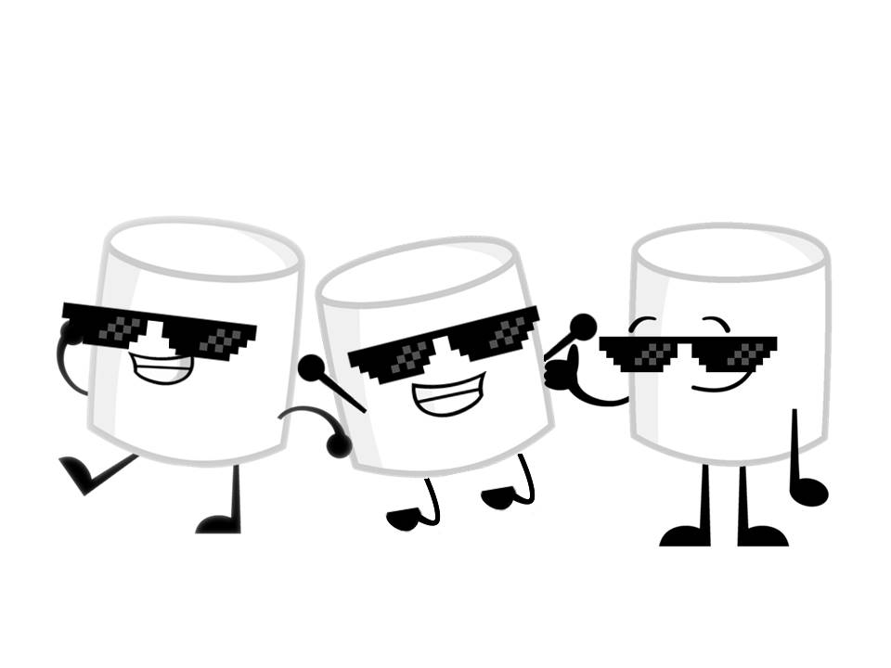
Badass Marshmallows

Slide 3
Going Bananas
Ideeas over ideeas.
Starting from marshmallows burning hot like fire to freezing cool like ice, ice, baby.
You’re a marshmallow spirit who takes over lifeless marshmallows and kills them in the most delicious ways possible.

