Slide 1
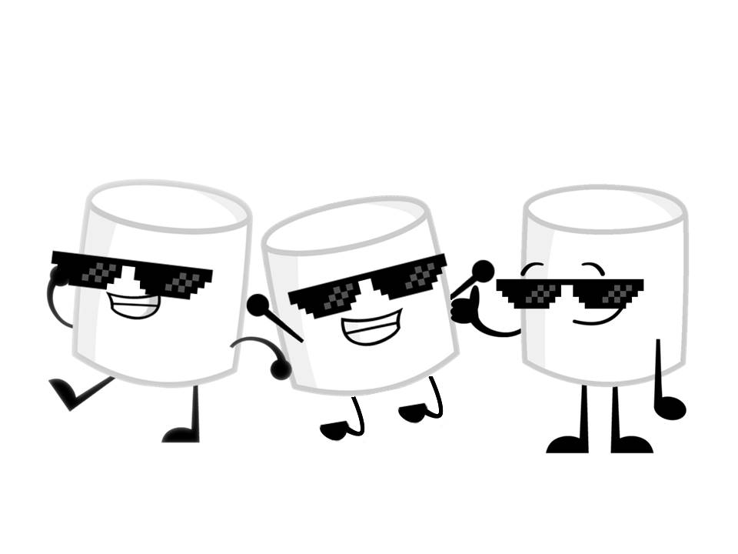
Badass Marshmallows
Marin Raluca Alina
Gurau Marius
Diana Andreea Drumea

Slide 2
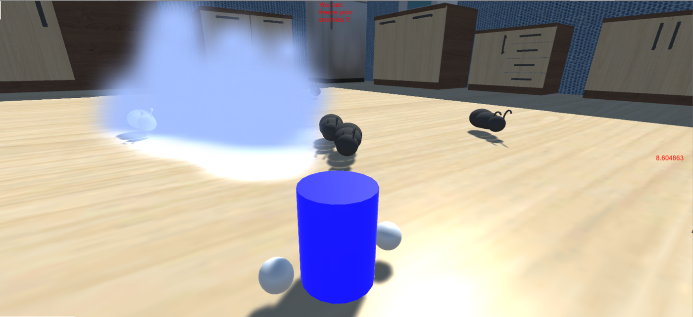
Game Name: Not so sweet Marshmallow

Slide 3
Going Bananas
Ideeas over ideeas.
Starting from marshmallows burning hot like fire to freezing cool like ice, ice, baby.
You’re a marshmallow spirit who takes over lifeless marshmallows and kills them in the most delicious ways possible.

Slide 4
But why?
Because it’s delicious.
Someone has too keep the ogre fed with sweets so the marshmallow spirit is happy to do it.
Before finally leaving the body of the well done or well frozen marshmallow you have a short time of power to also destroy the ants which are making your body poisonous(yuck).

Slide 5
Game Purpose
Have fun! Make your marshmallow character suicide, not yourself.
Kill bugs! Everyone hates ‘em!
Let us sacrifice our marshmallows today, so that our ogre can have a sweeter tomorrow!

Slide 6
Plans
Fire
Ice
Hot Chocolate
Microwaved Fluffy

Slide 7
IRL
Fire
Ice
Hot Chocolate
Microwaved Fluffy

Slide 8
Questions?

