Slide 1
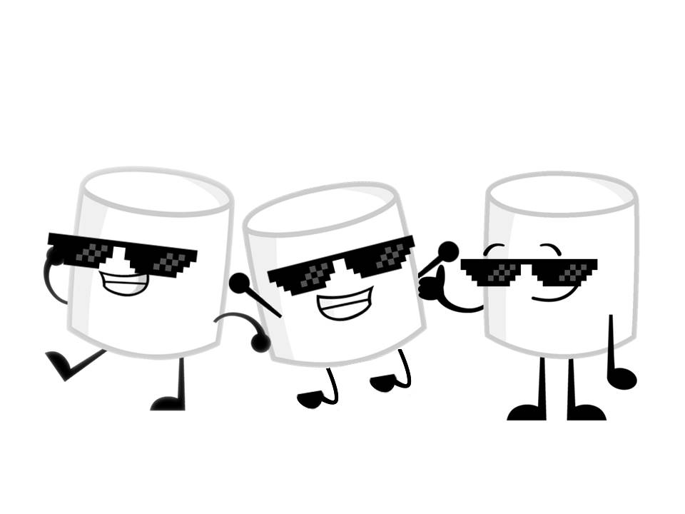
Badass Marshmallows
Marin Raluca Alina
Gurau Marius
Diana Andreea Drumea

Slide 2
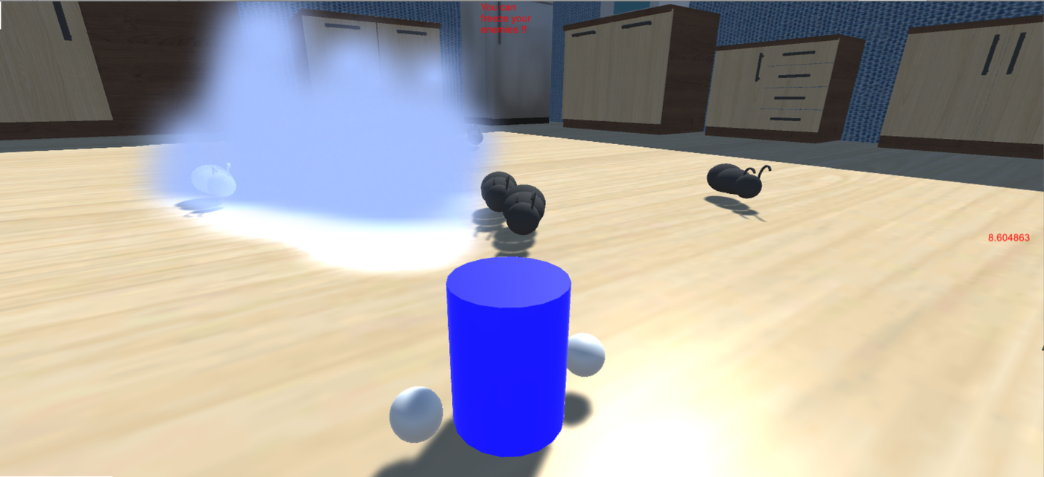
Game Name: Not so sweet Marshmallow

Slide 3
Going Bananas
Ideeas over ideeas.
Starting from marshmallows burning hot like fire to freezing cool like ice, ice, baby.
You’re a marshmallow spirit who takes over lifeless marshmallows and kills them in the most delicious ways possible.

Slide 4
But why?
Because it’s delicious

