Slide 1




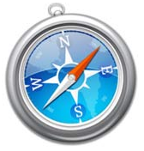
Registration-
Server (Eureka)
Looks for
“account-microservice”
Registers as
“account-microservice”
Accounts
DB
Web-
Application
Account-
Microservice
RESTful Requests
JPA/SQL

Slide 2
WebApplication
AccountMicroservice
Account
Controller
Account Microservice
Controller
Accounts
DB
Remote Account
Manager
JPA Account
Manager
RestTemplate
EntityManager
SQL

Slide 3
Online Shopping Service
Account
Service
Product
Catalog
Cart
Server
Order
Server
Accounts
DB
Products
DB
Cart
DB
Order
DB
This Blog

Slide 4
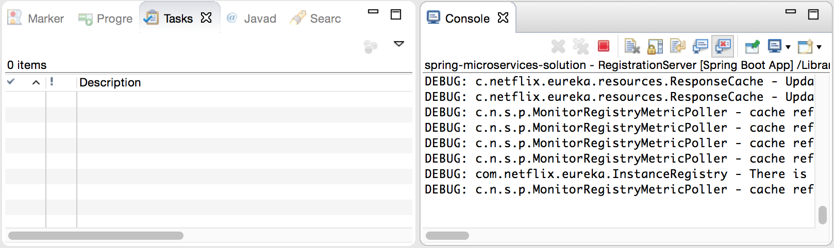
Display Selected Console

