Slide 1
計算機實習 10
2019/12/6

Slide 2
Outline
Class
deconstructor
const object and const member function
friend function
class pointer
this pointer
Operator overloading

Slide 3
Class

Slide 4
deconstructor
Deconstructor will be called when an object leaves the scope where it is declared.
Cannot be called independently like constructor.
Deconstructor is defined by adding ~ in front of the class name (e.g. have a class called fruit then the deconstructor of it will be ~fruit)

Slide 5
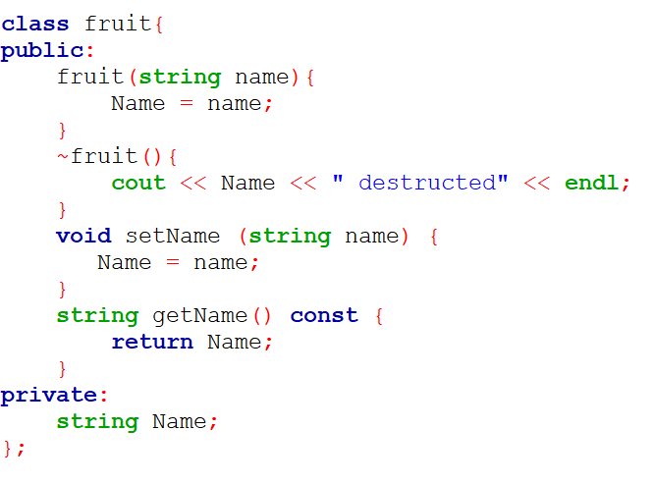
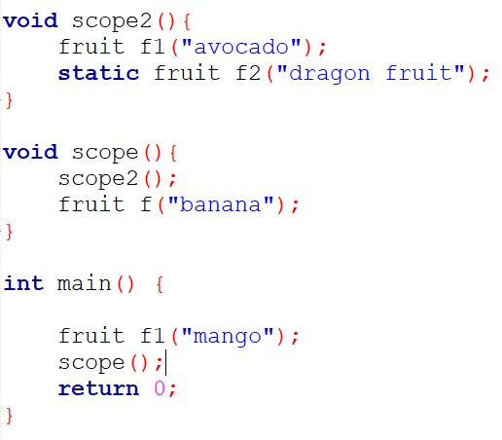

deconstructor example

Slide 6
const with Class
To prevent any modification to any variables inside class.
Can improve performance when used appropriately.
There are two types of const with class
const object
const member function
Cannot use const on constructor and deconstructor

Slide 7
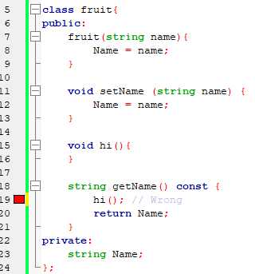
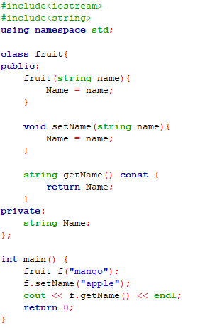
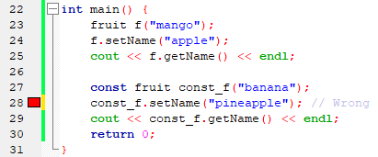
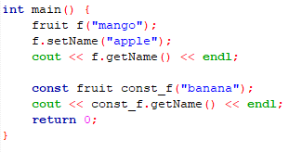

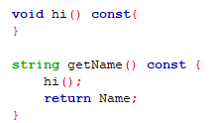
const example
const object can only call const member function
Similarly, const member function can only call const member function

Slide 8
friend function
Class private member can only be access by class member function in normal.
We can define a friend function to a class to access the private member outside the class.

Slide 9
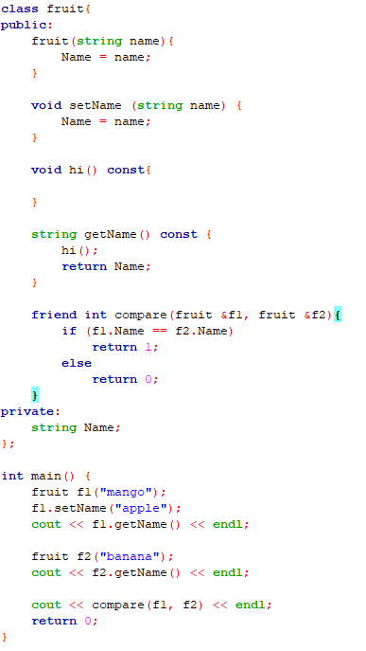

friend function example
friend function declared inside class
call friend function

Slide 10
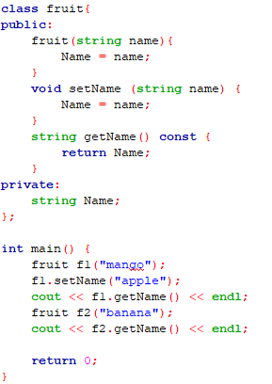
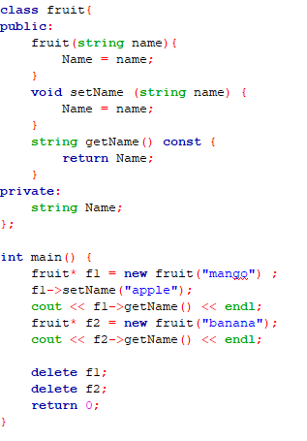
class pointer
Non-pointer version
Pointer version
new will request memory space in main memory for storing specified type and return the starting memory address of it
Use -> instead of . to call member function or access member variable
Use delete to release the memory space that claimed early

Slide 11
Why pointer?
For dynamic memory managment
stack
queue
linked list
tree
graph
etc

Slide 12
this pointer
A pointer that point to the object itself.
More flexibility when member variables have same name with other variable inside member function.
Allow cascade member function call.

Slide 13
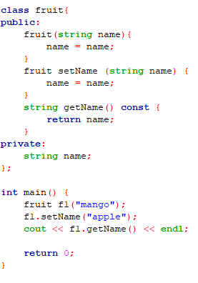
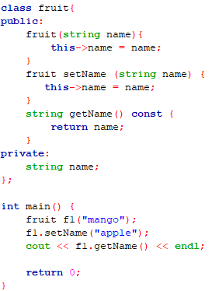
this pointer example
Modified private string name now
same name with the class private variable
Did not modify this private variable at all
Output a blank string
Output apple

Slide 14
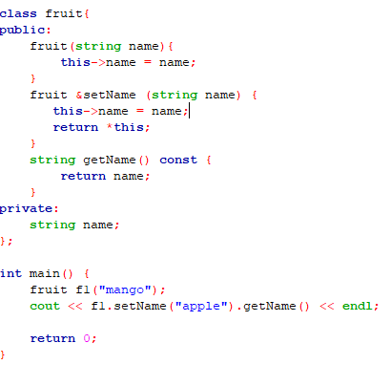
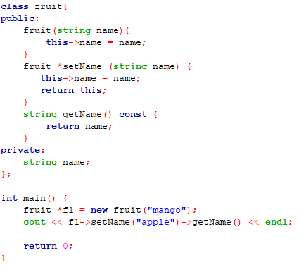
this pointer example(Cont.)
Pointer version
Return object itself by adding * before this
Return this pointer (object address)
Cascade member function call
Both output apple

Slide 15
Operator overloading

Slide 16
Operator overloading
Similar to function overloading but operator version.
Can only be used with object.
Provide more convenient way to implement some operation.

Slide 17
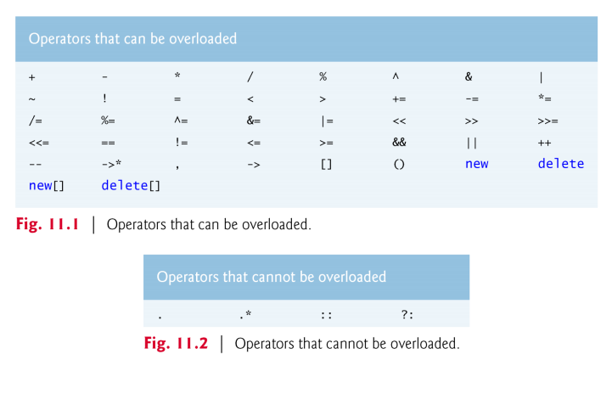
Operator overloading(Cont.)

Slide 18
Operator overloading(Cont.)
Expression | As member function (a as object & b as any type) | As non-member function (c & d as any type) | Example
a+b | a.operator+ (b) | operator+ (c, d) | a+b calls a.operator+ (b) (as member function of a)
a=b | a.operator= (b) | cannot use as non-member function | string s; s = “happy”; calls s.operator= ("happy") (as member function of s)
a+=b | a.operator+= (b) | operator+= (c, d) | string s; s += “sad”; calls s.operator+= (“sad”) (as member function of s)
a<<b | a.operator<< (b) | operator<< (c, d) | cout << x; calls operator<< (cout, x) (as non-member function)

Slide 19
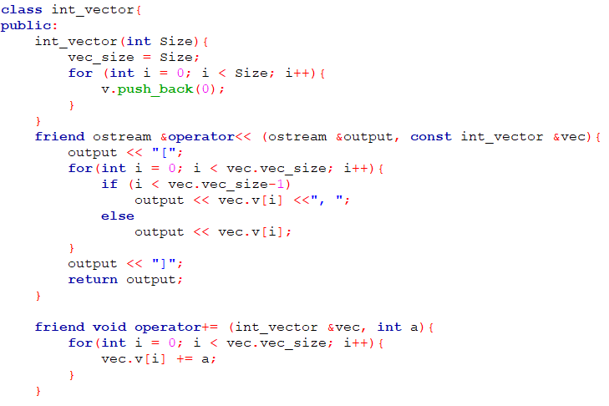
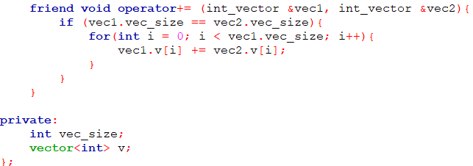
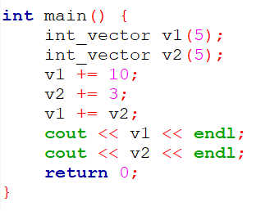

Operator overloading example
non-member function version of overloading +=
initialize vector with an input size
Overloading += operator to implement addition between vectors
Overloading << operator to implement vector output stream
Overloading += operator to implement addition between vector and integer

Slide 20
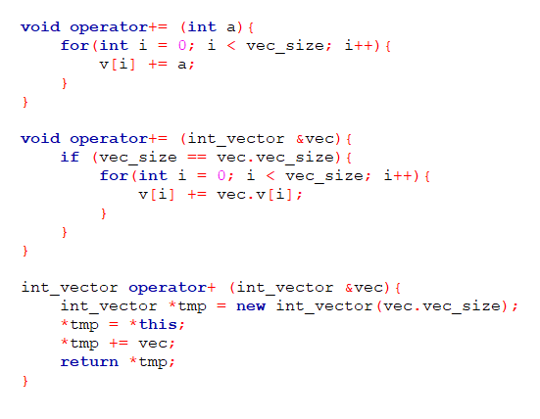
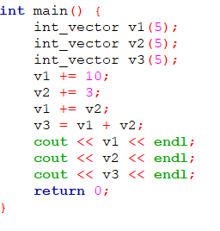

More example
member function version of overloading += and +
need a new temporary memory space to store the addition result to prevent modifying the original object

Slide 21
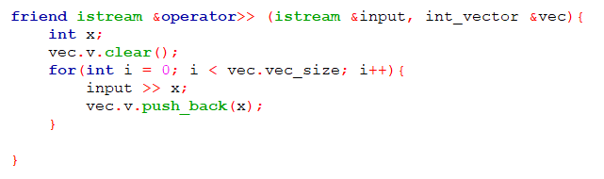
istream example
clear vector everytime when operator >> is used
Amount to read is decided by the size of the right element of the >> operator

Slide 22
課堂練習10
繳交截止日期：2019/12/6 23:55

Slide 23
練習10 - 串接向量和排序
利用class和operator overloading來實作向量的輸入、輸出和串接兩個向量後排序。
overload >> << +分別實現向量輸入、輸出和串接兩個向量後排序(由小到大)。
Input
第一行integer N(1~20)代表第一個向量(v1)的大小，第二行integer M(1~20)代表第二個向量(v2)的大小，接下來會有N + M個數字的輸入，分別代表v1和v2的內容。
Output
以特定格式輸出原本兩個輸出的向量和串接兩個向量後排序後的結果。
沒有用class和operator overloading會扣分
練習檔案的class和main寫在一個cpp一起繳交就可以。

Slide 24
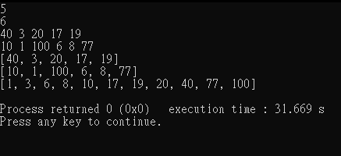
練習10 - 向量輸出格式
前後要有中括號[]包住
數值之間以逗號加空白, 分開
輸出完要記得換行

Slide 25
練習10 - 輸入輸出範例
Sample input | Sample output
5 6 40 3 20 17 19 10 1 100 6 8 77 | [40, 3, 20, 17, 19] [10, 1, 100, 6, 8, 77] [1, 3, 6, 8, 10, 17, 19, 20, 40, 77, 100]
1 1 10 2 | [10] [2] [2, 10]

Slide 26
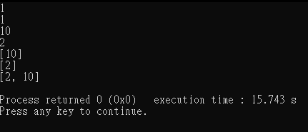
練習10 - 輸入輸出範例

Slide 27
繳交規範

Slide 28
繳交方式
1. 作業上傳以 LMS系統 為主 https://lms.ncu.edu.tw/
2. 有修計實者，作業繳交至 “計算機實習I”
3. 無修計實者，但有修計概者，作業繳交至 “計算機概論I”
4. 不接受補交

Slide 29
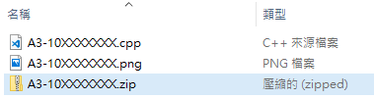
繳交內容
上傳內容須為 .zip 壓縮檔
內容包含:
程式碼 (.cpp)
執行結果截圖 (只接受 .png 或 .jpg 形式)
檔名皆須為 AX-10XXXXXXX 或 PX-10XXXXXXX
Assignment: A
Practice: P
壓縮的內容
要上傳的壓縮檔

Slide 30
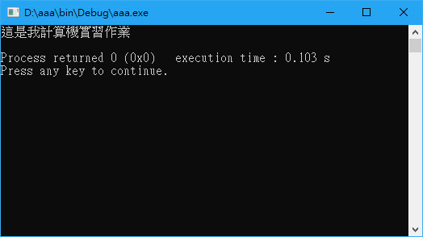
截圖範例

Slide 31
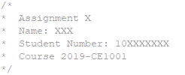
繳交格式
程式碼開頭要有以下文字
計算機概論Ⅰ : 2019-CE1001
計算機實習Ⅰ-A : 2019-CE1003-A
計算機實習Ⅰ-B : 2019-CE1003-B
作業: Assignment
練習: Practice

