Slide 1
Applying Data Skills to a Life-Long Passion
🏏
AN IMPOSSIBLE SPORTS PREDICTION PERSONAL PROJECT
TALHA A. SIDDIQUI

Slide 2
Background
Personal
Born and raised in Pakistan
Watching and playing cricket my entire life
Education
UBC’s Master of Data Science
BS Information Systems
Professional
Data Scientist, aDolus Inc.
Data and Analytics Consultant, KPMG US

Slide 3

Why Cricket Prediction?
Passion
Fun
Personal
Different
Data Available
Fits the Machine Learning Paradigm

Slide 4
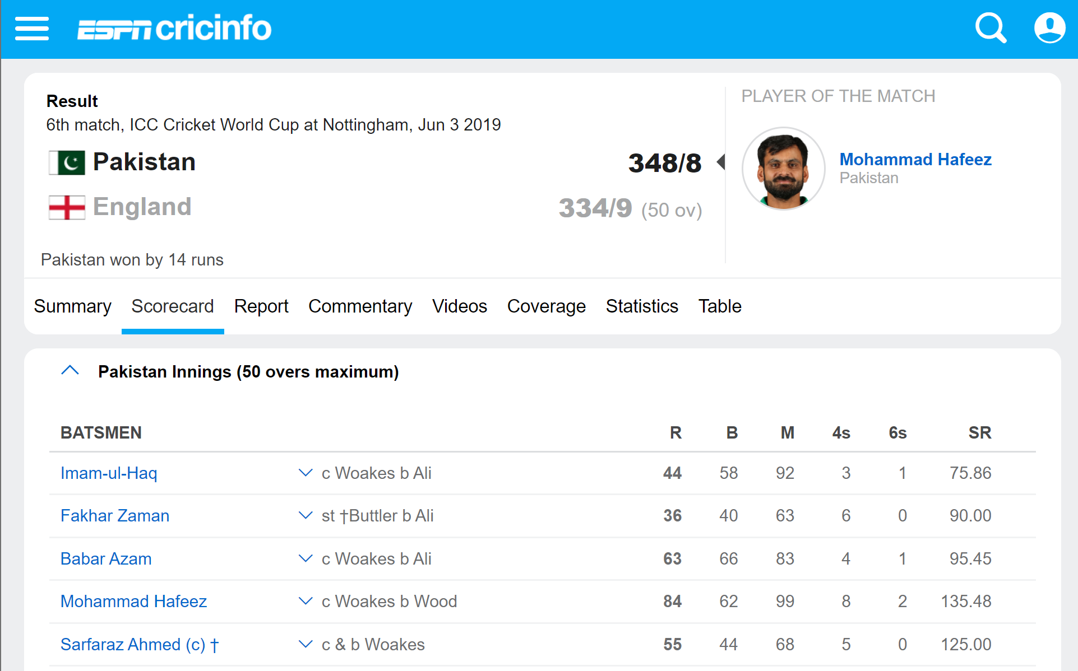
Breaking Down the Problem
Tournament
Venue
Teams
Players

Slide 5
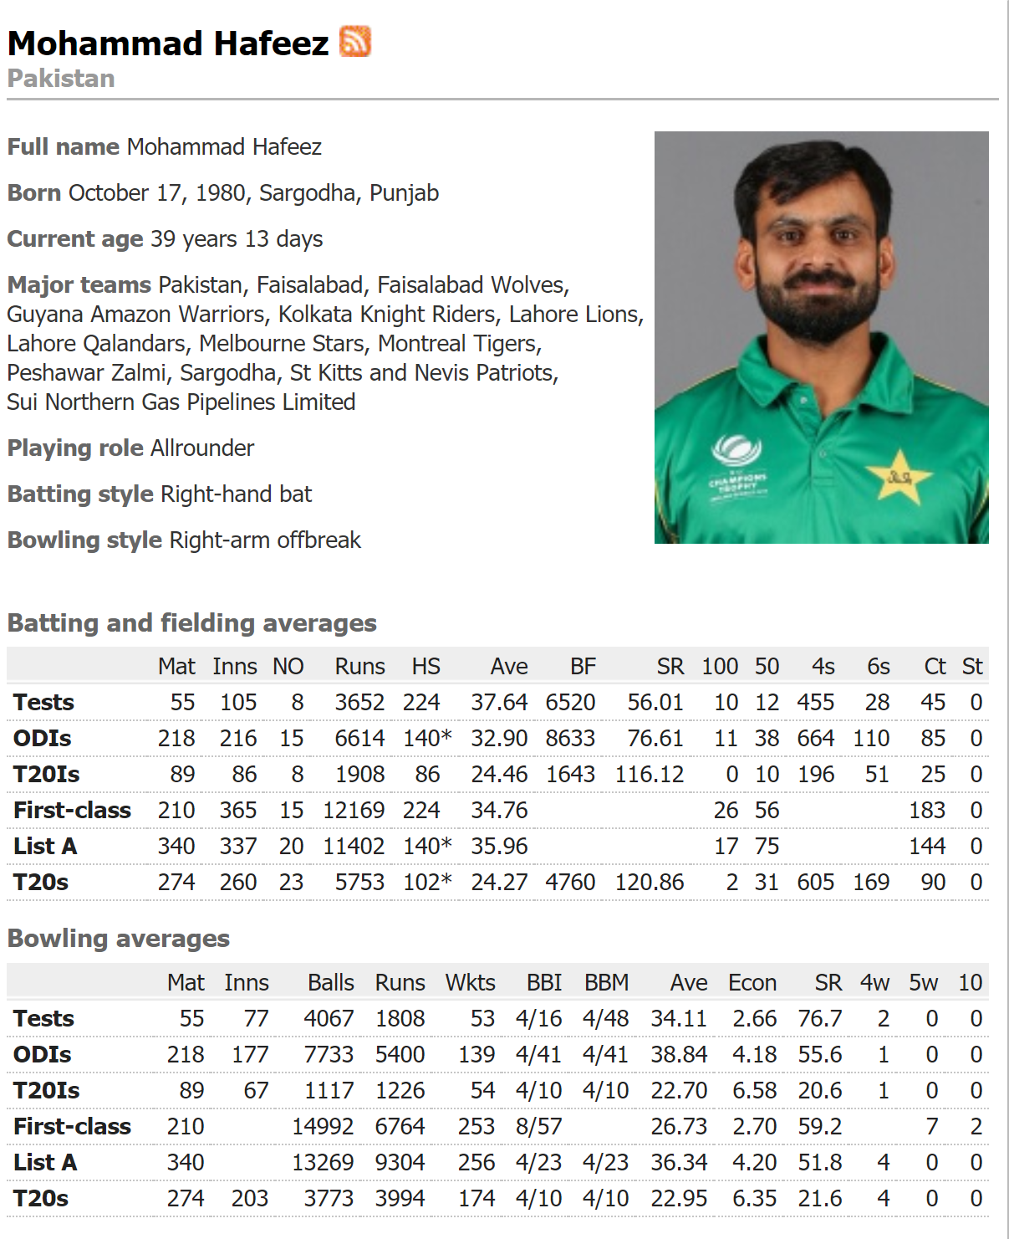
Keep Breaking
Players
Attributes
Bat
Bowl

Slide 6
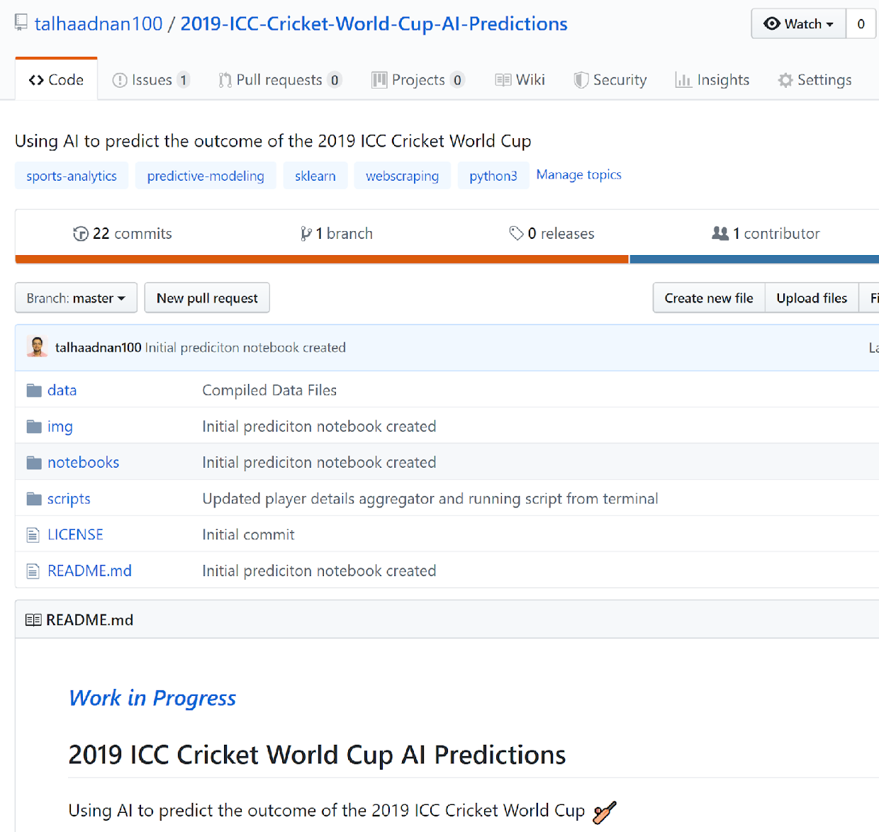
Data Science Workflow
Data Scrapping
6,000+ web pages: 4,000 one-day international matches played over 50 years by over 2,000 cricketers
Python Programming
Reproducible scripts and Jupyter Notebooks
Data Visualization
Python matplotlib and R ggplot2
Machine Learning
Scikit-learn models
Project Management
Issues / Projects
Documentation
Wiki

Slide 7
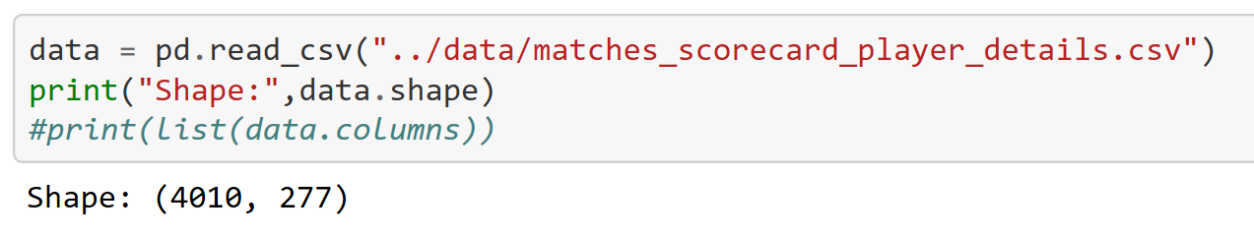
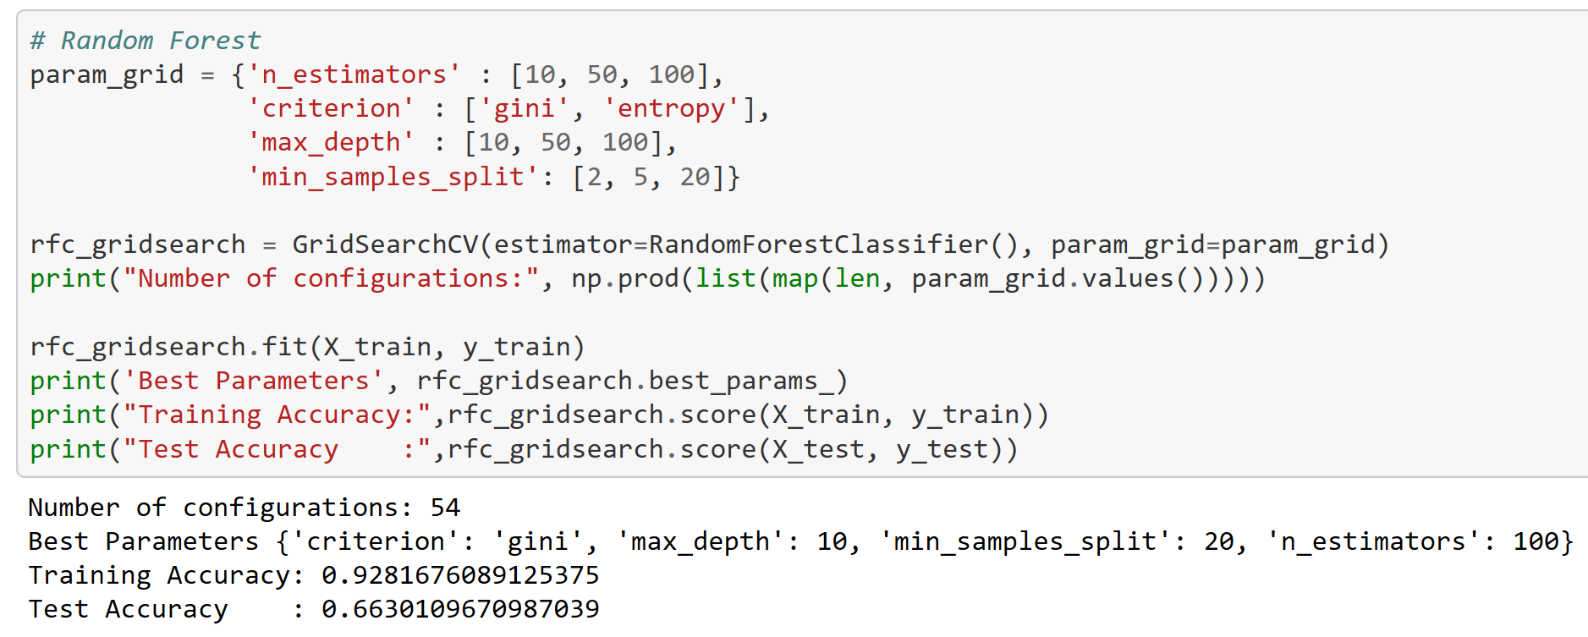
Predictions

Slide 8
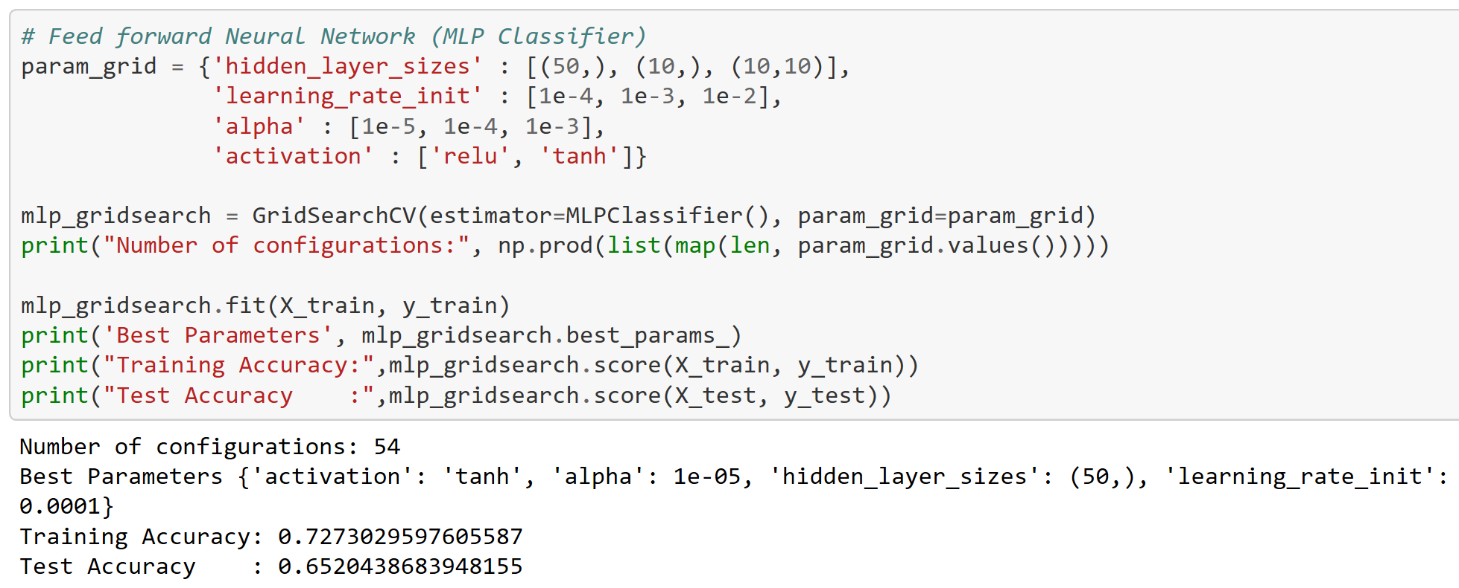
Predictions

Slide 9
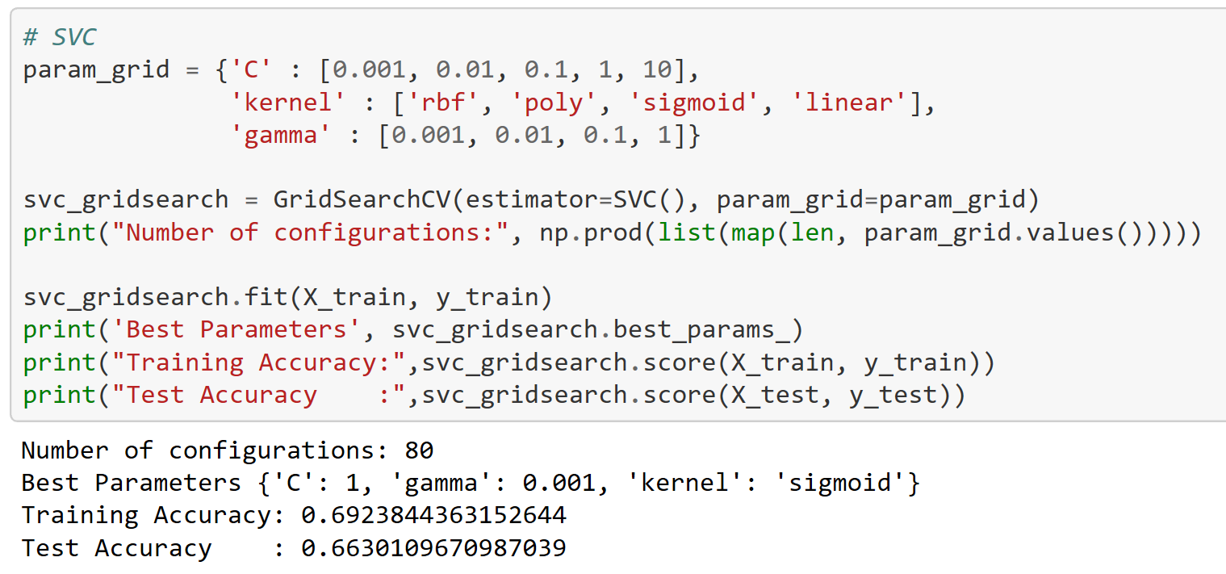
Predictions

Slide 10
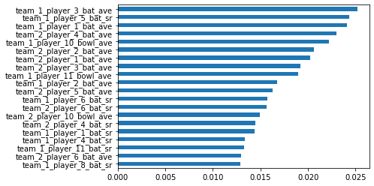
Feature Importance

Slide 11
Lessons Learnt
Did I succeed?
Skills to showcase
Quality over quantity
Passion
More about the data, less about the model
Make it public
Start small

Slide 12
How to Get Started?
R for Data Science’s #TidyTuesday
David Robinson’s Tidy Tuesday Screencast
FiveThirtyEight
Kaggle Datasets
UCI Machine Learning Repository
Namara.io by ThinkData Works
Open Data Portals by City of Vancouver, BC Government, StatisticsCanada

Slide 13
Questions? bit.ly/cricket-data-project

