Slide 1


Slide 2


CRM, BBUI and SKY UX
Tony Knopp
Notes:
Engineering manager for CRM
7 years at Blackbaud
All of that time on BBCRM.

Slide 3

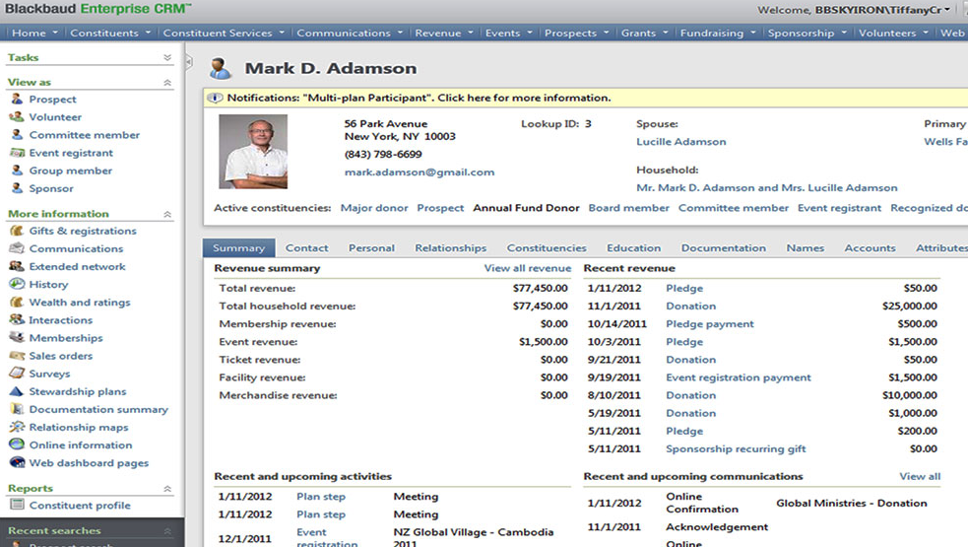
Who has tried to use webshell on their tablet or phone?
Not built to be responsive
‘Mobilize’ isn’t….pretty.
In comes SKY UX and Angular!
Notes:
Looks about as bad as that photoshop job on a mobile device
Targeted mobile functionality – all of CRM functionality within a mobile app is not ideal.

Slide 4

What are we going to talk about?
BBUI JavaScript library
What is AngularJS?
BBUI-Angular
SKY UX
Demo

Slide 5

BBUI JavaScript Library

Slide 6
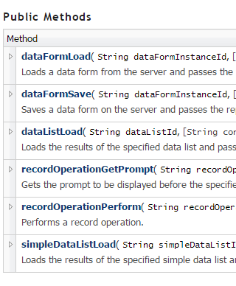
What is BBUI?
It’s the JavaScript library built by Blackbaud that drives UIModel/WebShell
Shipped around 2010 – the web development world moves quickly.
A bit chatty
https://www.blackbaud.com/files/support/guides/infinitytechref/Content/apidocs-BB_4-0/index.html
Notes:
When you’re taking any actions on a UIModel form – this is the thing driving the requests back to CRM to get data and update the form accordingly.
It also does a lot of the drawing and rendering of the form.
Since then 100’s of javascript frameworks built to make mobile first, responsive single page applications have sprung up

Slide 7
What is AngularJS?

Slide 8

AngularJS
Open source Javascript framework.
Mostly maintained by Google.
Single Page Applications are hard.
‘Two-way data binding’
https://egghead.io/courses/angularjs-app-from-scratch-getting-started
Notes:
Two way data binding – When value on the backend JS changes …update the HTML automagically
Simplify the developer experience – DOM manipulation should be abstracted away.

Slide 9
What you need to know about Angular
Define an application
<body ng-app="myApp">
Define a controller
<div ng-controller="myCtrl"> <p>The scope of the controller's favorite color:</p> <h1>{{color}}</h1> </div>
myApp.controller('myCtrl', function($scope) { });
Scope is a collection of properties accessible in your HTML
myApp.controller('myCtrl', function($scope) { $scope.color = "red"; });
Notes:
Two way data binding – When value on the backend JS changes …update the HTML automagically

Slide 10
BBUI-Angular

Slide 11
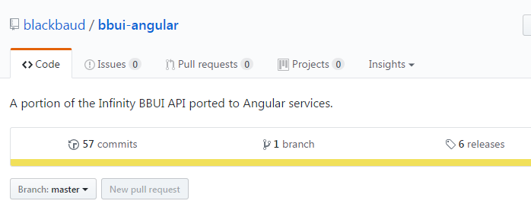
BBUI-Angular
The bbui-angular library wraps up calls to the Infinity web shell and UI Modeling services into Angular services.
Introduces ‘promises’ to function calls.
‘bbui’ Angular module
angular.module('skytutorial', ['sky', 'bbui’]);
angular.module('skytutorial')
.controller(‘ExampleController', ['bbuiShellService’])
var svc = bbuiShellService.create()
svc.dataFormLoad(CONSTITUENT_VIEW_ID,
{recordId: CONSTITUENT_ID});
https://github.com/blackbaud/bbui-angular
Notes:
You can think of angular modules and adding a module to your project as reference to a dll in .net land

Slide 12
SKY UX

Slide 13
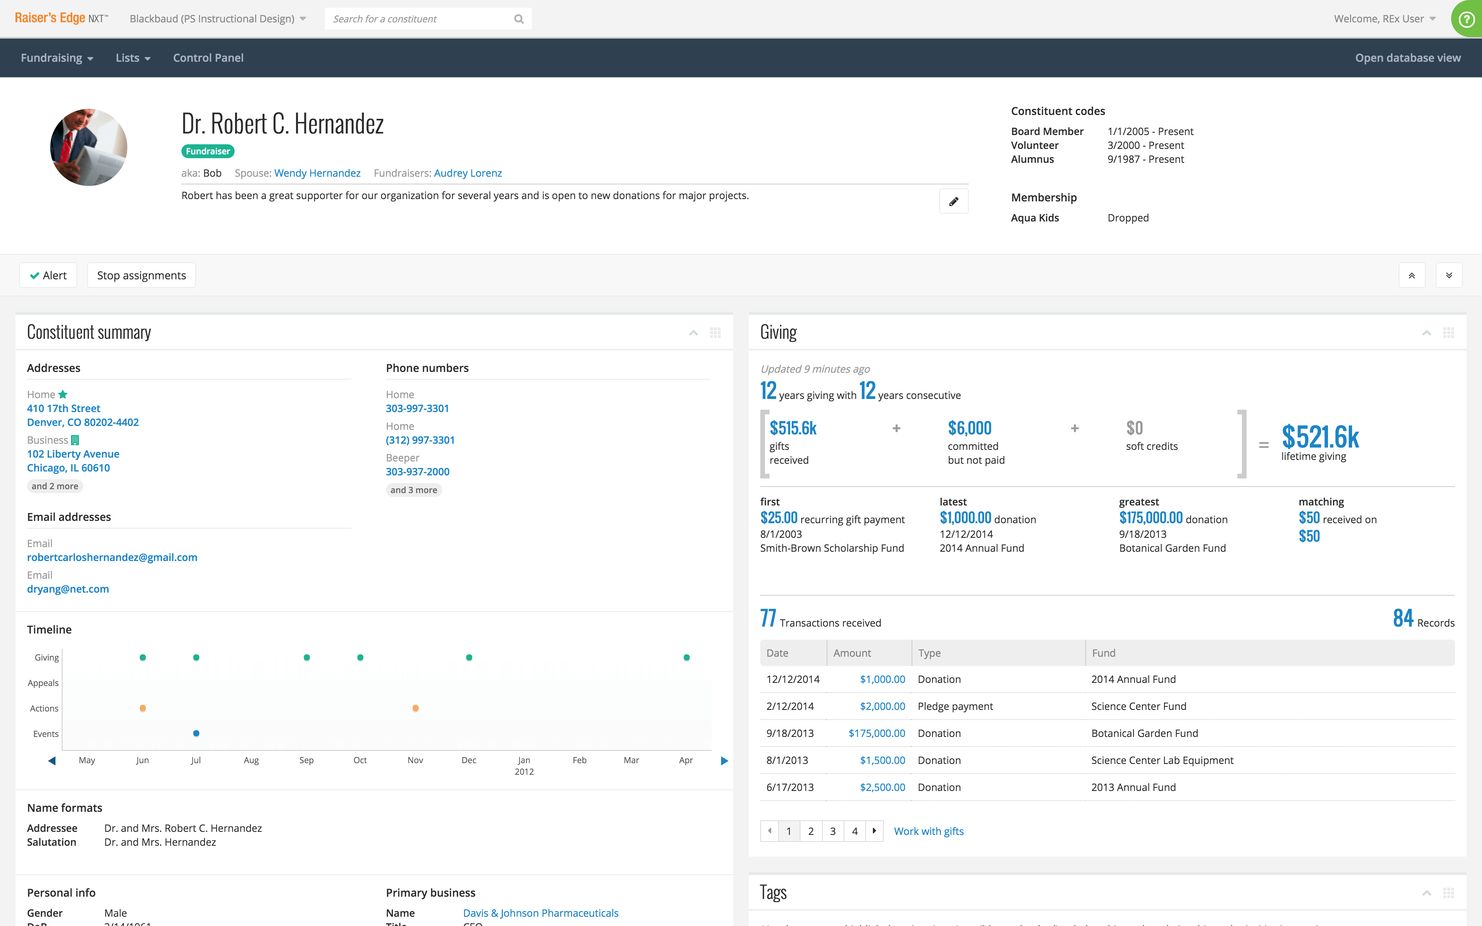
SKY UX
Blackbaud's open source UX framework
Uses Angular JS and Bootstrap
Responsive
Reusable ‘components’ – Angular directives
https://skyux.developer.blackbaud.com

Slide 14
DEMO

Slide 15


Thank you!

