Slide 1


Slide 2


Bulk Import Features and Architecture
Todd Yellin
Blackbaud, Senior Staff Software Engineer

Slide 3
What is bulk import?
New import capabilities designed from scratch
Integrated with, but exists outside of CRM
We’re not getting rid of CRM import/batch.
We’re not using CRM import/batch.

Slide 4
Why bulk import?
CRM Import
Import files often span the functionality of multiple batches
File pre-processing is common
Performance concerns
Batch extensions are common
Bulk import
Import entities
Mapping capabilities
Declarative validation
Shift logic to .Net
Bulk processing
Option to skip staging
Import entities for custom tables

Slide 5
Import Goals
Minimize customizations
Global batch import (GBI)
Batch extensions
File pre-processing scripts
Other CRM customizations/extensions
Minimize the end-to-end time to fully import a file
Processing time
Time waiting for and performing manual steps

Slide 6
Architectural Goals
Start integrating CRM w/ SKY services
Next generation implementation
SKY UX
Micro-services mostly in the cloud (Microsoft Azure)
Continuously deployed

Slide 7
Project status
Customer technical preview (CTP) begins in July
Will continue building out features towards general availability

Slide 8



DEMO!

Slide 9
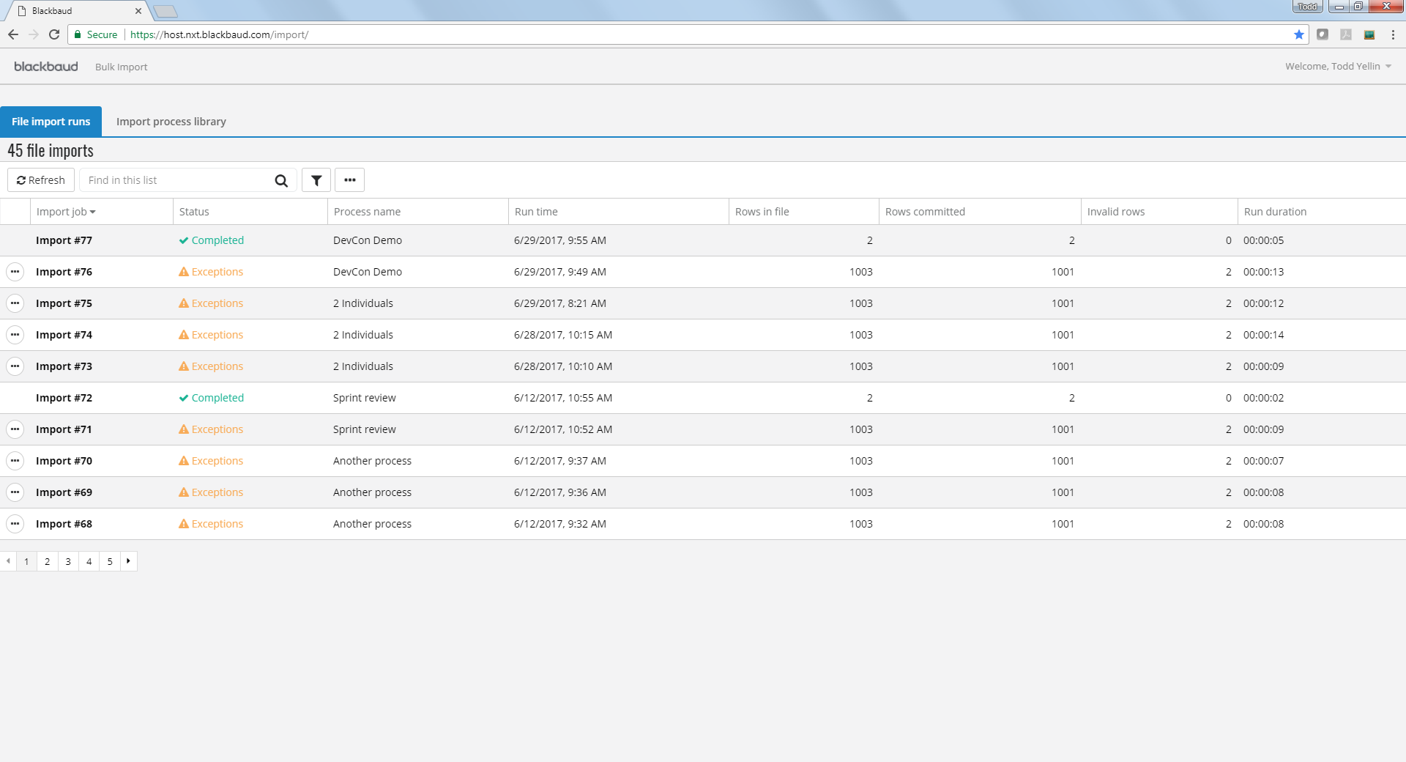

Slide 10
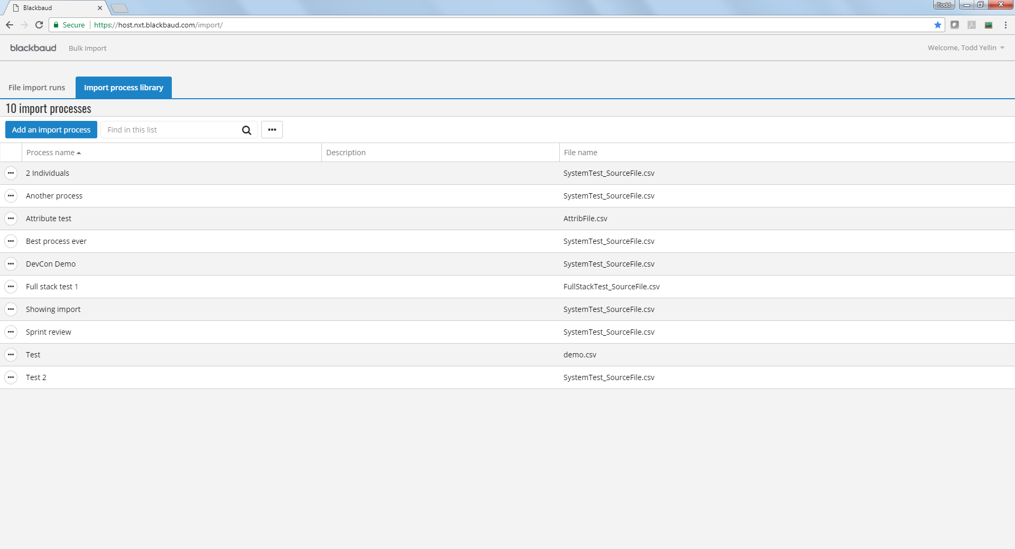

Slide 11
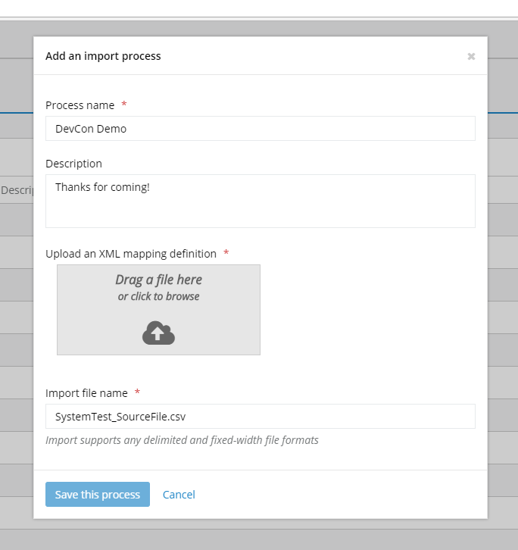

Slide 12
Import entities
Import entity ≈ record type
Map as many different entity types as needed
Map as many instances of a given entity type as needed
All instances of an entity type are equivalent
Example - all constituents can be checked for duplicates
Map only the entity types needed (e.g., an address import)

Slide 13
CRM import parity today
Constituent Update Batch
Plus direct support for households, groups, and relationships
Enhanced Revenue Batch
Pledges & pledge payments
Recurring gifts (new and updates) & payments
Donations
Benefits and marketing info
Interaction Batch
Any attribute
Additional areas will be built out per client needs

Slide 14
Support for custom tables (in development)
Most tables added through the CRM SDK
Basic validation
Max lengths
Foreign keys
Unique indexes
Improvements TBD
Update/delete support (initial feature is insert only)
Lookup capabilities (e.g., code table references)
Supporting validation/logic provided by check constraints, triggers, and batch extensions

Slide 15
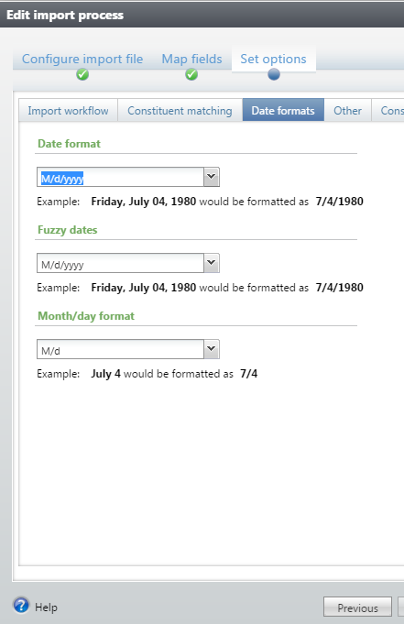
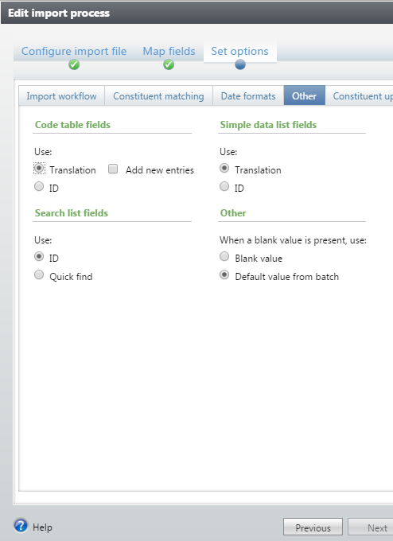
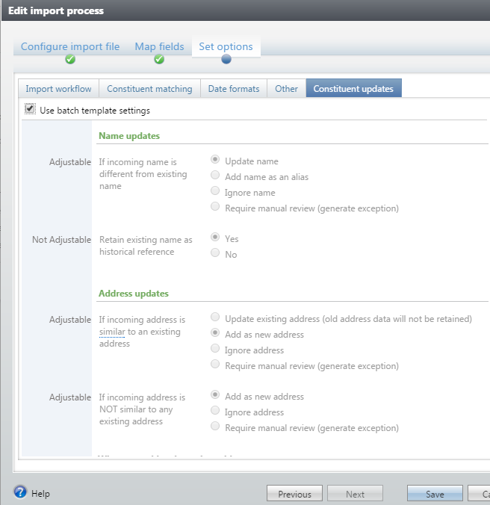
CRM import options

Slide 16
File mapping
Delimited and fixed format files
Import definition
1+ record formats (future)
1+ entity mappings
1+ entity field mappings
Current – XML
In design – Mapping UI
SAMPLE

Slide 17
Additional mapping features
Entity mapping type
Required (map every row, error if insufficient data provided)
Optional (map when data is present)
Fixed (fixed values, create when referenced entities are mapped)
Entity mapping filters
Entity mode
Insert/Update (update if match found, insert otherwise)
Insert (no matching, error on duplicates)
Match/Insert (don’t update if match found, insert otherwise)
Update (error if no match found)
Match (don’t update, error if no match found)
Required fields are only required for inserts
Matching performed against existing as well as incoming data

Slide 18
Additional transforms (in design) - Examples
Map source values/conditions to target values
Concatenate two or more fields
Basic string operations (e.g., uppercase, lowercase, trim, substring)
Basic math operations (e.g., sum, difference)
Relative dates
Date math
Span between two dates/times

Slide 19
Custom validation (in design)
When a condition is true, return a specified error
Example:
For a pledge entity,
When installment amount is less than $5.00,
Return error “Installments cannot be less than $5.00.”
Potentially associated with:
A particular entity mapping or import definition
An import entity (i.e., all entity mappings in the system)

Slide 20
Error workflow
Report multiple errors per entity in a single run (compared to one error per source row in CRM)
Produce a file containing:
The original file rows which had errors
The errors associated with those rows
Today: Direct commit clean rows, re-import the corrected exception file
Near future:
Options to not commit clean rows
Associate the error corrections with the original import until the overall job is successful
Further future: Targeted error resolution via the UI (bulk?)

Slide 21
Bulk import for global changes
Map only the entities you need
Custom filters and translations
Today: Export a file, create a mapping, import the file
Potential future: Reference a CRM query in the mapping

Slide 22
Bulk import from non-file data sources
Today: Delimited or fixed-width files
Potential future
REST APIs
Message queues
XML or JSON files

Slide 23
Performance
5-10x faster than CRM import (automatic batch commit)
All processing is either performed in bulk or in parallel
Large files are processed using in-memory “batches” (not CRM batch)
Database queries performed once per batch
Database writes performed primarily in bulk
Move processing out of the database to .Net
Option to skip staging for rows with no errors
Physical writes/reads
Minimize the need for manual edits

Slide 24
Bulk writes

Slide 25
Bulk writes
In-memory logic detects all errors enforced by the database
Inserts = SQL bulk copy
Updates and deletes
Bulk copy into a temp table
Update/delete using a join to the temp table

Slide 26
Bulk Import Architecture

Slide 27
Monitoring and support
All services are set up to raise alerts when something unexpected happens.
Services go down or are not responding appropriately/consistently
Cannot access databases
Imports are failing
Other unexpected situations or unhandled exceptions occur
Engineering and operations teams will receive alerts and respond
Failures reported to end-users should be cases they can resolve
Other types of failures should get retried automatically once the issue is resolved

Slide 28
Continuous deployment
Bulk import provides a single set of services that are used by all clients in a hosting data center
Changes are deployed to these services in a mostly automated fashion
Individual features, changes, or bug fixes can be made available as they are ready (no “big bang” releases)
Everyone is on the latest and greatest

Slide 29
Customer Technical Previews
Traditional CTP
Focuses on a Release
Limited to a handful of participants
Uses traditional release lifecycle
Slower to incorporate feedback
Tests existing processes
Concludes when program ends
SKY Capability CTP
Focuses on a Feature
Multiple participants cycle through
Uses continuous deployment
Quicker to incorporate feedback
Tests replacement processes
Concludes when participant becomes an early adopter

Slide 30
Bulk import CTP
Starting mid-July
Hosted customers on 4.0
Customers interested in implementing bulk import in production

Slide 31
Thank you!

Slide 32
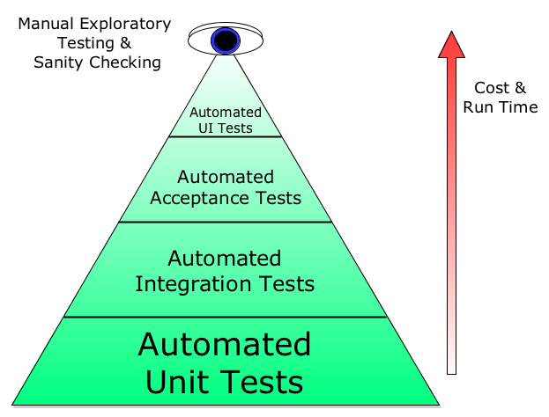
Test strategy
Unit tests of all features with dependencies mocked out
Integration tests of database and other dependencies
Pact tests for dependencies across micro-services
System tests of the full bulk import stack
Performance tests will prevent regression

Slide 33
Continuous deployment pipeline – each service

Slide 34
System test in TEST

Slide 35
System test in PROD

