Slide 1
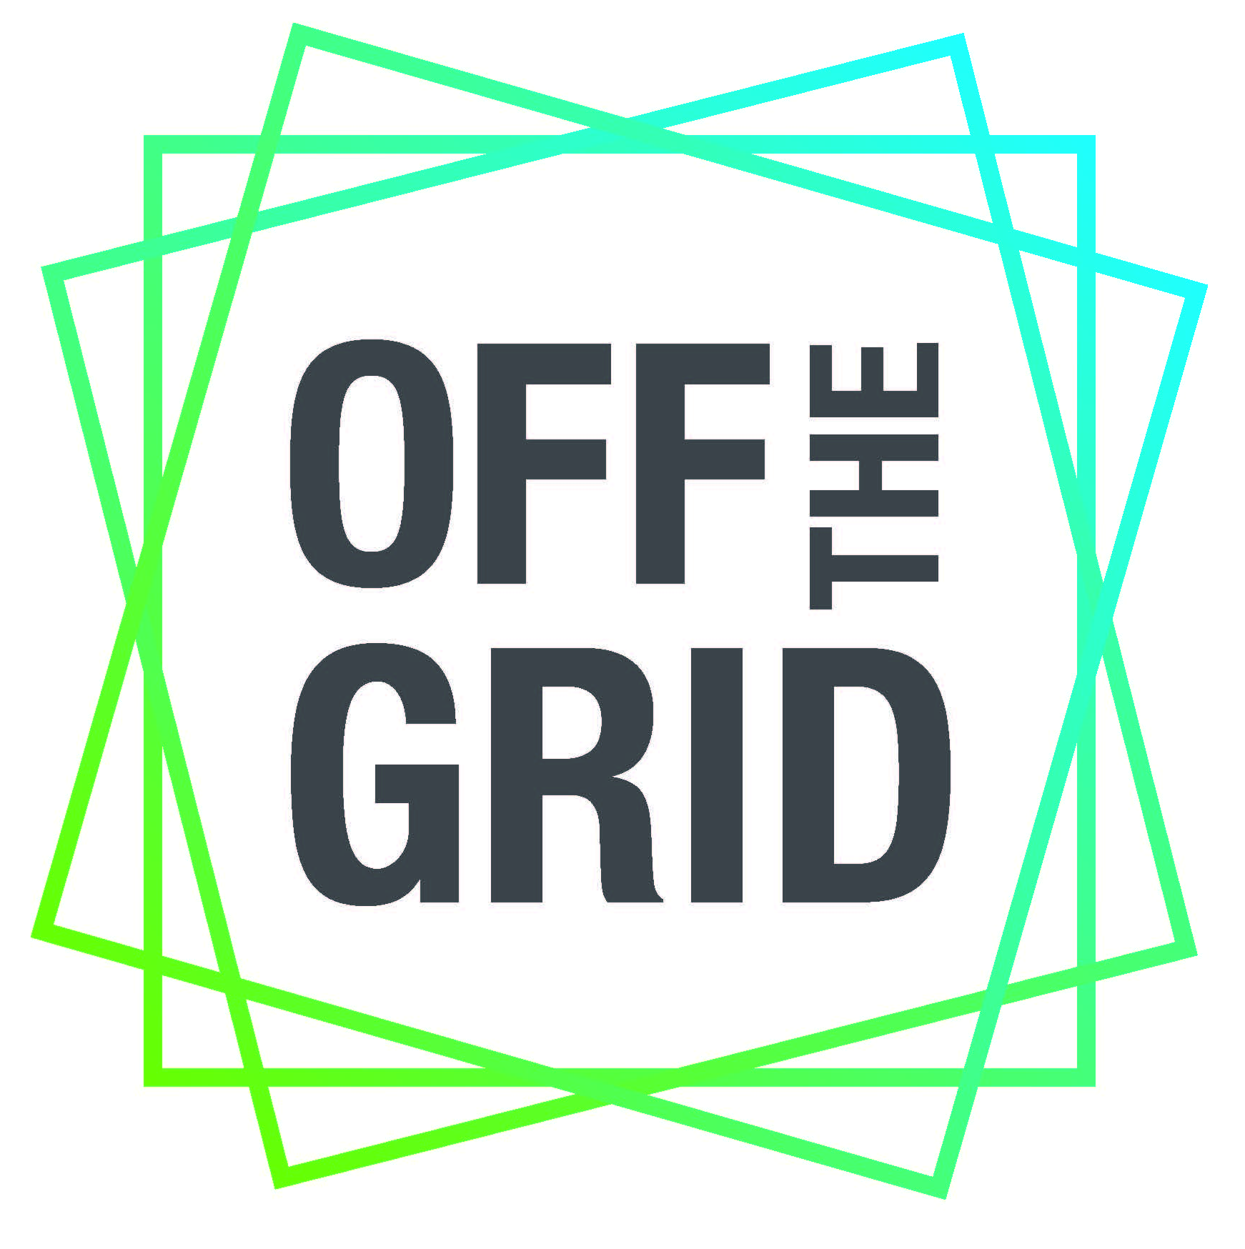
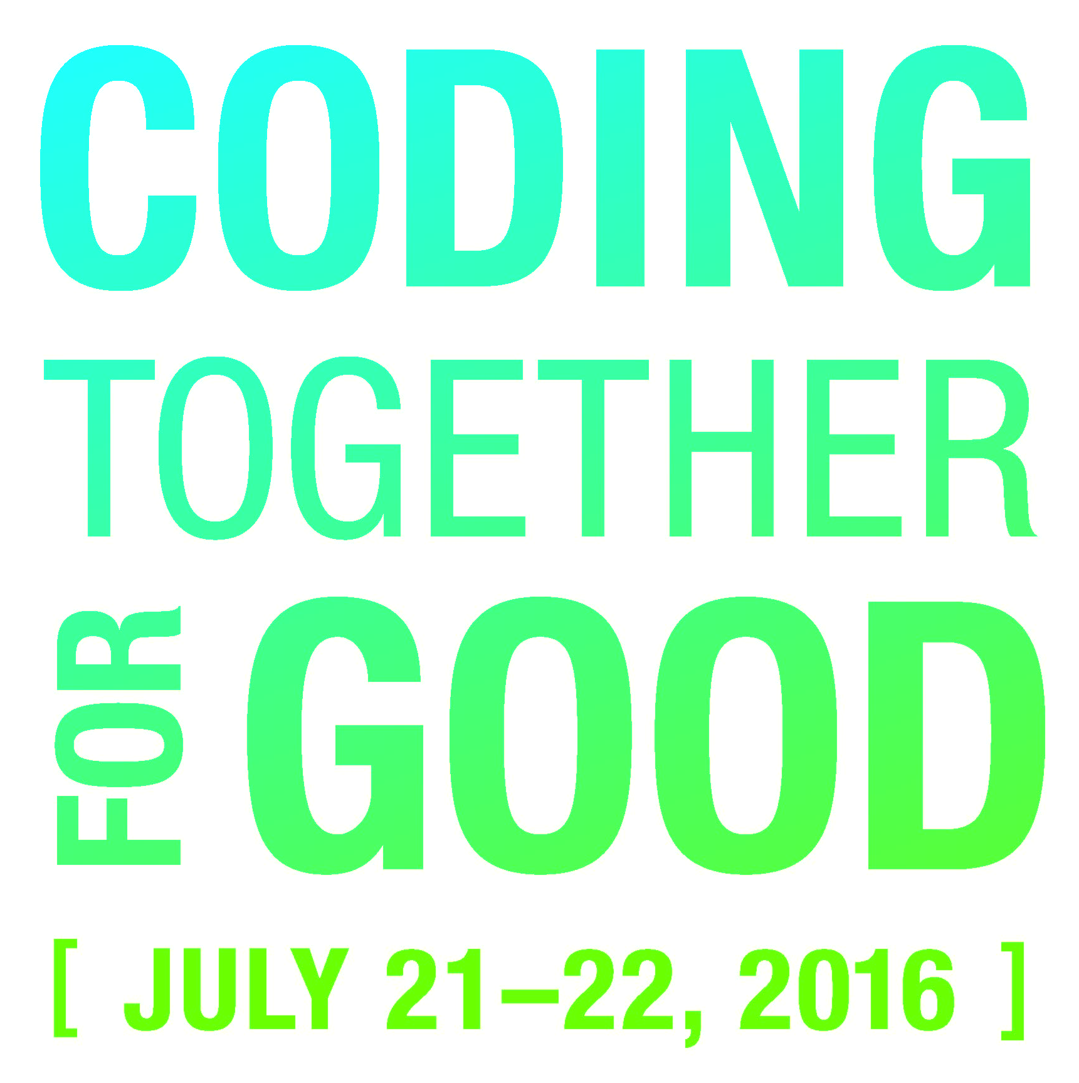
Full of Ideas:
Sky Beacons
Brandon Hare
Chris Rodgers
Steve Brush
Partnering with:
Children’s Science Center

Slide 2
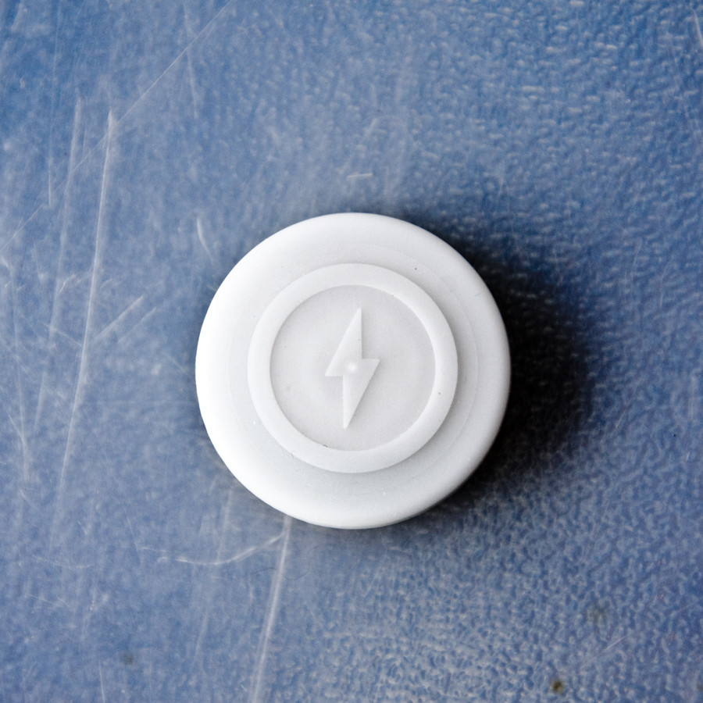
Introduction
What is a “beacon”?
A small device that broadcasts a URL
Our Goal:
Collect analytics surrounding a given location
Provide users with meaningful, contextual information
Ultimate Vision:
A One Blackbaud service that integrates beacon technology into any Blackbaud CRM
Notes:
Explain your project.

Slide 3
what did you create & what does it do?
Service that allows Blackbaud clients to integrate Beacon Technology into their CRM (most notably, Altru).
Beacons are small devices that transmit a URL of the owner’s choosing
Users can then receive the URL on their phones
Provides clients the ability to track capacity and visits to an exhibit, as well as tailor a user’s experience based on their proximity to a location
Delivers relevant information to constituents for a given exhibit
Informs visitors of nearby docents or staff to get help or directions
Notes:
Explain your project.

Slide 4
Who Benefits from this & How?
Clients and their constituents
Clients:
Analytics for exhibit capacity, visits, length of stay
Enhance experience while users are there
Constituents:
Receive tailored experience
Contextual information surrounding an entity (exhibit, docent, etc.)
Notes:
Describe who benefits from this project and how? How do our customers benefit?

Slide 5
What are the next steps?
Create a mobile application to utilize the phone’s hardware (beacon proximity and push notifications)
Constituent authorization to allow for a more personal experience
Link to Blackbaud data via SKY API
CRM integration for easy analytics consumption
Support Eddystone and iBeacon formats to make it platform agnostic
Notes:
Where do you go from here?

