Slide 1
BITS Pilani · EEE G513 — Machine Learning for Electrical Engineers
April 2026
ML-Driven Portfolio Optimization.
Supervised return forecasting and macroeconomic regime detection within a constrained Markowitz framework.
Submitted by
Dipesh Kohad
·
Nikhil Sheoran
·
Adit Sreenivasan
Asset universe: Nifty 50 USD · S&P 500 · Gold · US Bonds
End-Semester Presentation · 2005 — 2026

Slide 2
02
·
Objective
Research question
Can a machine-learning pipeline that combines supervised return prediction with unsupervised macroeconomic regime detection improve the risk-adjusted performance of a Markowitz-optimized portfolio compared to static baselines?
Classical mean-variance optimization depends heavily on estimates of expected returns, which are difficult to estimate because market behaviour shifts with inflation, interest rates, currency, and volatility regimes.
Portfolio Optimization
02 / 13

Slide 3
03
·
Asset Universe
Long-run characteristics, 2005 — 2024
Asset universe.
Indian equity
US equity
Commodity
Fixed income
6.7 %
8.7 %
5.8 %
4.2 %
Nifty 50 in USD. CAGR 6.71%, R² 0.79.
S&P 500. CAGR 8.73%, R² 0.88.
Spot gold. CAGR 5.77%, R² 0.68.
US Treasury bond index. CAGR 4.17%, R² 0.74.
CAGR estimated by log-linear regression on monthly prices
Pairwise correlations between −0.34 and +0.27
Portfolio Optimization
03 / 13

Slide 4
04
·
Methodology
Five stages
Methodology.
01 / Data
02 / Forecast
03 / Regime
04 / Optimize
05 / Test
EDA
Return prediction
Clustering
Markowitz QP
Walk-forward
Daily prices and macroeconomic factors. Trend, volatility, and correlation analysis.
Linear regression, SVR, Random Forest, Gradient Boosting per asset; best model selected.
PCA on macro factors followed by GMM and K-Means clustering into four regimes.
Mean-variance QP via cvxpy with 5 — 45% per-asset bounds and PSD-projected covariance.
Monthly rebalance, 60-month warm-up, evaluation on six historical stress periods.
Portfolio Optimization
04 / 13

Slide 5
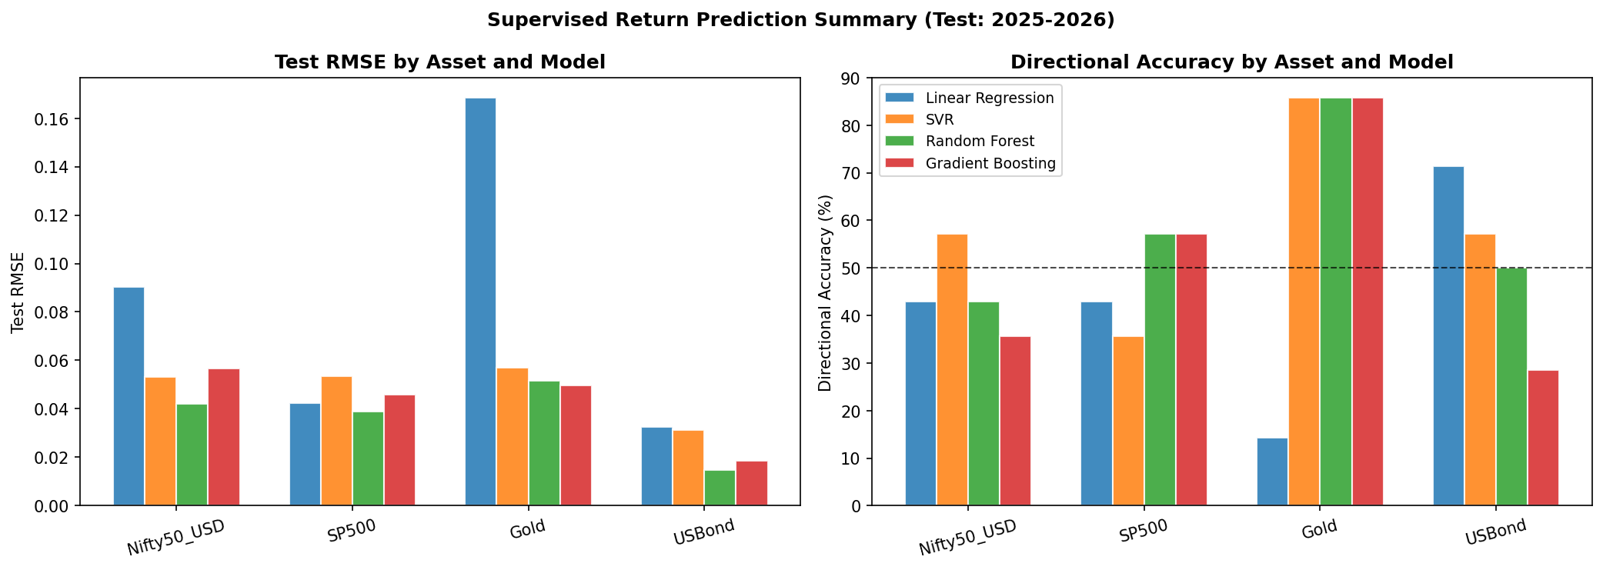
05
·
Supervised Return Prediction
Test split 2025 — 2026
Selected models.
Asset
Model
Test RMSE
Dir. Acc.
Gold
Gradient Boosting
0.0497
85.7%
S&P 500
Random Forest
0.0388
57.1%
US Bonds
Random Forest
0.0146
50.0%
Nifty 50
Random Forest
0.0419
42.9%
Tree-based ensembles dominate across assets. Gold yields the highest directional accuracy; Nifty 50 is the hardest to forecast, consistent with its higher idiosyncratic volatility.
Portfolio Optimization
05 / 13

Slide 6
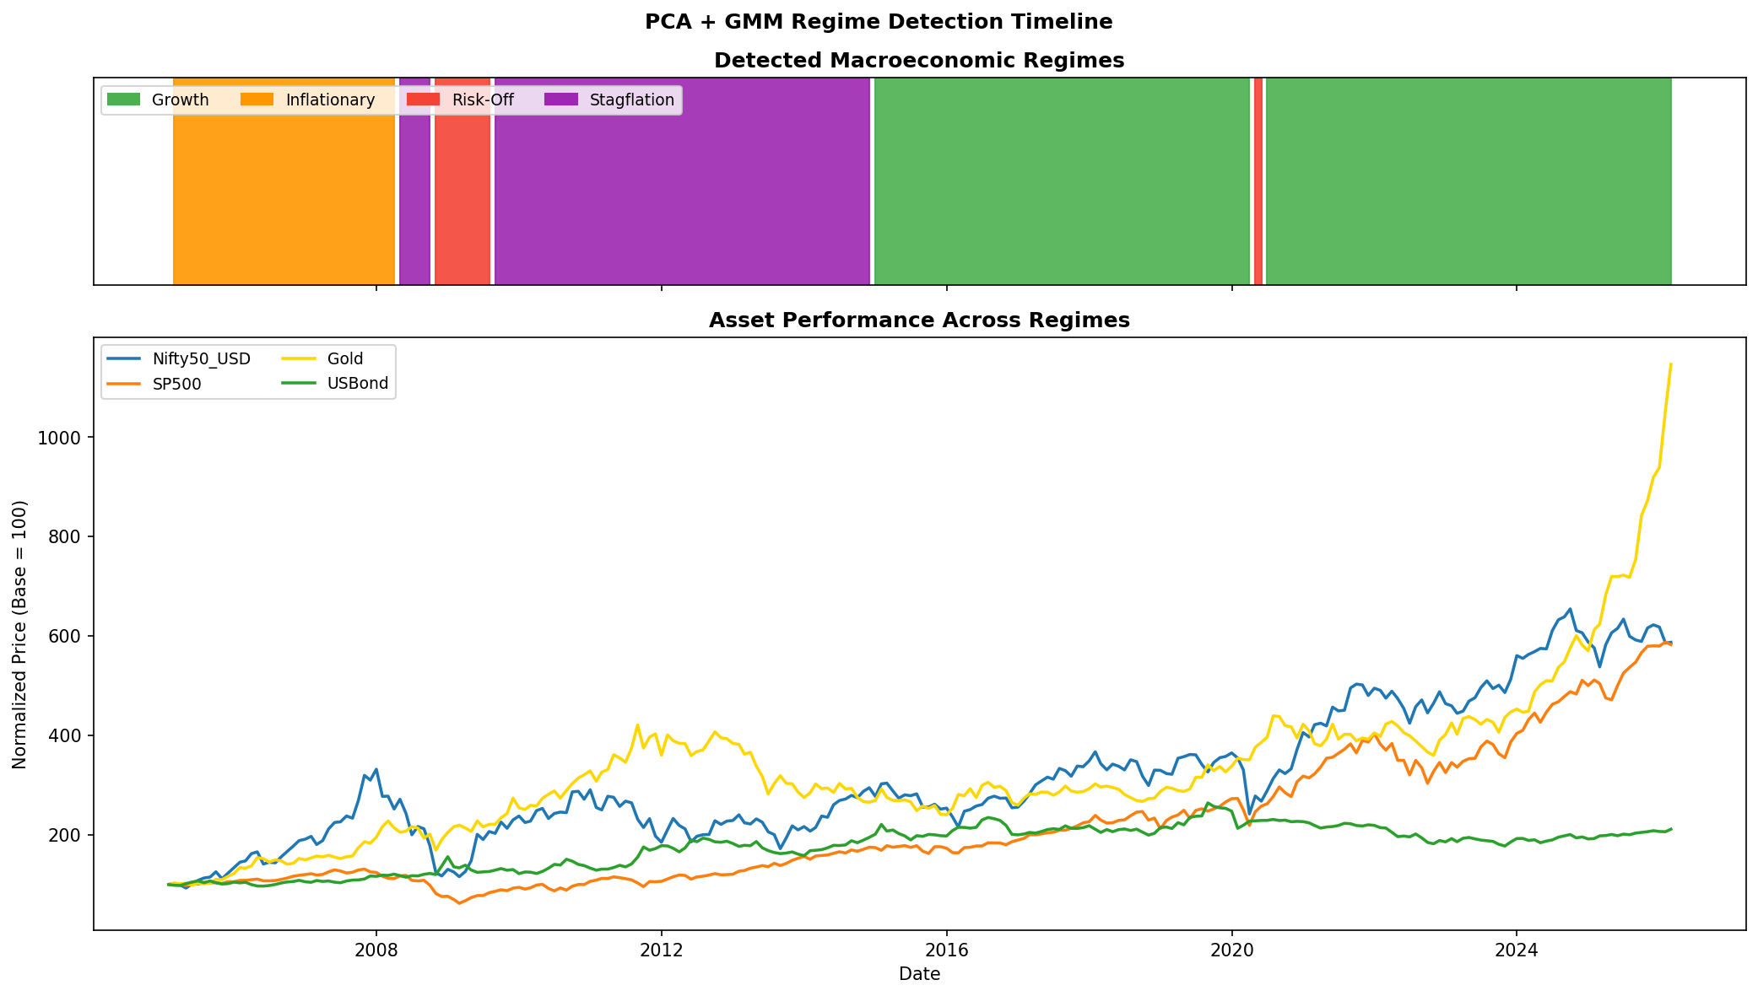
06
·
Regime Detection
PCA + GMM
Macroeconomic regimes.
PCA reduces the macro feature set; GMM clusters the components into four latent regimes. Each carries a distinct return signature across the four assets.
Growth
52.57% of months
Inflationary
15.02%
Risk-Off
4.74%
Stagflation
27.67%
PCA retains 13 components (~90.4% of variance). GMM and K-Means yield related partitions (Adjusted Rand Index 0.600); GMM is adopted as primary.
Portfolio Optimization
06 / 13

Slide 7
07
·
Strategies
Four allocators
Strategies compared.
Baseline · 01
Baseline · 02
Proposed · 03
Proposed · 04
Equal Weight
Classical Markowitz
ML Markowitz
ML + Regime-Aware (diagnostic)
Constant 25% per asset. No optimization.
Mean-variance QP with rolling-mean μ; 36-month rolling Σ.
Replace μ with the per-asset ML forecast; same 36-month rolling Σ.
Same μ and Σ as ML Markowitz; regime label attached for interpretation. Bounds currently identical, so results coincide.
25
25
25
25
μ = rolling mean
μ = ML forecast
μ = ML | Σ = 36-mo rolling
cvxpy · 5 — 45% per-asset bounds · monthly rebalance
PSD-projected covariance · 36-month rolling window
Portfolio Optimization
07 / 13

Slide 8
08
·
Walk-Forward Results
Monthly rebalance · 60-month warm-up
Walk-forward performance.
Strategy
Annualized return
Annualized volatility
Sharpe
Sortino
Max drawdown
Equal Weight
8.76%
9.54%
0.92
1.55
−14.87%
Classical Markowitz
7.67%
10.16%
0.75
1.29
−19.92%
ML Markowitz
9.49%
9.46%
1.00
1.73
−16.35%
ML + Regime-Aware †
9.49%
9.46%
1.00
1.73
−16.35%
† ML + Regime-Aware coincides with ML Markowitz because both pass identical μ, identical 36-month rolling Σ, and identical 5–45% per-asset bounds into the QP. The regime label is currently diagnostic.
Sharpe lift vs classical
Drawdown reduction
Annualized return lift
+0.25
357 bps
+182 bps
From 0.75 to 1.00 under identical 5–45% bounds.
Max drawdown −16.35% versus −19.92% for classical.
9.49% versus 7.67% for classical Markowitz.
Portfolio Optimization
08 / 13

Slide 9
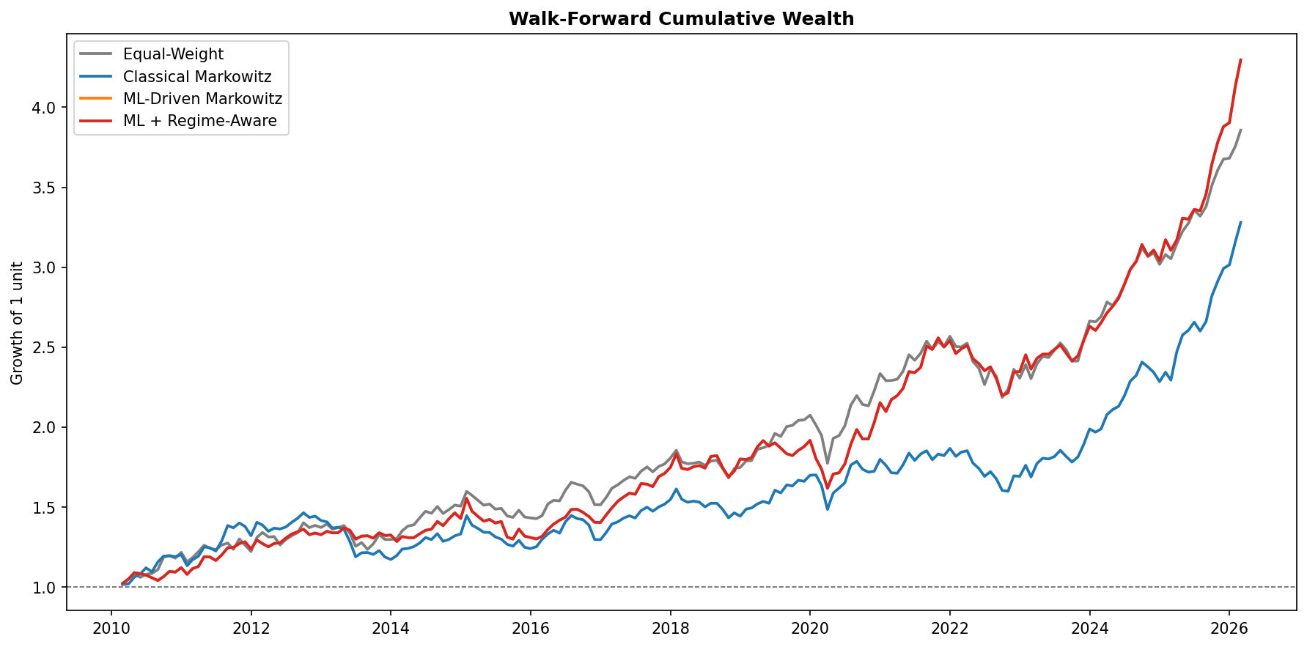
09
·
Cumulative Wealth
Walk-forward, monthly rebalance
Cumulative wealth curve.
Across the full backtest the four strategies track each other through stable periods. Classical Markowitz drifts behind because the rolling-mean μ produces less stable allocations.
The ML strategies separate from both baselines from 2022 onwards, consistent with the higher annualized return ( 9.49% ) and Sharpe ( 1.00) reported in the walk-forward summary.
ML / Regime-Aware
Equal Weight
Classical Markowitz
Portfolio Optimization
09 / 13

Slide 10
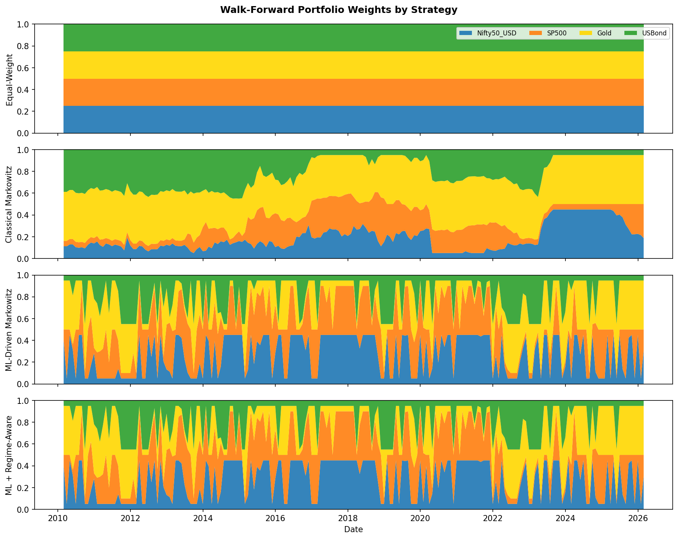
10
·
Portfolio Weights
Monthly weights by strategy
Allocation behaviour.
Classical weights drift smoothly. The ML allocator is far more tactical: per-asset weights pivot month-to-month as forecasts and covariance refresh, frequently reaching the 5% and 45% bounds.
Equal Weight
Constant 25% by construction.
Classical
Gold-heavy 2011–14; equity-heavy from 2023.
ML / Regime
Rotates Nifty & gold; bonds rarely above floor.
Portfolio Optimization
10 / 13

Slide 11
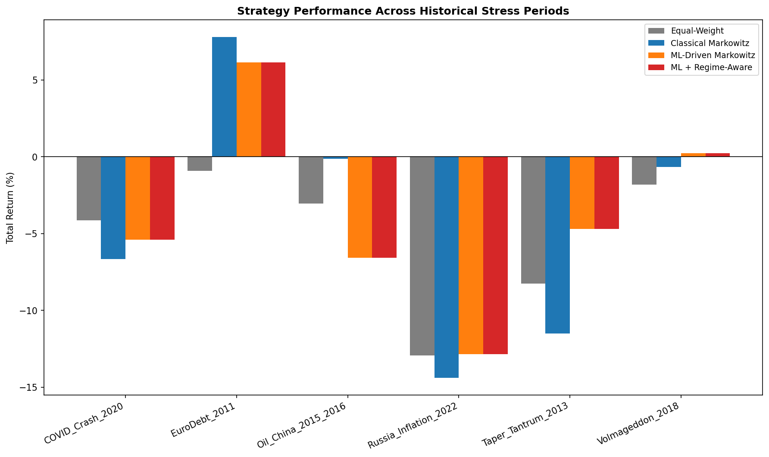
11
·
Stress Periods
Six historical episodes · total return
Stress-period analysis.
Episode
EW
Classical
ML
Euro Debt 2011
−0.92%
+7.79%
+6.15%
Taper Tantrum 2013
−8.25%
−11.49%
−4.70%
Oil / China 2015–16
−3.06%
−0.14%
−6.58%
Volmageddon 2018
−1.81%
−0.65%
+0.22%
COVID Crash 2020
−4.13%
−6.65%
−5.39%
Russia / Inflation 2022
−12.92%
−14.39%
−12.84%
No strategy dominates every crisis. ML performs better in slow-developing shocks (Taper Tantrum, Volmageddon, 2022 inflation) but equal-weight is more defensive in COVID and the 2015–16 oil/China drawdown.
Portfolio Optimization
11 / 13

Slide 12
12
·
Conclusions
Findings
Conclusions.
ML forecasts improve risk-adjusted returns.
Replacing the μ-vector with per-asset ML predictions raises Sharpe from 0.75 to 1.00 and reduces maximum drawdown by approximately 360 basis points relative to classical Markowitz.
Equal-weight is a competitive baseline.
Equal-weight outperforms classical Markowitz on Sharpe, total return, and drawdown, indicating that estimation error in μ can outweigh the diversification benefit.
The regime overlay is currently diagnostic, not allocative.
Because ML + Regime-Aware passes the same μ, the same 36-month rolling Σ, and the same 5–45% bounds into the QP, it produces metrics identical to ML Markowitz. The regime label is retained for interpretation; using regime-specific bounds is a natural next step.
Crisis robustness is uneven.
ML mitigates slow regime shifts but does not protect against fast equity-led drawdowns; covariance updates lag the underlying shock.
Portfolio Optimization
12 / 13

Slide 13
End
Questions
Thank you.
Code, artifacts, and figures are available in the project repository.
github.com/Blackbox-droid/portfolio-optimization
Authors
Dipesh Kohad
·
Nikhil Sheoran
·
Adit Sreenivasan
Course
Stack
Sample
Strategies
EEE G513
cvxpy · scikit-learn
2005 — 2026
4 compared
Portfolio Optimization
13 / 13

