Slide 1

RESEARCH FRAMEWORK · OPERATIONALIZED
A 3-Dimensional Classification System
for AI Agents in the Investment Industry
From the Schuller · Wierckx · Kuhn · Zilic (2025) framework to a live, queryable benchmark of 78 AI agents.
Andrea Signoretti · Panthera Solutions Internship
Presented to the authors of the framework & internship tutor · June 2026
PANTHERA · 3D AI Agent Classifier
01 / 15
Notes:
Good [morning/afternoon], and thank you for the time. My name is Andrea Signoretti. Over my internship I took your paper — the multi-dimensional classification system for AI agents — and turned it from a conceptual framework into a working software platform that classifies, visualizes and benchmarks the real AI-agent market in investment management. In the next 15 minutes I'll walk top-down: first the goal, then the method, then the platform itself, then what the data actually shows us about the market, my own design decisions, the honest limitations, and where this can go next. I built this directly on your four dimensions, so my hope is this is the empirical validation step your Discussion section calls for.

Slide 2
WHY THIS PROJECT
The goal: turn a taxonomy into a living instrument
▸ Framework in action. Take the paper's dimensions out of the page and make them executable — every agent gets a concrete, comparable coordinate.
▸ A rich benchmark. One catalogue of the AI-agent market for investment management — commercial, in-house and academic — classified consistently.
▸ A market view. Reveal where AI actually clusters across the investment process, and where it is conspicuously absent.
▸ A shared language. Give managers, developers and regulators one vocabulary to compare tools and align adoption with a firm's real edge.
ONE INSTRUMENT, THREE AUDIENCES
Investment managers
Which tool fits which decision — and does it match our edge?
Developers / vendors
Where is the market crowded, where is the white space?
Regulators
How autonomous is this system, and where does it touch compliance?
PANTHERA · 3D AI Agent Classifier
02 / 15
Notes:
The starting point was a gap your paper names directly: AI tools are flooding into investment workflows, but there is no consistent way to compare or categorize them. So the goal was deliberately practical. Four things. One — get the framework 'in action': make each of your dimensions something you can actually assign and compute, not just describe. Two — build a rich benchmark: a single, consistently-classified catalogue of the market. Three — from that catalogue, surface a market view: where AI concentrates and where it's missing. Four — deliver the shared language your paper argues for, usable by the three audiences on the right: managers choosing tools, developers and vendors hunting white space, and regulators assessing autonomy and compliance exposure. Everything that follows serves these four aims.

Slide 3
THE PROBLEM
Without a shared taxonomy, firms misjudge AI
The paper's core claim: absent a common structure, firms underutilize AI or misjudge its strategic potential. Three failure modes motivate the build.
Wrong tool, wrong context
Over-automation
Under-utilization
A white-swan optimizer deployed against a black-swan problem — confident answers where no distribution exists.
Handing genuine judgment calls to systems built for routine, well-characterized tasks.
Leaving durable edge on the table where AI could reliably compound an advantage.
My read: each failure is a classification error before it is an investment error. If you can place a tool precisely, you can govern it. The platform makes that placement cheap and repeatable.
PANTHERA · 3D AI Agent Classifier
03 / 15
Notes:
Why does an instrument like this matter? Because the paper frames the risk as strategic, and I'd push it one step further. Look at the three failure modes. Wrong tool for the context — a white-swan optimizer, which assumes a knowable distribution, pointed at a black-swan problem where no distribution exists. Over-automation — giving real judgment to a tool designed for routine tasks. And under-utilization — the quiet one — leaving durable edge unused. My interpretation is the line at the bottom: every one of these is a classification error before it becomes an investment error. Misplace the tool on the map and the bad outcome follows. So if placing a tool precisely becomes cheap and repeatable, governance becomes possible. That's the thesis the platform is built to serve.

Slide 4
THE FRAMEWORK I OPERATIONALIZED
Five dimensions — your paper, made assignable
COMPLEXITY — Swan Theory
White · Light-grey · Dark-grey · Black
How knowable is the outcome distribution? (Knight · Taleb)
COMPARATIVE ADVANTAGE
Informational · Analytical · Behavioral
What edge does the agent confer? One primary edge only.
AUTONOMY
Low · Medium · High · Full
How much human veto remains over the investment action?
INVESTMENT PROCESS STAGE
7 stages: idea-gen → stakeholder
Where in the lifecycle does it intervene? Multi-select.
AGENT TYPE (provenance)
Commercial · In-house · Academic
Origin of the system, for benchmark integrity.
PANTHERA · 3D AI Agent Classifier
04 / 15
Notes:
Here are the dimensions the platform makes assignable — four orthogonal ones plus provenance. Complexity uses your Swan Theory: the key question isn't whether uncertainty exists, but whether the probability distribution of outcomes can be characterized — white is classical risk, black is radical uncertainty, grounded in Knight and Taleb. Comparative advantage — informational, analytical, behavioral — the Fuller and Wierckx typology, and I enforce a single primary edge, which I'll defend later. Autonomy is about human veto over the investment action. Stages are the seven-step pipeline, multi-select because real tools span several. And agent type tracks origin so the benchmark stays honest about what's a shipping product versus a research prototype. The whole platform is just these five fields, applied rigorously, 77 times over.

Slide 5
METHODOLOGY
How an agent becomes a data point
1
2
3
4
SOURCE
›
AI-ASSISTED DRAFT
›
HUMAN REVIEW
›
PERSIST & PUBLISH
Scan the market — vendor products, bank in-house systems, academic prototypes — and capture name + URL.
Claude (claude-opus-4-8) researches each agent and returns a structured classification via forced tool-use — never free text.
I verify every call against the framework guide, focusing on the nuanced complexity tier and the rationale.
Stored in SQLite; only 'classified' agents surface in the matrix, finder and exports.
Design principle: AI for scale, human for judgment. The model does the breadth — researching dozens of tools — but the framework is mine to uphold. Forced tool-use guarantees a comparable shape for every record; the human pass guards the meaning. This is augmented intelligence applied to building the benchmark itself.
PANTHERA · 3D AI Agent Classifier
05 / 15
Notes:
This is the pipeline that turns a product name into a comparable data point. Four steps. I source agents across the three provenance types. Then — and this is the part I want to be transparent about — I use Claude to draft the classification. It researches each agent and must answer through a structured tool call, so every record comes back in the same shape, with the same fields. It cannot ramble in free text. Step three, I review every single one against the classification guide, paying most attention to the complexity tier, which is the subtlest dimension, and to the rationale. Then it's persisted, and only fully-classified agents are published to the views. The principle at the bottom is the honest summary: AI for scale, human for judgment. There's a nice reflexivity here — the benchmark about augmented intelligence is itself built with augmented intelligence. I'll come back to the limitations of leaning on the model in step two.

Slide 6
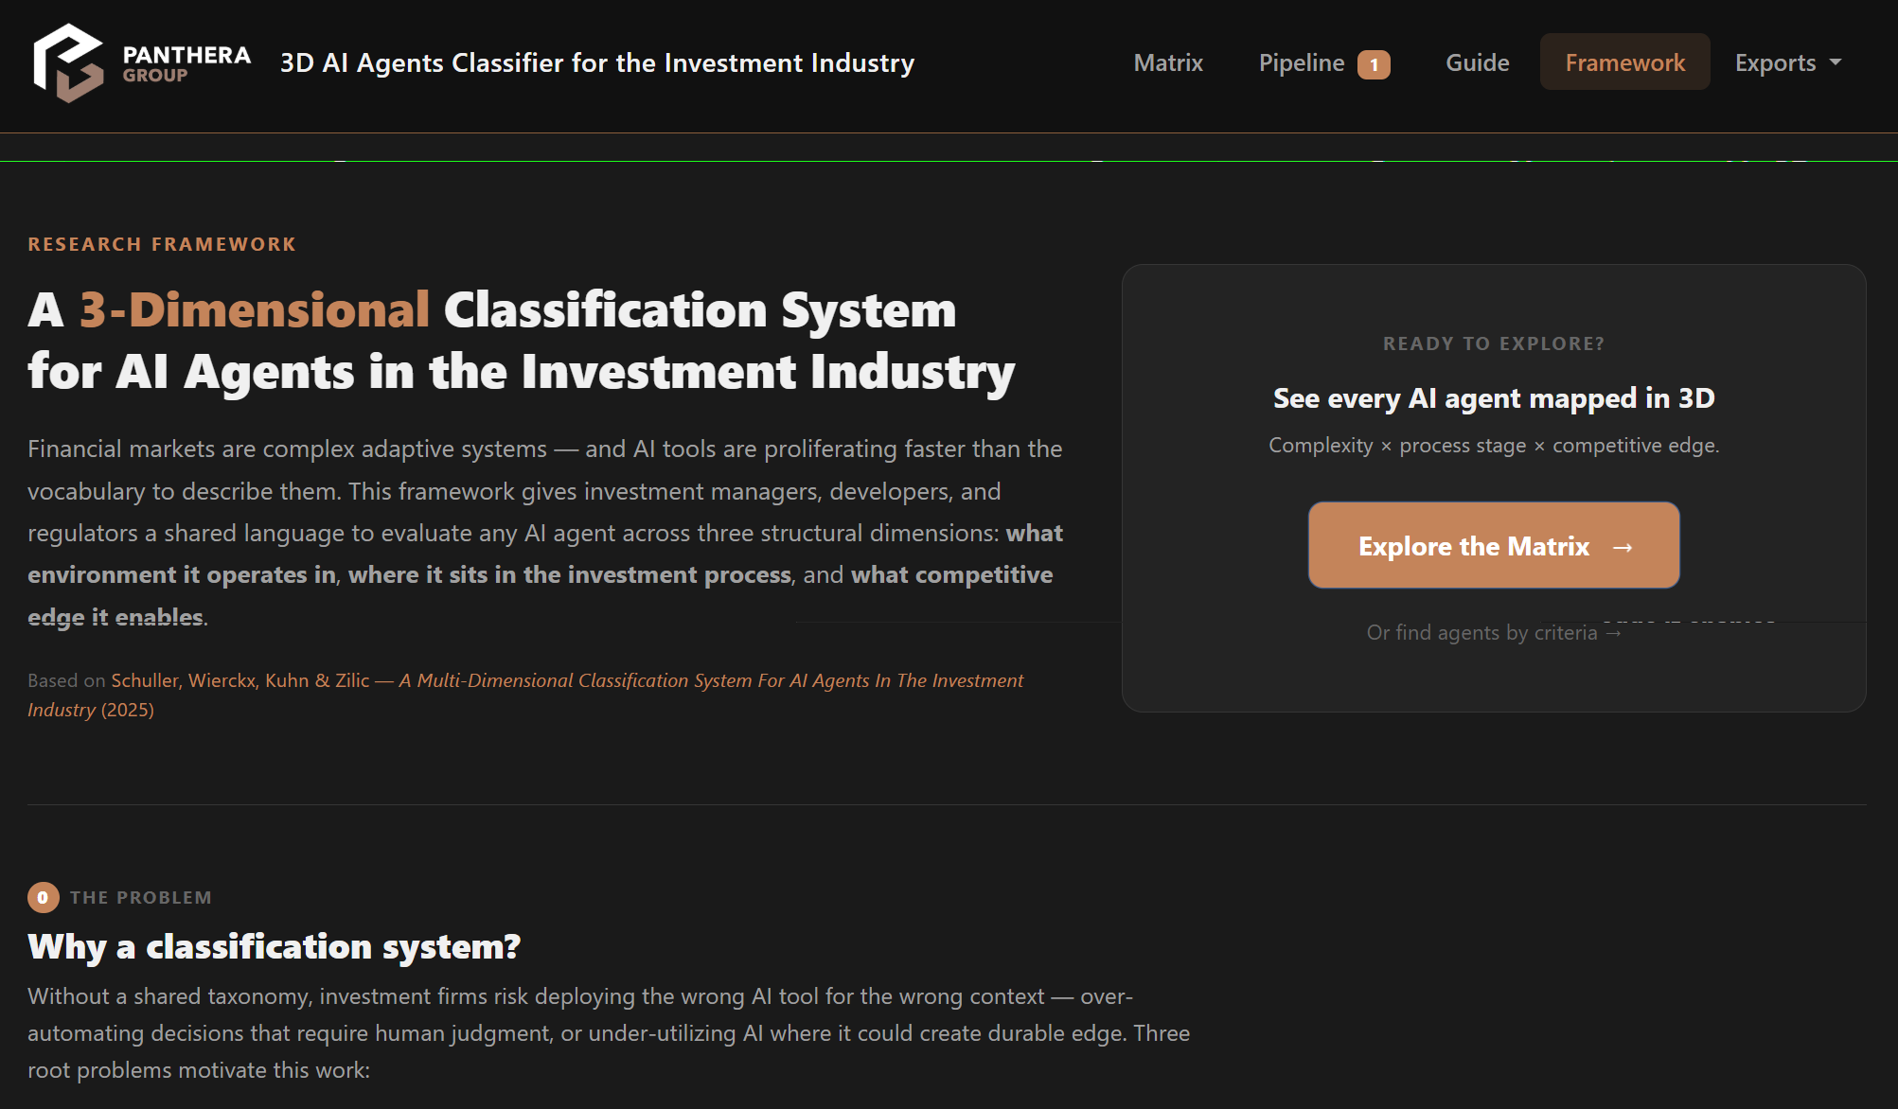
THE PLATFORM
Four lenses on one catalogue
▸ Matrix. The 3D classification grid — complexity × stage, every agent placed.
▸ Guide / Agent Finder. Reverse lookup — describe a need, get the right tools.
▸ Framework. The living methodology page, citing the source paper.
▸ Exports. One-click Excel, Word and PDF reports for stakeholders.
Stack: Flask · SQLAlchemy · SQLite · Bootstrap 5 · Anthropic Claude API. Self-hostable, no external dependencies at runtime beyond the browser.
PANTHERA · 3D AI Agent Classifier
06 / 15
Notes:
Here's the platform itself. It's a self-hostable Flask web app, and it gives you four lenses onto the same catalogue of agents. The Matrix is the flagship — the complexity-by-stage grid. The Guide, or Agent Finder, runs the framework in reverse: instead of 'what is this tool', you ask 'what do I need' and it filters down. The Framework page keeps the methodology live and cites your paper directly, so the provenance is always one click away. And Exports turn the whole thing into board-ready Excel, Word and PDF. The stack is deliberately boring and robust — Flask, SQLite, Bootstrap, plus the Claude API for the classification step. Nothing exotic to run. Let me show you each lens.

Slide 7
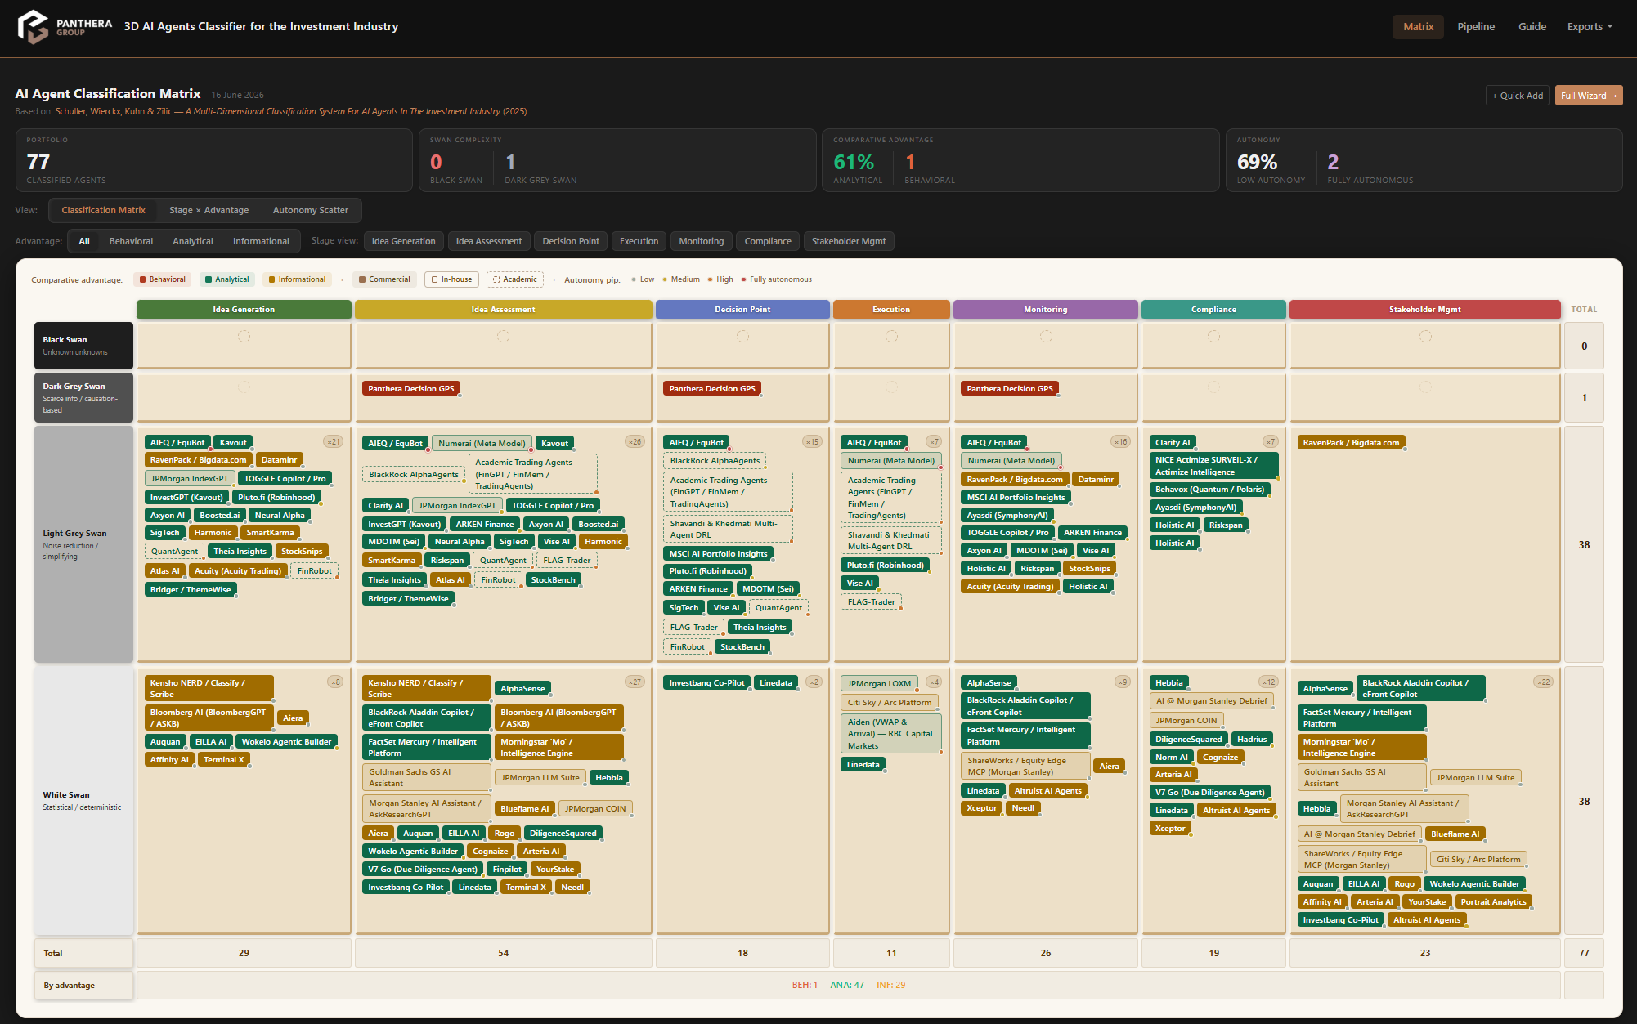
THE PLATFORM · 1
The 3D Matrix — three signals in one badge
EVERY BADGE ENCODES:
Fill colour
Comparative advantage
Border style
Agent type (solid/outline/dashed)
Corner pip
Autonomy level
Rows = Swan complexity. Columns = 7 process stages. One screen reads the whole market at a glance.
PANTHERA · 3D AI Agent Classifier
07 / 15
Notes:
This is the Matrix, and it's the densest part of the whole project, so let me decode it. Rows are the four Swan complexity tiers. Columns are the seven investment-process stages. So position alone tells you 'how hard is this problem, and where in the workflow does this tool act'. But I didn't want to lose the other dimensions, so each agent badge carries three more signals simultaneously: the fill colour is its comparative advantage, the border style is its provenance — solid commercial, outline in-house, dashed academic — and a small pip in the corner encodes autonomy, with a pulsing crimson pip for the fully autonomous systems. That's five dimensions legible in a single chip, and the entire market on one screen. This information-density was a deliberate choice and I'll own it in the reflections — it's powerful but it has a learning curve.

Slide 8
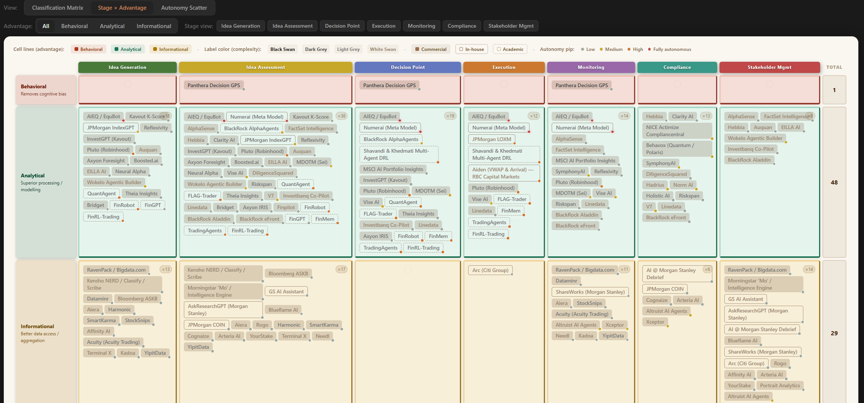
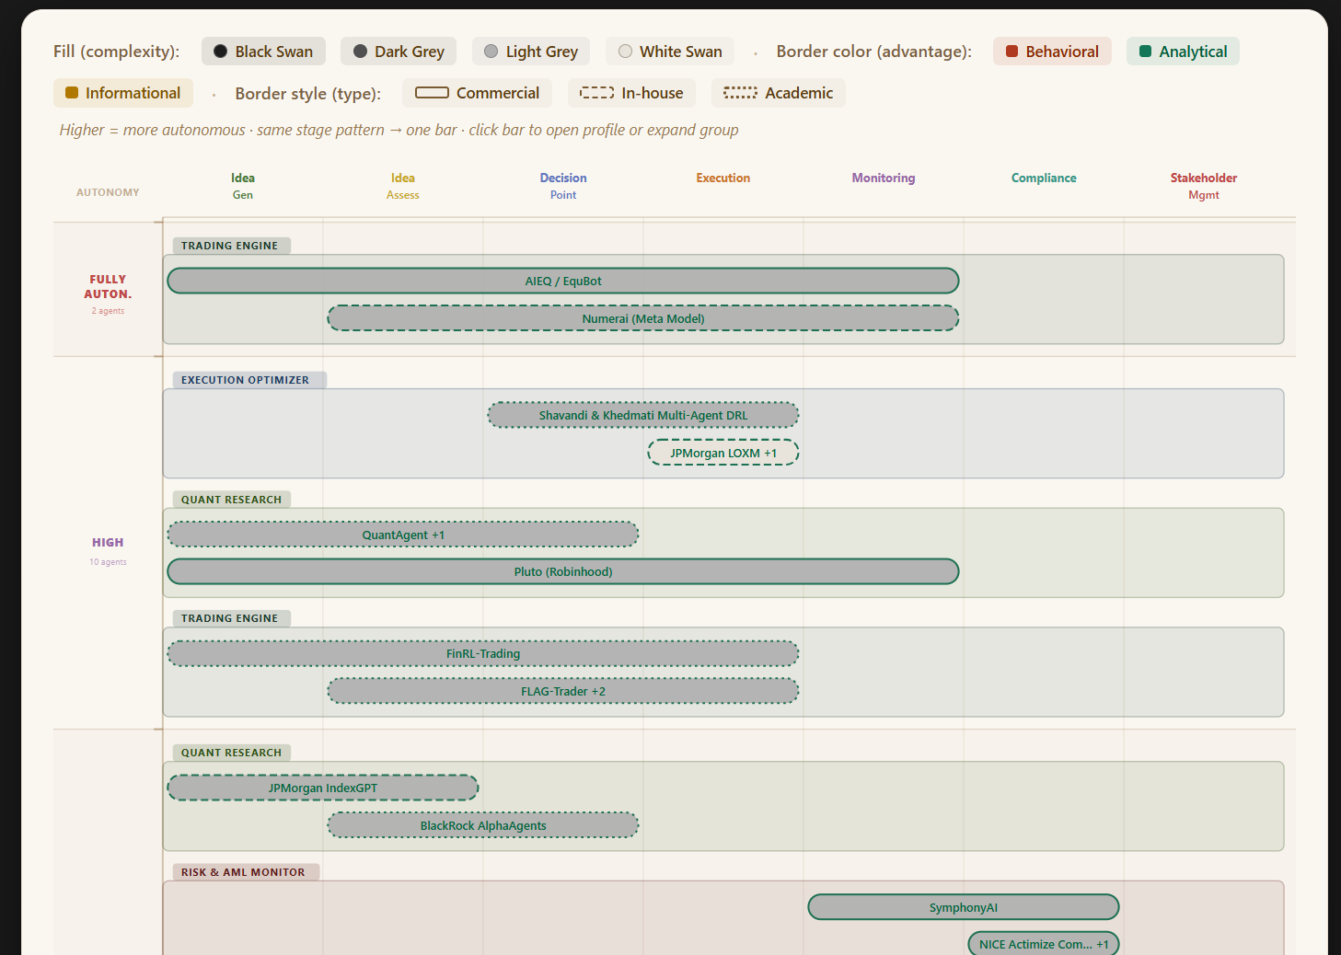
THE PLATFORM · 2
Re-pivot the same data: advantage & autonomy
Advantage view
Stage × advantage — which kind of edge dominates each phase of the process.
Autonomy scatter
Agents ranked by how much human veto they surrender — fully autonomous systems isolated at the top.
PANTHERA · 3D AI Agent Classifier
08 / 15
Notes:
A single arrangement can hide as much as it shows, so the same catalogue re-pivots. On the left, the advantage view holds the stages as columns but swaps the rows to the three edge types, so you can read which kind of advantage dominates each phase — for instance, informational tools concentrating at idea generation. On the right, the autonomy scatter ranks every agent by how much human veto it gives up, and deliberately isolates the fully-autonomous systems — the AIEQs and Numerais of the world — in their own band at the top, because those are the ones a regulator or a CIO needs to find first. Same data, three questions answered. This is the framework being genuinely multi-dimensional rather than a single fixed chart.

Slide 9
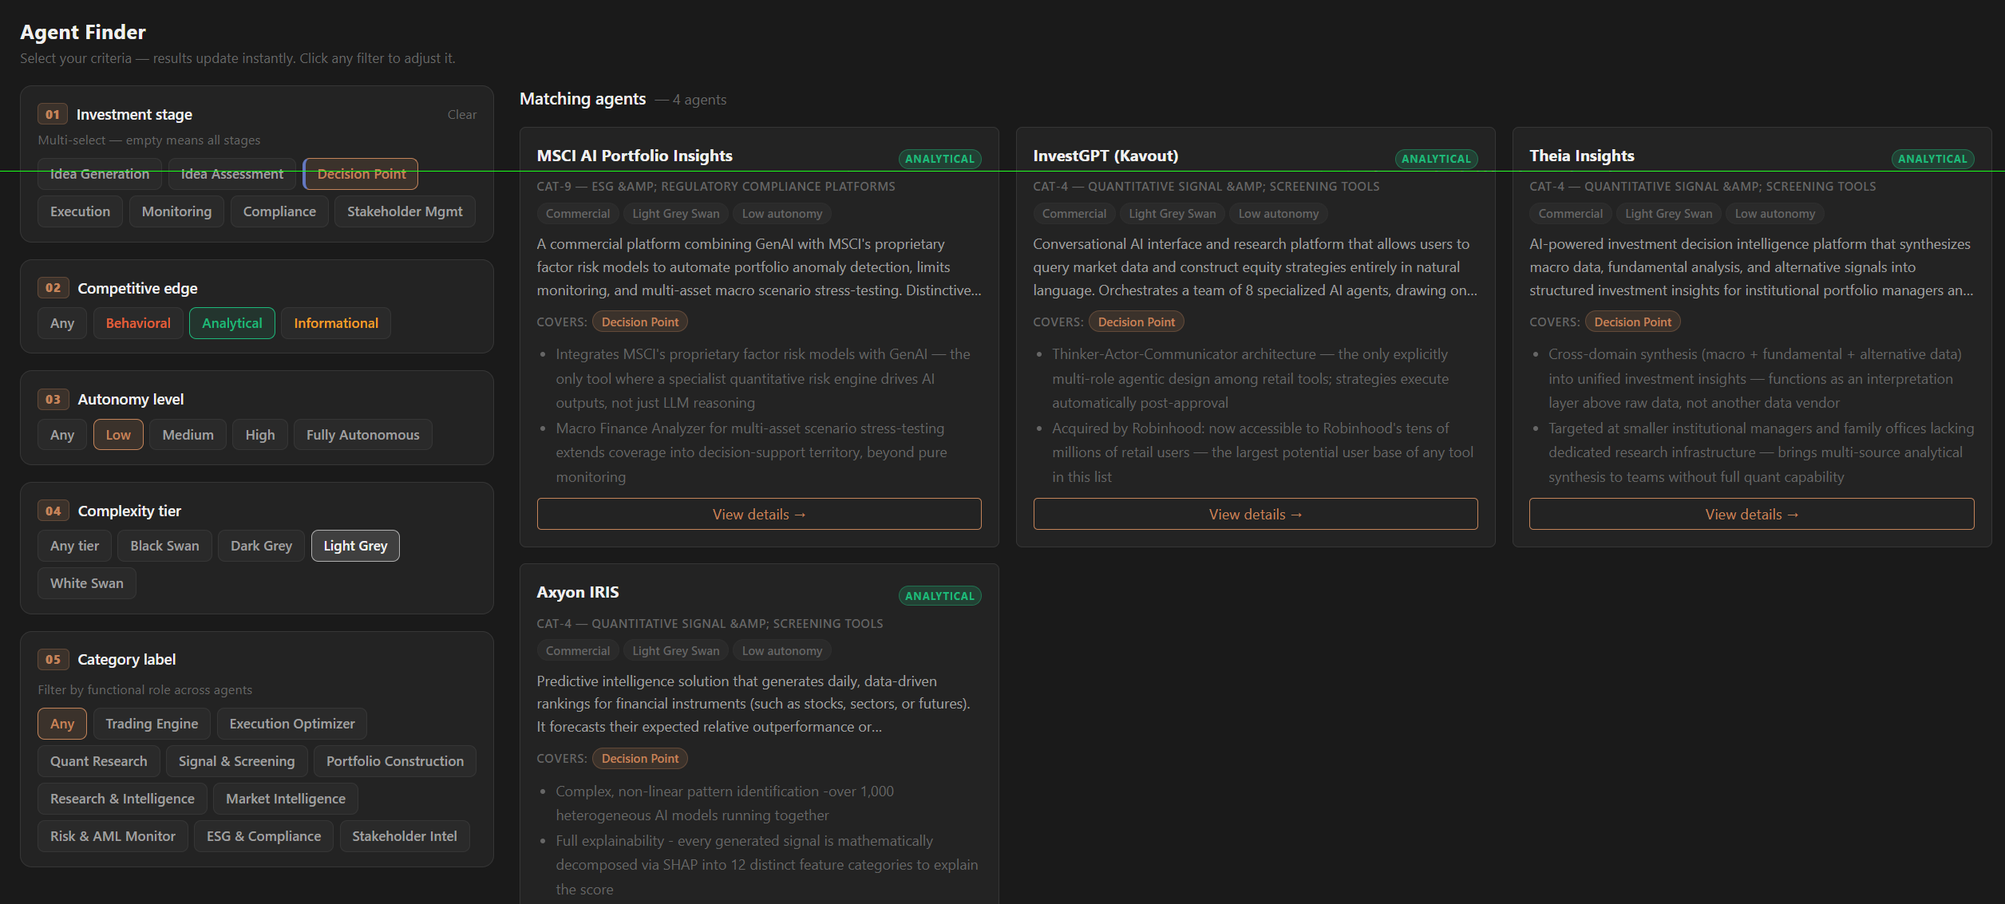
THE PLATFORM · 3
Agent Finder — the framework, run backwards
▸ From description to shortlist. Pick a stage, an edge, an autonomy ceiling and a complexity tier — get a filtered, ranked shortlist instantly.
▸ Decision support, not a catalogue. This is where the benchmark earns its keep: it answers "what should we use here?"
▸ Governance-aware. Cap autonomy or require a compliance-stage fit before a tool even appears.
My reasoning: classification is only half the value. The other half is retrieval — turning the map into a recommendation a manager can act on.
PANTHERA · 3D AI Agent Classifier
09 / 15
Notes:
The Matrix answers 'what is this tool'. The Finder answers the question a working manager actually asks: 'I have this need — what should I use?' You select the stage you're in, the kind of edge you want, an autonomy ceiling, a complexity tier, and it returns a ranked shortlist immediately. Crucially it's governance-aware: you can cap autonomy, or require that a tool fits the compliance stage, before it's even eligible to appear. My reasoning here was simple — classification is only half the value. A taxonomy that just sits there is an encyclopedia. The retrieval step is what turns the map into a decision a manager can defend. That's the difference between a catalogue and decision support.

Slide 10
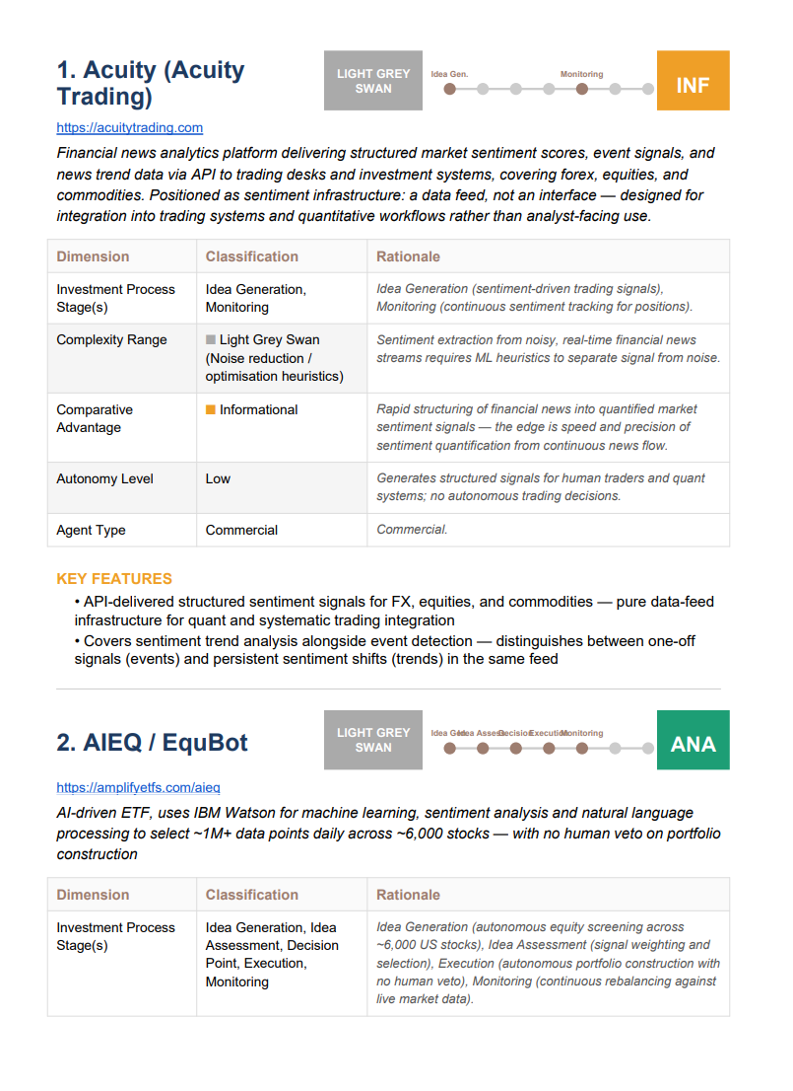
THE PLATFORM · 4
From screen to stakeholder in one click
The framework's stakeholder-management stage applied to itself — auditable, shareable artefacts.
Excel (.xlsx)
Three sheets — colour-coded matrix, tabular detail, summary statistics. Frozen panes, hyperlinks.
Word (.docx)
Cover, table of contents, one section per agent: classification table, key features, stage timeline.
PDF (.pdf)
Same structure, ReportLab-rendered with internal links — the board-ready handout.
PANTHERA · 3D AI Agent Classifier
10 / 15
Notes:
Last lens: reporting. A live web app is great for exploration, but a CIO or a regulator wants an artefact they can file and audit. So with one click the catalogue exports to Excel, Word or PDF. The Excel has the colour-coded matrix, the full tabular detail, and a statistics sheet. The Word and PDF are proper documents — cover, contents, a section per agent with its classification table and rationale. There's a small conceptual joke I like here: this is the framework's own stakeholder-management stage, applied to the framework. Only fully-classified agents are ever exported, so the reports stay clean. This is what makes the tool usable by the regulator audience the paper keeps pointing to.

Slide 11
RESULTS · WHAT THE BENCHMARK REVEALS
A map of where AI actually lives in investing
78
agents classified
~99%
White / Light-grey swan
63%
Compete on analytical edge
69%
Low autonomy (copilots)
▸ AI hugs the knowable. 39 white + 40 light-grey, but only 1 dark-grey and 0 black. AI concentrates exactly where a distribution exists.
▸ Behavioral edge is a desert. 49 analytical, 30 informational — and just 1 behavioral. The most durable edge is the least automated.
▸ Copilots, not autopilots. 54 low + 14 medium autonomy; only 2 fully autonomous. The market keeps humans in the loop.
▸ The funnel is front-loaded. Idea-assessment (56) and idea-generation (31) dominate; execution (13) trails.
MY INTERPRETATION
The data confirms the paper's thesis empirically: AI's impact is greatest where standardization is high and the distribution is knowable — and thins out toward genuine uncertainty.
The white space is the behavioral / black-swan corner. That is precisely where a human edge — and Panthera's Augmented-Intelligence thesis — still matters most.
PANTHERA · 3D AI Agent Classifier
11 / 15
Notes:
Now the payoff — what 78 classified agents actually tell us about the market. Four findings. First, AI hugs the knowable: 39 white-swan and 40 light-grey agents, but only one dark-grey and zero black. Tools cluster exactly where a probability distribution exists. Second, behavioral edge is a desert — 49 analytical, 30 informational, and a single behavioral agent. Your paper argues the behavioral advantage is the most durable; the market shows it's also the least automated. Third, copilots not autopilots — nearly 70% are low-autonomy; only two are fully autonomous. Fourth, the activity is front-loaded into idea assessment and generation, with execution trailing. And the interpretation on the right is the one I most want to leave you with: this is empirical confirmation of your central claim. AI's impact concentrates where standardization is high and the distribution is knowable, and it thins toward real uncertainty. Which means the white space — the behavioral, black-swan corner — is exactly where the human edge, and Panthera's augmented-intelligence thesis, still matters most. The benchmark didn't just catalogue the market; it located the frontier.

Slide 12
REFLECTIONS · THE CHOICES I MADE
Where I extended the framework — and why
I added a 4th autonomy tier: 'Full'
One advantage per agent — enforced
The paper implies low→high. I split off systems with zero human veto on live capital (AIEQ, Numerai). Governance treats 'acts within my limits' and 'sets its own limits' very differently.
I refused to let a tool be 'a bit of everything'. Forcing the single primary edge is what makes the benchmark comparable and the analyst think.
Five dimensions in one badge
AI-drafted, human-ratified
A density bet: colour, border and pip on every chip. It rewards a trained eye and pays off on the market-wide view — at the cost of a learning curve.
Using Claude to scale classification, but never to finalize it. The framework's authority stays human; the model only does the legwork.
PANTHERA · 3D AI Agent Classifier
12 / 15
Notes:
I want to be explicit about where I made judgment calls, because these are mine to defend. Four of them. One — I added a fourth autonomy tier, 'Full'. Your text implies a low-to-high range; I split off a top tier for systems with no human veto on live capital, like AIEQ and Numerai. My reasoning: from a governance and regulatory standpoint, 'acts within limits I set' and 'sets its own limits' are categorically different animals, and collapsing them loses the thing a regulator cares about most. Two — I enforce exactly one comparative advantage per agent. It would've been easier to let tools be a bit of everything, but that destroys comparability and lets the analyst off the hook. Forcing the primary edge is a feature. Three — the five-signals-in-one-badge density. That's a genuine bet, and I'll concede the cost: a learning curve. But on a market-wide view it's what lets you see structure instead of scrolling. Four — AI drafts, human ratifies. I used the model for reach, never for the final word. The framework's authority stays human. You may disagree with any of these, and I'd genuinely like to hear it.

Slide 13
LIMITATIONS · AN HONEST METHOD CRITIQUE
What this method does not yet prove
! Classifier subjectivity
! Single-source drafting
! Self-reported, unvalidated
The complexity tier especially is a judgment call. Two analysts could disagree — there is no inter-rater reliability score yet.
AI-assisted classification inherits the model's knowledge cutoff and blind spots; sparse-doc agents risk under-classification.
Classifications reflect vendor and paper claims, not audited behaviour. No agent was independently benchmarked on live performance.
! A snapshot, not a film
! Thin tails
! Forced single advantage
78 agents at one moment. The market moves weekly; autonomy and capability drift. There is no longitudinal dimension yet.
Only 1 behavioral and ~0 black-swan agents — too few to generalize about the most important corner of the map.
The very choice that aids comparability also flattens genuinely hybrid tools. Comparability bought with nuance.
Stance: none of these invalidate the instrument — they scope it. It is a structured, transparent first map, explicitly built to be challenged and refined. That is the validation work your paper calls for.
PANTHERA · 3D AI Agent Classifier
13 / 15
Notes:
I'd rather name the weaknesses than have you find them. Six. The classifier is subjective — the complexity tier especially is a judgment call, and I don't yet have an inter-rater reliability score. The drafting leans on a single model, so it inherits that model's cutoff and blind spots, and thinly-documented agents can get under-classified. The classifications are self-reported — they reflect what vendors and papers claim, not audited live behaviour; I benchmarked no agent on real performance. It's a snapshot, not a film — 78 agents frozen at one moment in a market that moves weekly. The tails are thin — one behavioral agent, basically no black-swan ones, which is too few to generalize about the very corner that matters most. And the forced single advantage that buys comparability also flattens hybrid tools. My stance is on the bottom line: none of this invalidates the instrument, it scopes it. This is a transparent first map, built to be argued with — which is exactly the empirical-validation agenda your Discussion section sets out. I see these as the roadmap, not the verdict.

Slide 14
CONCLUSIONS & NEXT STEPS
From a paper to a platform — and onward
What stands today
✓ Your framework is executable, not just descriptive.
✓ A 78-agent benchmark with four queryable lenses.
✓ An empirical market map that confirms the paper's core thesis.
✓ Board-ready reporting for managers, developers, regulators.
WHERE IT GOES NEXT
→ Validate. inter-rater scoring + vendor confirmation of classifications.
→ Track over time. snapshots → a longitudinal view of market drift.
→ Deepen the tails. targeted hunt for behavioral & black-swan agents.
→ Tie to outcomes. link classification to realized portfolio performance.
→ Generalize. extend the framework beyond investment management.
PANTHERA · 3D AI Agent Classifier
14 / 15
Notes:
To draw it together. What stands today, on the left: your framework is now executable rather than just descriptive; there's a 78-agent benchmark with four lenses; an empirical market map that independently confirms your central thesis; and reporting that reaches all three of your audiences. Where it goes next, on the right, maps almost one-to-one onto your own future-research section: validate it with inter-rater scoring and vendor confirmation; turn snapshots into a longitudinal study of how the market drifts; deliberately go hunting in the thin tails — the behavioral and black-swan agents; connect classification to realized portfolio outcomes; and finally test whether the framework generalizes beyond investment management. The throughline of my internship was simple: take a strong idea on paper and prove it can live as a working instrument. I think it can.

Slide 15
Thank you.
I'd value your critique of the classifications — you wrote the framework I built on.
· Discussion — where would you challenge a classification?
· Which agents are missing from the benchmark?
· Is the 'Full' autonomy tier a distinction worth keeping?
PANTHERA · 3D AI Agent Classifier
15 / 15
Notes:
Thank you. Genuinely — you wrote the framework, and getting to build on it has been the most engaging part of the internship. I'd love this to be a discussion rather than just a presentation, so three openers: Where would you challenge a specific classification? Which agents am I missing? And is the 'Full' autonomy tier a distinction you'd keep, or did I over-engineer it? Over to you.

