Slide 1

Empowering Women: Education and Labor Participation DATA
CJ

Slide 2
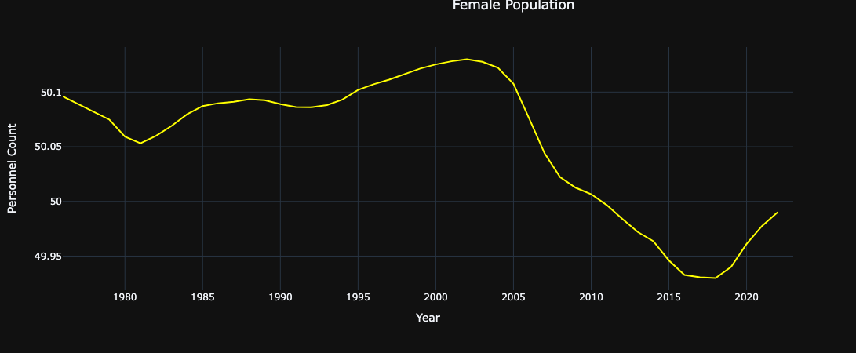
Female population

Slide 3
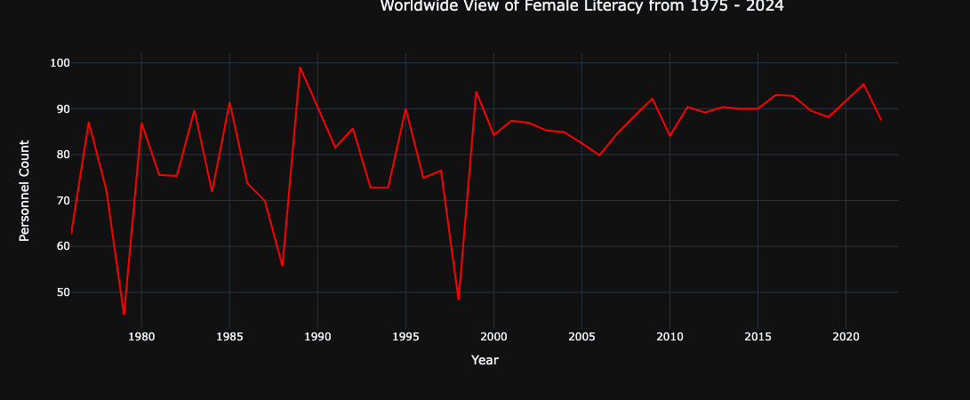
Worldwide view of female literacy from 1974 - 2024

Slide 4
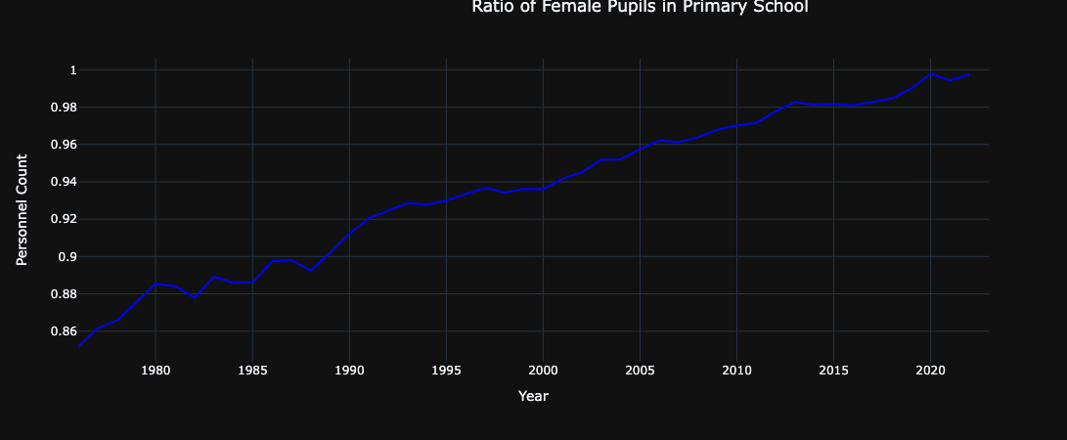
PUPILS IN PRIMARY SCHOOL

Slide 5
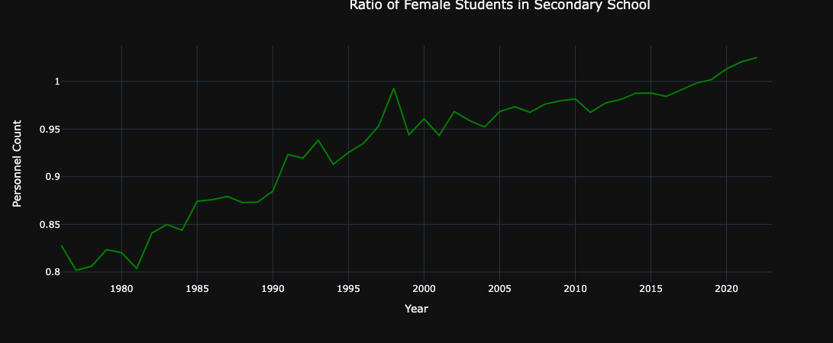
PUPILS IN SECONDARY SCHOOL

Slide 6
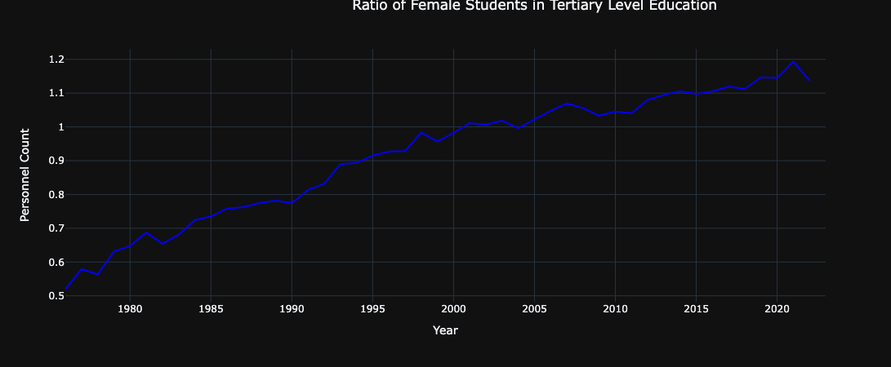
PUPILS IN TERTIARY LEVEL EDUCATION

Slide 7
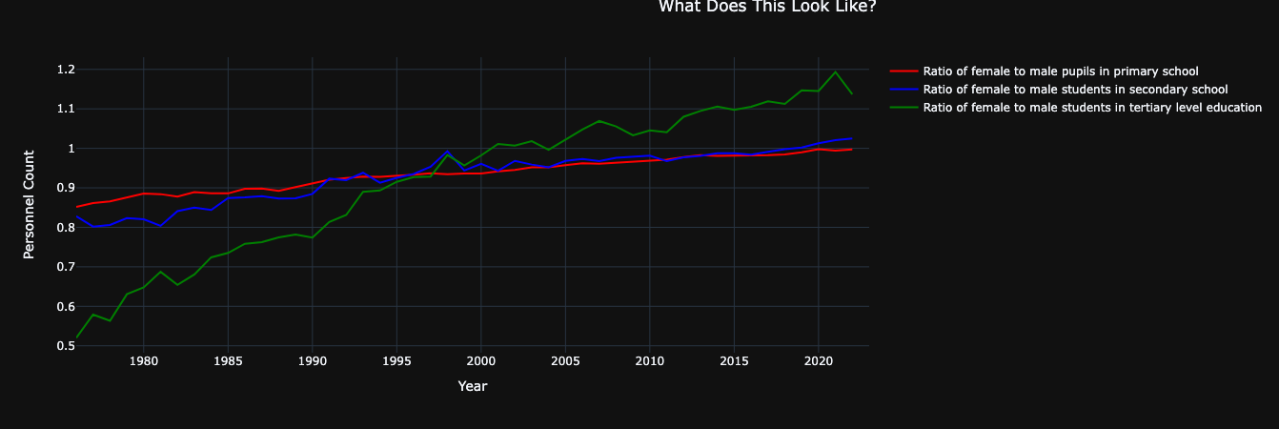
Ratio of female to male pupils in school

Slide 8
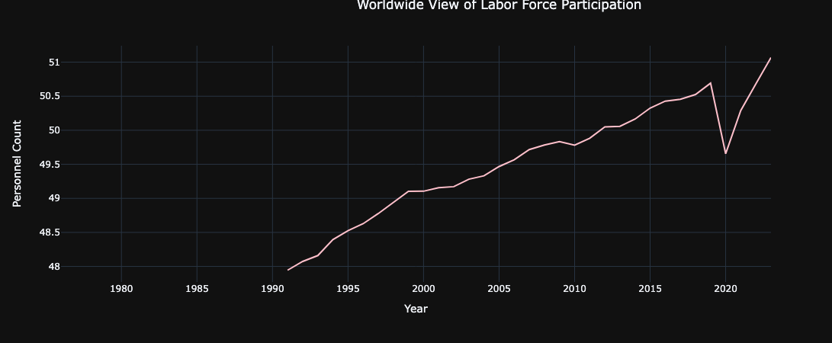
LABOR FORCE PARTICIPATION

Slide 9
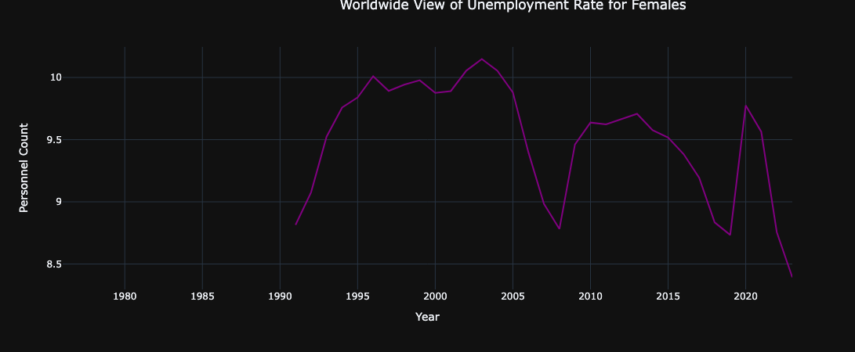
UNEMPLOYMENT RATE

Slide 10
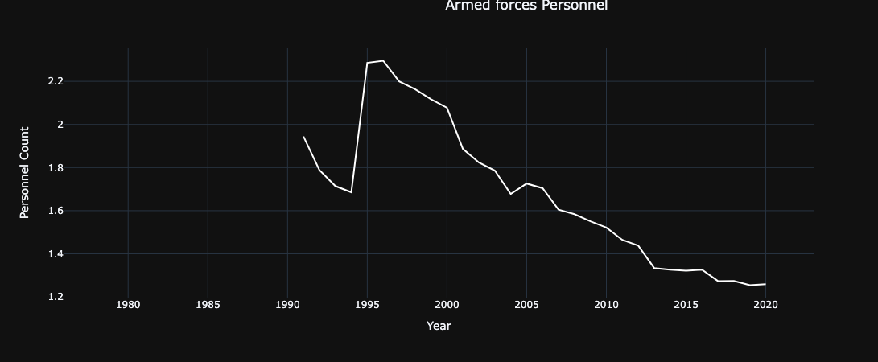
ARMED FORCES

Slide 11
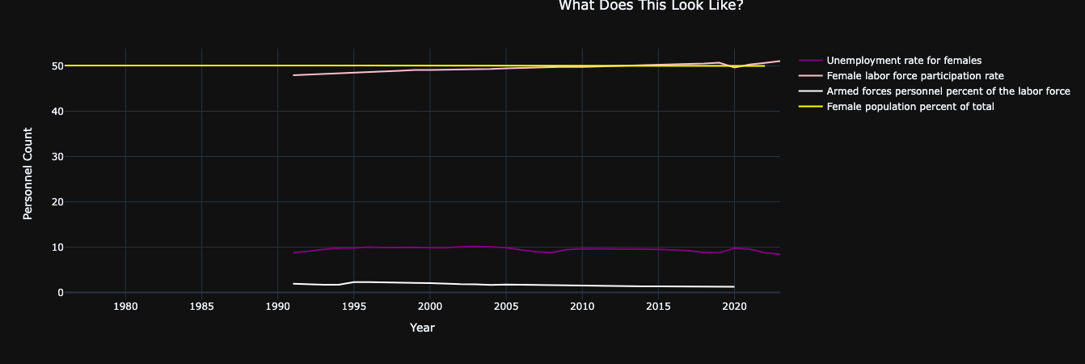
THE RESULTS ARE IN!

