Slide 1

Empowering Women: Education and Labor Participation DATA
CJ

Slide 2
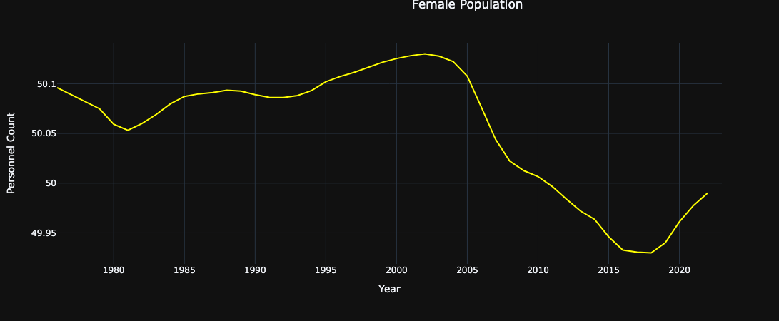
Female population
Notes:
The spike that we see in the 2000s is due to fertility rate fluctuations. This view is worldwide and some countries experienced a decrease in birth rates.

Slide 3
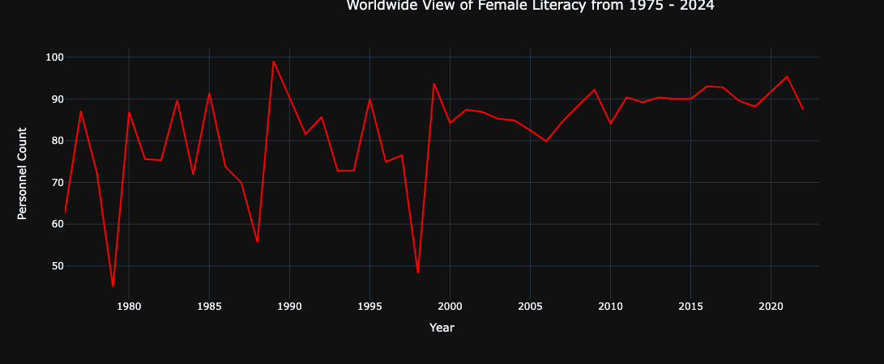
Worldwide view of female literacy from 1974 - 2024
Notes:
By the 1980s, female literacy rates were on the rise worldwide. This progress likely stemmed from a global push for education and initiatives specifically aimed at girls' schooling. Despite this improvement, a significant gap between male and female literacy rates still existed on a global scale.
Though uncommon today, in the late 1990s, females were generally less literate than males globally. Social norms often prioritized boys' education, and girls might lack access to schools or be pulled out early for marriage or childcare. Poverty and cultural attitudes also played a role in this historical gap.

Slide 4
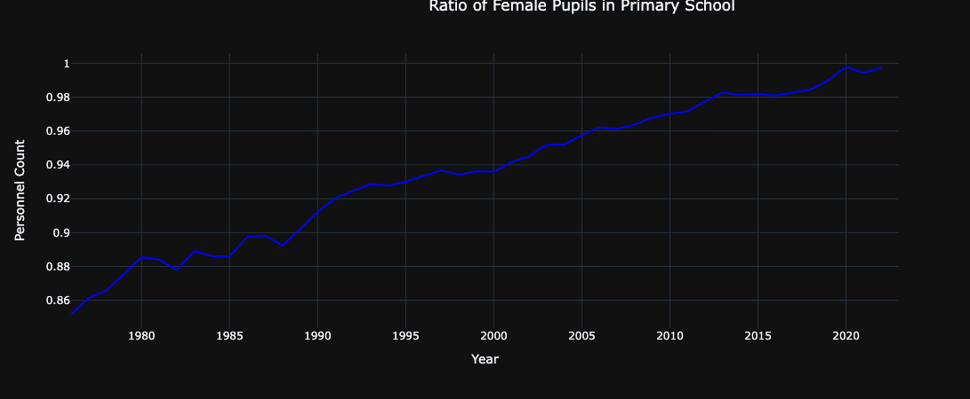
FEMALES IN PRIMARY SCHOOL
Notes:
Huge incline of female pupils in elementary or primary schools since 1975.

Slide 5
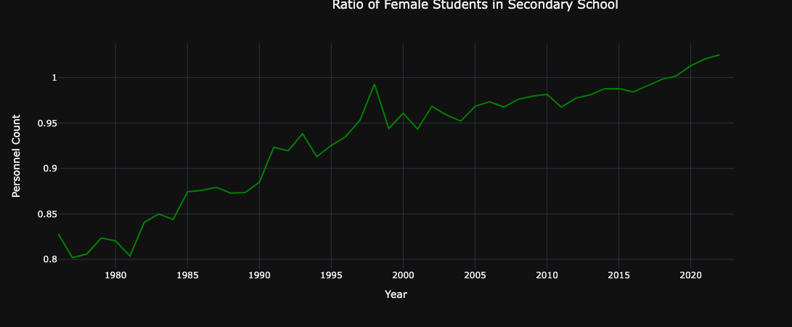
PUPILS IN SECONDARY SCHOOL
Notes:
The late 1990s likely continued a trend of rising female enrollment in secondary school, not necessarily a sudden spike.This resulted from a global focus on education, including girls' education, along with changing social norms and economic factors that made education more valuable for girls.

Slide 6
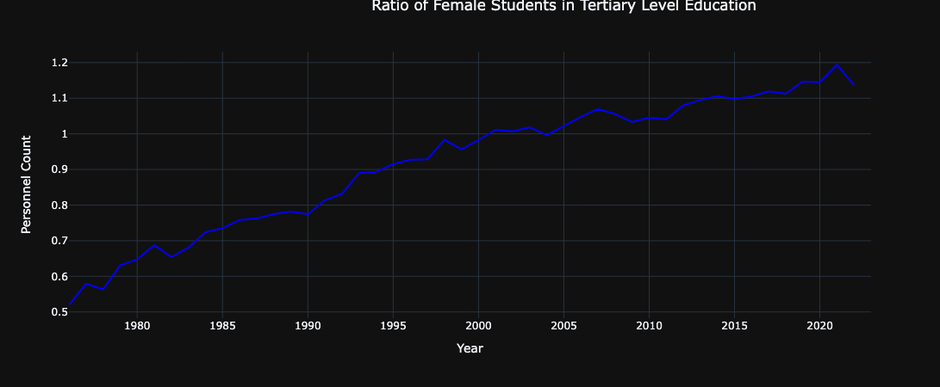
PUPILS IN TERTIARY LEVEL EDUCATION
Notes:
Huge incline of female pupils in elementary or primary schools since 1975.

Slide 7
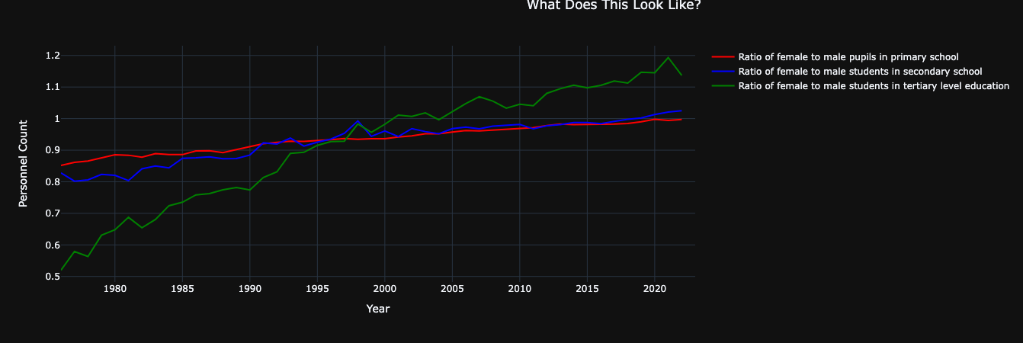
Ratio of female to male pupils in school

Slide 8
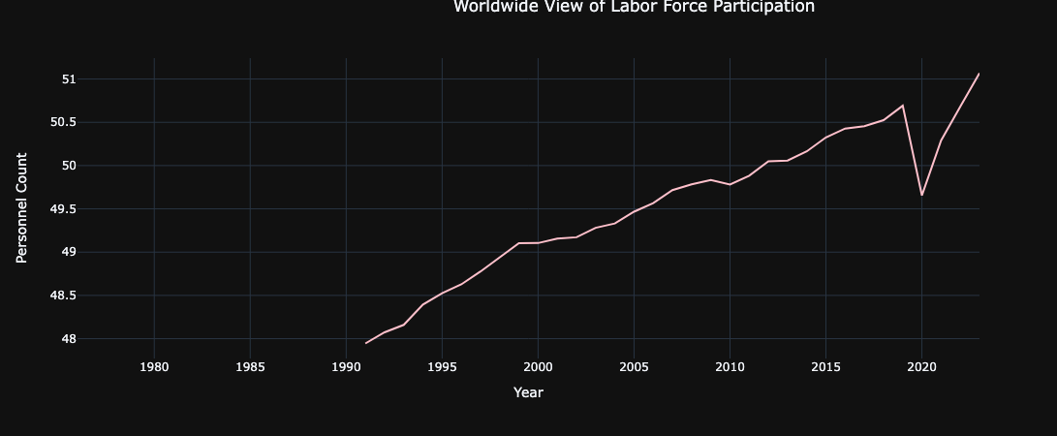
LABOR FORCE PARTICIPATION
Notes:
The COVID-19 pandemic caused a decline in female labor force participation in 2020. School closures, job losses in female-dominated industries, and increased caregiving needs pushed many women out of the workforce or into reduced hours.
Add males chart

Slide 9
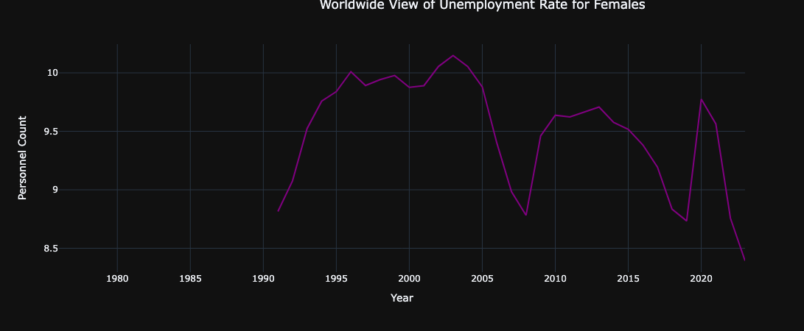
UNEMPLOYMENT RATE
Notes:
Decreases in unemployment
The Great Recession, which began in late 2007, significantly impacted the job market and led to rising unemployment rates across the board. In 2008, women begun acquiring jobs.
The strong job market in 2018 led to a decrease in the female unemployment rate. This resulted from a combination of factors including a tight labor market, growth in female-dominated industries, and more women re-entering the workforce.

Slide 10
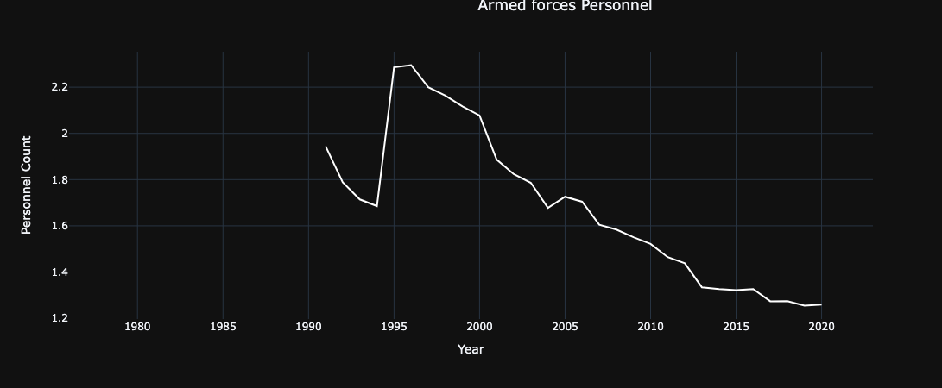
ARMED FORCES
Notes:
The late 1990s did see a rise in female enlistment. This can be attributed to policy changes allowing women to fly combat missions, serve on warships, and hold positions closer to combat zones. These advancements, along with broader social changes, made the military a more viable career path for women.
What other countries followed suit?

Slide 11
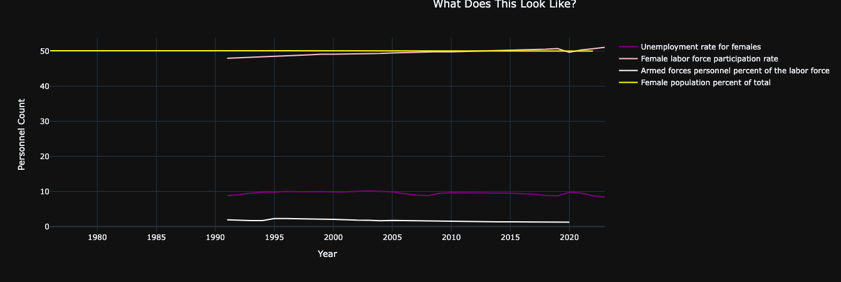
THE RESULTS ARE IN!
Notes:
In the grand scheme women are about 50% of the population and consistently adding to the labor force across the glob. 10 percent of women are unemployed and about 1.5% are in the Armed Forces.

