Slide 1
Test PPT

Slide 2
Datacenter | Server Room | Hub room | Network Room/Telco Room
Data center is primarily for hosting common server (ex: mail servers, domain controllers etc.,), termination of links like WAN links, Internet links | Server rooms provide LAN termination, host generic servers, project specific servers and in few cases links which need to be extended | Hub room houses LAN switches and cabling only. No servers are hosted in hub rooms | This location is where the service providers terminate their links and host equipment like multiplexers (mux). Preferably this room needs to be separated from the Datacenter. Since it is not practical to implement this in existing datacenters, future datacenters can be planned accordingly
Accessing Devices in these critical areas
All the server racks are closed and locked at all the times
All the server rack keys will be deposited to building security
Rack key authorization will be given to building security on quarterly basis. This will be get it signed from Regional manger-IT
Building Security team will validate the list before giving the server rack key to the personnel
Separate register being maintained for all these critical areas and all these key access been updated. This is with building security

Slide 3
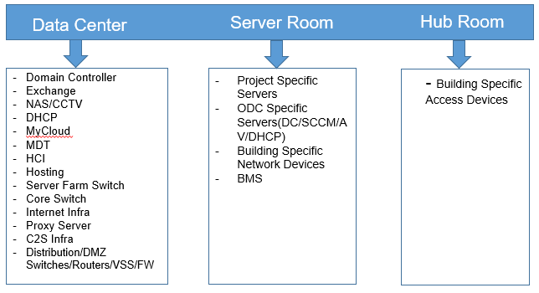
Services Hosted

Slide 4
Datacenter/Server Room Details
Server Rooms
Building No. | Floor | ODC/Generic | Remarks
B4 | First Floor | Generic
B8 | Second Floor | ODC | CS
B19 | Fifth Floor | ODC | BOFA
Hub Rooms
Building No. | Floor | ODC/Generic | Remarks
B3 | First Floor | Generic
B3 | Second Floor | ODC | BOFA
B2 | Second Floor | ODC | BOFA
B7 | First Floor | Generic
B8 | Second Floor | ODC | Apple
B10 | Second Floor | Generic
B12 | Ground Floor | Generic
B14 | Second Floor | Generic
B14 | First Floor | Generic
B14 | Fourth Floor | ODC | Verizon
B15 | Fourth Floor | ODC | Verizon
B18 | First Floor | Generic
Datacenters
Building No. | Floor | ODC/Generic | Remarks
B3 | Basement | Generic
B19 | Third Floor | Generic

Slide 5
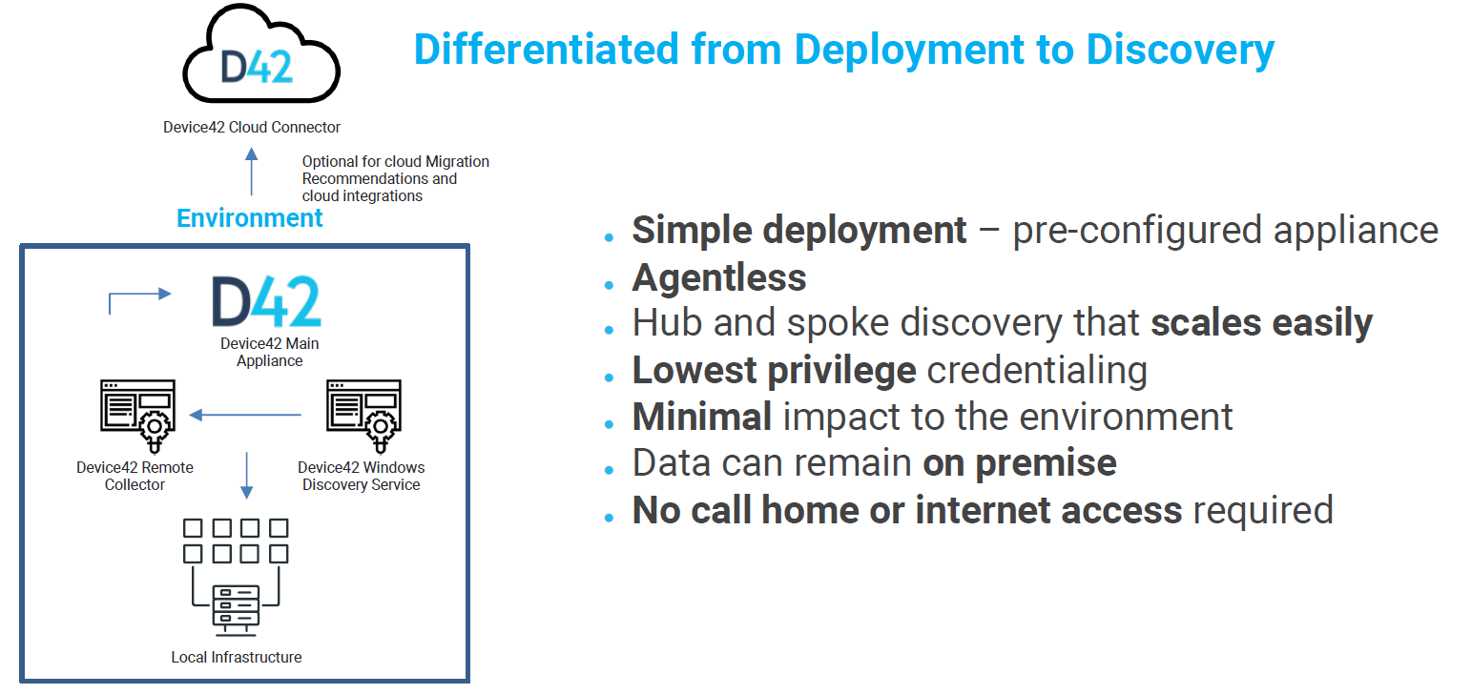

Slide 6
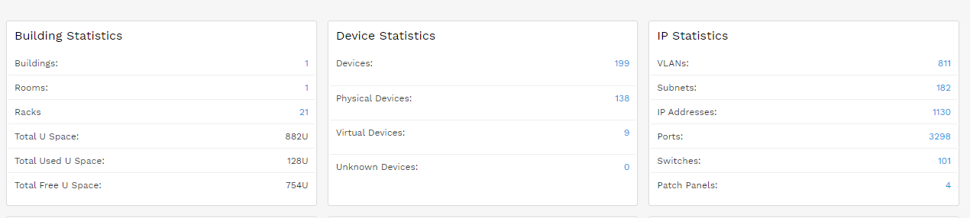
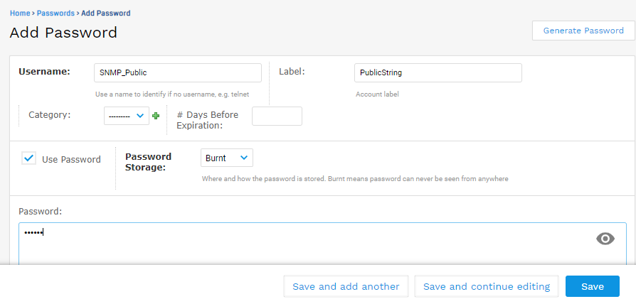

Slide 7
