Slide 1
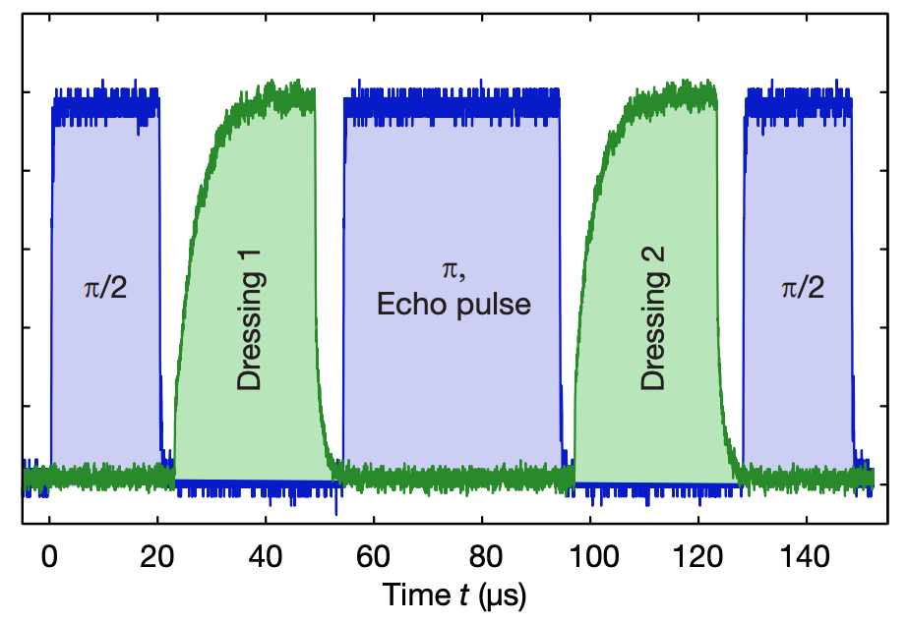
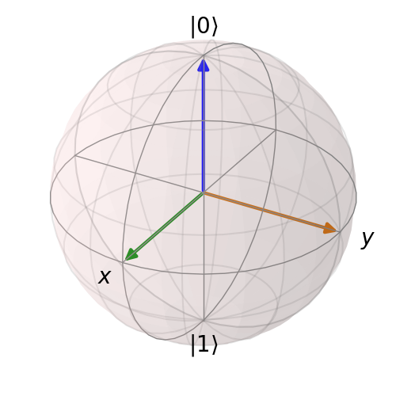


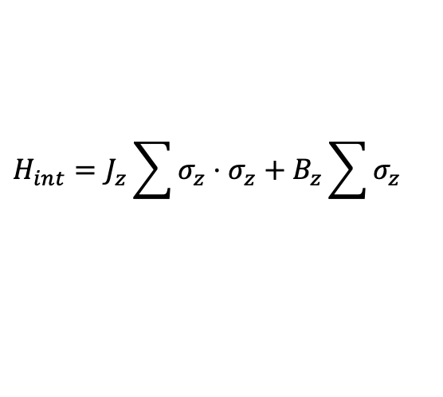

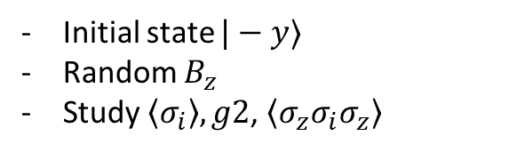
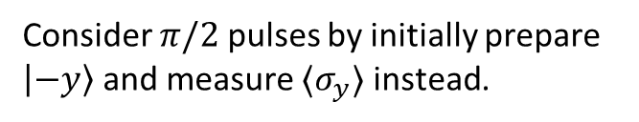

Ramsey/echo
$$H_{int}=J_{z}\sum{σ_{z}⋅σ_{z}+B_{z}\sum{σ_{z}}}$$
fluctuation
Difference of two dressing pulses leads to
global fluctuation but random from shot to shot
$π/2$: rotates around x axis
Only consider inner atoms
to avoid edge effect
$$|−y⟩$$
$$H_{int}$$
$$⟨σ_{y}⟩$$
Consider $π/2$ pulses by initially prepare $\left|−y\right\rangle$ and measure $⟨σ_{y}⟩$ instead.
Initial state $|−y⟩$
Random $B_{z}$
Study $\left\langle σ_{i}\right\rangle , g2$, $\left\langle σ_{z}σ_{i}σ_{z}\right\rangle$

Slide 2
Projection pair
N=4
0
1
2
3
Middle pair
Projection pair
Projection pair
N=6
0
1
2
3
4
5
N=6
0
1
2
3
4
5
Middle pair
Middle pair
Projection pair
N=8
0
1
2
3
4
5
6
7
Middle pair

