Slide 1
PostGenius: Innovating News Synthesis and Distribution
A Generative AI Project Leveraging RAG for Multiformat Content
By Stefano Roy Bisignano & Mirko Di Maggio
TechTwins team

Slide 2
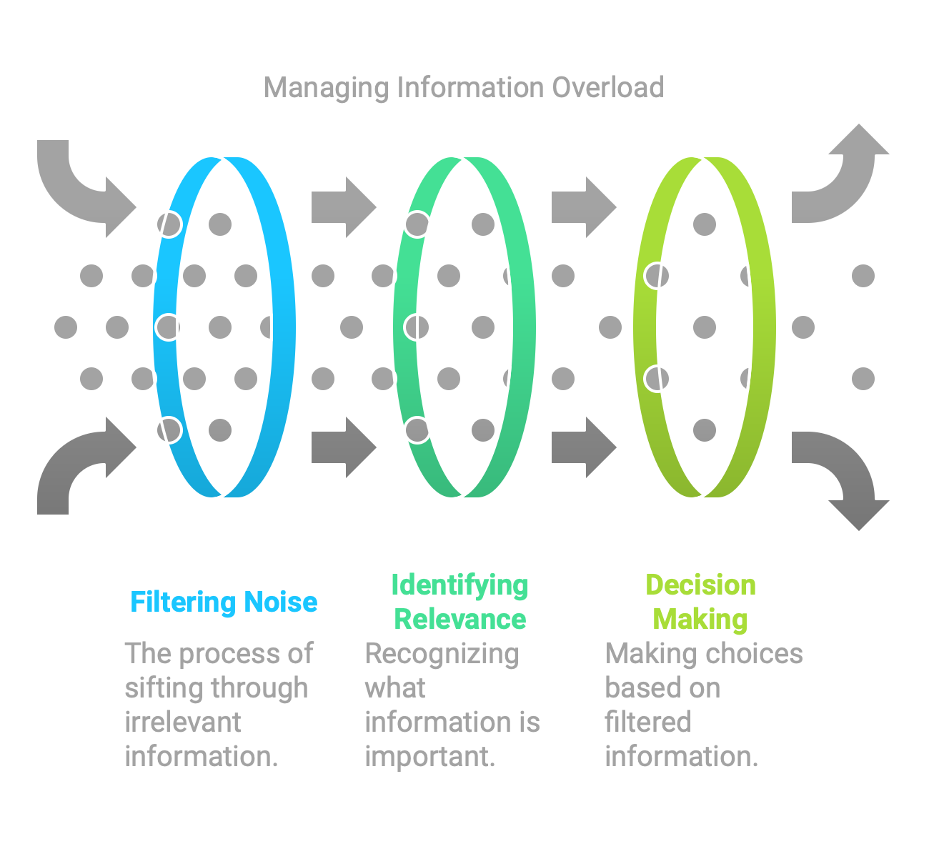
Introduction
The problem:
"Accessing relevant, synthesized news is challenging in the era of information overload."
"Platforms demand content that adapts to various formats and tones."
Significance:
"An automated system saves time and broadens reach."
"Rapid, customizable solutions are essential for content marketing and social distribution."

Slide 3
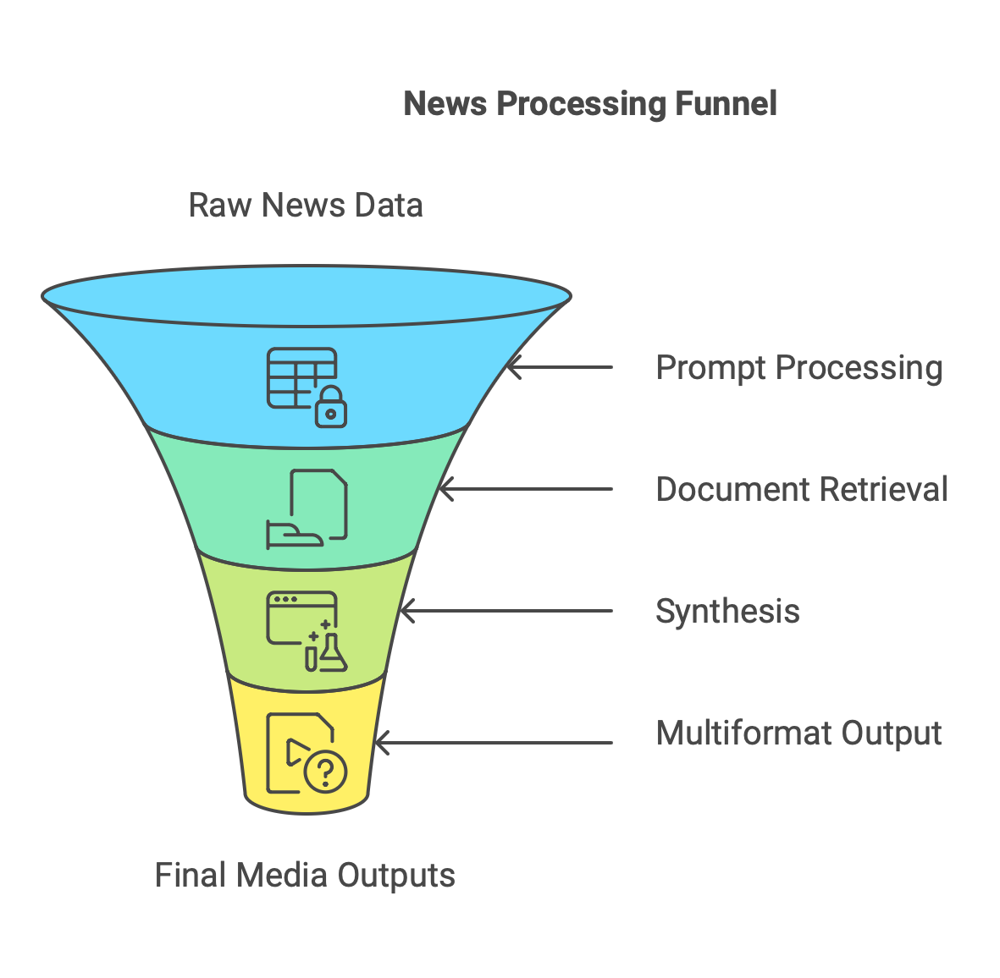
Workflow
Key Steps:
User input (prompt, tone, platform).
Retrieval of relevant documents from external APIs.
Information synthesis with LLM models.
Multiformat generation: text (OpenAI), images (DALL·E), videos (Runway), memes (Imgflip).
Personalized, optimized output.

Slide 4
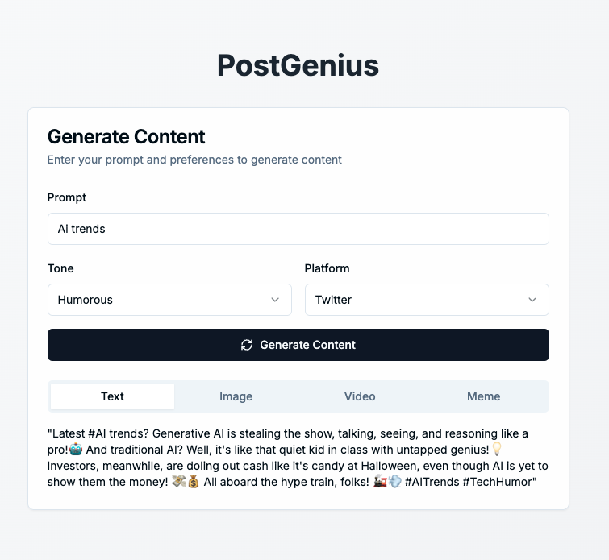
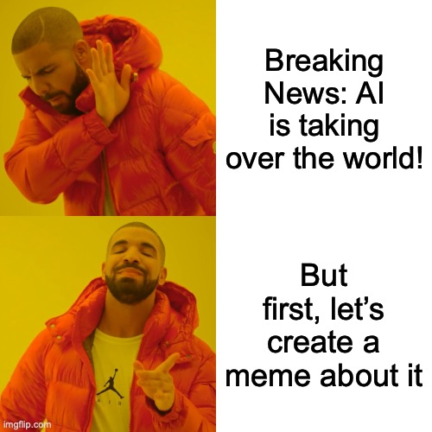
Generated Meme Output

Slide 5
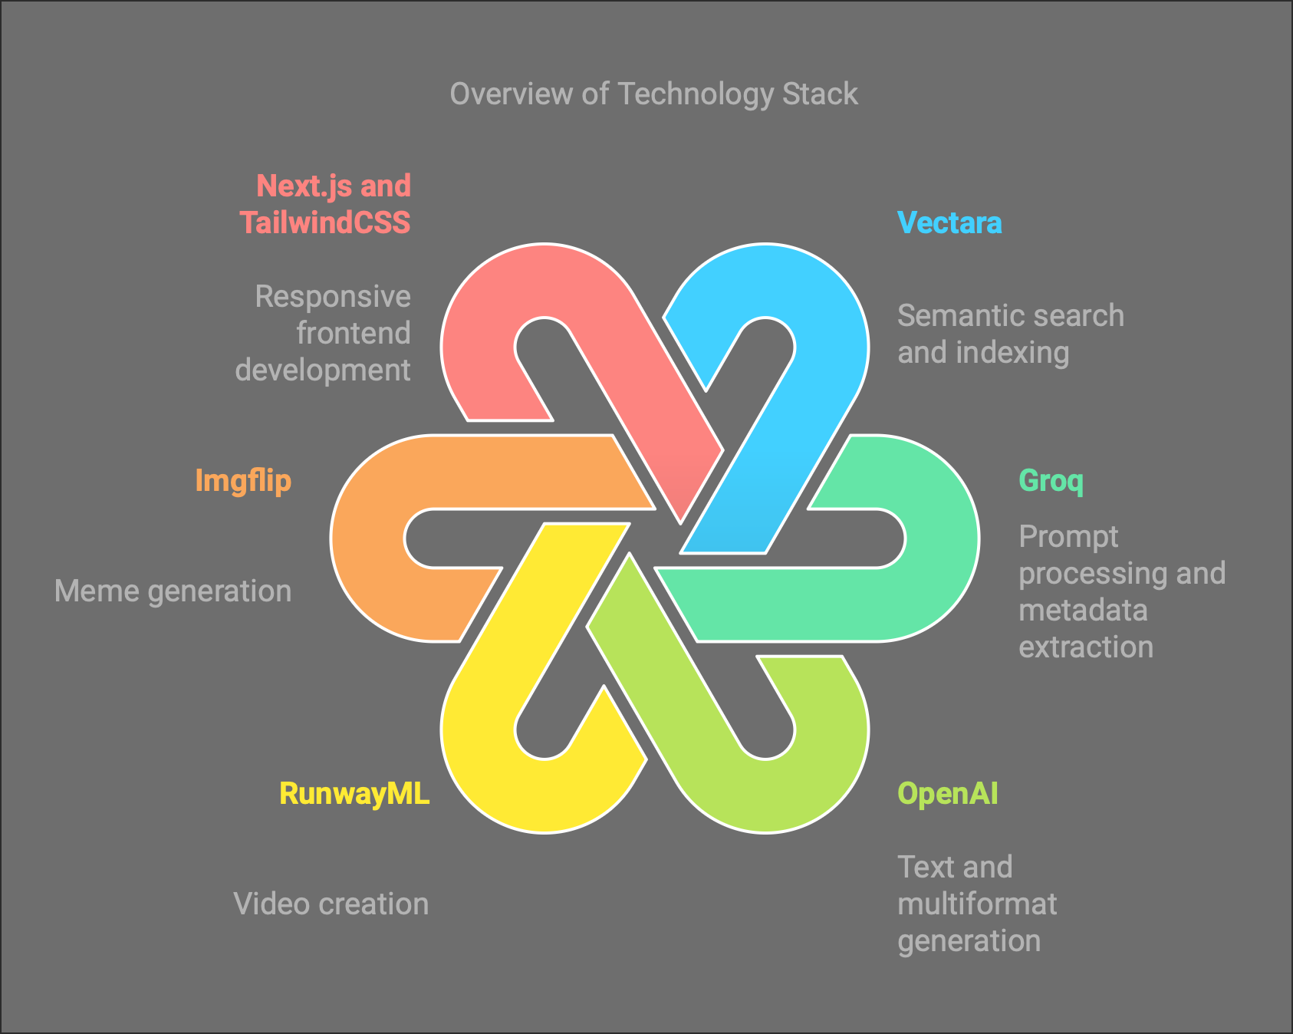
Technology Stack
Vectara: Semantic search and indexing.
Groq: Accelerating prompt processing and metadata extraction.
OpenAI: Text and multiformat generation.
RunwayML: Video creation.
Imgflip: Meme generation.
Next.js and TailwindCSS: Responsive frontend development.

Slide 6
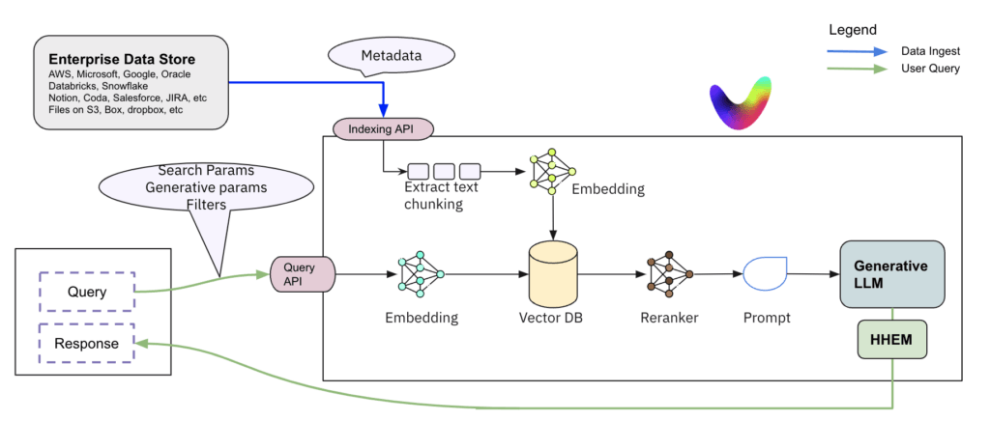
Understanding Vectara's RAG
Vectara's Retrieval-Augmented Generation combines semantic search with AI content generation.
It retrieves contextually relevant documents using Natural Language Understanding (NLU) and uses this information to guide AI in generating accurate, grounded, and personalized content.
This ensures outputs are both creative and factually aligned with the user's input.

Slide 7
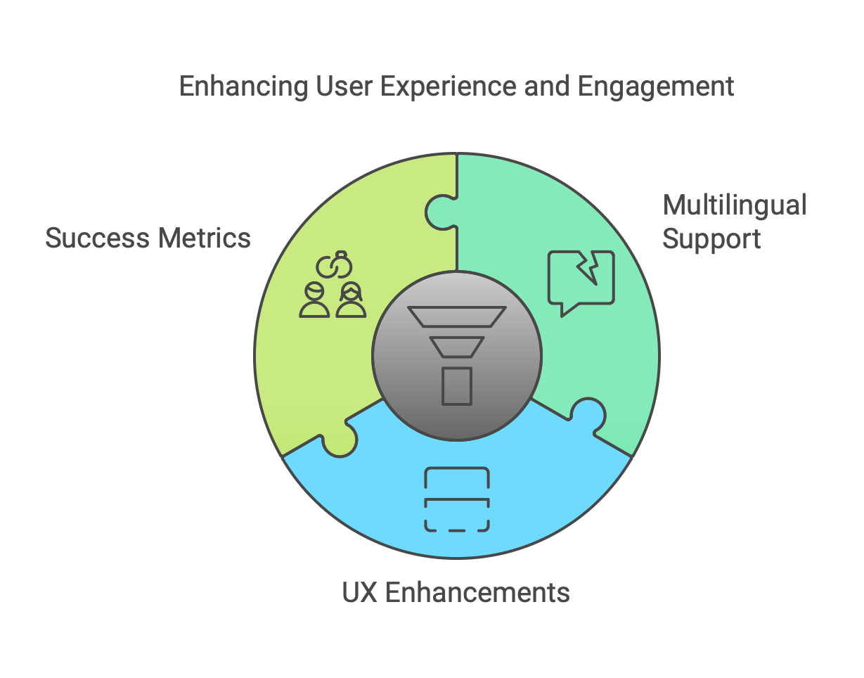
Future Extensions
Integration with more APIs for different news sources.
Multilingual support.
UX enhancements, such as dynamic output previews.
Introduction of success metrics for content (engagement rate).

Slide 8
Conclusion
Summarize the benefits:
"Reduced time to create personalized, multiformat content."
"Optimized news distribution across multiple platforms."
Call to Action:
"Learn more about Daily News Content Generator."
"Contact us for collaboration and custom implementations."

