Slide 1
Plant Care
Scheduler
PROJECT REVIEW
REVIEW
Plant Care Scheduler
Overview
Problem Statement
Objectives
Functional
Requirements
Spring Boot REST API for plant care
management
Future Enhancements
DIAGRAMS
Entity Relationship
STACK
Spring Boot 3 · Java 17 · REST API
UML Class
Activity & Sequence
Repository
Status
BACKEND COMPLETE
git clone \
{
github.com/Blackie15/
"phase": "Review I",
Plant-Care-Scheduler.git
"scope": "Backend only",
Review I • 2026
"stack": "Spring Boot"
}
Plant Care Scheduler — Project Review I

Slide 2
Plant Care
Scheduler
OVERVIEW
REVIEW
Problem Statement
Overview
Problem Statement
Modern plant care requires continuous monitoring
rather than occasional watering reminders.
Objectives
Functional
Requirements
Current applications separate scheduling, health tracking, environmental monitoring, and
community support into different platforms,
forcing users to switch between multiple tools.
Future Enhancements
DIAGRAMS
Access to expert advice is limited, and there is no structured workflow connecting
plant owners with specialists when health issues occur.
Entity Relationship
UML Class
Activity & Sequence
Lack of historical care records makes it difficult to understand why a plant's condition
changes over time or to diagnose recurring problems.
A unified digital platform is required to connect plant management, automated
scheduling, health records, environmental monitoring, expert consultation, and community interaction.
Review I • 2026
02
Plant Care Scheduler — Project Review I

Slide 3
Plant Care
Scheduler
OVERVIEW
Objectives
REVIEW
Overview
Design and build a secure,
role-based REST API as the
backend foundation for the Plant
Care Scheduler
Enforce data integrity with
validation (Jakarta Bean
Validation) and DTO-based
request/response contracts
Problem Statement
Objectives
Functional
Requirements
Lay the groundwork for automated
care scheduling, health
monitoring, environmental
tracking, and specialist
collaboration features
Future Enhancements
Model the core domain — Users,
Plants, Species, Care Tasks,
Health Records, Environment
Data, Notifications, Community
Posts, Comments, and
Consultations
DIAGRAMS
Entity Relationship
UML Class
Activity & Sequence
Establish a maintainable, layered
codebase ready for frontend
integration in the next phase
Implement full CRUD operations
for each domain entity through a
clean Controller -> Service ->
Repository architecture
Review I • 2026
03
Plant Care Scheduler — Project Review I

Slide 4
Plant Care
Scheduler
REQUIREMENTS
REVIEW
Functional Requirements — Core Modules
Overview
Species Database
Problem Statement
FR1
User Authentication &
Account Management
FR4
Objectives
care requirements and reference
data per species
Functional Requirements
secure registration, role
assignment, profile data
Future Enhancements
FR5
Care Scheduling & Task
Management
DIAGRAMS
Entity Relationship
FR2
Role-Based Access Control
create, update, and track
watering/fertilizing/pruning tasks
with status and priority
UML Class
distinct permissions for Owners,
Specialists, and Administrators
Activity & Sequence
FR3
Plant Profile & Collection
Management
FR6
Health Monitoring
health records capturing
condition, diagnosis, and
treatment history per plant
plant records linked to species,
owners, and care history
Review I • 2026
04
Plant Care Scheduler — Project Review I

Slide 5
Plant Care
Scheduler
REQUIREMENTS
REVIEW
Functional Requirements — Extended
Modules
Overview
Problem Statement
Objectives
FR7
Environmental Tracking
FR9
Community & Social Features
Functional Requirements
Future Enhancements
logging of light, temperature,
humidity, and soil condition data
per plant
community posts and threaded
comments for knowledge sharing
DIAGRAMS
Entity Relationship
FR10
Notification System
UML Class
FR8
Specialist Consultation
structured alerts and reminders
tied to users and care events
Activity & Sequence
consultation requests and
records linking specialists to plant
owners
All modules expose REST endpoints (Controller layer) backed by Service, Repository, and
Mapper layers with dedicated Request/Response DTOs
Review I • 2026
05
Plant Care Scheduler — Project Review I

Slide 6
Plant Care
Scheduler
ROADMAP
REVIEW
Future Enhancements
Overview
Problem Statement
Implement Java Enums to replace string-based fields, improving type safety, code readability,
and data consistency.
Enable Image Upload Support for Health Records using MultipartFile and integrate local
or cloud-based image storage.
Integrate Email Notification Services to send reminders for plant care tasks, consultations,
and important account-related activities.
Automate Scheduled Operations using Spring Scheduler for generating care tasks and sending
timely reminders.
Enhance Search and Filtering by introducing advanced search, filtering, sorting, and pagination for
improved user experience and scalability.
Objectives
Functional
Requirements
Future Enhancements
DIAGRAMS
Entity Relationship
UML Class
Activity & Sequence
06
Plant Care Scheduler — Project Review I
Review I • 2026

Slide 7
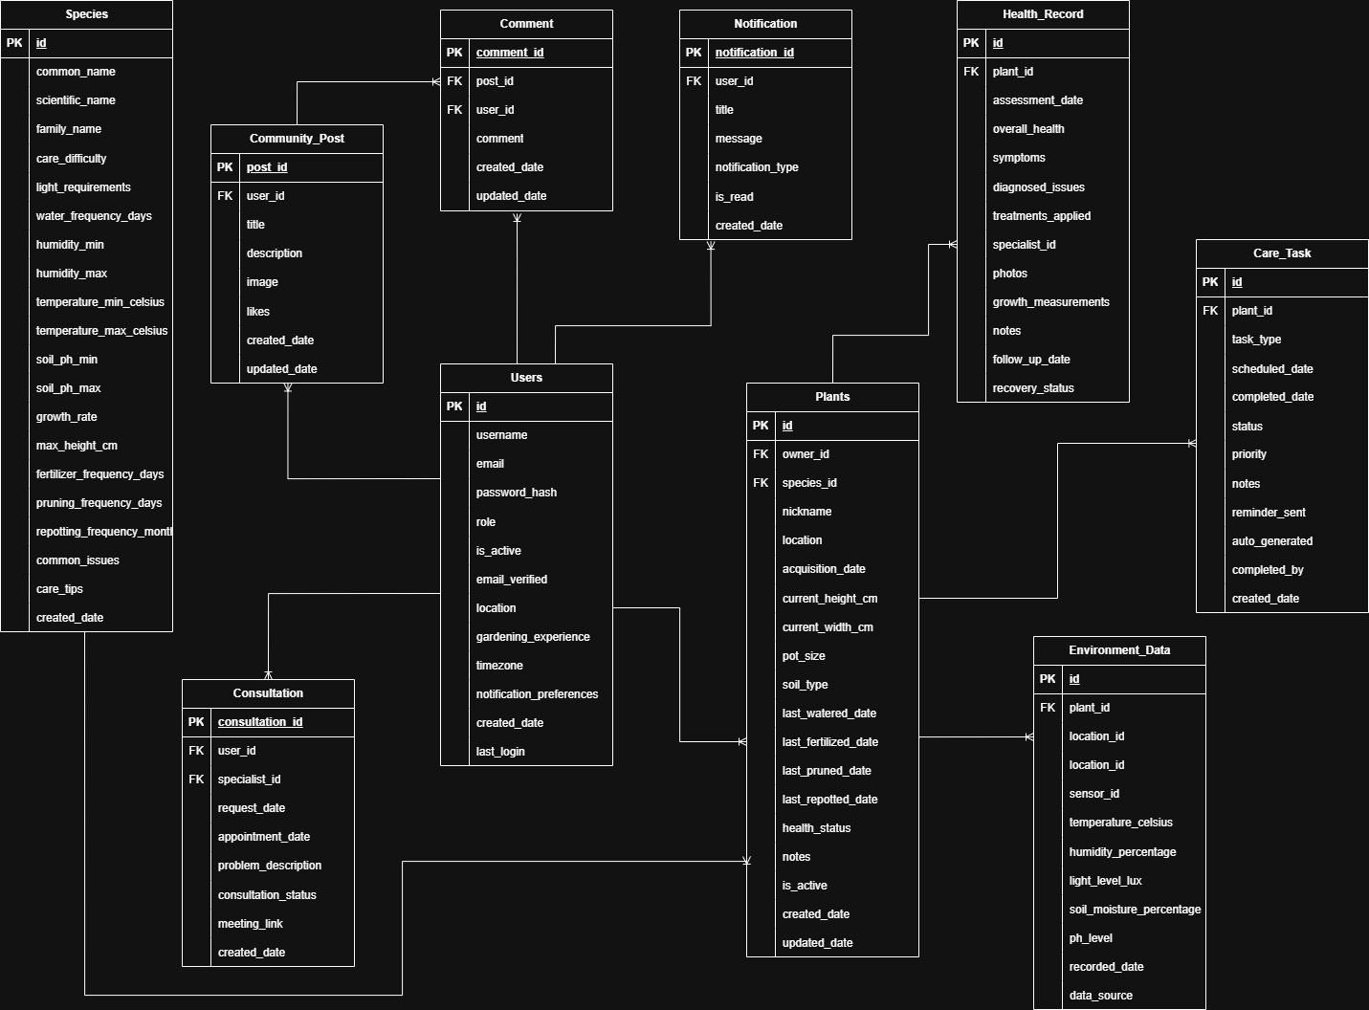
Plant Care
Scheduler
DIAGRAMS
REVIEW
Entity-Relationship Diagram
Overview
Problem Statement
Objectives
Functional
Requirements
Future Enhancements
DIAGRAMS
Insert ER Diagram
Entity Relationship
UML Class
Activity & Sequence
Review I • 2026
07
Plant Care Scheduler — Project Review I

Slide 8
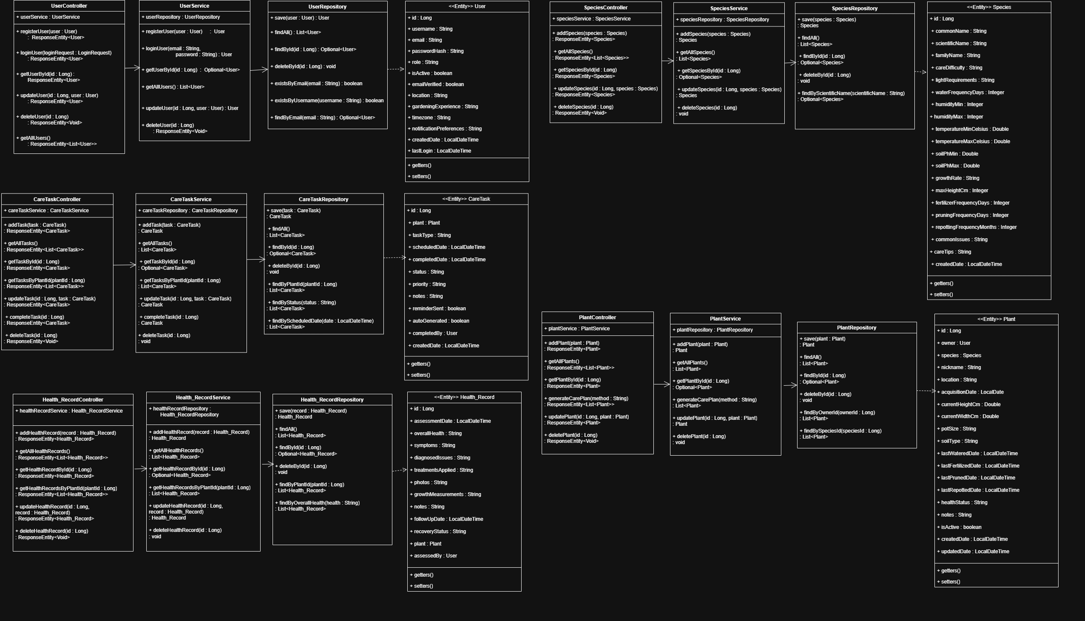
Plant Care
Scheduler
DIAGRAMS
UML Diagram
REVIEW
Overview
Problem Statement
Objectives
Functional
Requirements
Future Enhancements
DIAGRAMS
Entity Relationship
UML Class
Activity & Sequence
Review I • 2026
08
Plant Care Scheduler — Project Review I

Slide 9
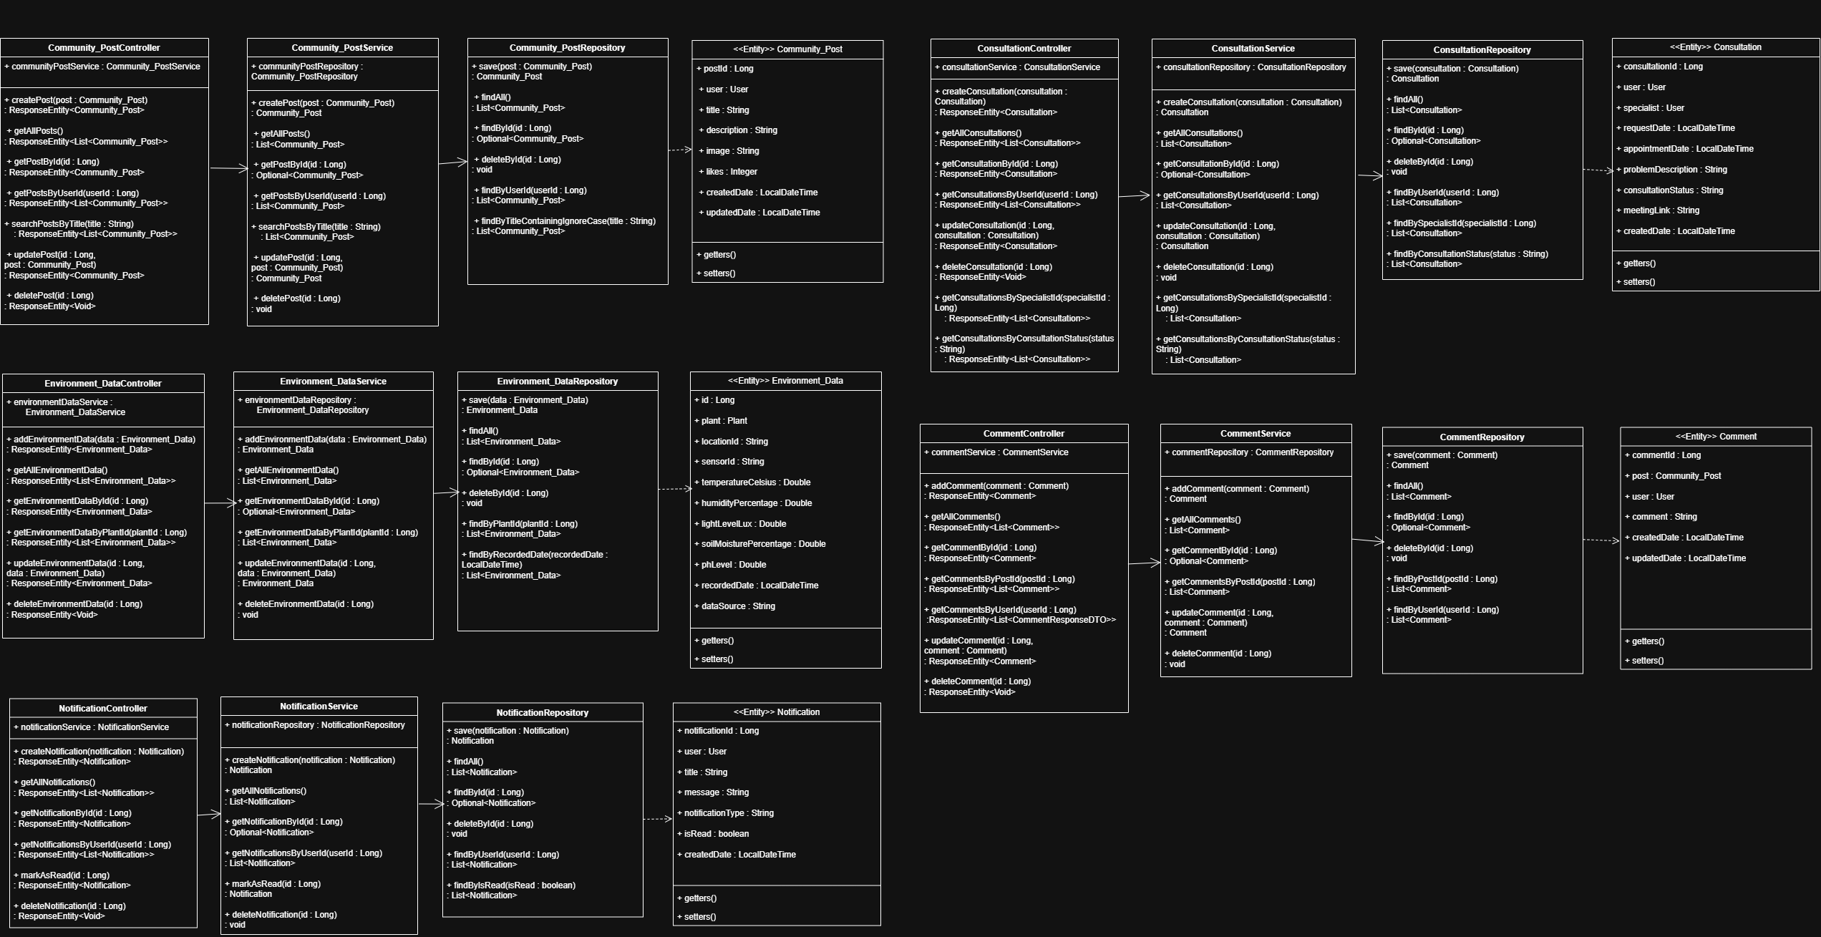
Plant Care
Scheduler
DIAGRAMS
UML Diagram
REVIEW
Overview
Problem Statement
Objectives
Functional
Requirements
Future Enhancements
DIAGRAMS
Entity Relationship
UML Class
Activity & Sequence
Review I • 2026
08
Plant Care Scheduler — Project Review I

Slide 10
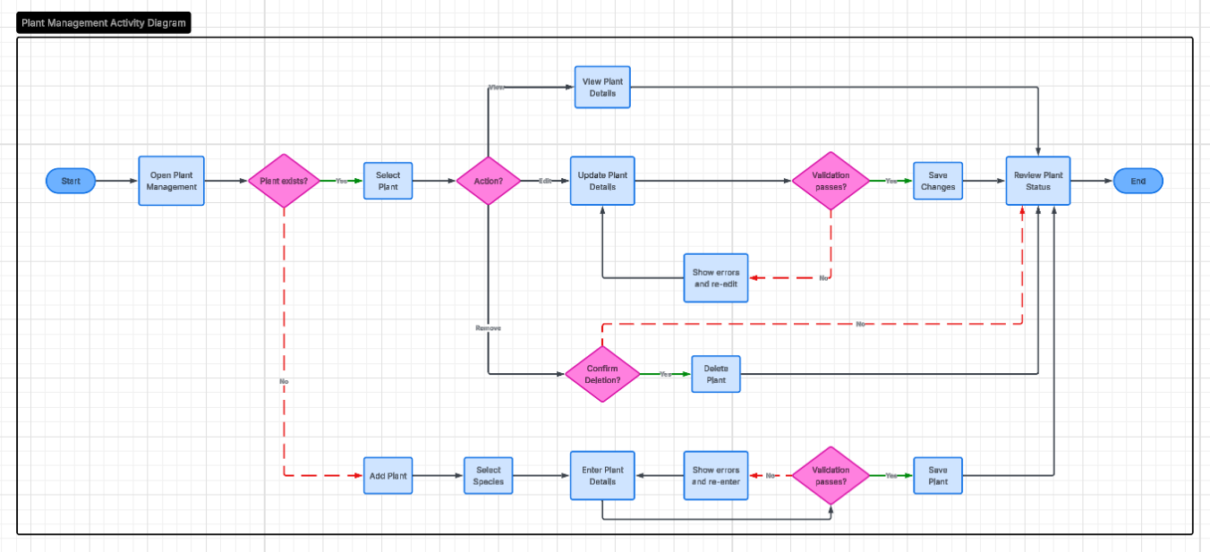
Plant Care
Scheduler
DIAGRAMS
REVIEW
Plant Management Activity Diagram
Overview
Problem Statement
Objectives
Functional
Requirements
Future Enhancements
DIAGRAMS
Entity Relationship
UML Class
Activity & Sequence
09
Plant Care Scheduler — Project Review I
Review I • 2026

Slide 11
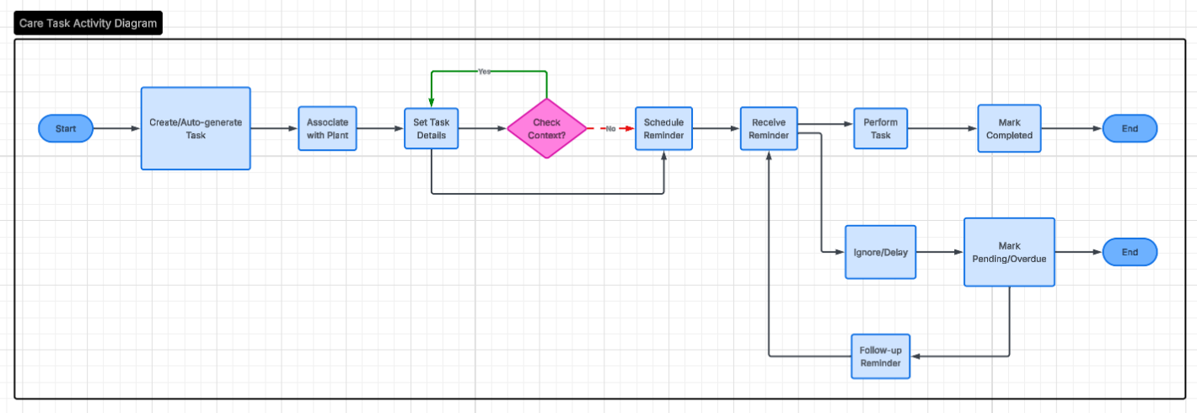
Plant Care
Scheduler
DIAGRAMS
REVIEW
Care-Task Activity diagram
Overview
Problem Statement
Objectives
Functional
Requirements
Future Enhancements
DIAGRAMS
Entity Relationship
UML Class
Activity & Sequence
10
Plant Care Scheduler — Project Review I
Review I • 2026

Slide 12
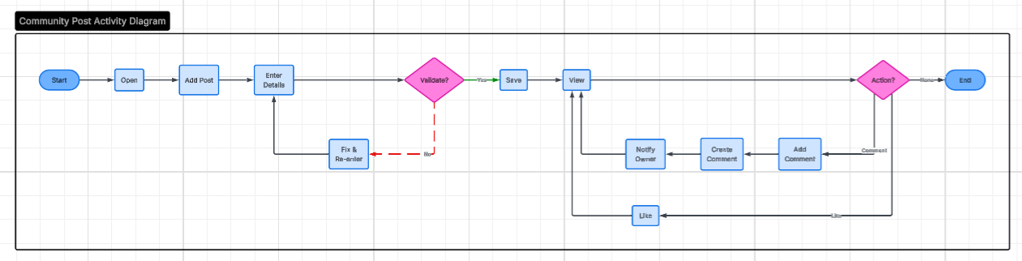
Plant Care
Scheduler
DIAGRAMS
REVIEW
Community Post Activity diagram
Overview
Problem Statement
Objectives
Functional
Requirements
Future Enhancements
DIAGRAMS
Entity Relationship
UML Class
Activity & Sequence
10
Plant Care Scheduler — Project Review I
Review I • 2026

Slide 13
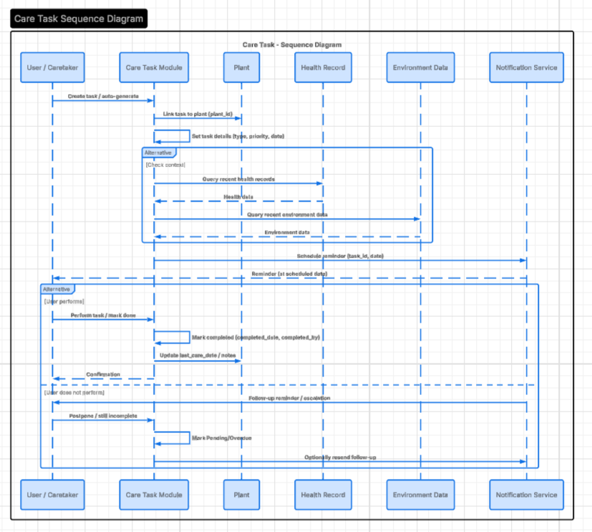
Plant Care
Scheduler
DIAGRAMS
REVIEW
Sequence Diagram
Overview
Problem Statement
Objectives
Functional
Requirements
Future Enhancements
DIAGRAMS
Entity Relationship
UML Class
Activity & Sequence
11
Plant Care Scheduler — Project Review I
Review I • 2026

Slide 14
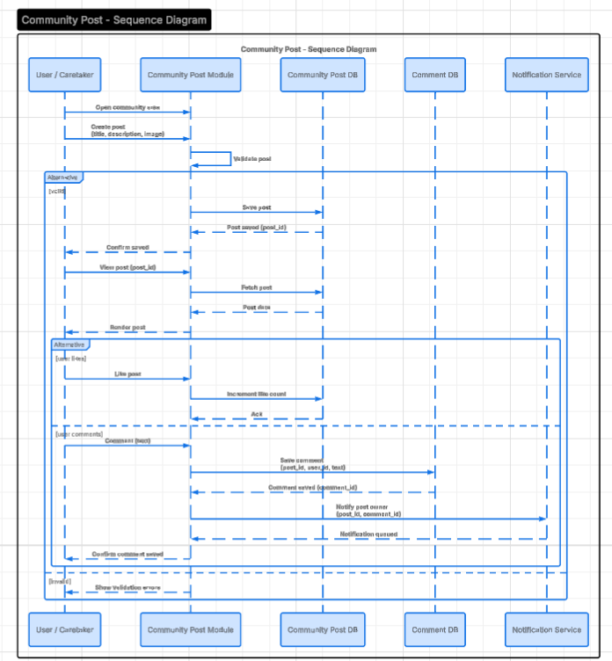
Plant Care
Scheduler
DIAGRAMS
REVIEW
Sequence Diagram
Overview
Problem Statement
Objectives
Functional
Requirements
Future Enhancements
DIAGRAMS
Entity Relationship
UML Class
Activity & Sequence
Review I • 2026
11
Plant Care Scheduler — Project Review I

Slide 15
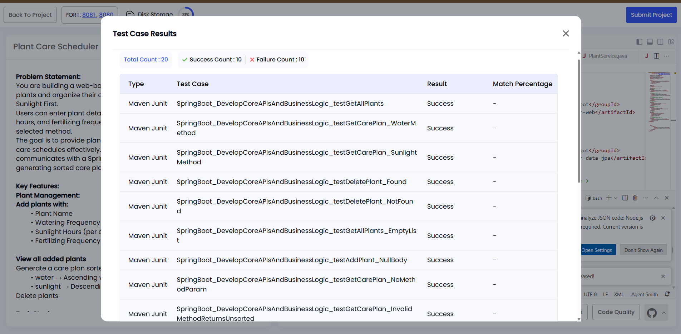
Plant Care
Scheduler
PROJECT TESTCASE - PORTAL
Review I • 2026
11
Plant Care Scheduler — Project Review I

