Slide 1
PROJECT REVIEW PRESENTATION
Plant Care Scheduler
Every plant gets a medical record.
Student name: Suchitra K M
Register / roll number: 2403727715022051
Class / section: CSD - A
Guide / trainer: Mariselvam
Course / subject: App Development
Notes:
Fill in the project title and all identity fields before presenting.

Slide 2
01
PROJECT OVERVIEW
Introduction
Plant Care Scheduler gives every plant a medical record. One platform ties species-based care schedules, health diagnostics, environmental readings and specialist consultations to each individual plant — so nothing about its care is ever only in someone's memory.
Problem addressed
Plants rarely die suddenly — they decline over weeks of slightly-too-little light or slightly-too-dry soil, and by the time it shows, the cause is a month in the past with no record of it. That's not a scheduling problem. It's a memory problem, and no reminder app solves it.
Purpose
To turn plant care from a set of alarms into a longitudinal record — one a specialist can actually read — so problems are caught from the history instead of guessed at from a single bad-looking leaf.
Project Review · Suchitra K M

Slide 3
02
PROBLEM STATEMENT
Existing problem
Every plant app on the market is an alarm clock — it rings when told to ring. It doesn't know the species, what the plant's been through, or why it's struggling now. Symptoms and readings are never logged, so the cause is invisible by the time it matters.
Limitations of current approach
Reminder apps carry no botanical knowledge and no history. Identification apps stop at a single photo. Neither keeps a per-plant timeline, neither understands environmental context, and neither gives a specialist anything to actually review.
Why this project is required
An alarm clock tells you when. A record tells you why. This project builds the record — species-derived schedules, health history, environmental logs and specialist access — all attached to the same plant, under one secured platform.
Project Review · Suchitra K M

Slide 4
03
OBJECTIVES
Key objectives
Expected outcomes
Develop a centralized platform to manage plants and care activities.
Centralized plant and care management
Provide species-based care scheduling for watering, fertilizing, and other activities.
Organized and automated care scheduling
Maintain plant health records and environmental information.
Better plant health and environmental tracking
Enable users to connect with specialists through consultations and community interaction.
Secure role-based access
Implement secure authentication and role-based access for USER, SPECIALIST, and ADMIN.
Improved user–specialist collaboration
Project Review · Suchitra K M

Slide 5
04
PROPOSED SOLUTION
How it works
Major features
JWT-secured authentication with 3-tier role-based access control
Plant collection manager with growth metrics and health status
Botanical species catalog with care baselines and toxicity notes
Species-derived care task scheduler with priority and overdue tracking
Health records for symptoms, diagnosis, treatment and recovery
Environmental telemetry logging per plant and location
Specialist consultation booking with status lifecycle
Community forum with posts, comments and notification feed
One Smart Workspace → All plant information in one place
Care Planner → Converts plant needs into scheduled activities
Health Tracker → Maintains a continuous record of plant condition
Expert Connect → Enables users to seek specialist guidance
Community Support → Encourages knowledge sharing among plant owners
Why this solves the problem
From remembering plant care → to managing it systematically.
Replaces scattered/manual tracking with a structured system.
Turns routine care into trackable actions.
Keeps plant history available for better care decisions.
Brings management, guidance, and community into one platform.
Project Review · Suchitra K M

Slide 6
05
TECHNOLOGY STACK
Frontend
Backend
Database
React 19 · HTML · CSS · JavaScript
Spring Boot 3.5.15
Java 17 · Maven
Spring Data JPA (Hibernate)
MySQL 8.x
APIs / libraries / frameworks
Development tools
Other
REST API (11 controllers)
Spring Security 6 + JJWT 0.12.6
SpringDoc Open API 2.8.9 (Swagger UI)
Lombok · Hibernate Validator
Git / GitHub · VS Code
MySQL Workbench
Swagger UI / Postman
BCrypt password hashing
CORS config for Vite client
spring-dotenv (.env secrets)
Global exception handling
Project Review · Suchitra K M

Slide 7
06
SYSTEM ARCHITECTURE
Frontend
Backend
Database
External services / APIs
React 19 SPA (Vite)
Axios client · JWT in headers
Spring Boot 3.5 REST API
JWT filter → Controller →
Service → Repository
MySQL 8
Spring Data JPA / Hibernate
10 related entities
SpringDoc OpenAPI 3
Swagger UI docs
spring-dotenv config
Data flow description
The user acts in the React SPA; Axios sends an HTTP/JSON request to the Spring Boot API with the JWT in the Authorization header.
JwtAuthenticationFilter validates the token, loads the user via CustomUserDetailsService, and sets the security context; SecurityConfig then authorizes the endpoint against the user's role.
The controller validates the request DTO, delegates to the service layer for business rules, and the service uses a Spring Data JPA repository to read or write MySQL.
The entity returned is converted to a response DTO by a mapper, serialized to JSON, and rendered by the React page; errors are normalized by GlobalExceptionHandler into a consistent error payload.
Project Review · Suchitra K M
Notes:
Replace the block labels and arrows with your project's real components, and describe the data flow underneath.

Slide 8
07
MODULES / FEATURES
Module | Purpose
Authentication & RBAC | Login, JWT, role-based access
Plant Management | Add, view, update, delete plants
Care Task Management | Schedule and track care tasks
Health & Environment | Health records and environment data
Consultation | User–specialist interaction
Project Review - Suchitra K M

Slide 9
08
DATABASE / DATA MODEL
User
Plant
Species
id, username, email
passwordHash, role
location, timezone
isActive, emailVerified
id, nickname, location
owner_id → User
species_id → Species
height/width, healthStatus
id, commonName
scientificName, family
waterFrequencyDays
humidity/temp ranges
Key entities & relationships
10 entities: User, Species, Plant, CareTask, HealthRecord, EnvironmentData, CommunityPost, Comment, Consultation, Notification.
User → Plant: One user can own multiple plants.
Species → Plant: One species can be associated with multiple plants.
Plant → Care/Health/Environment: Plant records connect to care tasks, health records and environmental data.
Project Review · Suchitra K M
Notes:
Replace with your actual ER diagram or entity list if you have one — this is a placeholder structure.

Slide 10
09
APPLICATION WORKFLOW
Start
Register /
Login (JWT)
Add species
& plants
Care tasks
Schedule & Track Care
Log health &
environment
Consult &
community
End
Start
End
Start — Visitor lands on the public page; other routes are protected.
Register / Login — Secure registration and JWT-based authentication.
Add Species & Plants — Select a species and add plant details.
Care Tasks — Schedule and track watering, fertilizing, pruning, repotting and misting.
Health & Environment — Record plant health and environmental data.
Consult & Community — Connect with specialists, post, comment and receive notifications.
End — Dashboard shows plants, upcoming tasks and health status.
Project Review · Suchitra K M
Notes:
Expand the flowchart to match your actual number of workflow steps.

Slide 11
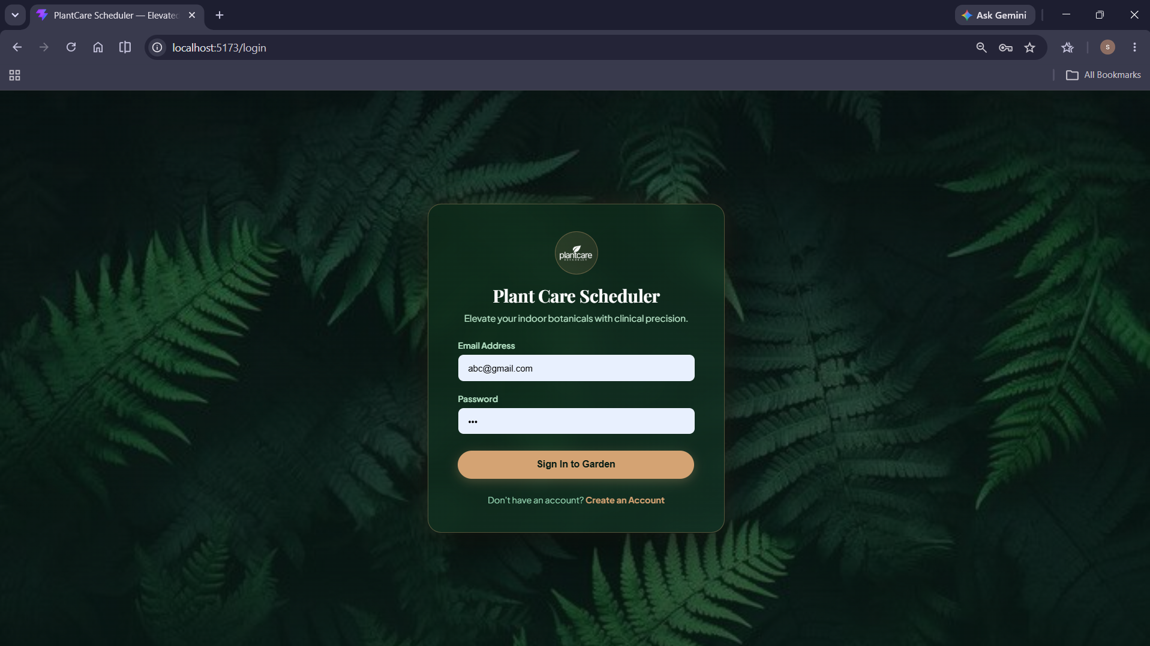
10
KEY FUNCTIONALITY
Authentication & Role-Based Access
What the user can do
Register as a plant owner, specialist or administrator
Log in and receive a JWT valid for 24 hours
View and update their own profile from /api/auth/me
How it works
User credentials are securely verified using BCrypt, and successful login generates a JWT token.
The token is validated on each request, with role-based access controlling the resources available to each user.
Project Review · Suchitra K M
Notes:
This slide is a repeatable template — duplicate it once per key functionality (Slide 11 onward) and swap in the real name, behavior, and screenshot.

Slide 12
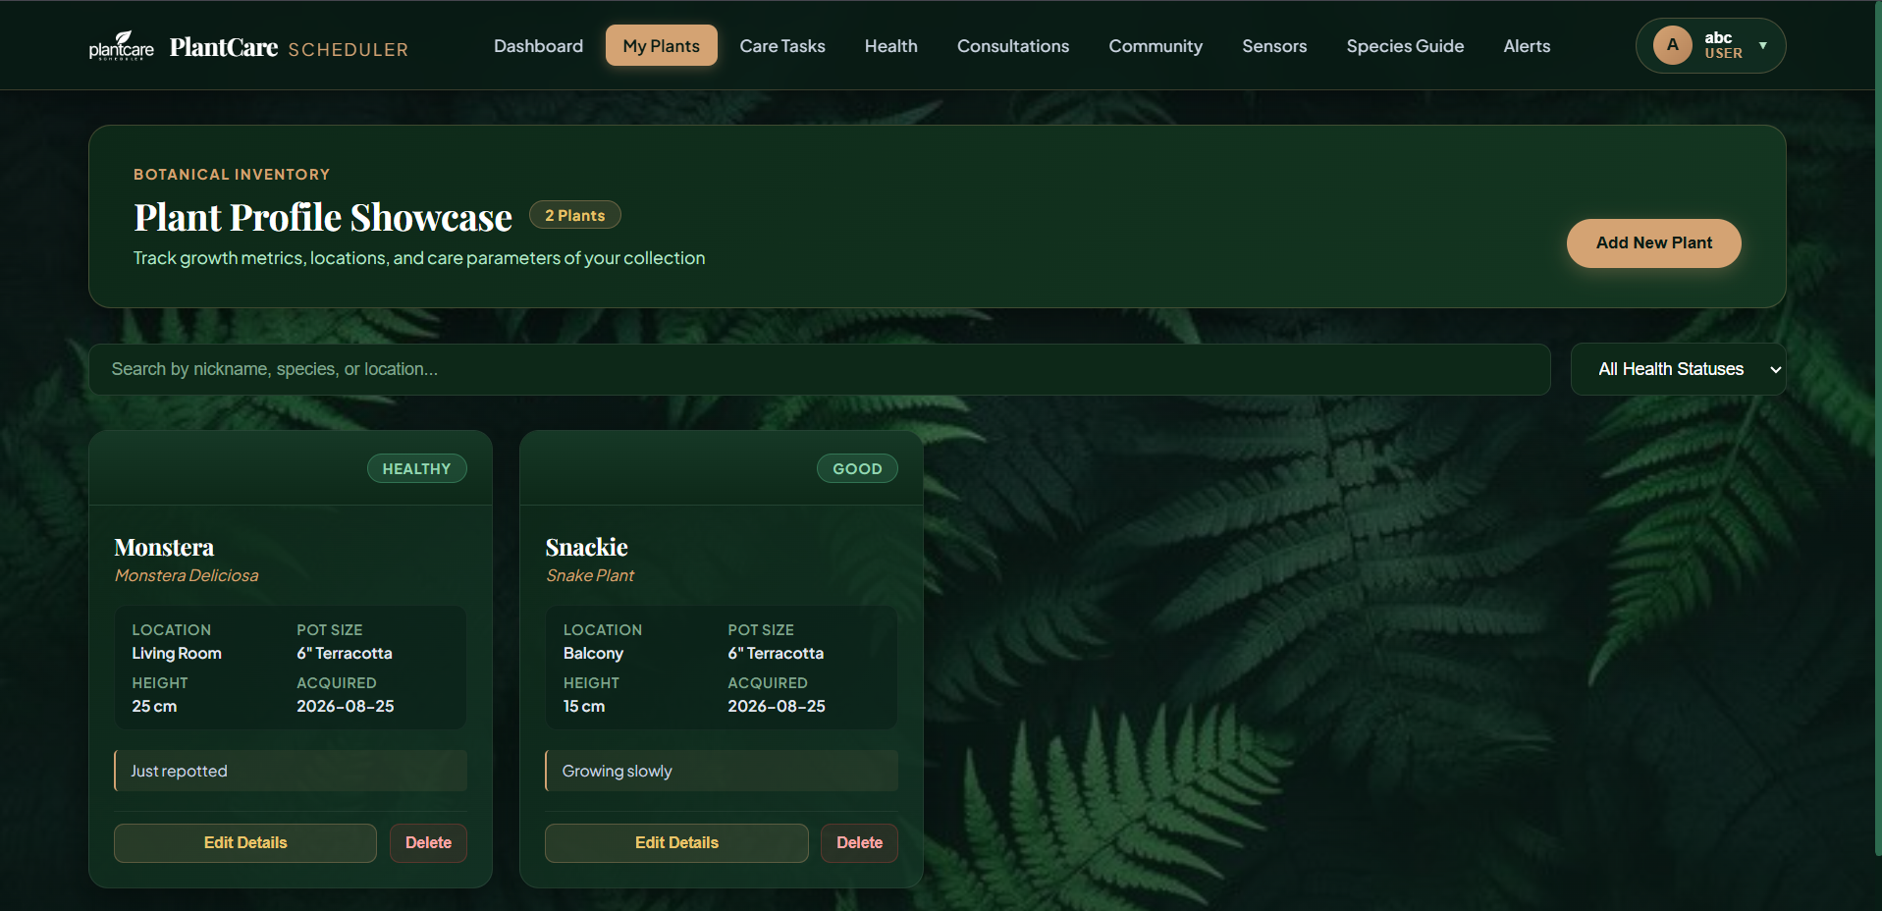
10
KEY FUNCTIONALITY
Plant Collection & Care Task Scheduling
What the user can do
Add plants with nickname, location, pot size, soil type and growth metrics
Create watering, fertilizing, pruning, repotting and misting tasks
See priority and overdue state, and complete a task in one click
How it works
Plant details are linked to the selected species, and care tasks are created based on plant care requirements.
Tasks are stored and tracked through the backend, allowing users to view priority, overdue status, and completion.
Project Review · Suchitra K M
Notes:
This slide is a repeatable template — duplicate it once per key functionality (Slide 11 onward) and swap in the real name, behavior, and screenshot.

Slide 13
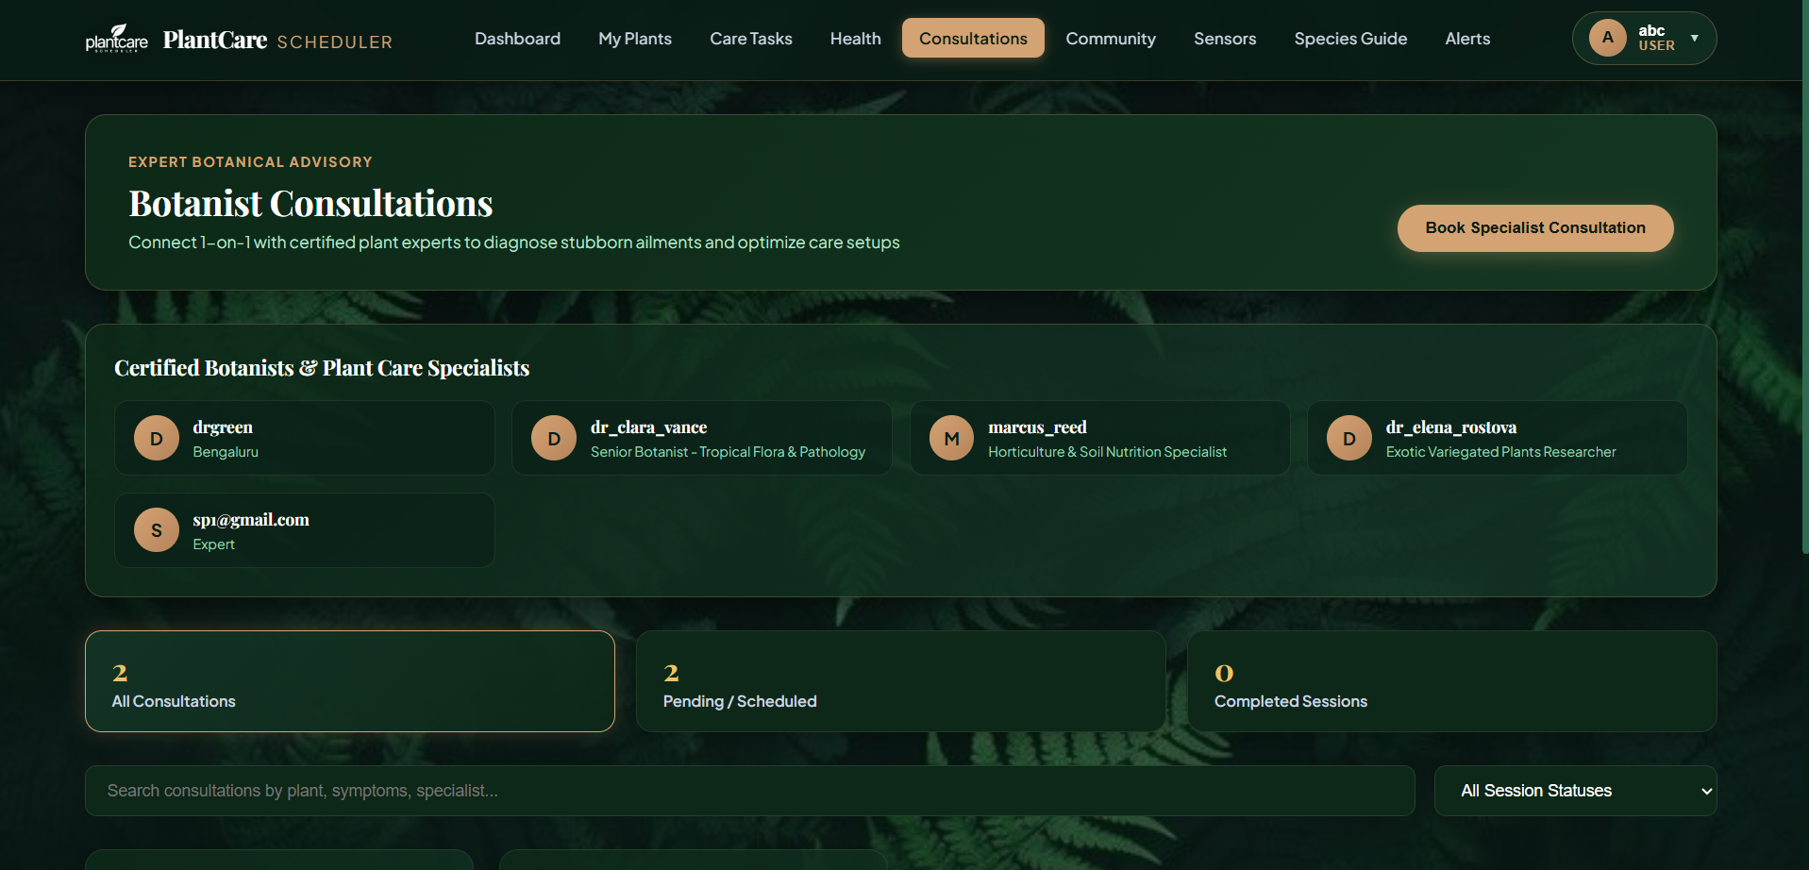
10
KEY FUNCTIONALITY
Health Records, Environment & Consultations
What the user can do
Log health assessments with symptoms, diagnosis and treatments applied
Track recovery status and follow-up dates per plant
Request a specialist consultation and track it to completion
How it works
Users record plant health and environmental data, which is stored against the respective plant for tracking.
For unresolved issues, users can request a specialist consultation and track its status.
Project Review · Suchitra K M
Notes:
This slide is a repeatable template — duplicate it once per key functionality (Slide 11 onward) and swap in the real name, behavior, and screenshot.

Slide 14
11
CHALLENGES & SOLUTIONS
Challenge | Solution
Infinite JSON recursion from bidirectional entity relationships | Used DTOs, mappers and @JsonIgnoreProperties to prevent recursion.
Inconsistent error responses across 11 controllers | Implemented a global exception handler with standardized error responses.
Keeping database and JWT secrets out of the repository | Moved credentials and JWT keys to .env configuration
Project Review · Suchitra K M

Slide 15
12
TESTING
Testing approach
Testing combined a Spring Boot context-load test with manual API testing through Swagger UI and end-to-end verification in the React client. Every endpoint was exercised for the success path, the unauthorised path (missing or wrong-role JWT) and the invalid-input path. Request DTOs are annotated with Hibernate Validator constraints, and MethodArgumentNotValidException is caught by GlobalExceptionHandler so validation failures return field-level messages with HTTP 400 instead of a stack trace.
Test case | Expected result | Actual result | Status
Register with an email that already exists | Rejected with a clear conflict message | HTTP 409 — EmailAlreadyExistsException handled | Pass
Login with an incorrect password | Access denied, no token issued | HTTP 401 — InvalidCredentialsException handled | Pass
Call /api/plants without a JWT | Request blocked before reaching the controller | HTTP 401 — rejected by JwtAuthenticationFilter | Pass
Project Review · Suchitra K M

Slide 16
13
FUTURE ENHANCEMENTS
Possible improvements
AI-based Plant Disease Detection can identify plant diseases from leaf images and suggest suitable care recommendations.
Personalized Care Recommendations can provide plant-specific suggestions based on species, health history, and care patterns.
Email & Push Notifications can provide timely reminders for upcoming and overdue plant care activities.
Cloud Deployment & Scalability can make the application accessible remotely and support more users and data.
Project Review · Suchitra K M

Slide 17
14
CONCLUSION
Summary
Plant Care Scheduler delivers a complete, working full-stack solution to a real and untracked problem. The Spring Boot backend exposes a secured REST API across 11 controllers over 10 related entities, protected by stateless JWT authentication and three-tier role-based access control. The React 19 client consumes that API through eleven service modules and eleven guarded pages, giving owners, specialists and administrators a single place to schedule care, record plant health and growing conditions, consult experts and share knowledge.
Key achievements
Designed and implemented a 10-entity relational data model in MySQL with full JPA mapping, LAZY fetching and a dedicated DTO/mapper layer
Built a secured REST API of 11 controllers with stateless JWT authentication, BCrypt hashing and role-based authorisation for USER, SPECIALIST and ADMIN
Standardised validation and error handling through Hibernate Validator and a global exception handler, and documented the full API with SpringDoc OpenAPI / Swagger UI
Thank you · Questions welcome

