Slide 1
21AIE304
BIG DATA AND
DATABASE MANAGMENT
END SEM PROJECT PRESENTATION

Slide 2
Batch - B Group 9
Group Members :-
Kuppala Gowtham Sai Chandra - CB.EN.U4AIE21125
Atmuri Likith Aditya - CB.EN.U4AIE21127
Kode Sri Naga Harsha Vardhan - CB.EN.U4AIE21124
Miriyala Ruthvik Guptha - CB.EN.U4AIE21134

Slide 3
GLOBAL MARKET
DATASET ANALYSIS

Slide 4
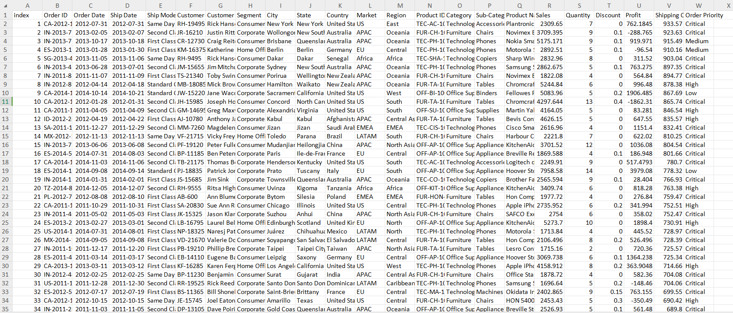
DATASET

Slide 5
Our dataset consists of :
DATASET ROWS:30000
DATASET COLUMNS:23
DATASET SIZE:4.6 mb

Slide 6
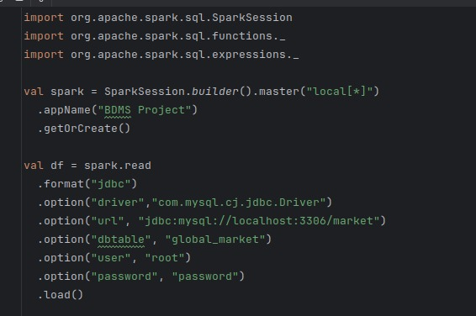

Slide 7
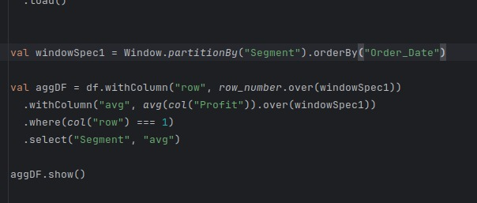
ANALYSIS

Slide 8
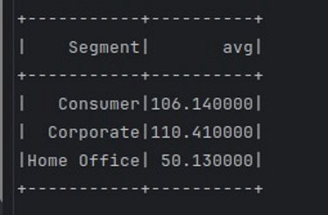
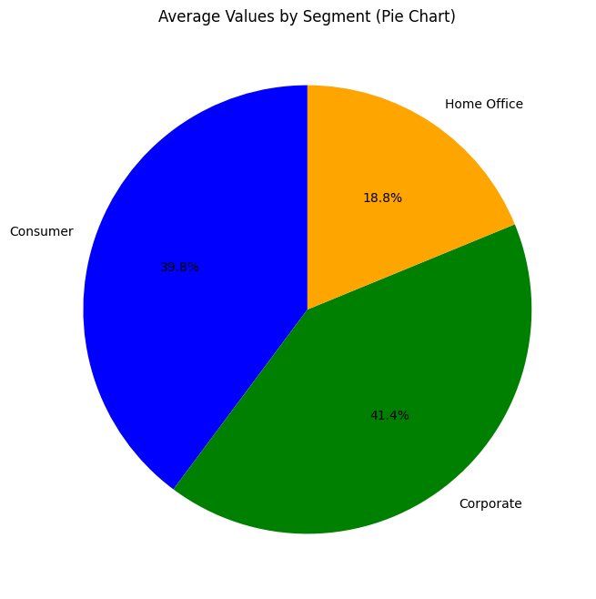

Slide 9
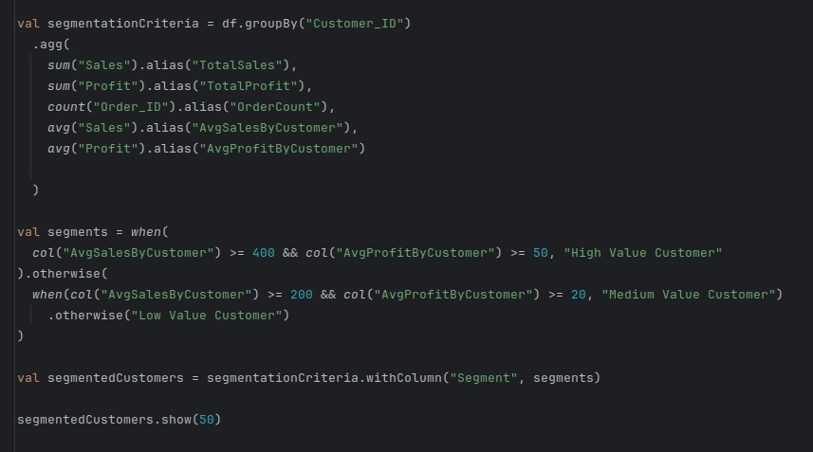

Slide 10
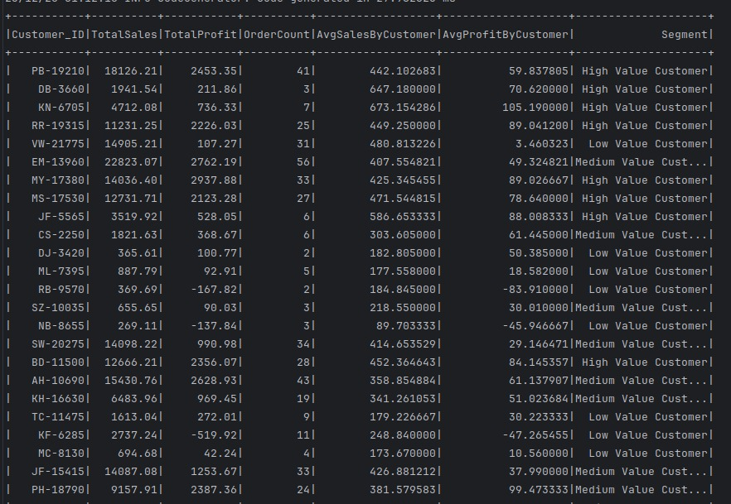

Slide 11
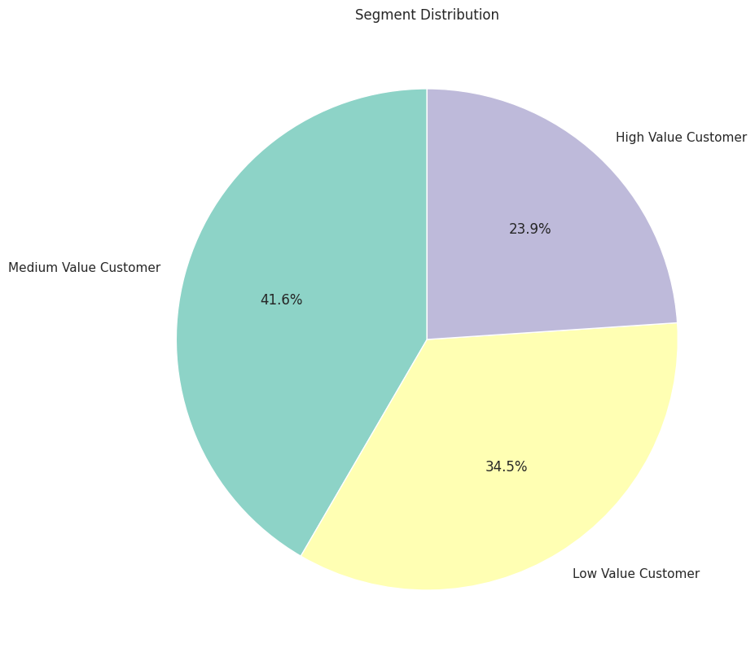

Slide 12
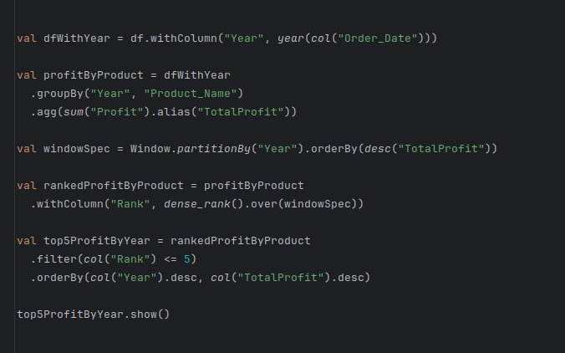

Slide 13
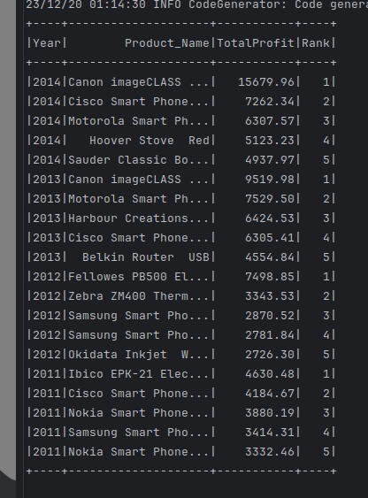
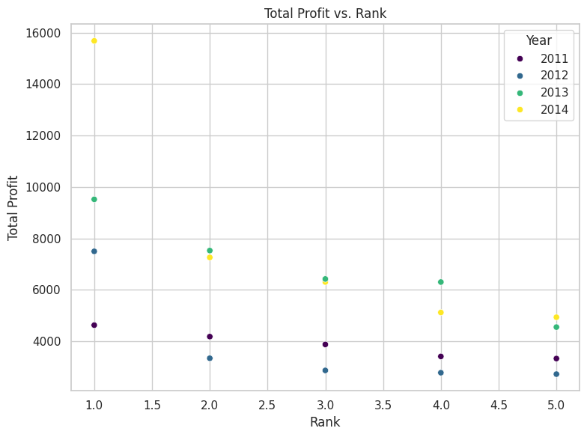

Slide 14
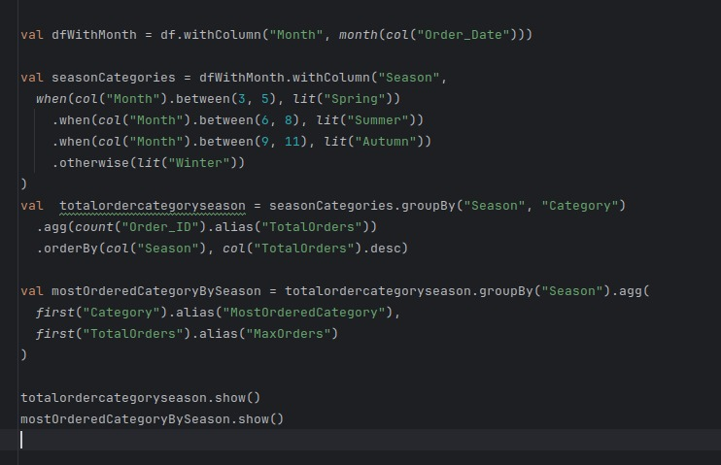

Slide 15
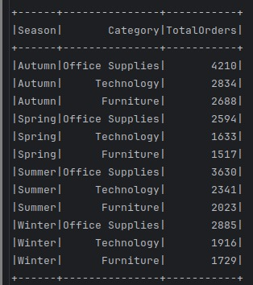
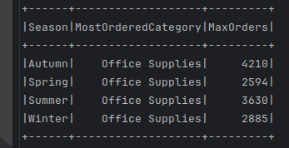

Slide 16
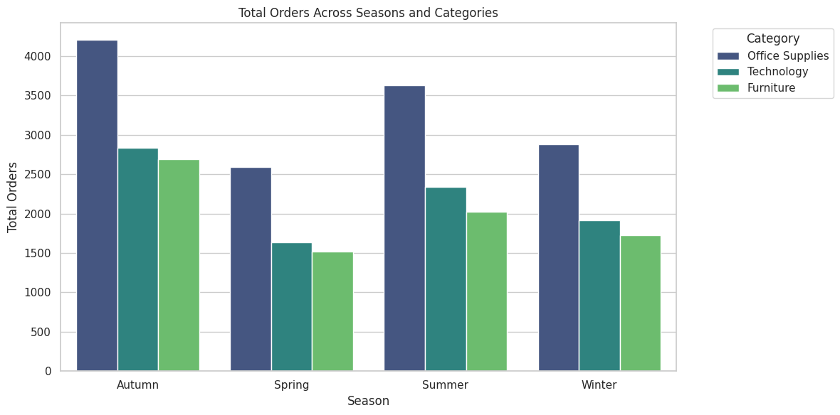

Slide 17
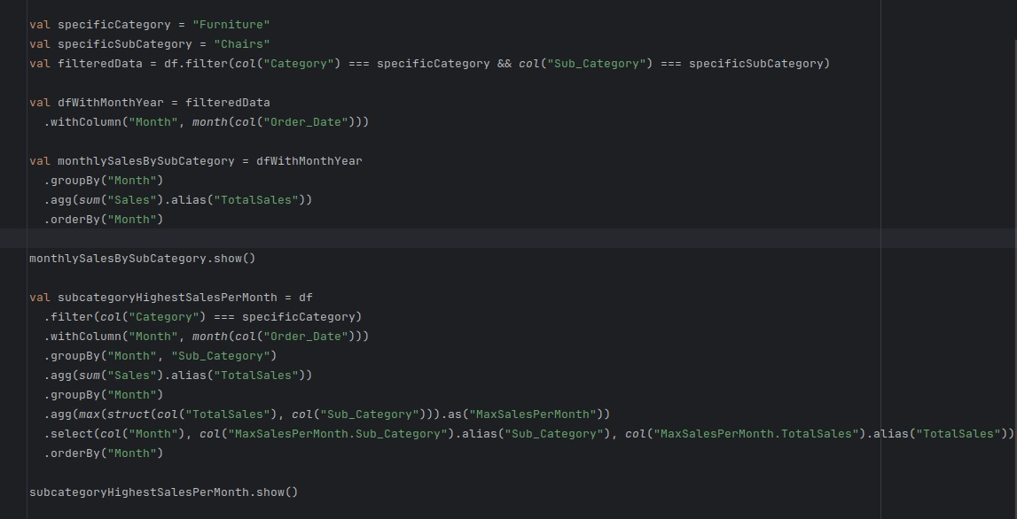

Slide 18
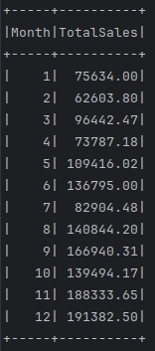
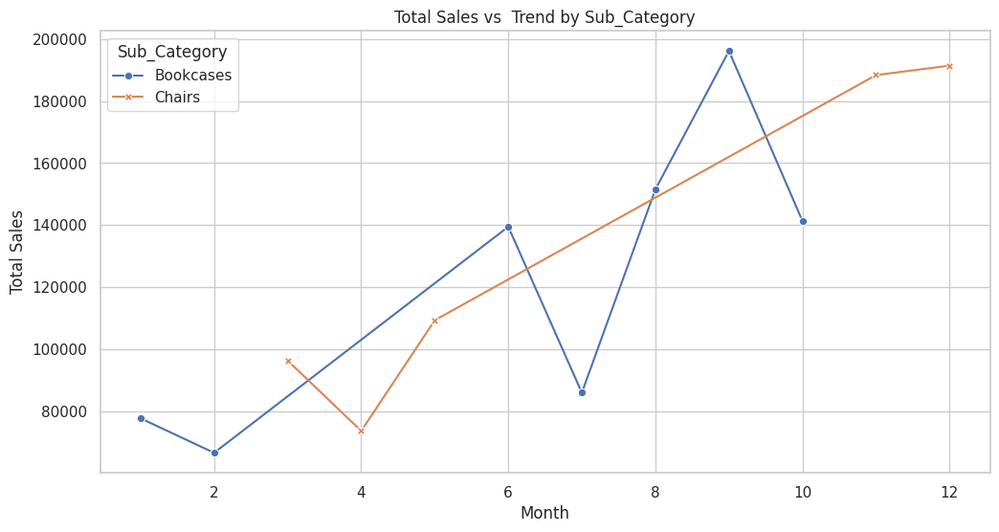
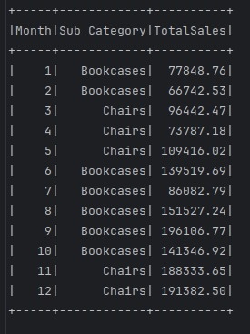

Slide 19
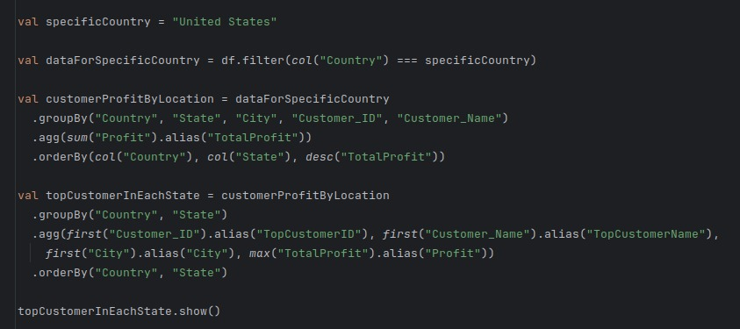

Slide 20
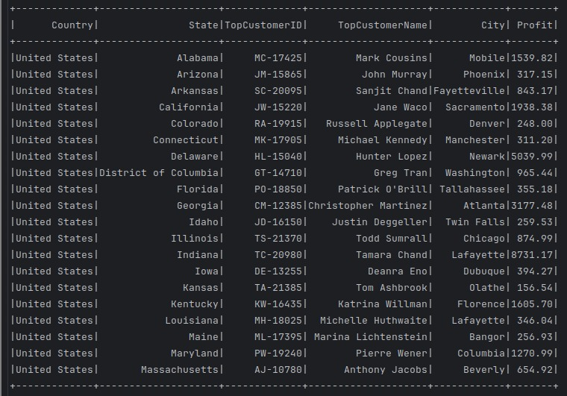

Slide 21
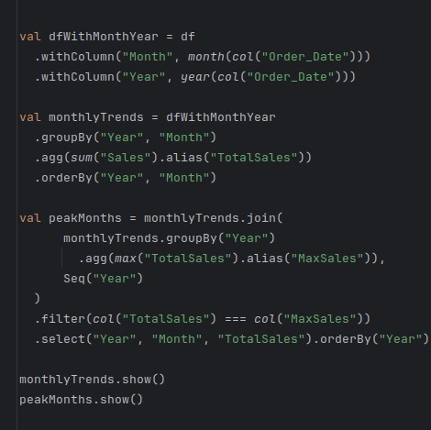

Slide 22
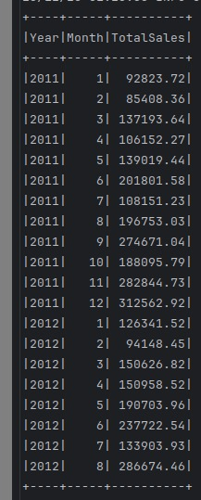
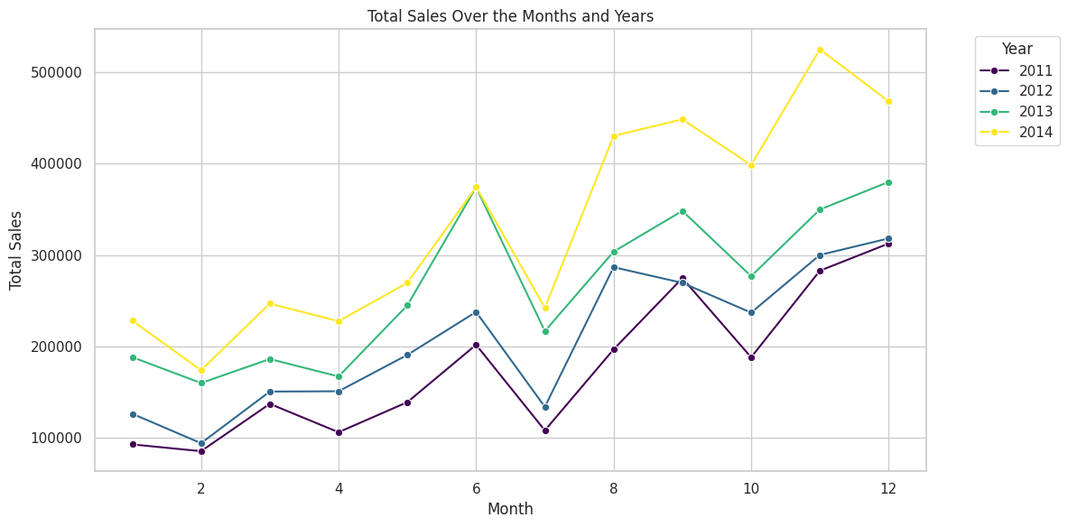

Slide 23
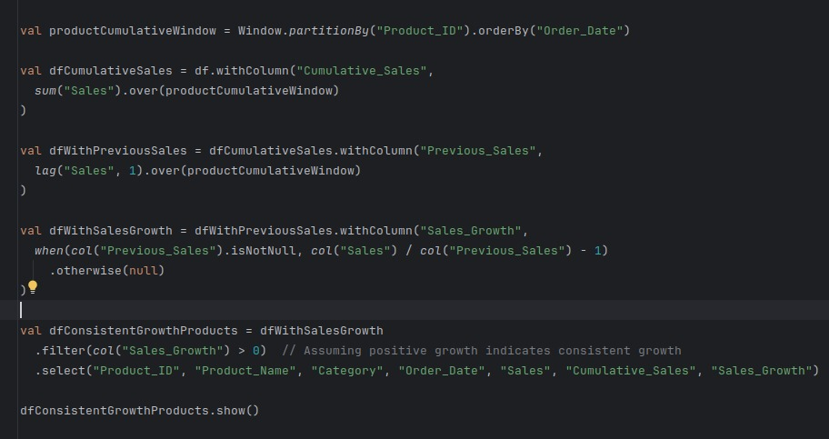

Slide 24
