Slide 1
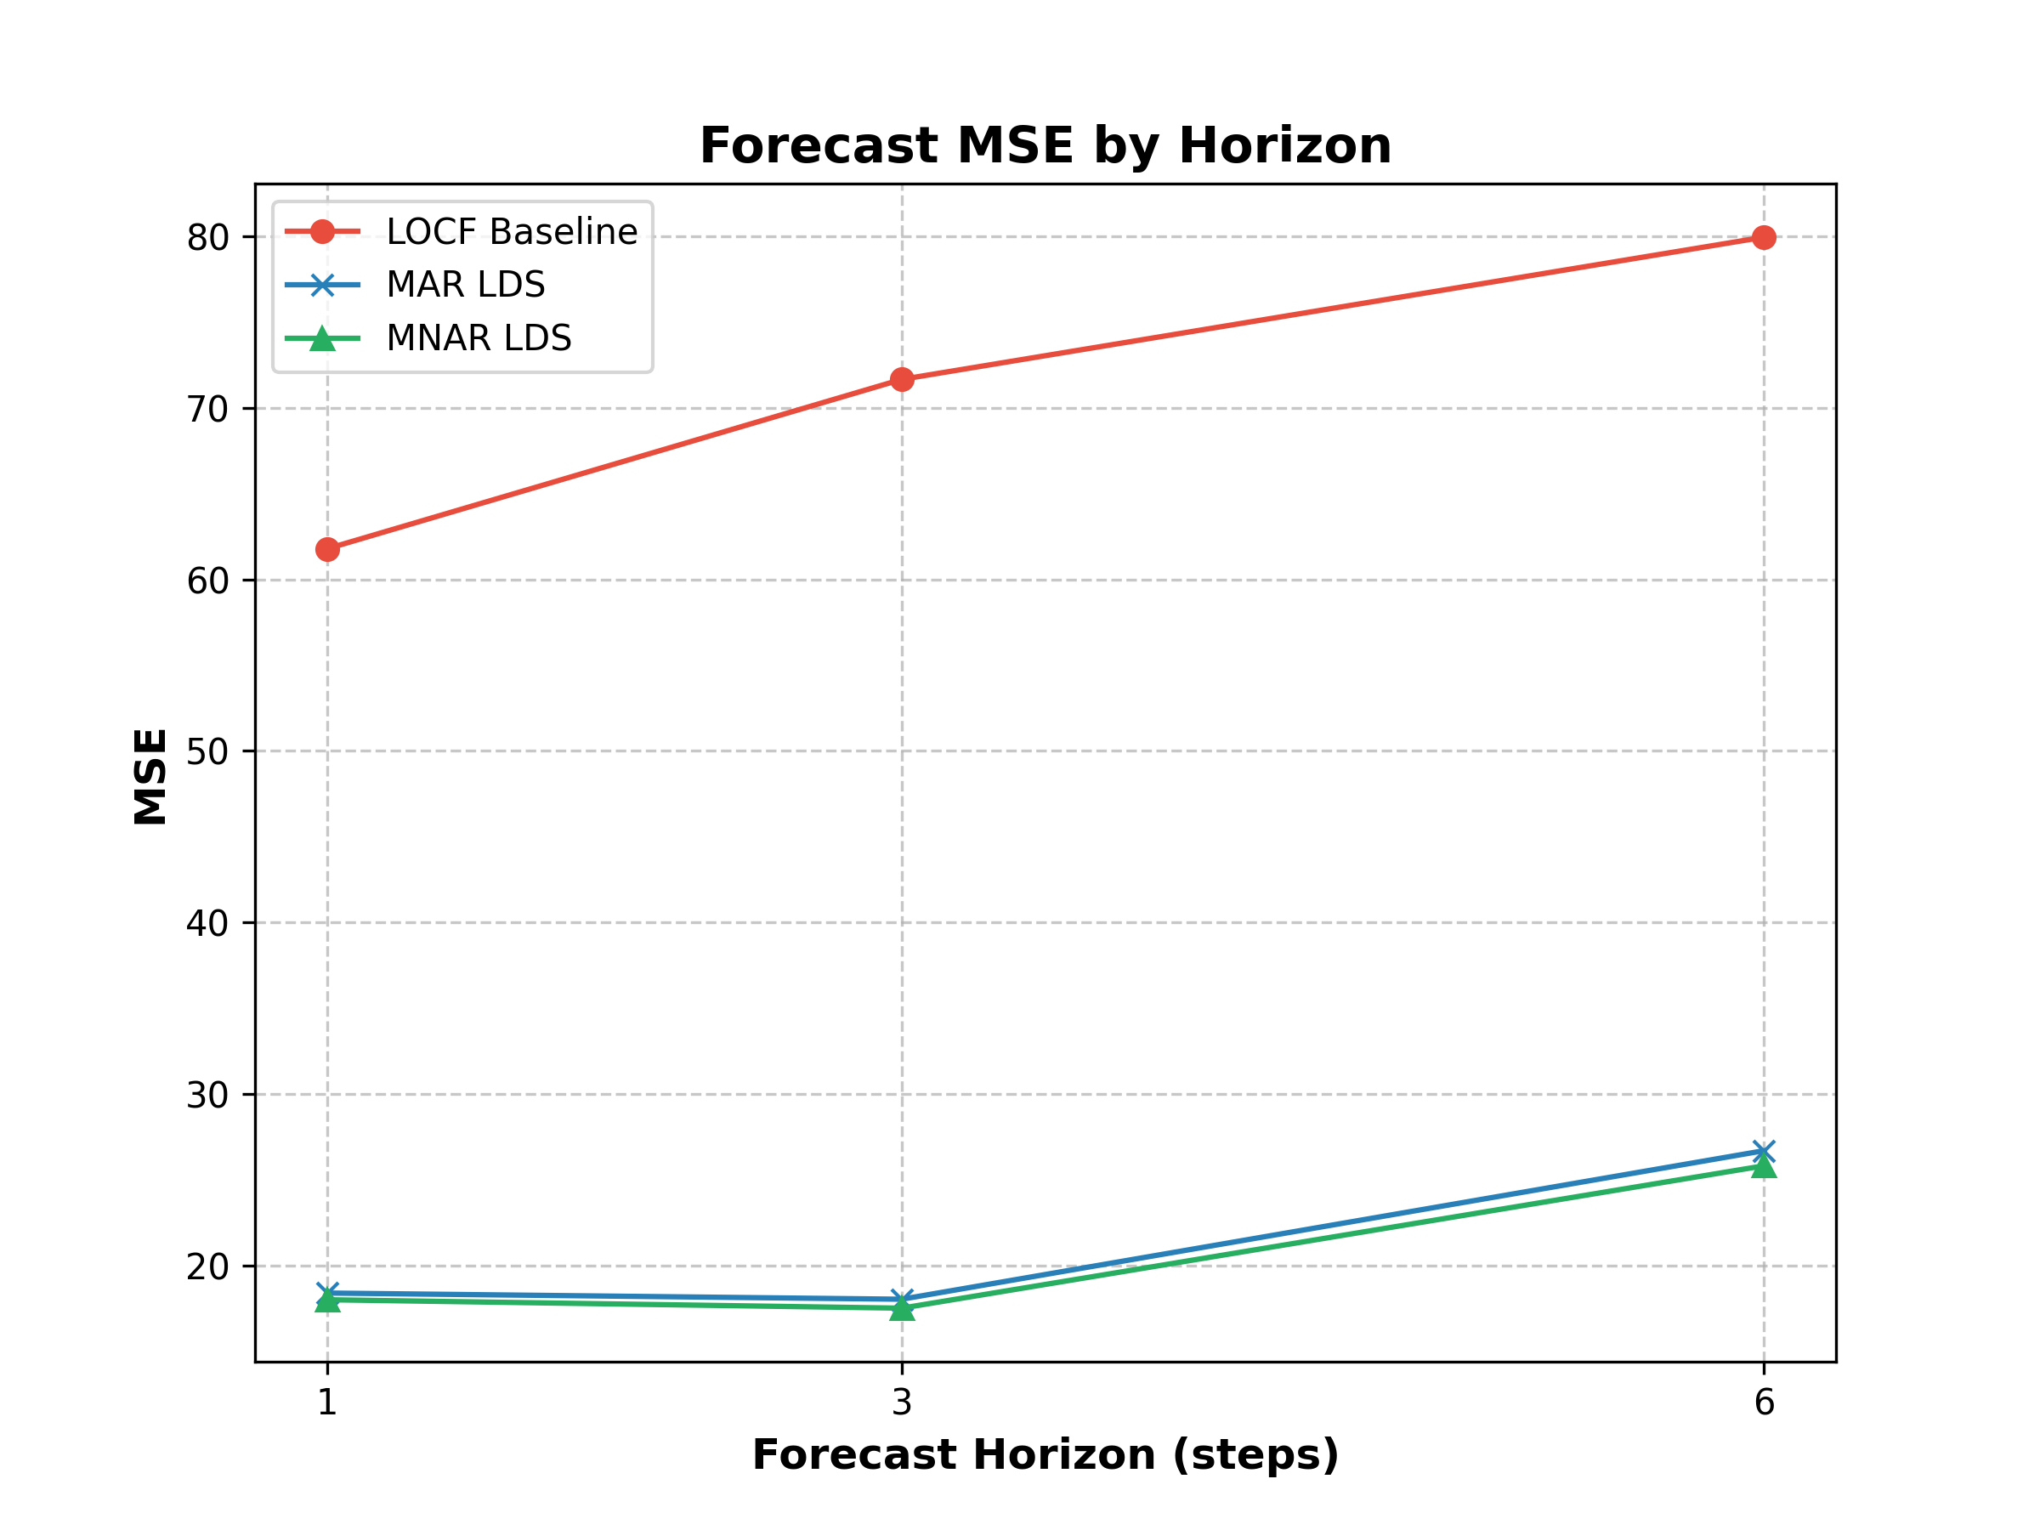
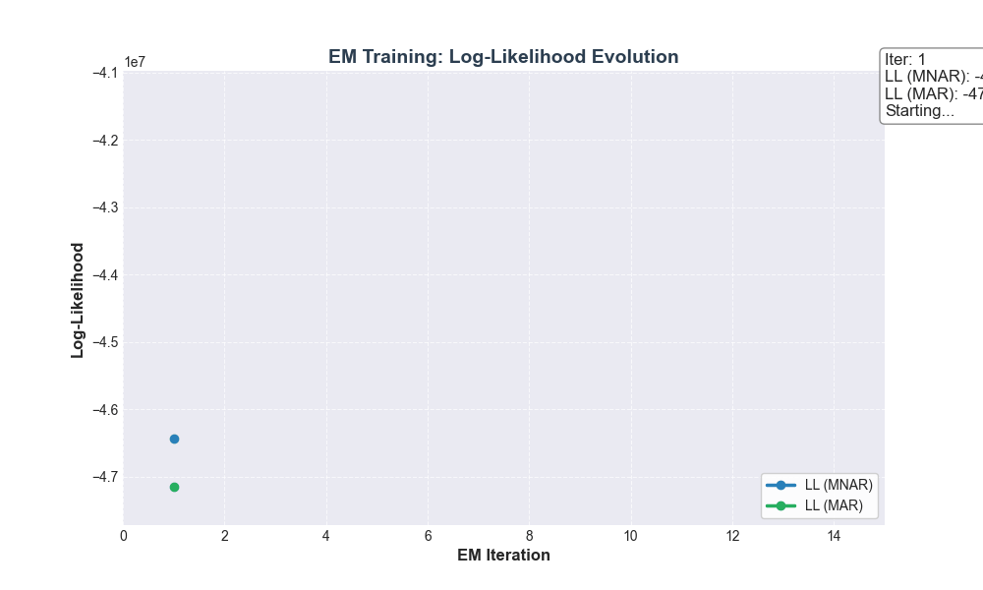
MNAR Performance Analysis
A. Summary Statistics
B. Forecast MSE by Horizon
Metric | LOCF | MAR | MNAR | % improvement (LOCF → MAR) ⬇️ | % improvement (MAR → MNAR) ⬇️
Impute (MSE) | 49.29 | 17.57 | 16.89 | 64.35% | 3.85%
1-Step Forecast (MSE) | 61.78 | 18.40 | 18.01 | 70.21% | 2.12%
3-Step Forecast (MSE) | 71.66 | 18.04 | 17.52 | 74.82% | 2.85%
6-Step Forecast (MSE) | 79.95 | 26.70 | 25.82 | 67.39% | 3.29%
Key Findings:
STATE SPACE MODELING IS CRITICAL: The transition from LOCF to MAR LDS yields ~70% reduction in MSE across all tasks. This demonstrates that capturing temporal dynamics through latent state representation is far more important than naïve forward imputation.
MNAR PROVIDES CONSISTENT REFINEMENT: The additional ~2-4% reduction in MSE from MAR to MNAR, while modest, is consistent across all metrics and horizons. This suggests the missingness mechanism carries some predictive signal.
MISSINGNESS IS WEAKLY INFORMATIVE: The small MAR → MNAR gap indicates that in this traffic dataset, blackouts are largely infrastructure-driven (sensor failures, maintenance) rather than state-dependent (congestion-induced). Therefore, in domains where data loss correlates more strongly with the underlying state, larger MNAR benefits are expected.
BIAS-VARIANCE TRADEOFF AT HORIZON STEP = 3: We observed non-monotonic MSE with respect to horizon, with 3-step forecasts outperforming 1-step forecasts. We attribute this to the bias-variance tradeoff when forecasting from blackout endpoints: the filtered state at blackout termination carries estimation bias due to prolonged missing observations, which the learned dynamics progressively correct at intermediate horizons before variance accumulation dominates at longer horizons.
MONOTONOUS INCREASE OF DATA LOG-LIKELIHOOD: The visualization indicates that the model confirms proper EM convergence. The MNAR model consistently achieves higher log-likelihood than MAR which shows that modelling missingness explicitly provides better and reliable fit to the observed data.
C. Log-Likelihood Evolution

