Slide 1
PulsePrep
AI Mock Interview Coach — hackathon prototype
Role-based practice, clear feedback, and PDF reports.
Track: Skill Tank (EdTech) | Centle Tri-City AI Hackathon 2026
Team: Sriswathvik KOUDAGANI, Abhishek, Koushik, Siddharth
Notes:
Opening (15 seconds): We are presenting PulsePrep, a browser-based mock-interview prototype. It helps students practice a chosen role and review structured feedback. Be explicit: the current evaluator is an illustrative heuristic, not live Gemini or a validated hiring assessment. Introduce Sriswathvik KOUDAGANI, Abhishek, Koushik and Siddharth.

Slide 2
THE PROBLEM
Students know the material, not how they come across.
Mock interviews are scarce
One score hides the next step
Feedback doesn't reach the answer
Real practice with a mentor or peer is hard to schedule and expensive to scale.
A single number doesn't tell a student what to fix or why.
Students need feedback on what they actually said, not general advice.
Product hypothesis: repeatable practice is more useful when the next step is clear.
PulsePrep | Skill Tank track | 2
Notes:
Problem hypothesis, not research findings: mentor-led practice can be hard to arrange; an overall score alone is not actionable; students need feedback tied to their own answers. We have not completed user research or verified a placement-gap statistic. Do not claim measured placement impact.

Slide 3
OUR SOLUTION
We close the gap with three things
1
2
3
Realistic questions
Five-dimension scoring
Actionable report
6 to 8 technical and behavioral questions for the chosen role
Clarity, relevance, domain knowledge, communication, STAR
Readiness label, tips, example answers, and a downloadable PDF
Potential fit: Skill Tank’s Interview Master / CRT programs and college placement practice.
PulsePrep | Skill Tank track | 3
Notes:
Three parts: role-based questions, a transparent five-dimension rubric, and an actionable report. Six to eight curated technical/behavioral questions vary by level. Example answers are curated, not generated by live AI. Skill Tank and colleges are proposed use cases, not confirmed customers or partnerships.

Slide 4
HOW A STUDENT USES IT
A four-step journey, entirely in the browser
Select
Answer
Evaluate
Export
Pick a role, level, and mode
Type answers to each question
Five scores, tips, and a readiness level
Download the PDF report
No install. Sign in with email/password; your sessions are saved privately in Convex.
PulsePrep | Skill Tank track | 4
Notes:
First sign in with an email/password demo account. Then select a role, level and mode; answer questions; finish and review feedback; export a PDF. Better Auth handles sessions and Convex stores account-scoped practice data. The hosted version needs internet access. Use demo-only details and avoid sensitive answers.

Slide 5
STEPS 1 AND 2
Role-based practice, with feedback at the right time
Six roles
Two modes
Software Engineer
Data Analyst
Practice Mode
Feedback after every answer
Business Analyst
Frontend Developer
Full Mock Mode
Feedback only at the end, like a real interview
Marketing Associate
HR Executive
6–8 curated questions per session. Optional references tailor selected questions with your consent.
PulsePrep | Skill Tank track | 5
Notes:
Six roles and two modes are implemented. Practice Mode reveals feedback after submission; Full Mock hides it until the session is finished. Levels include fresher and experienced. Optional personalization: public GitHub project metadata, manually supplied LinkedIn skills/experience, and self-reported coding topics. LinkedIn and LeetCode are not connected accounts; no solved-history scraping.

Slide 6
STEP 3
Transparent five-dimension evaluation
Example answer scores (illustrative)
Readiness gauge
Clarity & Structure
7/10
Interview Ready
7.5 and above
Relevance to Role
8/10
Good
5.0 to 7.4
Domain Knowledge
6/10
Communication
7/10
Needs Improvement
Below 5.0
STAR Method
5/10
Heuristic scores, not a hiring verdict. STAR applies only to behavioral answers.
PulsePrep | Skill Tank track | 6
Notes:
The five bars are an illustrative example, not a measured user result. Current scoring uses structure/keyword signals and cannot establish factual correctness. STAR is not scored for technical questions. Readiness thresholds are 7.5+ Interview ready, 5.0–7.4 Good, below 5.0 Needs improvement. These are preparation labels, not placement guarantees.

Slide 7
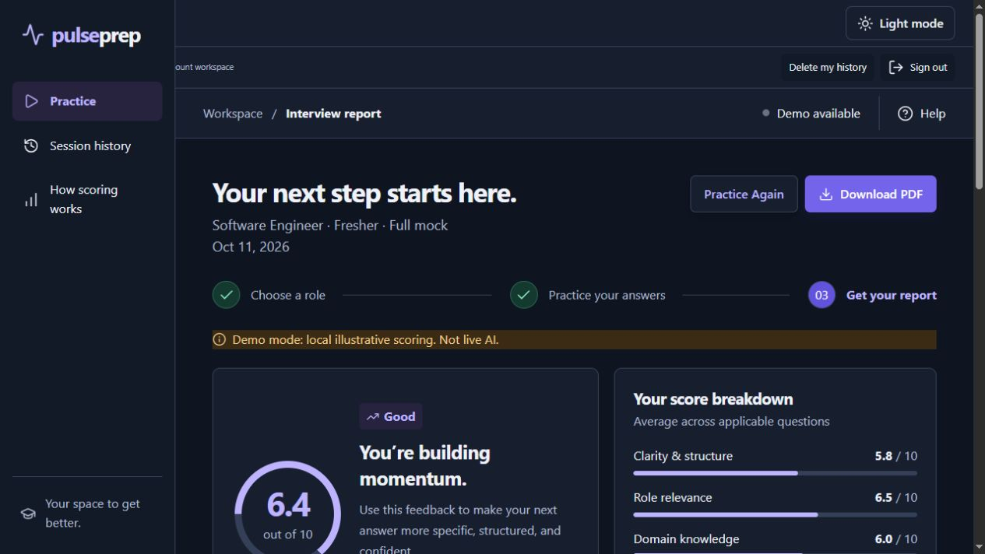
STEP 4
A report you can keep, review, and act on
What the report includes
Applicable dimension averages
Actionable improvement tips
Questions, answers, and feedback
Curated example answers
Downloadable PDF report
Actual sample report: 6.4/10 (illustrative, not a real candidate result).
PulsePrep | Skill Tank track | 7
Notes:
This is a screenshot of the deployed app, using prepared sample answers. The overall score is 6.4/10, Good. Do not describe it as a real student result. Click Download PDF in the actual demo. Reports and session history are account-scoped; users can delete their history. Curated example answers are reference material, not AI-generated factual verification.

Slide 8
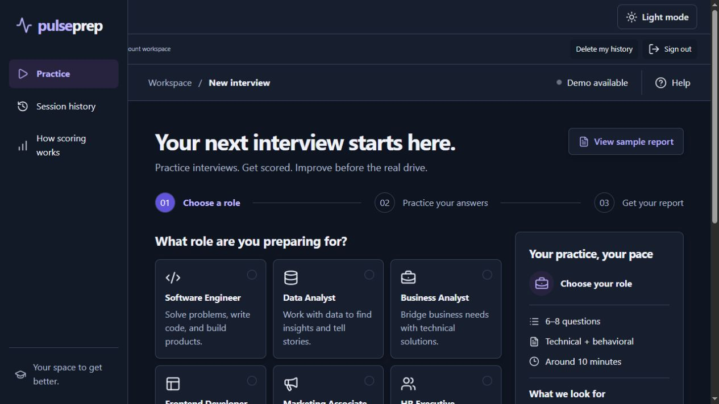
DEMO
Live demo: practice, report, and dark mode
Sign in; select a role, level, and mode
Answer a question and explain the rubric
Open the sample report and download PDF
Toggle dark/light; refresh to show it persists
PulsePrep | Skill Tank track | 8
Notes:
Demo plan (90 seconds): open https://pulseprep-blackster9263.spry-haven-6235.chatgpt.site; sign in to your prepared demo account; select Software Engineer / Fresher / Practice to show one submission and its feedback. For the short presentation, use View sample report rather than pretending 2–3 answers complete a six-question session. Explain that sample answers and scores are illustrative. Download PDF, toggle theme and refresh. The theme persists in the same browser. If internet is unavailable, show these screenshots and a previously downloaded PDF; cloud login/database are not offline. Source: https://github.com/Blackster9263/level-1.

Slide 9
HOW IT WORKS
Deployed architecture: browser, server, and Convex
Frontend React / Vinext, Cloudflare Workers, jsPDF, persistent themes
Authentication Better Auth email/password, server-checked sessions
Evaluation Curated question bank + illustrative heuristic (not live AI)
Data Convex Canada (Central): private sessions, answers, reports
PulsePrep | Skill Tank track | 9
Notes:
This is the stack actually deployed, not the original aspirational plan. Frontend React/Vinext runs on Cloudflare Workers via Sites; it is not hosted on Netlify. Better Auth is integrated with Convex, with server-side identity/ownership checks. Convex Canada Central stores sessions/answers and reference previews. PDF generation uses jsPDF. No live LLM provider is configured. Cloudflare R2, PostHog, social OAuth, email verification, password recovery, voice/video and billing are not included.

Slide 10
REQUEST FLOW
What happens when a student submits an answer
1
Student submits answer
2
Server verifies account ownership, length, and duplicate submissions
3
Heuristic evaluates structure and role-related keywords
4
Applicable dimensions are averaged; technical STAR excluded
5
Convex persists the answer and computed feedback
6
Feedback follows mode; finished sessions produce a report
No AI-provider request occurs in this release. Authentication and persistence require internet.
PulsePrep | Skill Tank track | 10
Notes:
Actual flow: authenticated submission, server ownership/input/duplicate checks, deterministic heuristic evaluation, applicable-dimension averaging, atomic Convex persistence, mode-aware feedback and final report. Skipped questions are excluded; unanswered questions count as zero in the overall report. There is no AI JSON response, prompt-version storage or model retry/cache pipeline in this release.

Slide 11
AI INTEGRATION STATUS
Why live Gemini is not connected
No provider API key
No live request validated
Current prototype
Illustrative heuristic
Next step
Supported Gemini model
What we can honestly explain
No Gemini key was supplied, so live AI could not be connected and tested.
Google lists June 1, 2026 as Gemini 2.0 Flash’s shutdown date.
Google Gemini API docs, checked 11 Oct 2026. Links and speaking answer in presenter notes.
PulsePrep | Skill Tank track | 11
Notes:
Ready-to-say answer: "We did not have a Gemini API key, so we could not authenticate or validate live AI scoring. We shipped a clearly labeled heuristic prototype; the next step is a server-side integration using a supported Gemini model and tested structured feedback." This is an unfinished integration, not a fundamental technical impossibility. Do not blame billing, quota, an outage or a failed API request: none was verified. Separately, Google's current deprecation table lists June 1, 2026 as the shutdown date for gemini-2.0-flash and gemini-2.0-flash-001; Google notes dates can be earliest possible retirement dates. Use a currently supported model rather than targeting 2.0. Credentials must remain server-side. The fallback avoids a model dependency, not the internet dependency of Better Auth/Convex. Sources, checked 2026-10-11: https://ai.google.dev/gemini-api/docs/api-key and https://ai.google.dev/gemini-api/docs/deprecations.

Slide 12
SCORING DESIGN
Current evaluator and the next AI milestone
Implemented now
Required for live AI
Structure / keyword-based signals; no factual verification
Mode-aware feedback and curated example answers
Deterministic averages and readiness thresholds
Server-only credential and a supported Gemini model
Structured-output validation, rate limits, and error handling
Quality checks against reviewed example answers
PulsePrep | Skill Tank track | 12
Notes:
The heuristic is deliberately disclosed and is not equivalent to LLM reasoning. It can reward form/keywords without proving correctness. Before enabling live AI: obtain a provider key, select a supported model, store the secret only on the server, validate structured scores/feedback, enforce rate limits and timeouts, and test answer quality and prompt-injection handling. This slide describes future work, not completed features. Existing code computes averages and excludes STAR for technical answers.

Slide 13
MARKET AND ECOSYSTEM
Potential fit: students and placement programs
Proposed first users
Students in interview preparation and CRT-style programs
Potential buyers
Colleges and training institutes with placement cells
Value hypothesis
Repeatable role-based practice with a report to review
Pilot to validate
Measure completion, repeat practice, and usefulness of feedback
PulsePrep | Skill Tank track | 13
Notes:
These are proposed segments and validation plans. We do not claim a Skill Tank partnership, paying customers, market-size statistic, improved placement rate or measured learning outcome. Propose a small pilot to measure session completion, repeat practice, and usefulness of feedback. Validate the heuristic and future AI feedback with human reviewers before any high-stakes use.

Slide 14
ROADMAP
What is live, and what comes next
Now (MVP)
Next
Later
Six roles / two modes
Better Auth + Convex history
Reports / PDF / dark mode
Optional reference inputs
Supported Gemini integration
Feedback quality evaluation
Email recovery / verification
Deeper opt-in personalization
Voice and delivery practice
College placement dashboard
Trainer review workflow
Company-specific question banks
Open live demo | GitHub: Blackster9263/level-1 | Questions?
PulsePrep | Skill Tank track | 14
Notes:
Close: The live prototype includes dark/light theme persistence, email/password accounts, account-scoped history, role/mode practice, illustrative scoring and PDF reports. Public GitHub metadata import is implemented; LinkedIn skills and coding topics are manual references, not OAuth connectors or scraped LeetCode solved histories. Live AI is future work. Website: https://pulseprep-blackster9263.spry-haven-6235.chatgpt.site. Repository: https://github.com/Blackster9263/level-1 (downloadable source ZIP plus README and submission guide). QA this release: 19 automated tests passed, typecheck and production build passed; live sign-in, sample report and theme refresh persistence were checked. Thank the judges and invite questions.

