Slide 1

Car Wash Service
Final Presentation
Designed By: Abubakar Yagob

Slide 2
Intrudction
Our program will allow the user to select the type of vehicle and list of services which preferred to serve the specified vehicle.
The program has the formula that needed to calculate the total price that will be payed for specific service and vehicle type.
The washing process will be ongoing after the payment has been done by customer and the payment receipt will be printed for the selected user service is finished.

Slide 3
Functions
=> void tags (): Decoration, separating between different parts of the program.
=> void Services (): Services and their selection of many options.
=> void Receipt (): print Receipt after service is finished.
=> void Ongoing(): stop the program for a specific amount of time based on serivce
=> void Meta (): generate a service number and get today's date.
=> void Another_Service (): function to let user choose another service after finishing first service.
=> void payment(): function to calculate the total price of washing process with various types of service and for different types of vehicle.

Slide 4
Code
The program code is written in C++ and some componenets from C like strings header file and time generation process.
Its devided into 2 files with a file being used as a header file and another file which contains the main elements.
The header file payment.h contains the payment function which calculates the amount to be payed for a specific service based on a specific type of vehicle.
The Meta function has various operations like getting current date and month and year, and also convert it to a day of the week or a char month instead of numbers.

Slide 5
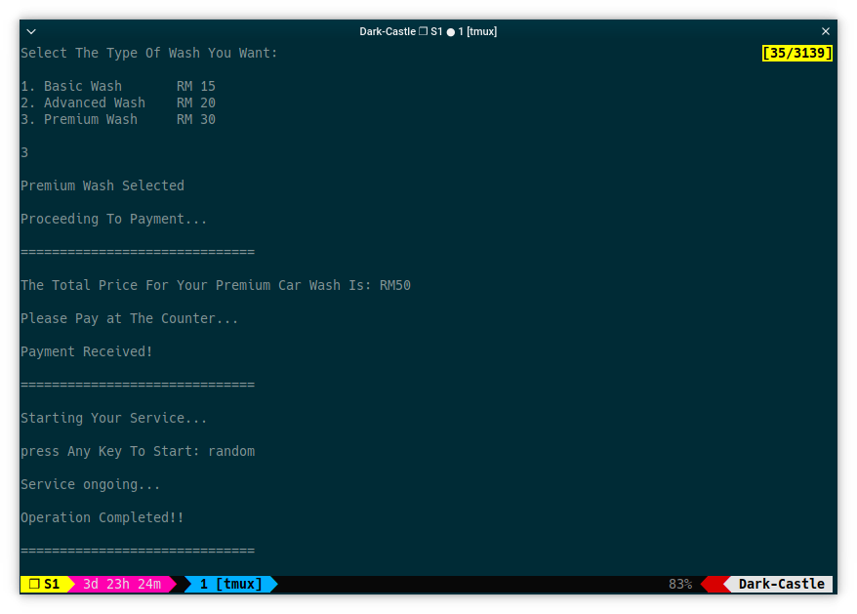
Screenshot

