Slide 2
abstract
Generative Adversarial Networks (GANs), pose the training process as a game between two separate networks:
A generator network and discriminative network that tries to classify samples as either coming from the true distribution p(x) or the model distribution p^​(x).
Every time the discriminator notices a difference between the two distributions the generator adjusts its parameters slightly to make it go away, until at the end the generator exactly reproduces the true data distribution and the discriminator is guessing at random, unable to find a difference.

Slide 3
Literature survey

Slide 4
improvements

Slide 5
background
Neural Networks are good at classifying and predicting things, and AI Researchers wanted to make the neural net more human in nature by allowing it to CREATE rather than just letting it see things, and turns out that Ian Goodfellow was successful in inventing a class of Deep Learning Model which could do that.

Slide 6
Main issues covered
The advantage is that Markov chains are never needed, only backpropagation is used to obtain gradients, no inference is needed during learning, and a wide variety of functions can be incorporated into the model.
Another advantage of adversarial networks is that they can represent very sharp, even degenerate distributions, while methods based on Markov chains require that the distribution be somewhat blurry in order for the chains to be able to mix between modes.

Slide 7
Importance and need of your project
Generative adversarial network (GAN) is proved to be a very effective model/method for training Generative models.
There are a lot of field that needs dataset to train a machine learning though there is less data. You can use GAN generated data for that.
Image super- resolution: take a low- resolution image and synthesize a high-resolution equivalent

Slide 8
Features
Here is a list of some additional techniques that are used to improve GAN training:
Feature Matching
Mini Batch Discrimination
Historical Averaging
One-sided Label Smoothing
Virtual Batch Normalization

Slide 9
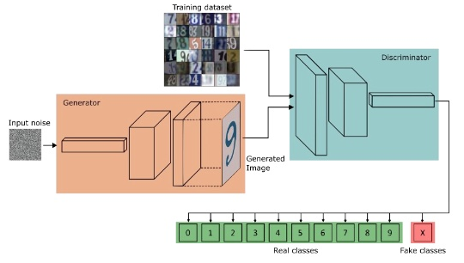
System architecture diagram

Slide 10
Tools and technologies

