Slide 1

Mystical Bureau “SCP Foundation”
Web Application Development Tools
01.01.2025
Author: Alexander Dozorin
St. Code: st81039

Slide 2

Content
INTRODUCTION
RESULTS FROM TESTING
DESIGN
DIFFICULTIES
CONCLUSION

Slide 3
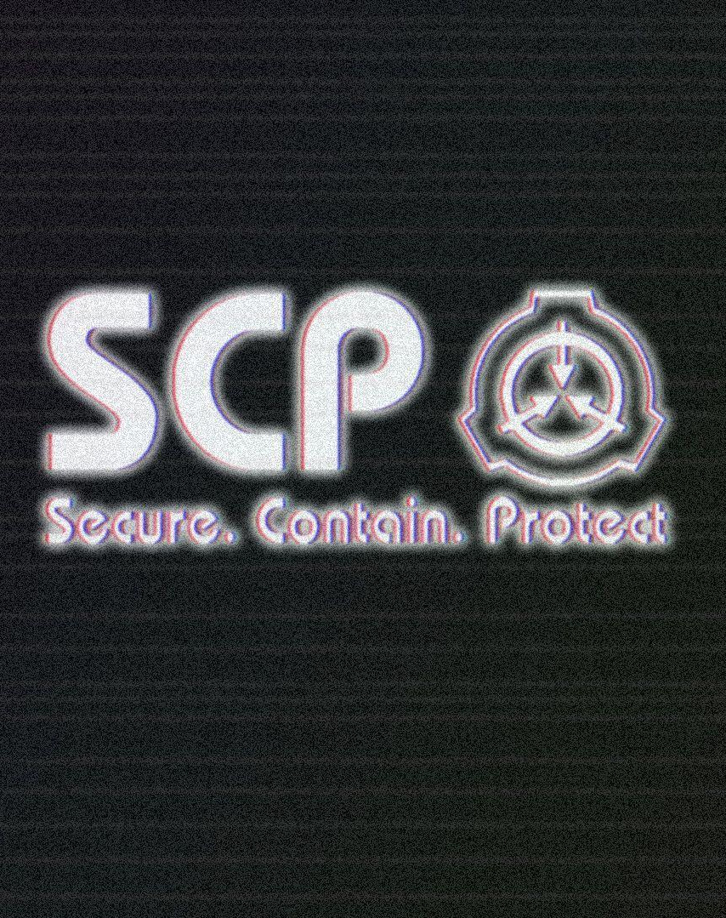
INTRODUCTION
Our program is created for storing records about different abnormalities, where and how they are stored. Our program provide:
Adding, Updating and Deleting records
Filtering and Sorting

Slide 4

Results from Testing
Unit Testing

Slide 5
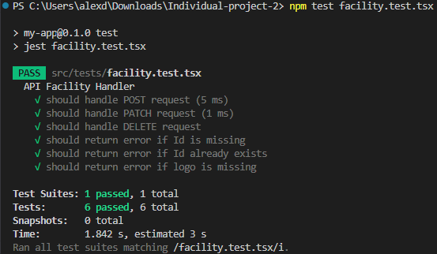
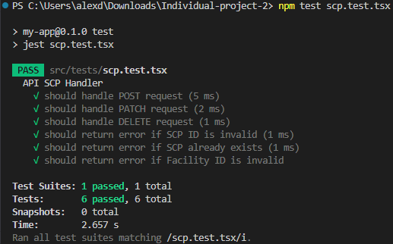
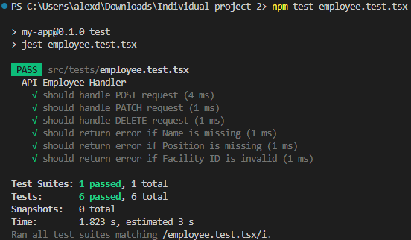
Unit testing
Facility Entity API Test of the POST, PATCH, DELETE, as well checking of the different user scenarios, such as no Facility Id etc.
SCP Entity API Test of the POST, PATCH, DELETE, as well checking of the different user scenarios, such as creation of existing SCP etc.
Employee Entity API Test of the POST, PATCH, DELETE, as well checking of the different user scenarios as creation of the Employee with no Name etc.

Slide 6
Stable Program
All Tests passed!
Therefore, the program is working reliably for different user scenarios including incorrect inputs from user.

Slide 7

Design
User UI

Slide 8
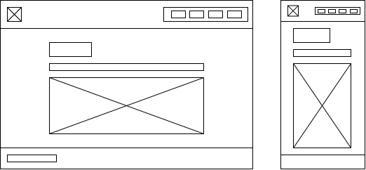
Prototyping
The prototype of the Desktop and Mobile design except the Homepage

Slide 9
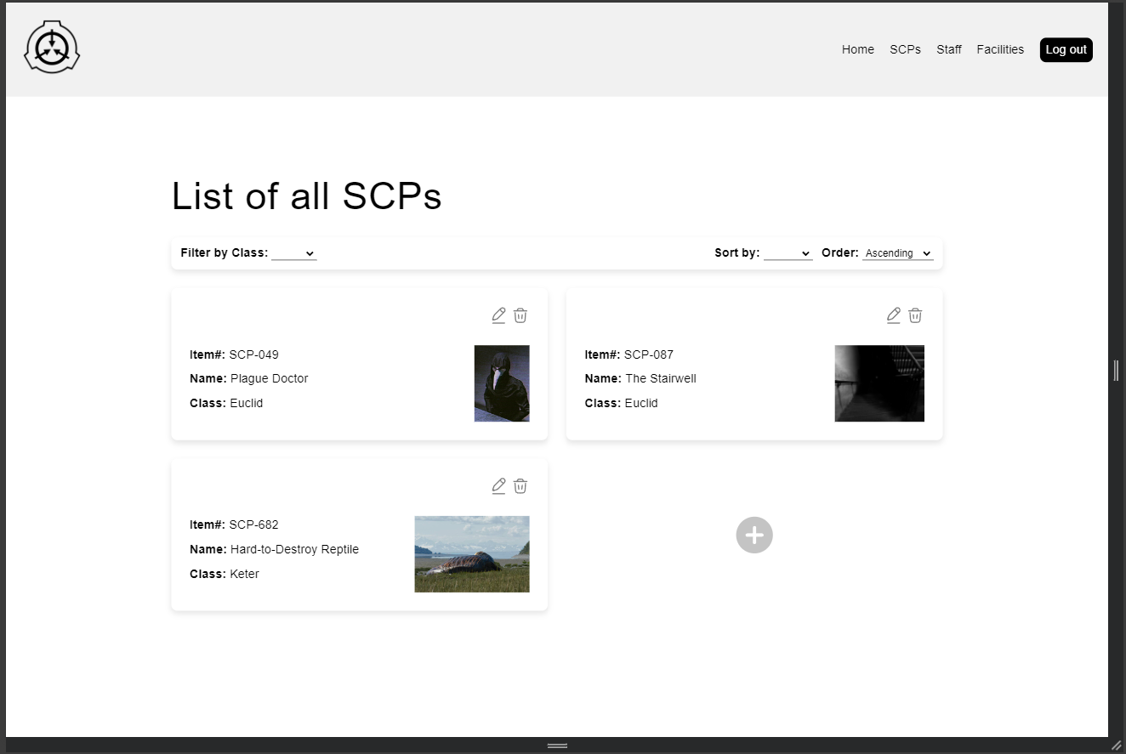
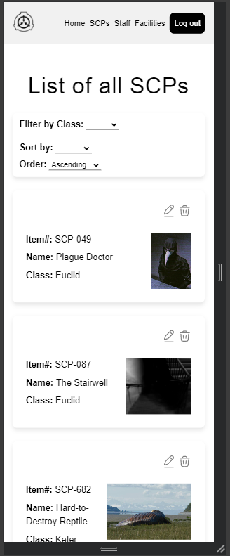
USER Interface
Desktop Design
Mobile Design
Resolution: 1440x960
OS: Windows
Browser: Google Chrome
Resolution: 375x960
OS: Windows
Browser: Google Chrome

Slide 10
Technical Overview
FRONT END
JavaScript Frameworks/Libraries: React
Styling: CSS, SCSS
Structure: Typescript (as HTML)
Languages: Typescript, CSS, SCSS
BACK END
Server-Side Framework: Next.js
Database ORM: Prisma
Database: SQLite
Languages: TypeScript, JavaScript

Slide 11

Conclusion
The program fulfil all the requirements and is working without serious errors. This application will help users to add records about new Abnormalities and allow to classification them by dangerous level etc.

Slide 12


THANK YOU
Alexander Dozorin
https://github.com/BlacktorDied/WebADT/upload/master/Course_Work

