Slide 1
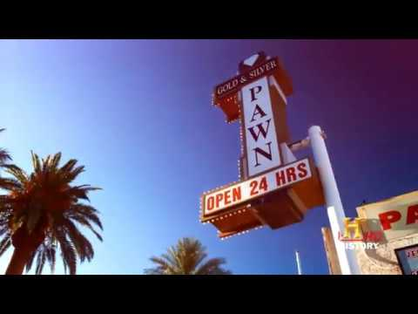
DATA CLEANING
YOU NEVER KNOW WHAT IS GOING TO COME THROUGH THAT ATTACHMENT.

