Slide 1
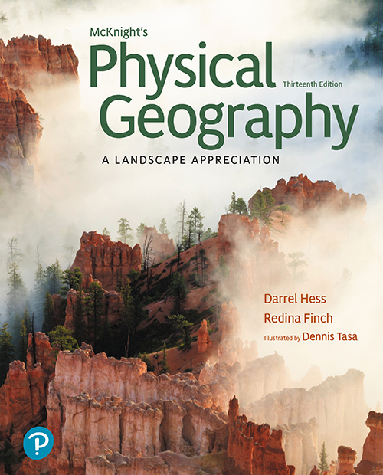

Physical Geography: A Landscape Appreciation
Thirteenth Edition
Lecture
Chapter 1
Introduction to Earth
Copyright © 2022, 2014, 2011 Pearson Education, Inc. All Rights Reserved
Notes:
If this PowerPoint presentation contains mathematical equations, you may need to check that your computer has the following installed:
1) MathType Plugin
2) Math Player (free versions available)
3) NVDA Reader (free versions available)
Slides in this presentation contain hyperlinks. JAWS users should be able to get a list of links by using INSERT+F7

Slide 2
Outline: Introduction to Earth (1 of 3)
The Study of Geography
  Studying the World Geographically
  Geography in the National Parks
Geography and Science
  The Process of Science
  Numbers and Measurement Systems
Environmental Spheres and Earth Systems
  Earth’s Environmental Spheres
  Earth Systems

Slide 3
Outline: Introduction to Earth (2 of 3)
Earth and the Solar System
  The Solar System
  The Size and Shape of Earth
The Geographic Grid―Latitude and Longitude
  Latitude
  Longitude
  Locating Points on the Geographic Grid

Slide 4
Outline: Introduction to Earth (3 of 3)
Earth–Sun Relations and the Seasons
  Earth Movements
  The Annual March of the Seasons
  Seasonal Transitions
  Significance of Seasonal Patterns
Telling Time
  Standard Time
  International Date Line
  Daylight-Saving Time

Slide 5
Key Questions: Introduction to Earth
How do geographers study the world?
How do we make sense of different environments on Earth?
How do we describe location on Earth?
Why do the seasons change?
How do global time zones work?

Slide 6
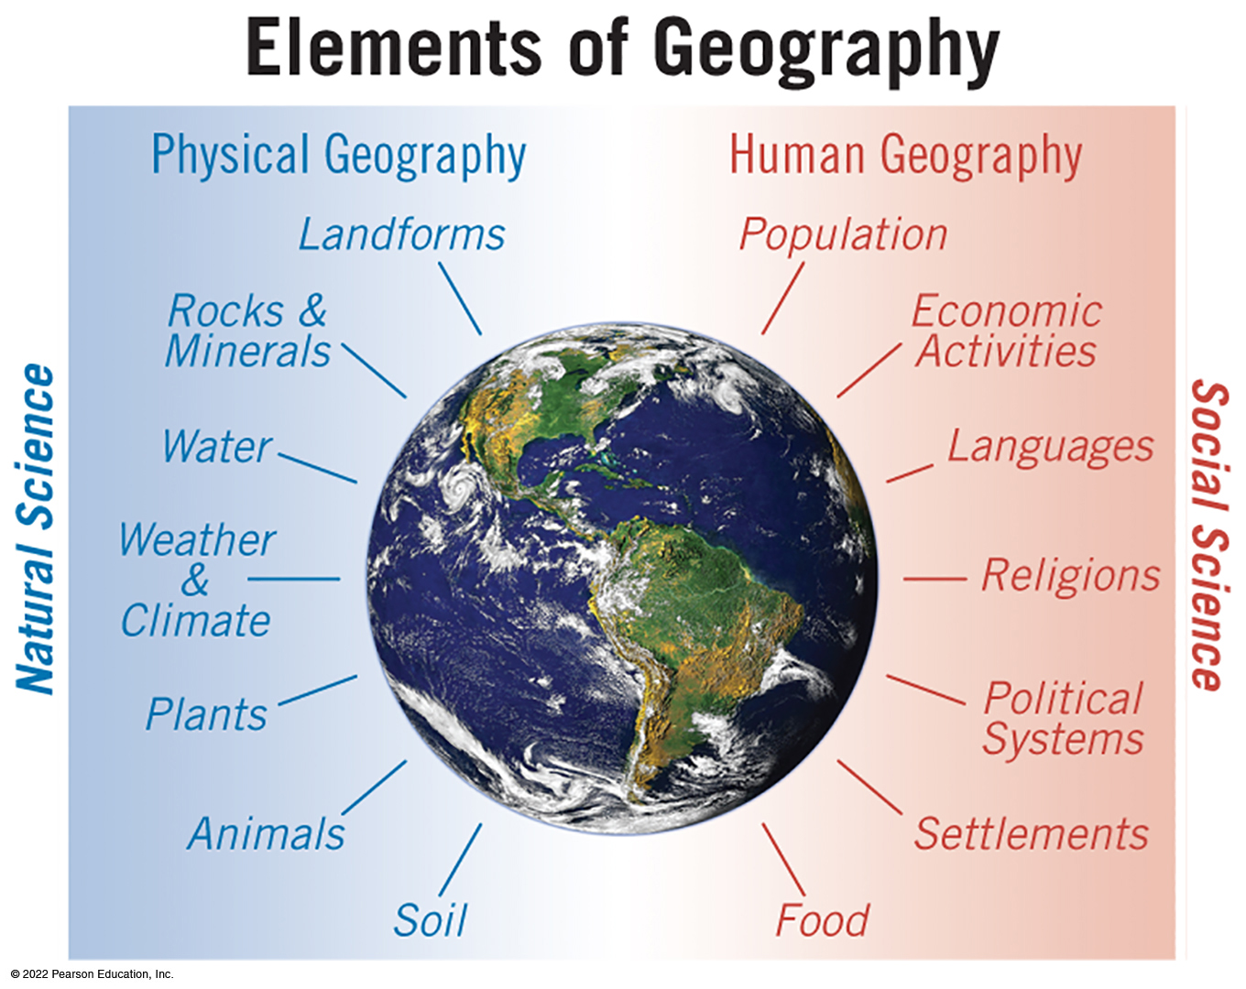
The Study of Geography (1 of 2)
Geography or “Earth description”
  from place to place, how things differ and how they are interrelated
Mobile Field Trip
Introduction to Physical Geography
https://media.pearsoncmg.com/ph/esm/esm_mcknight_physgeo_13/media/
Studying the World Geographically
Physical geography or environmental geography
Human Geography and subfields
Interrelationships
  Natural processes and human alterations
Notes:
Physical geography primarily involves the study of natural science, which includes landforms, rocks and minerals, water, weather and climate, plants, animals, and soil. Human geography primarily entails the study of social science, including population, economic activities, languages, religions, political systems, settlements, and food.

Slide 7
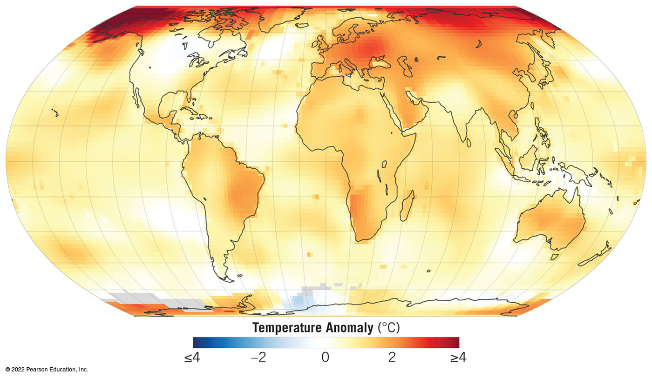
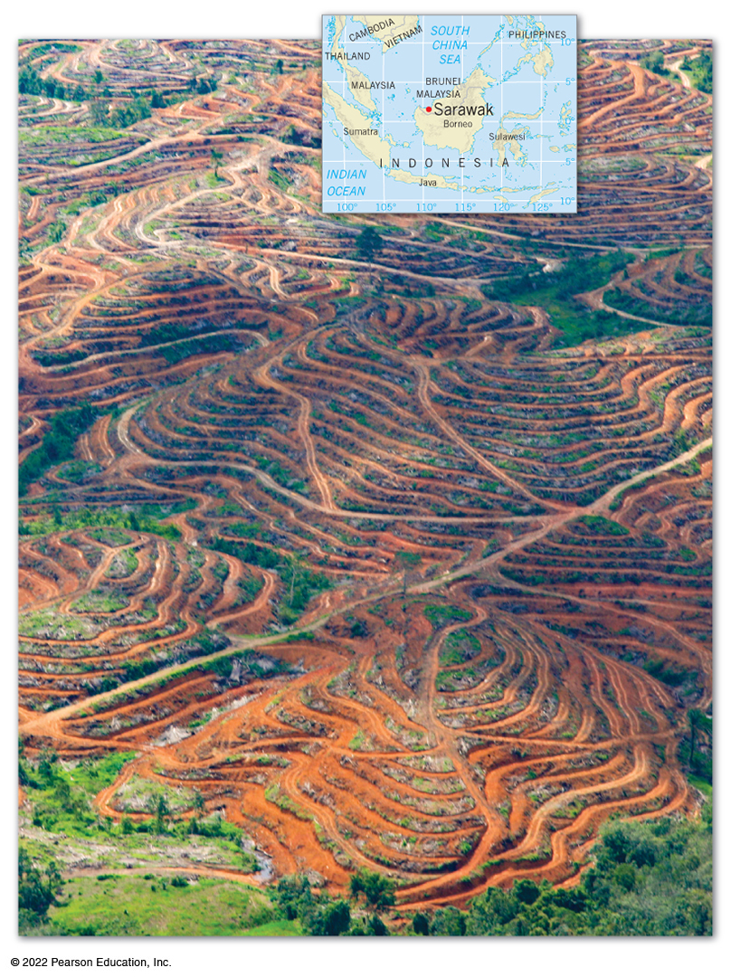
The Study of Geography (2 of 2)
Global Environmental Change
  human-caused and natural processes currently altering landscapes of the world
  special attention to the accelerating impact of human activities on the global environment
Globalization
  processes and consequences of an increasingly interconnected world
  environmental components of global economy
Notes:
On the map, the most significant temperature anomalies increase four degrees Celsius appear over the North Pole and Europe. Generally, the entire planet has increased in temperature about two degrees Celsius.

Slide 8
Geography and Science (1 of 2)
The Process of Science
Scientific method
  observe phenomena
  formulate a hypothesis
  design an experiment to test the hypothesis
  predict the outcome of the experiment
  conduct the experiment
  draw conclusions
A process or an attitude for gaining knowledge
  data collection through observation of phenomena is the basis of knowledge
  based on logical reasoning, skepticism of unsupported conclusions, and willingness to modify or reject long-held ideas in the face of new contradicting evidence
  works by eliminating alternative explanations that are not supported by evidence
  a true “theory” is developed through method, review, and uncertainty

Slide 9
Geography and Science (2 of 2)
Numbers and Measurement Systems
Necessary to quantify and compare scientific processes
International System (S I) versus English System
  units can be converted between systems
Table 1-1 Unit Conversions—Quick Approximations
Blank | S.I. to English Units | English to S.I. Units
Distance: | 1 centimeter = a little less than half inch | 1 inch = about 2 and a half centimeters
Blank | 1 meter = a little more than 3 feet | 1 foot = about one third meters
Blank | 1 kilometer = about 2 thirds mile | 1 yard = about 1 meter
Blank | Blank | 1 mile = about 1 and a half kilometers
Volume: | 1 liter = about 1 quart | 1 quart = about 1 liter
Blank | Blank | 1 gallon = about 4 liters
Mass: | gram = about 1 thirtieth ounce | 1 ounce = about 30 grams
Blank | 1 kilogram 5 about 2 pounds | 1 pound = about half kilogram
Temperature: | 1 degree Celsius change = 1.8 degrees Fahrenheit change | 1 degrees Fahrenheit change 5 about 0.6 degrees change
For exact conversion formulas, see Appendix

Slide 10
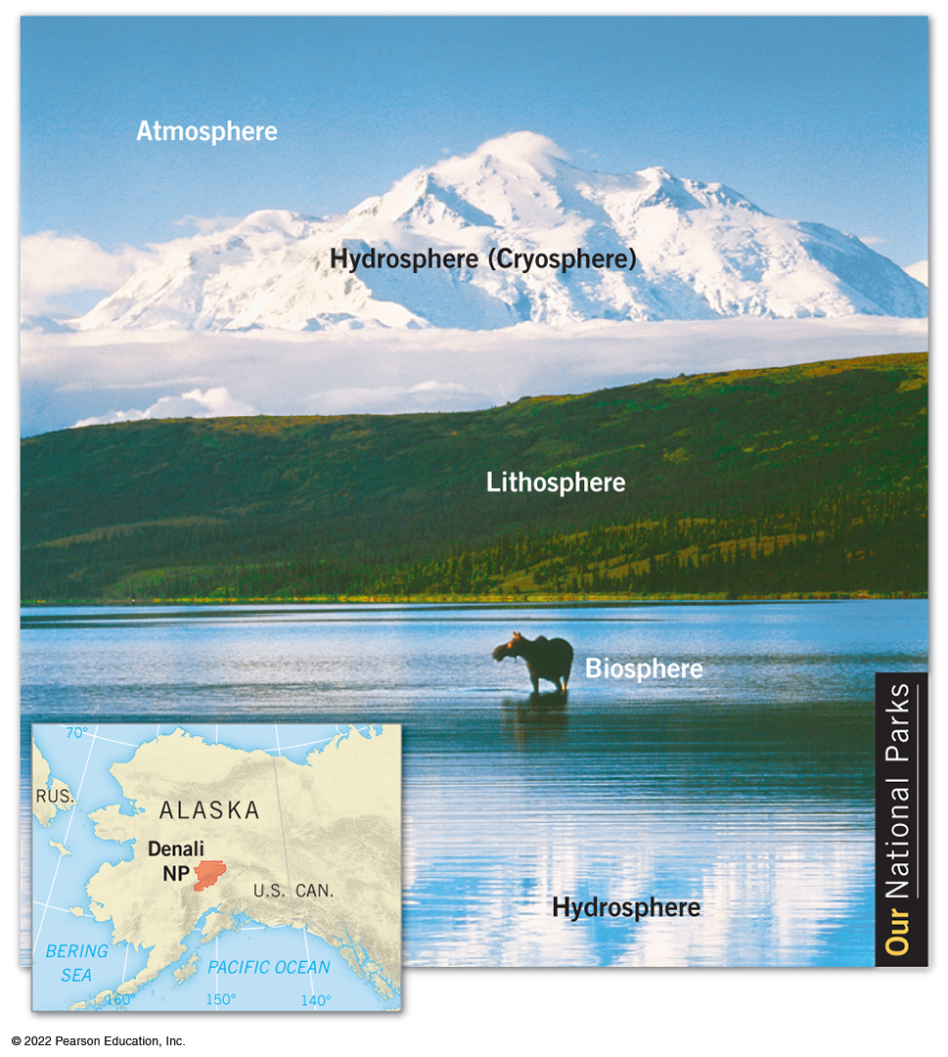
Environmental Spheres and Earth Systems (1 of 3)
Earth’s surface a complex interface
  four principal components of environment meet, overlap, interact, and interconnected
Earth’s Environmental Spheres
Lithosphere is made up of rocks and mineral matter
Atmosphere is a mix of gases
Hydrosphere comprises water in all its forms, frozen water exists in cryosphere
Biosphere encompasses all the parts where living organisms exist
Notes:
The spheres appear in overlapping layers, as follows, the hydrosphere is Wonder Lake, the biosphere is a moose, the lithosphere is a hillside, mount McKinley also appears as the hydrosphere or cryosphere, and the atmosphere is the sky.

Slide 11
Environmental Spheres and Earth Systems (2 of 3)
Earth Systems
Environmental spheres operate, interact as complex Earth systems
  “system” is a collection of things and processes that operate as a whole
Closed Systems
  self-contained systems, which are therefore isolated from outside influences and rarely found in nature
Open Systems
  energy can be exchanged across systems, as inputs and outputs
Equilibrium
  when inputs and outputs are in balance, conditions within system remain the same
Interconnected Systems
  change in one system affects another
Feedback Loops
  outputs that “feed back” into that system, reinforcing change
  positive feedback loops versus negative feedback loops
  tipping point or threshold is point of instability and changes abruptly

Slide 12
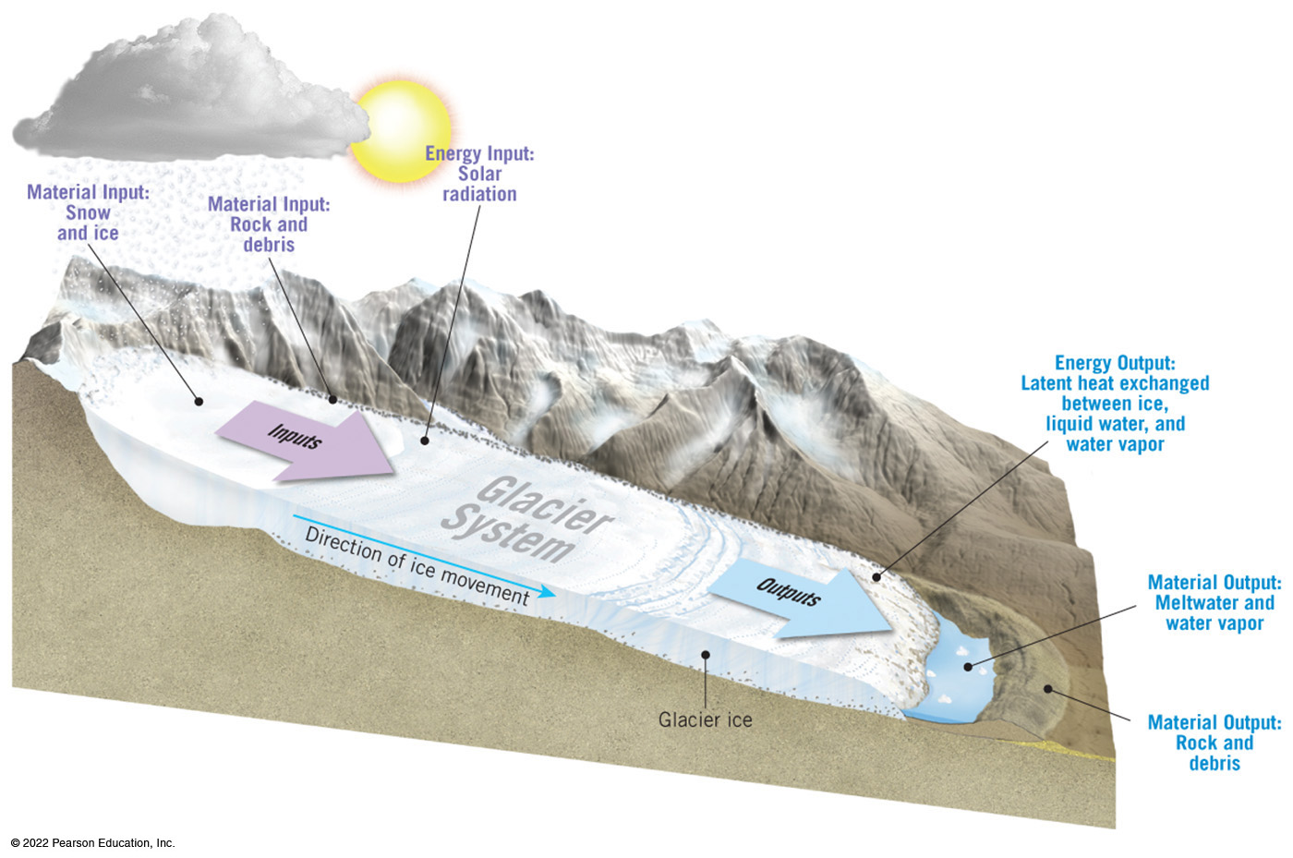
Environmental Spheres and Earth Systems (3 of 3)
Glacier as an open system
Notes:
The diagram appears as follows. The primary material inputs are snow, ice, and rock and debris. Glacier ice moves down a slope to where the primary material outputs are deposited. These material outputs are meltwater, water vapor, and rock and debris. The energy input of incoming solar radiation is exchanged for the energy output of latent heat exchanged between ice, liquid water, and water vapor.

Slide 13
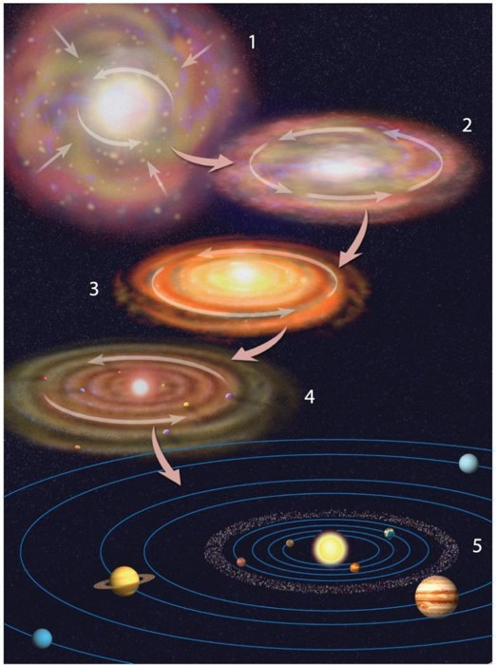
Earth and the Solar System (1 of 4)
The Solar System
Open system, Earth interacts with
  planets, “moons,” dwarf planets, comets, asteroids, and meteoroids
Origins
  incompletely understood
  scientific consensus, big bang took place 13.7 billion years ago
  our system originated between 4.5 and 5 billion years ago when a nebula contracted into protostar and then into our Sun
Animation
Solar System Formation
https://media.pearsoncmg.com/ph/esm/esm_mcknight_physgeo_13/media/

Slide 14
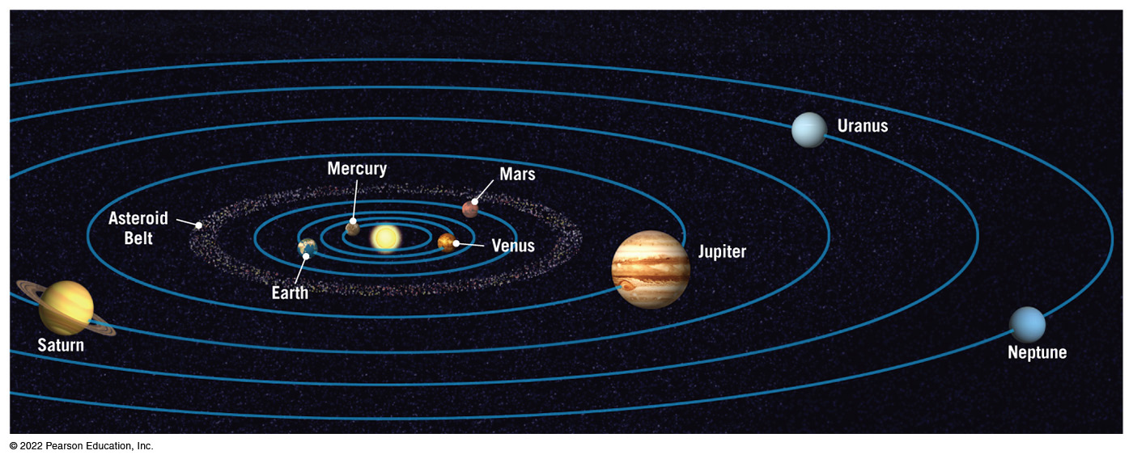
Earth and the Solar System (2 of 4)
The Planets
  eight planets revolve in elliptical orbits around the Sun
  four inner terrestrial planets are mostly smaller, denser, composed of mineral matter with small atmospheres
  four outer Jovian planets (gas giants) have deep atmospheres and frozen interiors

Slide 15
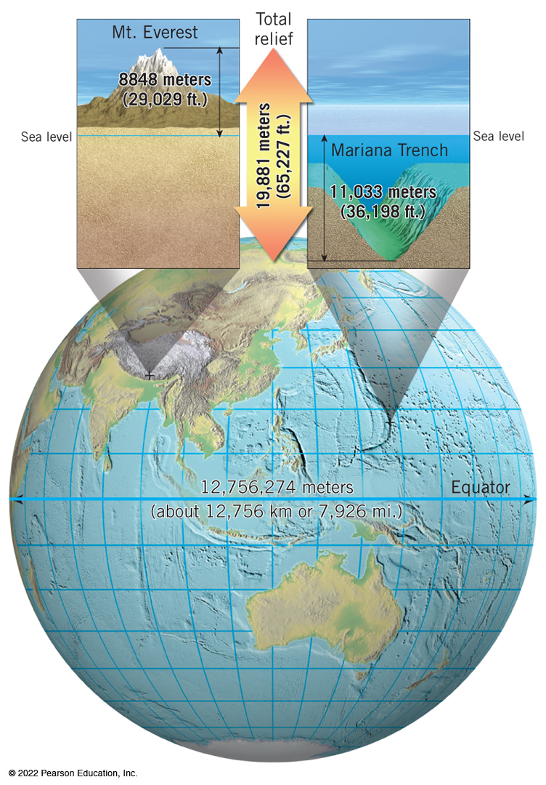
Earth and the Solar System (3 of 4)
The Size and Shape of Earth
The Size of Earth
  total relief, or the difference between highest mountain and deepest trench, is minor on the planetary scale
  perception of relative sizes distorted by maps and globes
Notes:
The highest point on Earth is Mount Everest, located in the Himalayas, and stands at 8,848 meters (29,029 feet) above sea level. The lowest point on Earth is Mariana Trench, located in the Western Pacific Ocean, and is found 11,033 meters (36,198 feet) below sea level. The difference between these two land marks is 19,881 meters (65,227 feet).

Slide 16
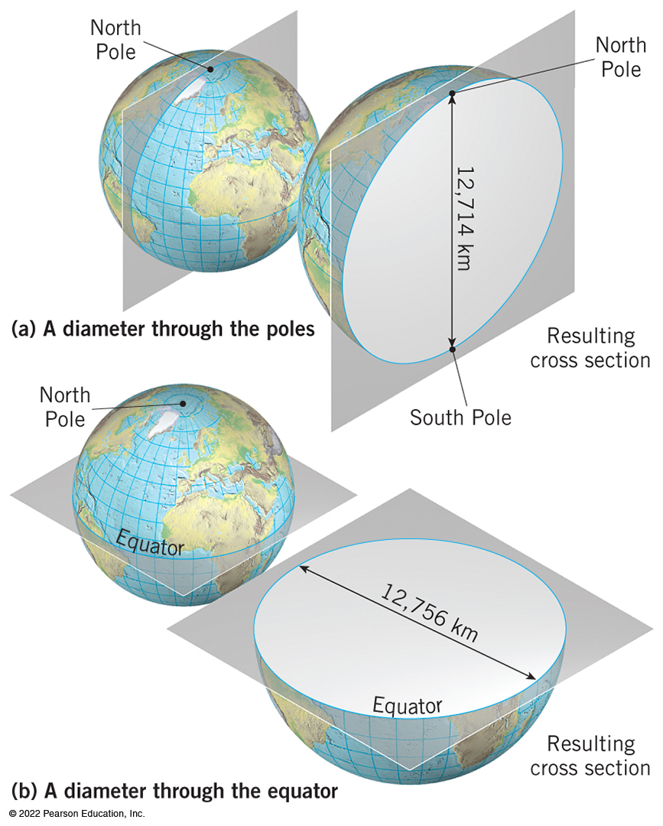
Earth and the Solar System (4 of 4)
The Shape of Earth
  not quite spherical
  as a rotating body, with pliable rocks
    bulges at the equator
    flattens at the poles
  properly called as an oblate spheroid
Notes:
In diagram A, a plane is drawn to split the Earth through the North and South Poles. The resulting cross section has a diameter of 12,714 kilometers. In diagram B, a plane is drawn to split the Earth at the equator, an equatorial plane. The resulting cross section has a diameter of 12,756 kilometers.

Slide 17
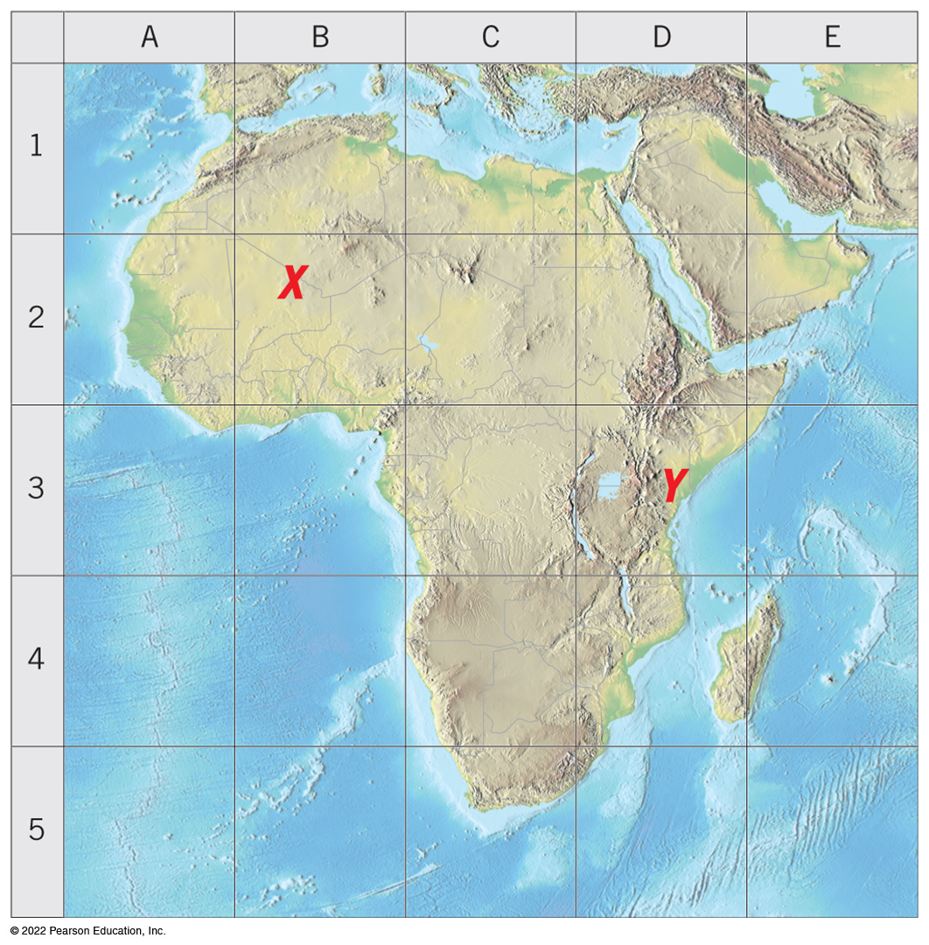
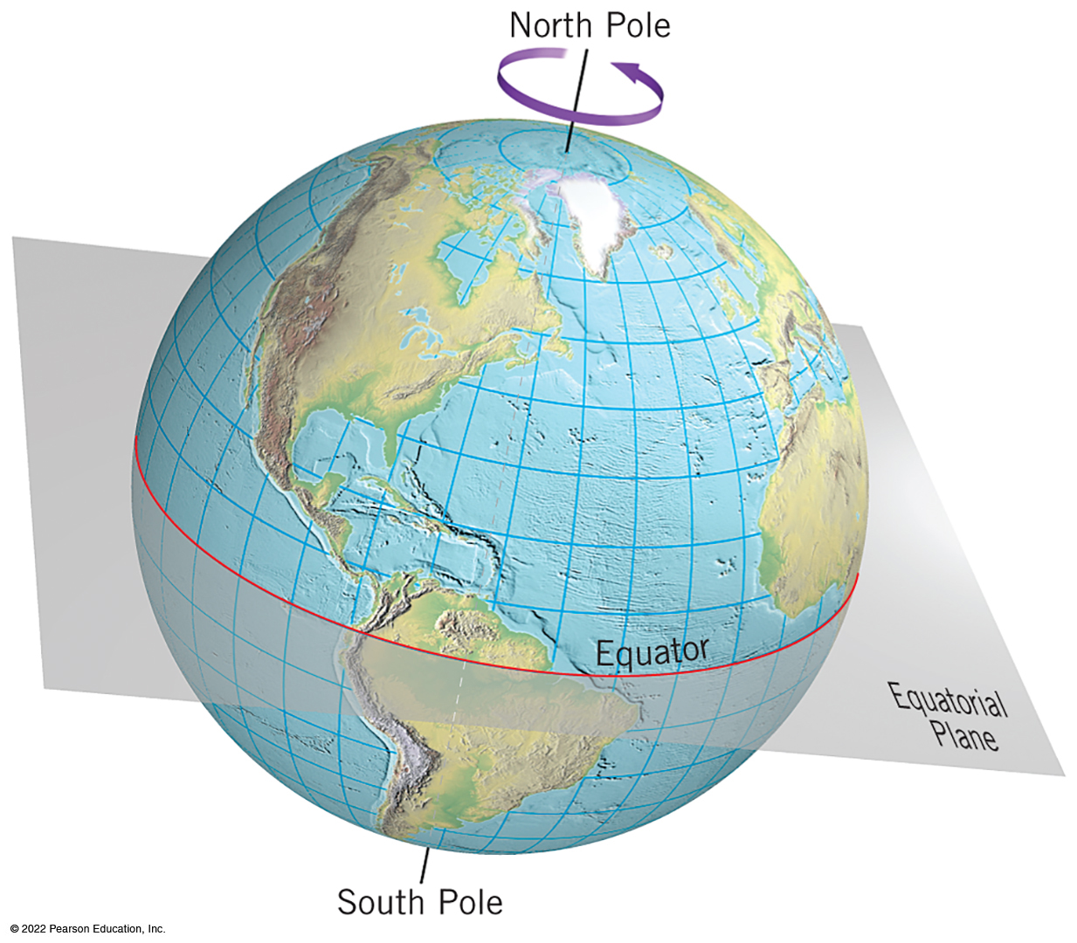
The Geographic Grid―Latitude and Longitude (1 of 8)
A system of accurate location
  a graticule is a grid system of two sets of lines, intersect at right angles
  Earth’s rotation axis is an imaginary line passing through North Pole and South Pole
  plane of the equator is an imaginary line through Earth’s midline or equator
Notes:
In the grid system the columns are labeled A through E, and the rows are labeled one through 5. The points X and Y appear on the map located in the squares B2 and D3, respectively.

Slide 18
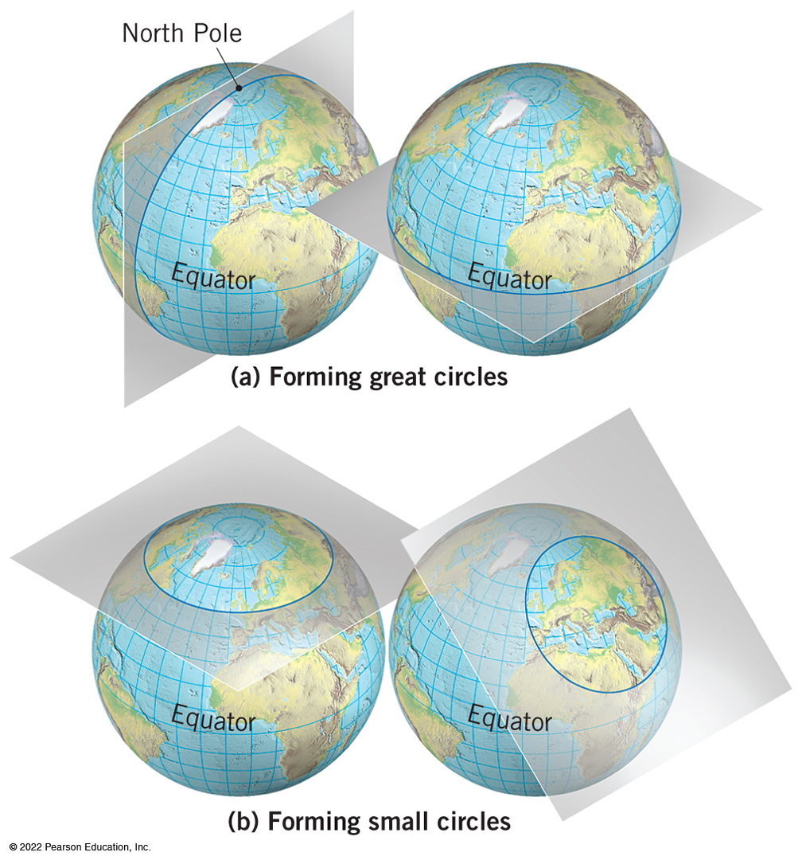
The Geographic Grid―Latitude and Longitude (2 of 8)
Great Circles
  any plane that passes through center of a sphere
  divide into two equal halves or hemispheres
    the equator is a great circle
  great circle route is a path between two points along the arc of a great circle is always the shortest route
Small circles do not pass through center
Notes:
The models show that great circles form when a plane passes through the center of a sphere, whereas small circles form when the plane passes through any other part of the sphere.

Slide 19
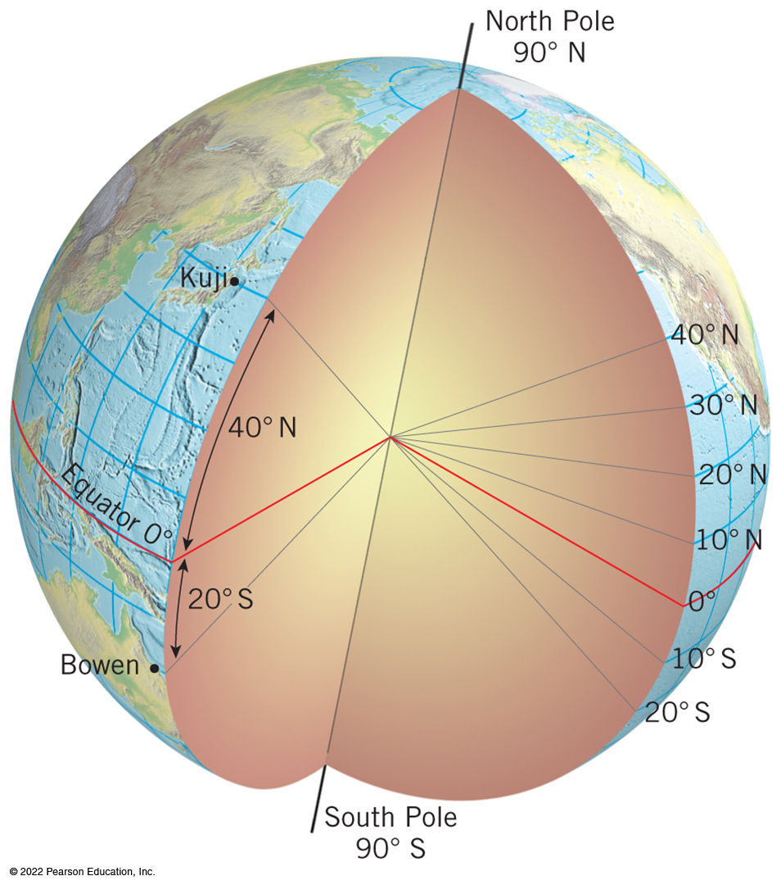
The Geographic Grid―Latitude and Longitude (3 of 8)
Latitude
Description of location as an angle north or south of equator
  expressed in degrees, minutes, and seconds or decimal notation
  at equator
  north at North Pole,
  south at South Pole
Notes:
In the model an imaginary line is drawn from Kuji, Japan, to Earth’s center. The line makes an angle of 40 degrees with the equator. Therefore, Kuji’s latitude is 40 degrees North. Likewise, an imaginary line from Bowen, Australia, to Earth’s center makes an angle of 20 degrees, giving this city a latitude of 20 degrees south.

Slide 20
The Geographic Grid―Latitude and Longitude (4 of 8)
Parallel is a line that connects all points of the same latitude
  equator parallel, at
  latitude, the only great circle
  other parallels are small circles
  North Pole and South Pole are not lines, but points, or infinitely small parallels

Slide 21
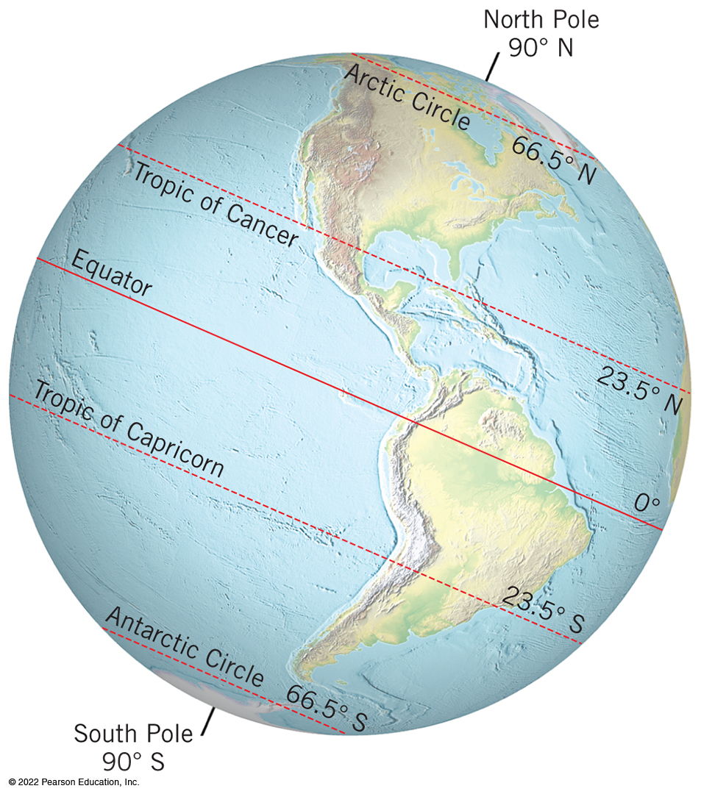
The Geographic Grid―Latitude and Longitude (5 of 8)
Seven significant latitudes
  special locations on Earth where Sun’s rays strike the surface each year
Descriptive Zones of Latitude
  bound by seven significant latitudes into bands or zones
  Equatorial, tropical, subtropical, low latitude, midlatitude, high latitude, and polar
Nautical Miles
  Measurement using knots
Notes:
The seven important latitudes appear as follows.
The North Pole at 90 degrees north.
The arctic circle at 66.5 degrees north
The Tropic of Cancer at 23.5 degrees north.
The equator at 0 degrees.
The Tropic of Capricorn at 23.5 degrees south.
The Antarctic circle at 66.5 degrees south.
The South Pole at 90 degrees south.

Slide 22
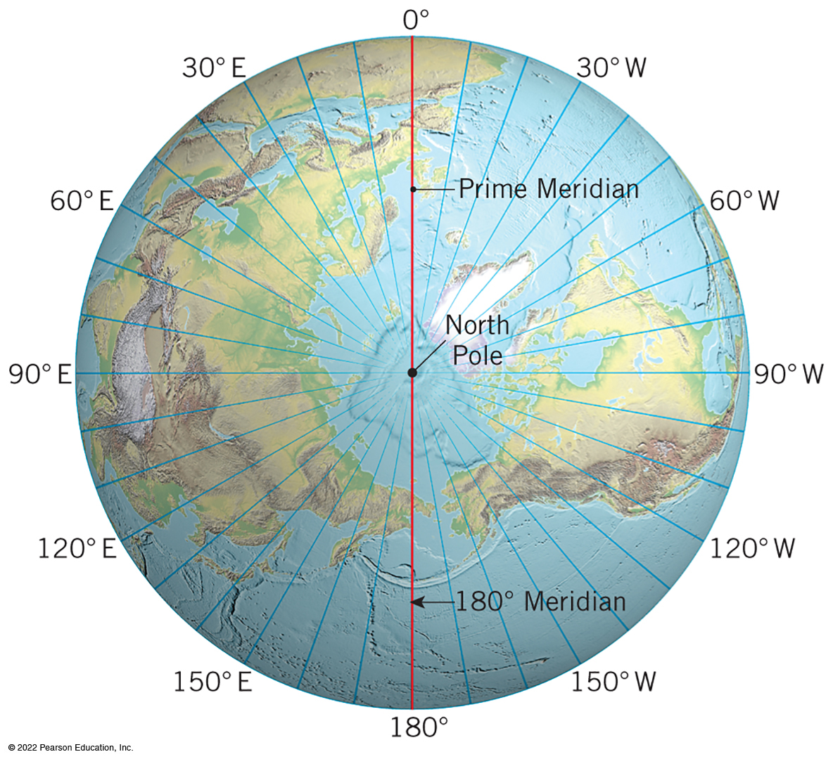
The Geographic Grid―Latitude and Longitude (6 of 8)
Longitude
Angular description of location, east or west
Meridians are imaginary lines extending from pole to pole
Cross parallels at right angles
Farthest apart at equator, converge at the poles
Notes:
In the model all meridian planes are perpendicular to the plane on the page. The 0 degree prime meridian line continues at the pole and becomes the 180 degree median line. Similarly, the 90 degree west meridian line continues at the pole and becomes the 90 degree East meridian line.

Slide 23
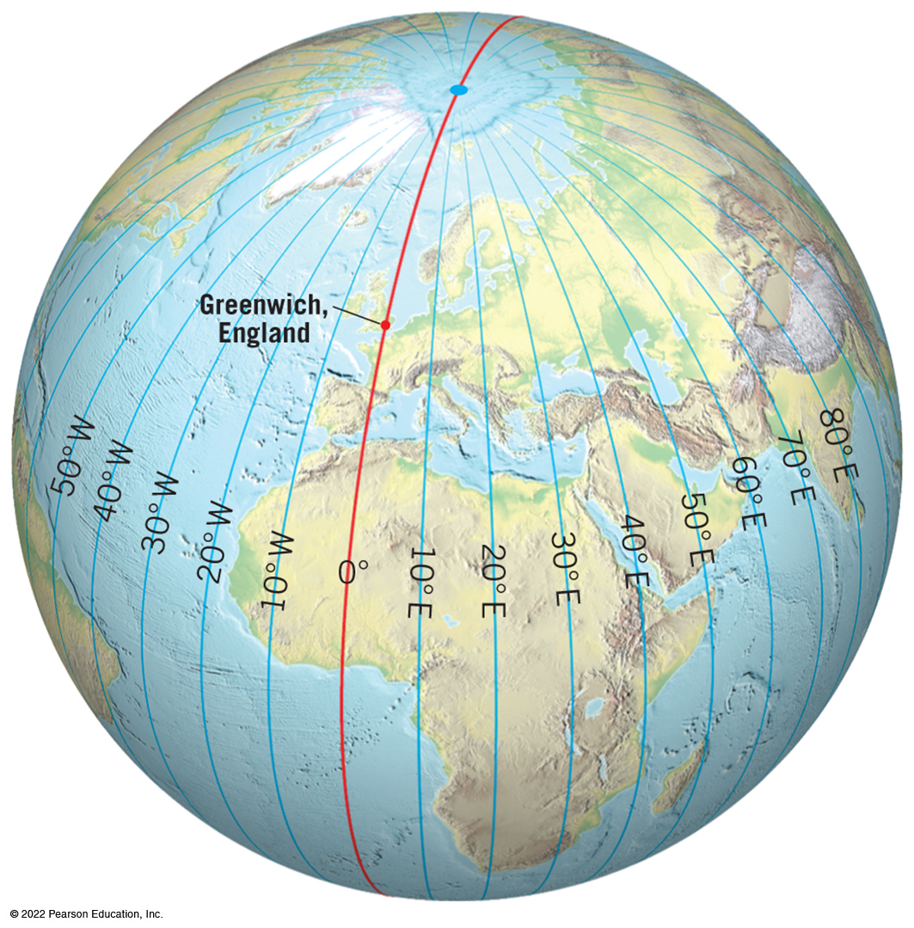
The Geographic Grid―Latitude and Longitude (7 of 8)
Establishing the Prime Meridian
  no natural baseline like the equator
  international conference selected prime meridian
  meridian was chosen as
  Greenwich, England
Measuring Longitude
  meridian in the middle
  of the Pacific
  distance between meridians

Slide 24
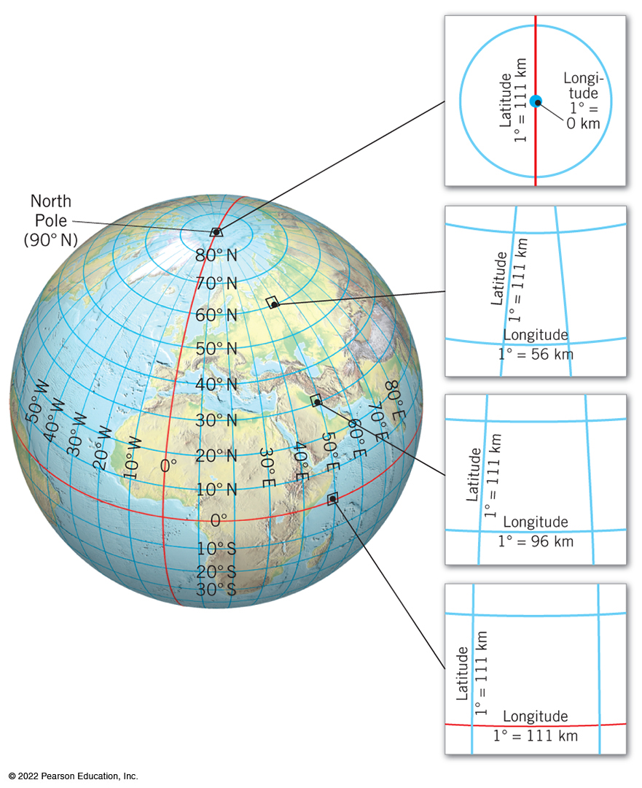
The Geographic Grid―Latitude and Longitude (8 of 8)
Locating Points on the Geographic Grid
Precise location
Latitude angles referenced first with N or S
Longitude angles referenced second with E or W
Notes:
Four locations of interest show how the distance of one degrees longitude becomes greater as it moves further from the pole.
The four locations of interest in the model appear as follows.
One degree longitude at the North Pole equals 0 kilometers.
One degree longitude at 60 degrees North latitude equals 56 kilometers.
One degree longitude at 30 degrees North latitude equals about 96 kilometers.
One degree longitude at the equator equals about 111 kilometers.

Slide 25
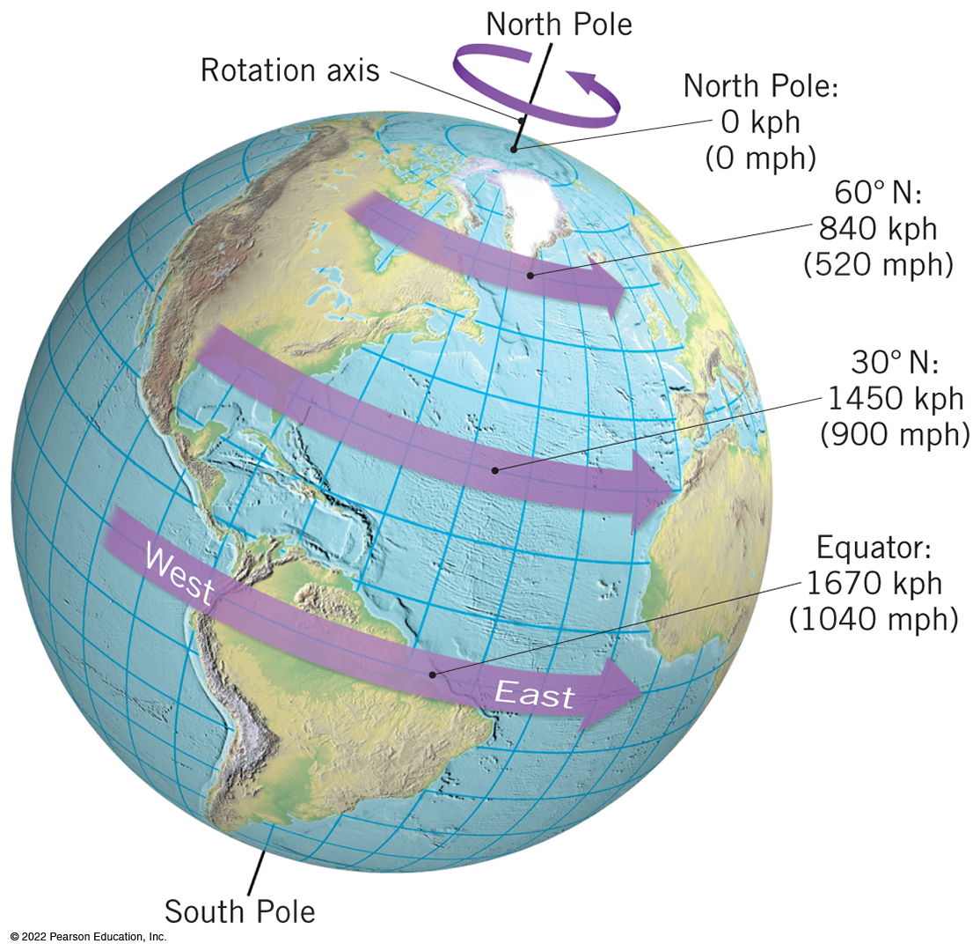
Earth–Sun Relations and the Seasons (1 of 10)
Earth Movements
Earth’s Rotation on Its Axis
  rotation from west to east on its axis takes 24 hours
  speed varies by latitude
  relative to the North Pole, from space, rotation is counterclockwise, or eastward
Animation
Earth-Sun Relations
https://media.pearsoncmg.com/ph/esm/esm_mcknight_physgeo_13/media/
Notes:
The speeds appear as follows for the varying latitudes.
At the equator the speed is 1,670 k p h (1,040 m p h).
At 30 degrees north the speed is 1,450 k p h (900 m p h).
At 60 degrees north the speed is 840 k p h (520 m p h).
At the North Pole the speed is effectively 0 k p h slash m p h.

Slide 26
Earth–Sun Relations and the Seasons (2 of 10)
Rotation’s important effects
  diurnal transition from daylight to darkness, human circadian cycles
  pull of the Moon and the Sun, effect on tides
  deflection of wind and ocean currents by the Coriolis effect
Notes:
The speeds appear as follows for the varying latitudes.
At the equator the speed is 1,670 k p h (1,040 m p h).
At 30 degrees north the speed is 1,450 k p h (900 m p h).
At 60 degrees north the speed is 840 k p h (520 m p h).
At the North Pole the speed is effectively 0 k p h slash m p h.

Slide 27
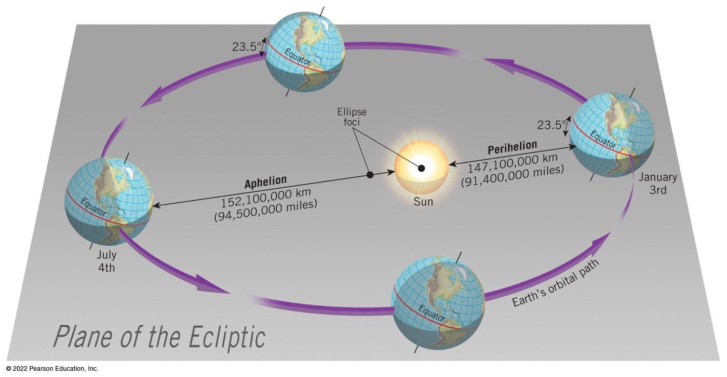
Earth–Sun Relations and the Seasons (3 of 10)
Earth’s Revolution around the Sun
  revolution, orbit around the Sun is an ellipse
    tropical year takes 365.25 days
  Earth−Sun distance is not constant
    perihelion is closest point to the Sun and aphelion is farthest point to the Sun
  Earth–Sun distance does not cause change in seasons
Notes:
The schematic shows that at perihelion the Earth is about 147,100,000 kilometers (91,400,000 miles) from the sun. At aphelion the Earth’s distance from the sun is about 152,100,000 kilometers (94,500,000 miles).

Slide 28
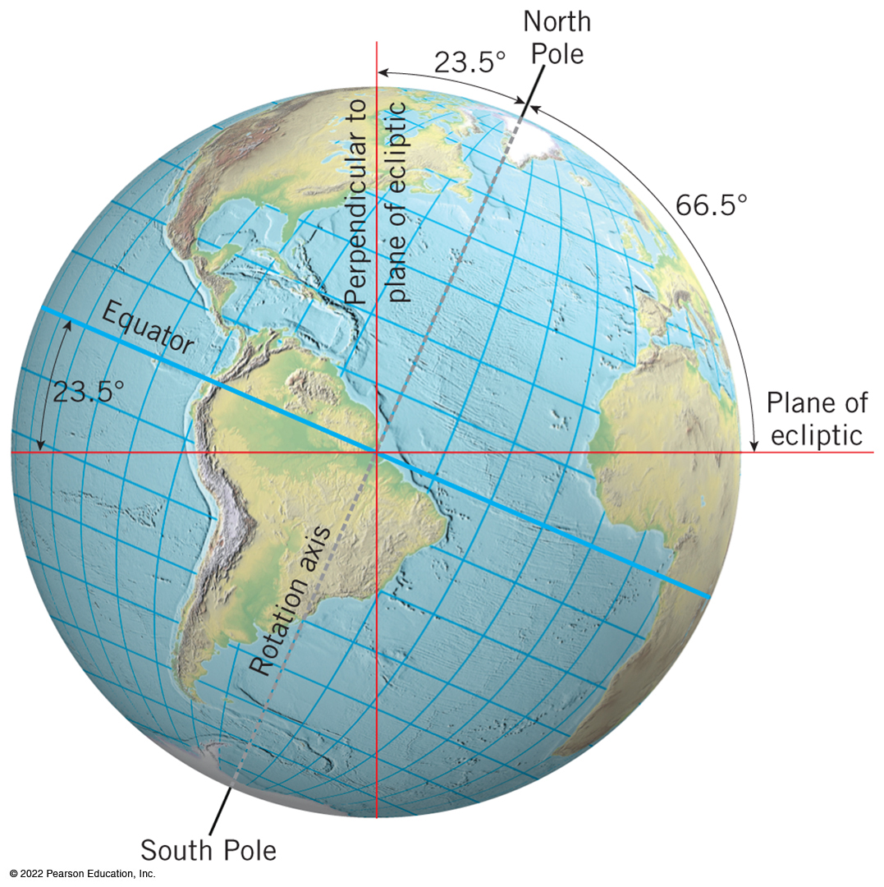
Earth–Sun Relations and the Seasons (4 of 10)
Inclination of Earth’s Axis
  based on imaginary plane of the ecliptic
  axis is tilted
  known as inclination of Earth’s axis
Polarity of Earth’s Axis
  axis always points toward the same stars
  known as polarity of Earth’s axis or parallelism

Slide 29
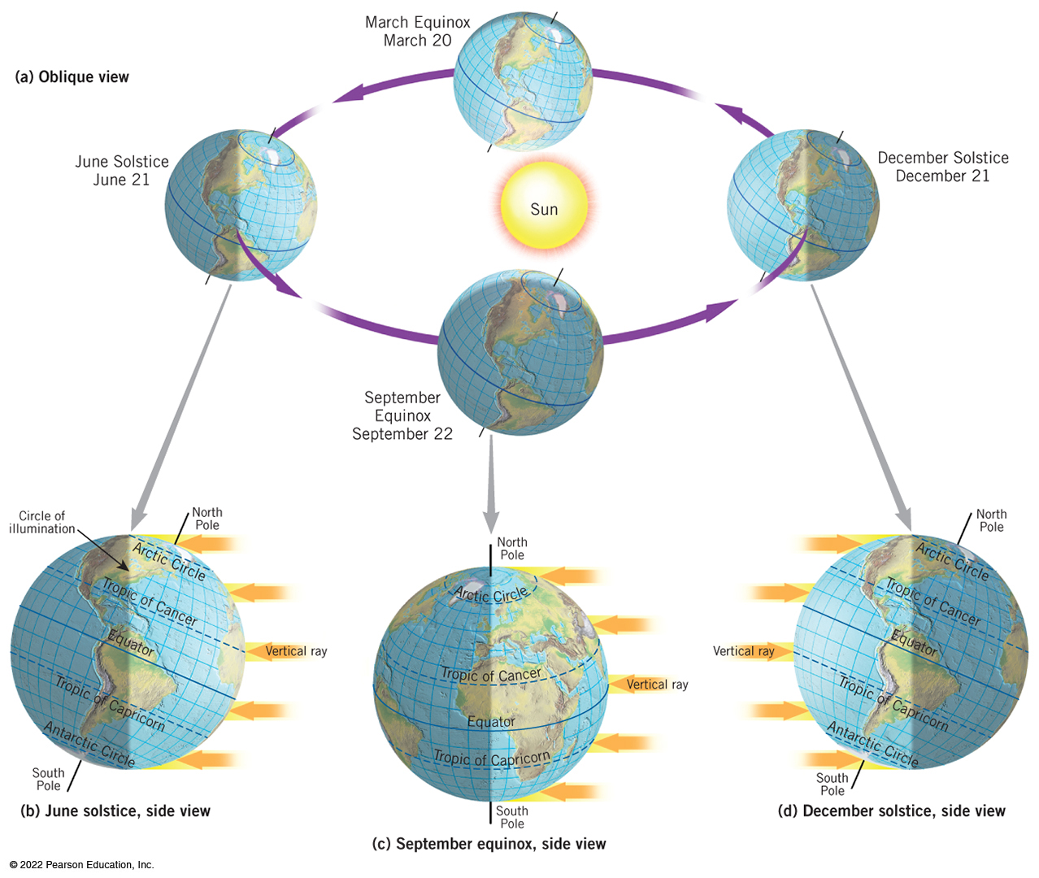
Earth–Sun Relations and the Seasons (5 of 10)
The Annual March of the Seasons
Resulting from combined effects of rotation, revolution, inclination, and polarity
Each year’s variation in day length and angle of the Sun at Earth’s surface
Notes:
The schematic views appear as follows.
The oblique view shows the Earth to Sun relations on the June solstice, September equinox, December solstice, and March equinox. The axis of the Earth is always tilted toward the North Star, so during the June solstice the North Pole is tilted toward the sun, during the December solstice the North Pole is tilted away from the sun, and during the March and September equinoxes the North Pole is tilted not toward or away, but parallel to the sun.
A side view of the June solstice shows the vertical rays of the noon Sun striking 23.5 degrees North latitude. When looking at North America, the circle of illumination connects the western edge of the arctic circle in a straight line to the eastern edge of the Antarctic circle. The Atlantic Ocean is in daylight, while the Pacific Ocean is in darkness.
A side view of the September equinox shows the vertical rays of the noon Sun strike the equator. The circle of illumination connects the North Pole to the South Pole in a straight line.
A side view of the December solstice shows the vertical rays of the noon Sun strike 23.5 degrees south latitude. When looking at North America, the circle of illumination connects the western edge of the arctic circle in a straight line to the eastern edge of the Antarctic circle. The Pacific Ocean is in daylight, while the Atlantic Ocean is in darkness.

Slide 30
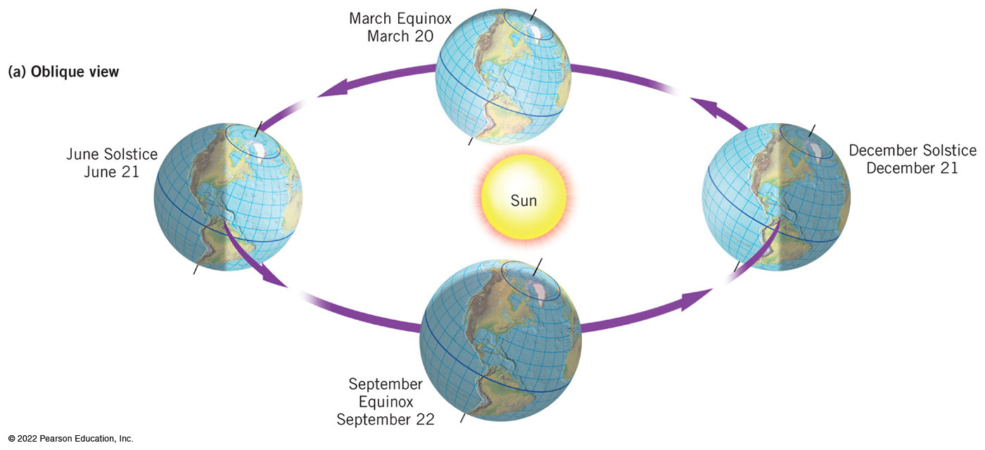
Earth–Sun Relations and the Seasons (6 of 10)
Seasonal changes vary by latitude
  the declination of the Sun is the latitude receiving vertical rays of the Sun
  the solar altitude is Sun’s height over the horizon
  the length of day varies in number of daylight hours
Notes:
An oblique view shows the Earth to Sun relations on the June solstice, September equinox, December solstice, and March equinox. The axis of the Earth is always tilted toward the North Star, so during the June solstice the North Pole is tilted toward the sun, during the December solstice the North Pole is tilted away from the sun, and during the March and September equinoxes the North Pole is tilted not toward or away, but parallel to the sun.

Slide 31
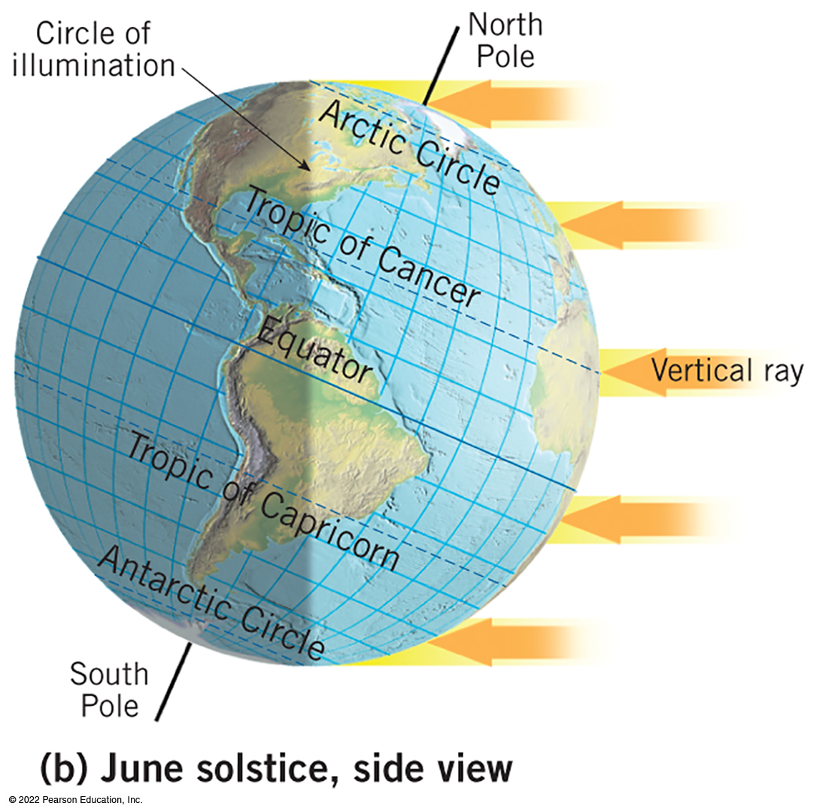
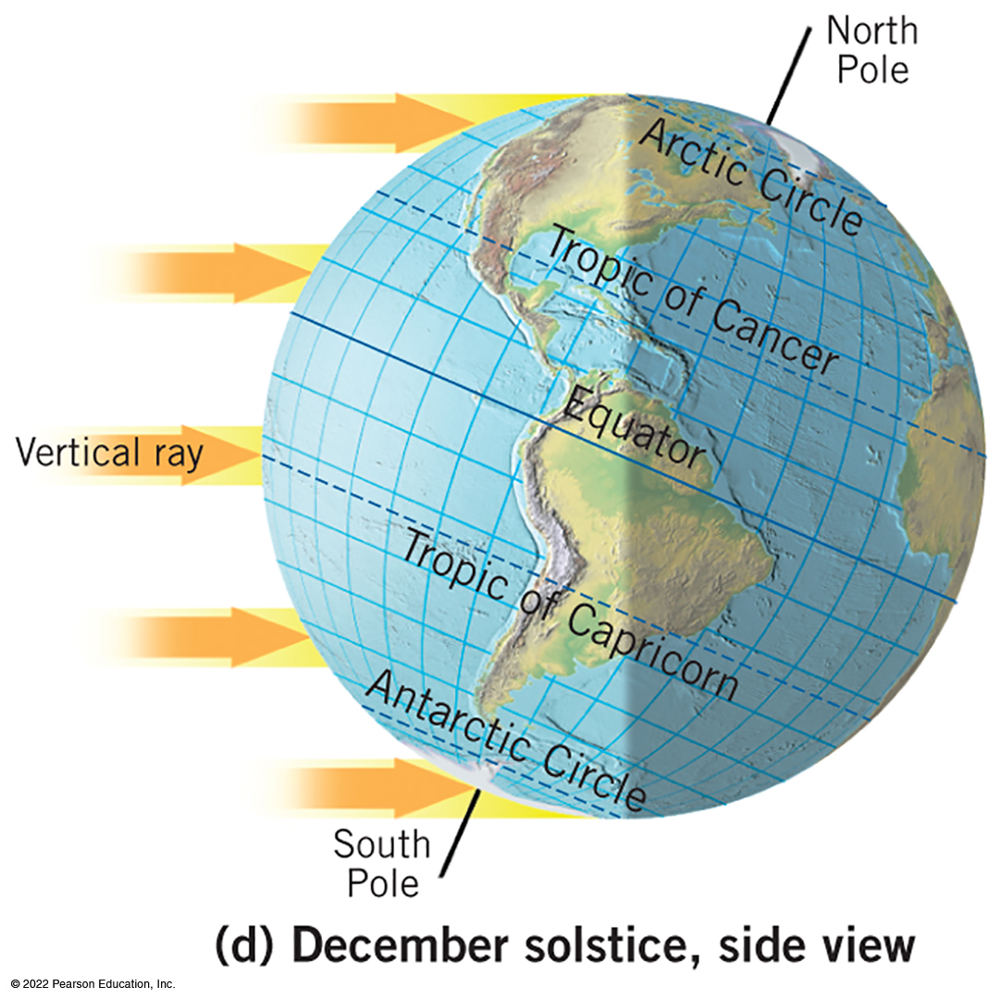
Earth–Sun Relations and the Seasons (7 of 10)
June solstice
  On the June solstice, North Pole oriented toward the Sun
  vertical rays strike at Tropic of Cancer
  circle of illumination bisects the equator and impacts polar circles
  Antarctic Circle dark for 24 hours, Arctic Circle in 24 hours of light
December solstice
  On the December solstice, North Pole oriented away from the Sun
  vertical rays at Tropic of Capricorn
  Arctic Circle in 24 hours of dark, Antarctic Circle in 24 hours of light
Notes:
A side view of the June solstice shows the vertical rays of the noon Sun striking 23.5 degrees North latitude. When looking at North America, the circle of illumination connects the western edge of the arctic circle in a straight line to the eastern edge of the Antarctic circle. The Atlantic Ocean is in daylight, while the Pacific Ocean is in darkness.
A side view of the December solstice shows the vertical rays of the noon Sun strike 23.5 degrees south latitude. When looking at North America, the circle of illumination connects the western edge of the arctic circle in a straight line to the eastern edge of the Antarctic circle. The Pacific Ocean is in daylight, while the Atlantic Ocean is in darkness.

Slide 32
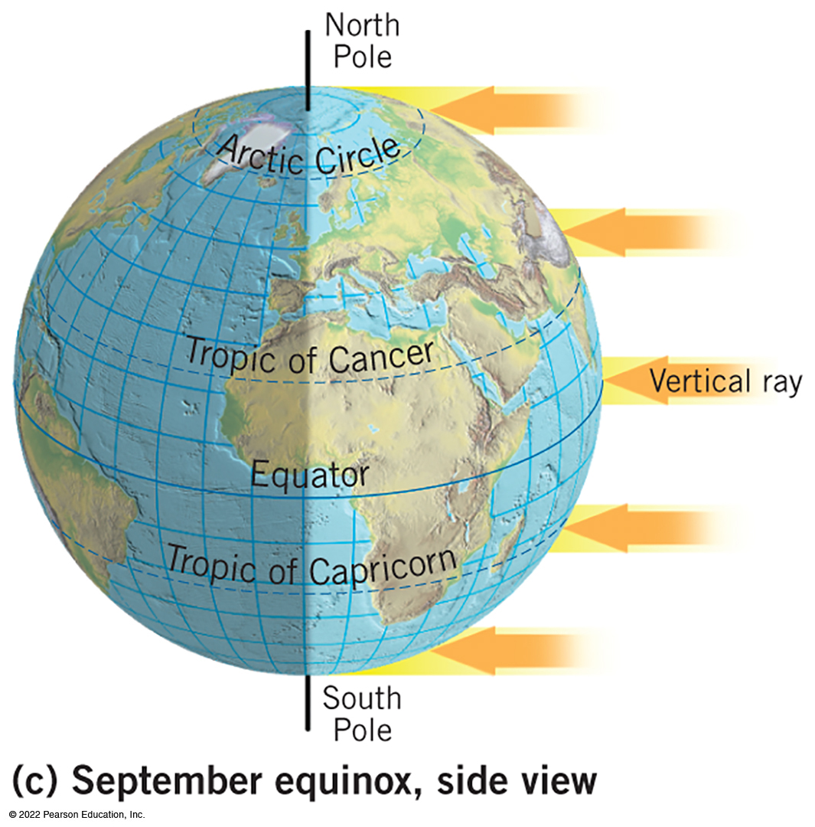
Earth–Sun Relations and the Seasons (8 of 10)
September Equinox
  vertical rays at the Equator
  circle of illumination bisects poles, all parallels
  brings 12 hours of light and dark only that day
March Equinox
  Earth–Sun relationship at March equinox identical to September equinox
each equinox starts spring/fall in a hemisphere

Slide 33
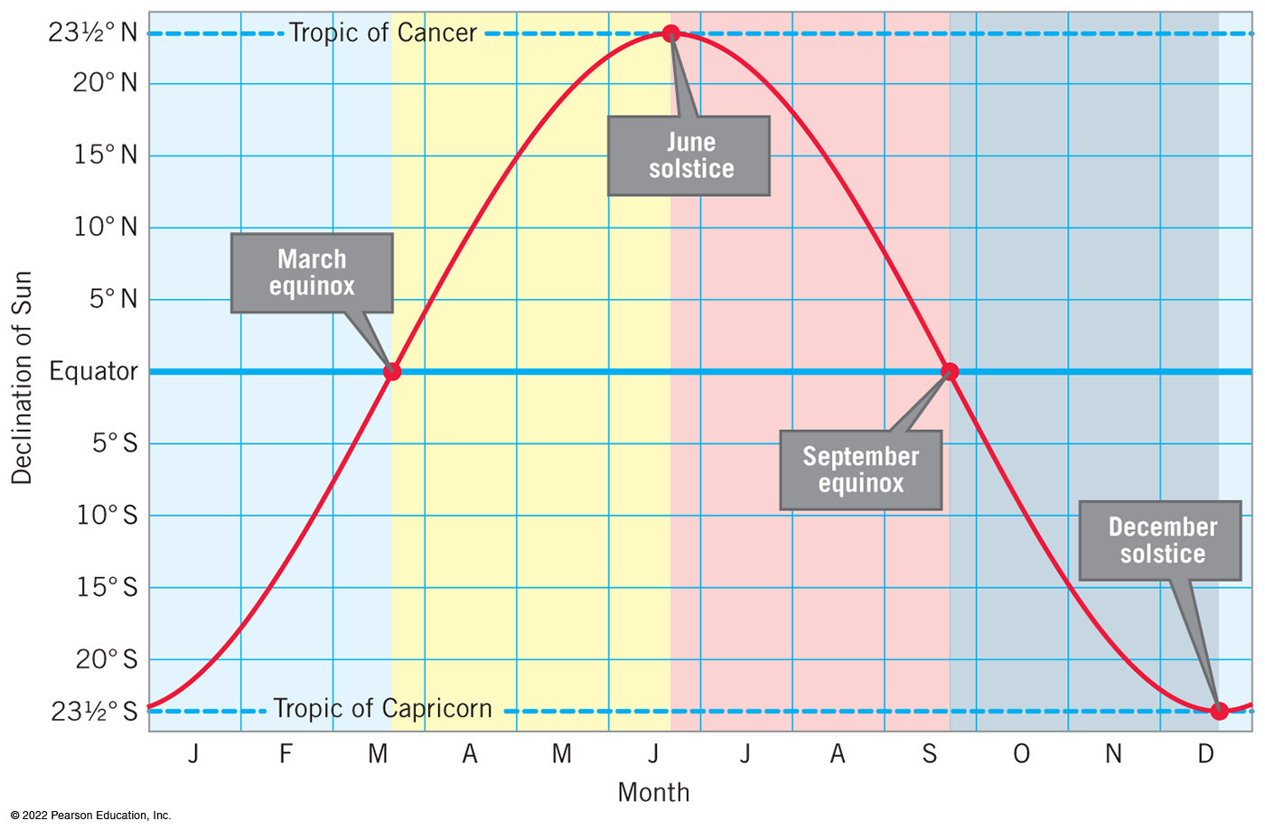
Earth–Sun Relations and the Seasons (9 of 10)
Seasonal Transitions
Latitude Receiving the Vertical Rays of the Sun
  only between the tropics
Day Length
  only equator has constant day lengths
  variation is least in tropics, greatest at high latitudes
  hemisphere patterns are mirror images
Day Length in the Arctic and Antarctic
  Equinoxes and 24 hours of daylight or darkness
Notes:
The graph presents the month on the X axis, the latitude declination of the sun on the Y axis, and appears as follows. The plot appears as a bell curve from January to December. The increase of the bell curve occurs from January to June, where the vertical rays of the sun is at the Tropic of Cancer, 23.5 degrees south in January, moves closer to the equator until the march equinox, and then moves away from the equator to the Tropic of Cancer, 23.5 degrees north, at the June Solstice. The decrease of the bell curve occurs from June to December, where the vertical rays of the sun is at the Tropic of Cancer, 23.5 degrees south in June, moves closer to the equator until the September equinox, and then moves away from the equator to the Tropic of Capricorn, 23.5 degrees South, at the December Solstice.

Slide 34
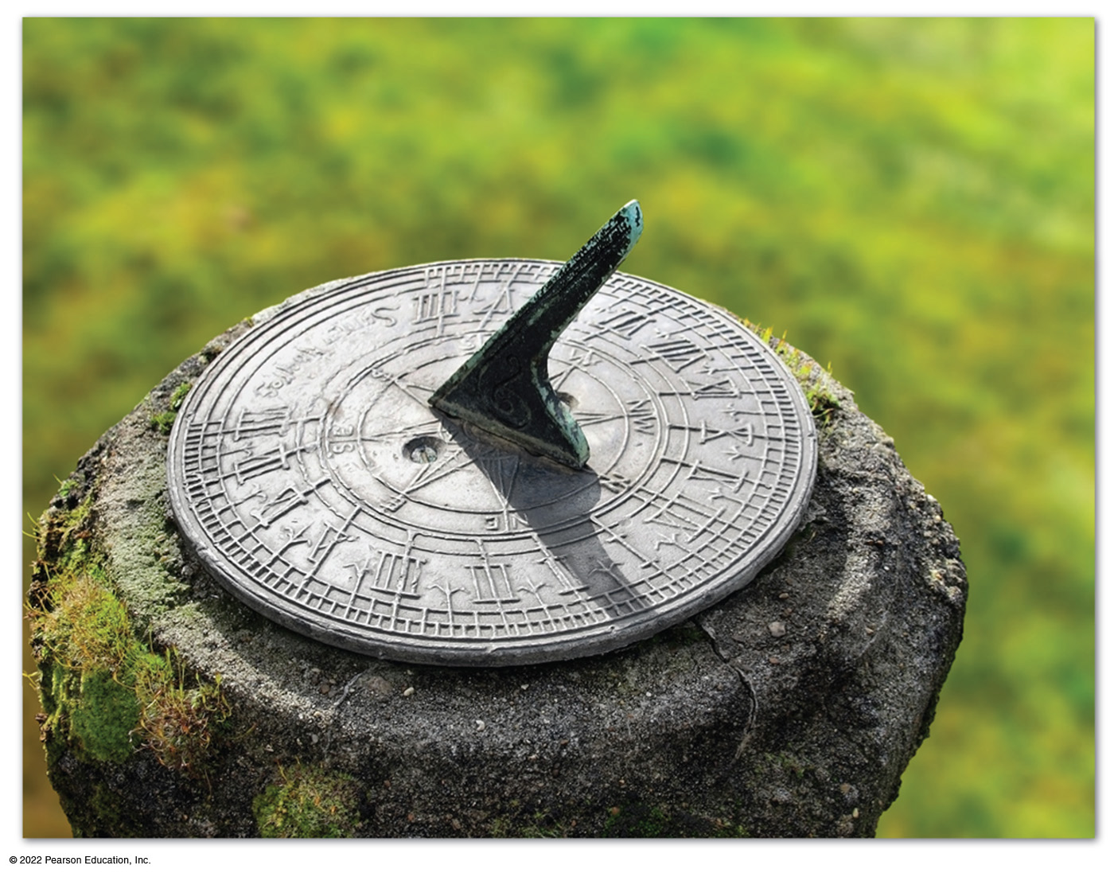
Earth–Sun Relations and the Seasons (10 of 10)
Significance of Seasonal Patterns
Tropical latitudes are warm due to high Sun angles and consistent day length
Polar latitudes are consistently cold due to low Sun angles
Midlatitudes have greatest seasonal variation
Notes:
The caption reads as follows. A typical sundial. The edge of the vertical gnomon slants upward from the dial face at an angle equal to the latitude of the sundial, pointing toward the North Pole in the Northern Hemisphere and the South Pole in the Southern Hemisphere. As the Sun appears to move across the sky during the course of a day, the position of the shadow cast by the gnomon changes. The time shown on this sundial is about two p m.

Slide 35
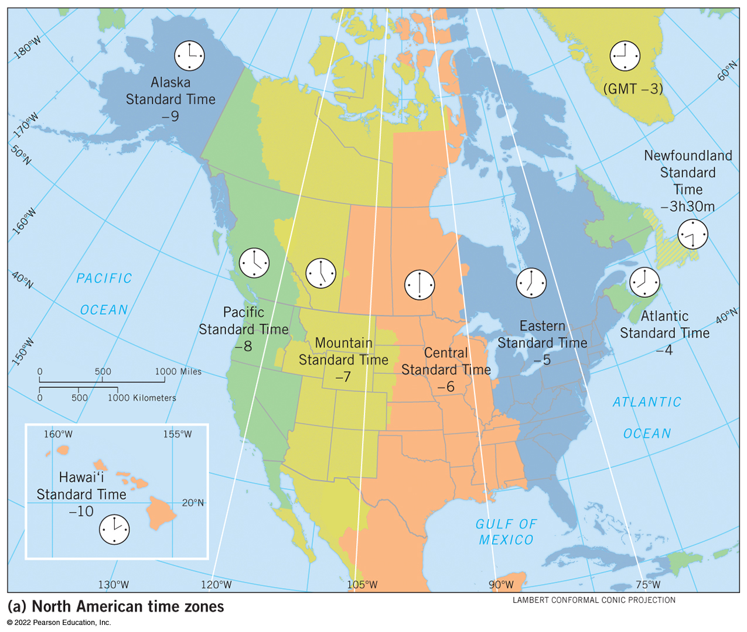
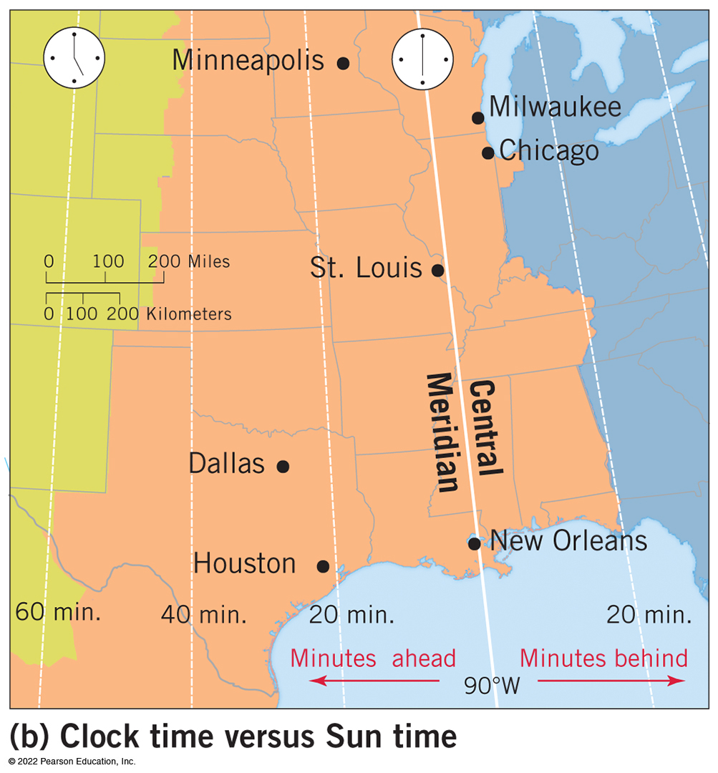
Telling Time (1 of 4)
Standard Time
  24 time zones were created around 24 central meridians spaced
  Time zone geographies
    some countries extend across many time zones
    some countries modify standard time
Notes:
The time zones for North America appear as the number of hours earlier than U T C (G M T), as follows. Hawaii standard time is minus 10. Alaska standard time is minus 9. Pacific standard time is minus 8. Mountain standard time is minus seven. Central standard time is minus six. Eastern standard time is minus five. Atlantic standard time is minus four. Newfoundland standard time is minus three and a half. Greenland is minus three.
The map of the central standard time region shows that locations along the central meridian like Saint Louis and New Orleans experience the sun at its highest point in the sky at noon. Areas east experience the sun highest in the sky slightly before noon, whereas areas west experience the sun highest in the sky slightly after noon.

Slide 36
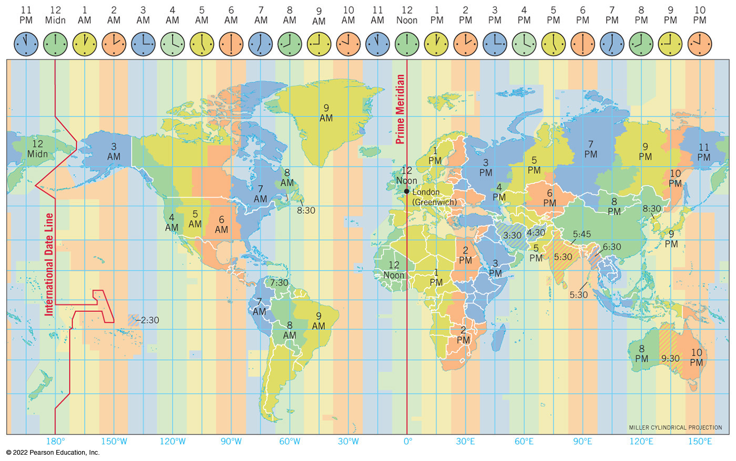
Telling Time (2 of 4)
Greenwich Mean Time (G M T) or Coordinated Universal Time (U T C) use prime meridian as reference for standard time

Slide 37
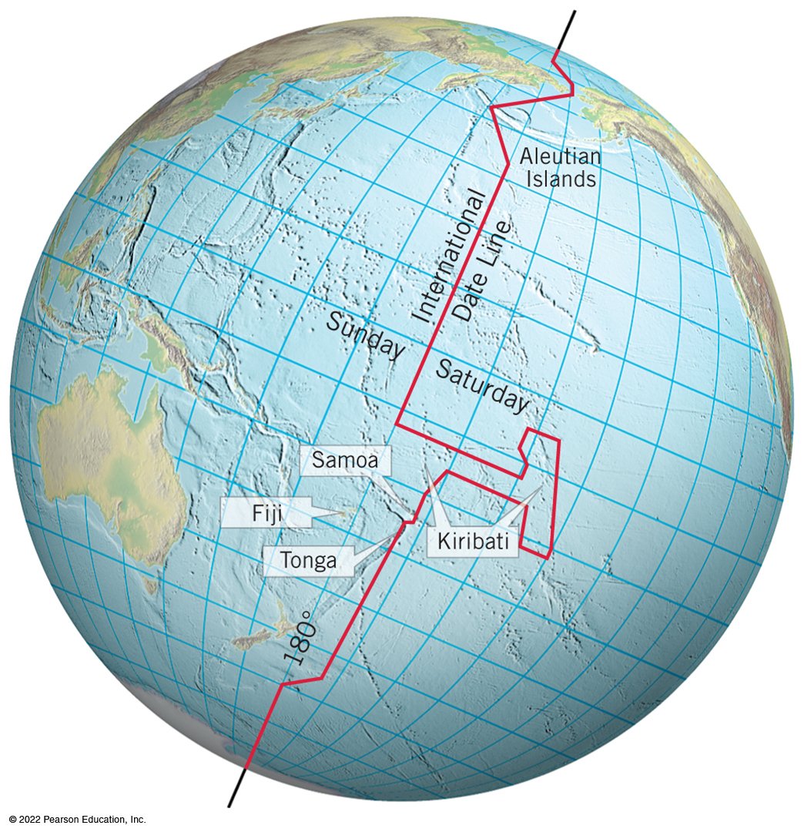
Telling Time (3 of 4)
International Date Line
  opposite arc of prime meridian
  runs across the sparsely populated mid-Pacific
  upon crossing, new days begin but time does not change
  line’s displacement due to scattered locations of some island countries

Slide 38
Telling Time (4 of 4)
Daylight-Saving Time
  move clocks ahead by an hour during the summer months
  shifts an hour of daylight to evening hours, initially to reduce the consumption of electricity
  “spring forward” and “fall back”
  adoption and utility varies geographically

Slide 39

Copyright
This work is protected by United States copyright laws and is provided solely for the use of instructors in teaching their courses and assessing student learning. Dissemination or sale of any part of this work (including on the World Wide Web) will destroy the integrity of the work and is not permitted. The work and materials from it should never be made available to students except by instructors using the accompanying text in their classes. All recipients of this work are expected to abide by these restrictions and to honor the intended pedagogical purposes and the needs of other instructors who rely on these materials.

