Slide 1

Stock Market Analyzer
Presented BY: Violetta Haveman, Romi Oinam, Alessia Presotto and Wayne Williams

Slide 2
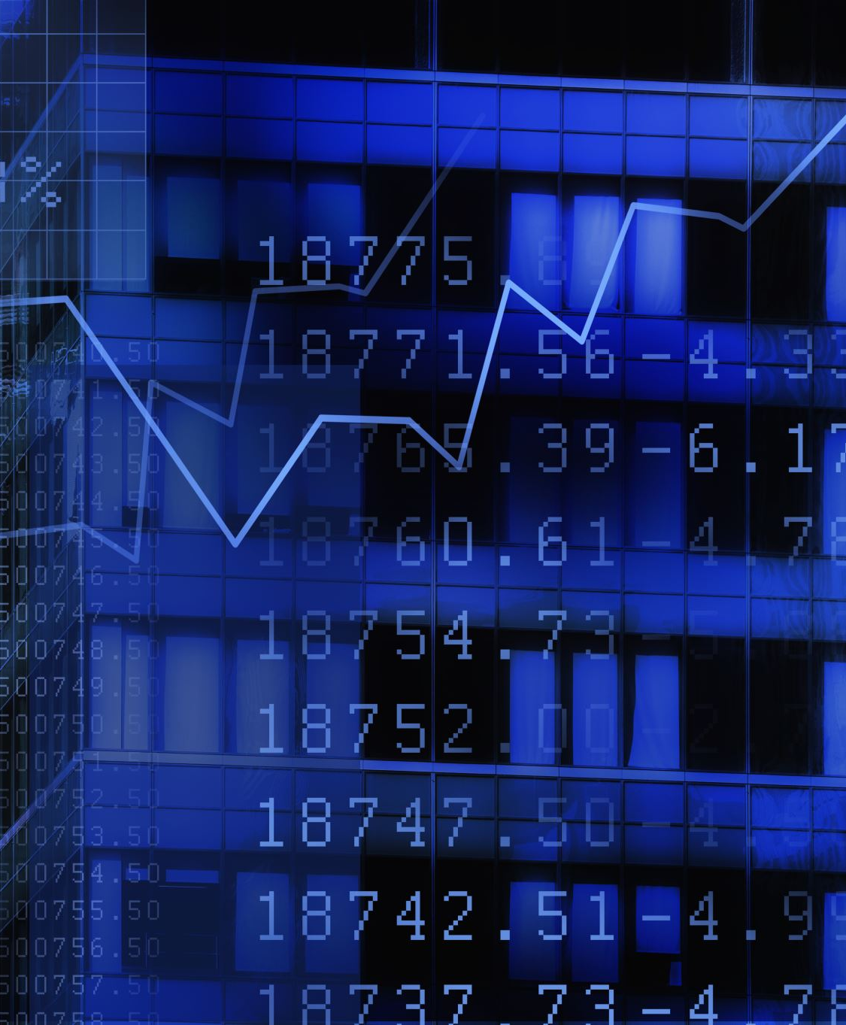
Contents
Executive Summary
Project Background
Solution , Approach and Data Source
Project Timeline
Risk
Conclusion

Slide 3

Executive Summary
According to the Ontario Securities Commission (2021), 74% of all Canadian investors have self-directed investments. This project aims to build an App that collects, analyzes, and visualizes stock data in a user-friendly manner.
This project will take two weeks to complete and will use data from the following two sources:
Alpha Advantage: https://www.alphavantage.co/
Wall Street Journal (WSJ): https://www.wsj.com/market-data
Apparent risks to this project are time constraints and reliable data. Despite these risks and constraints, the team there is a genuine need for such an App and would like to proceed with the project.

Slide 4

Project Background
According to the Ontario Security Commission, 74 % of Canadian inventors invest via a self-directed medium.
Almost 2/3 of all self-directed investors will use tools that help assess the performance of their investments.

Slide 5

Solution, Approach, and Data Sources
This App will allow investors to analyze their stock performance and make comparisons to market performance.
The App will pull data from the WJS and Alpha Advantage and push it to the dashboard. Users will have the ability to choose a stock. Once a stock is selected, the user can view their stock information on the dashboard.
Notes:
Consider talking about:
Demographics of market participation

Slide 6

Project Timeline and Roles
Responsibility | Team Player | Expected Date of Completion
Git Repo and Proposal | Violetta | Wednesday June 07, 2023
ETL ( Python, Flask, SQL) | Wayne | Sunday, June 11, 2023
HTML | Violetta | Sunday, June 11, 2023
JavaScript | Alessia | Sunday, June 11, 2023
CSS | Romi | Sunday, June 11, 2023
Review and Modifications | All | Sunday, June 12, 2023
Presentation Deck | Violetta | Tuesday , June 13, 2023
Review Presentation and Practice | All | Wednesday June 14, 2023
Present | All | Thursday, June 15, 2023
Notes:
Consider talking about:
Function and purpose
Relation to the modern financial system
Behavior of stock prices
Irrational behavior
Crashes

Slide 7

Risk
The two most inherent risks are reliable data and being able to complete this project within the timeline.
To mitigate these risks, the team will:
Implement a robust data cleaning process.
2) Stick to agreed timelines and ask for help from other team members and the instructor/TA as needed.

Slide 8

Conclusion
Despite these risks and constraints, the team there is a genuine need for such an App and would like to proceed with the project.

